Slide 1

E-Commerce Data Pipeline
2026
KAUSHANG TRIPATHI

Slide 2

Executive Summary
2026
Purpose of the Project Transform raw e‑commerce transactional data into clean, structured, and insightful information using SQL, Python, and Power BI.
Workflow Overview
SQL – Create tables, insert data, clean inconsistencies, and run analysis queries.
Python – Automate query execution, export results into CSV files.
Power BI – Import CSVs, build dashboards, and visualize KPIs.
Report – Present findings and insights in a structured format.
Key Deliverables
Cleaned dataset ready for analysis.
Automated CSV outputs for business queries.
Interactive Power BI dashboard with KPIs and charts.
Final report summarizing insights and recommendations.
Business Impact
Identify top products and customers.
Track monthly revenue trends.
Detect declining sales early.
Understand customer behaviour (repeat buyers, inactive customers, payment preferences).

Slide 3

Project Objectives
🧹Data Cleaning Ensure raw e‑commerce data is consistent, accurate, and free of duplicates or missing values.
📊Data Analysis Write SQL queries to uncover business insights such as top products, customer revenue, monthly trends, and declining sales.
🐍Automation Use Python scripts to execute SQL queries automatically and export results into CSV files for reporting.
📈Visualization Import CSV outputs into Power BI to build interactive dashboards with KPIs and charts.
📑Reporting Summarize findings in a structured report (PowerPoint) to communicate insights clearly to stakeholders.
2026

Slide 4

Methodology
2026
Data Source
Raw dataset stored in 1data/ (customers, products, orders, payments).
CSV files serve as the foundation for the pipeline.
SQL Scripts
01_create_tables.sql → Define schema for customers, products, orders, payments.
02_insert_data.sql → Load sample data into tables.
03_data_cleaning.sql → Handle duplicates, nulls, and inconsistent values.
04_analysis.sql → Generate business insights queries.
Python Automation
run_cleaning.py → Executes cleaning queries automatically.
run_analysis.py → Runs analysis queries and exports results into CSV.
utils.py → Handles database connection and CSV export functions.
Power BI Visualization
Import CSV outputs from results/csv/.
Build dashboards with KPIs (AOV, Repeat Buyers) and charts (Top Products, Declining Sales, Payment Distribution).
Reporting
Summarize findings in PowerPoint with visuals, insights, and recommendations.

Slide 5
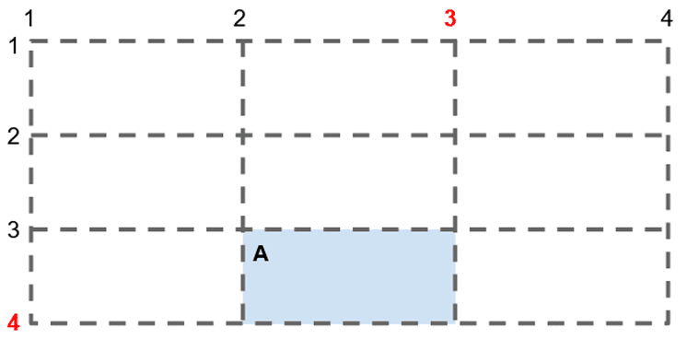
Analysis Queries
2026
Top Selling Products
Purpose: Identify products with the highest sales volume.
Best Visual: Bar Chart (Top 5 products).
Revenue by Customer
Purpose: Find customers contributing most to revenue.
Best Visual: Table or Bar Chart (Top customers).
Monthly Revenue
Purpose: Track revenue trends over time.
Best Visual: Line Chart (Month vs Revenue).
Repeat Buyers
Purpose: Measure customer loyalty.
Best Visual: KPI Card (Number of repeat buyers).
Inactive Customers
Purpose: Detect customers who haven’t purchased in 6+ months.
Best Visual: Table with conditional formatting (highlight inactive).
Average Order Value (AOV)
Purpose: Show mean spend per order.
Best Visual: KPI Card (currency formatted).
Declining Sales
Purpose: Highlight products with downward sales trends.
Best Visual: Line Chart (Top N products) or Matrix with conditional formatting.
Payment Distribution
Purpose: Understand customer payment preferences.
Best Visual: Pie Chart (UPI, Card, Cash, etc.).

Slide 6
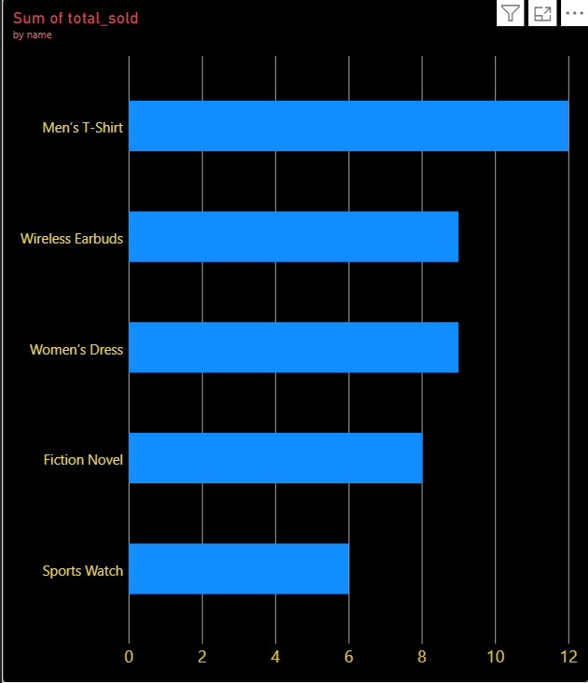
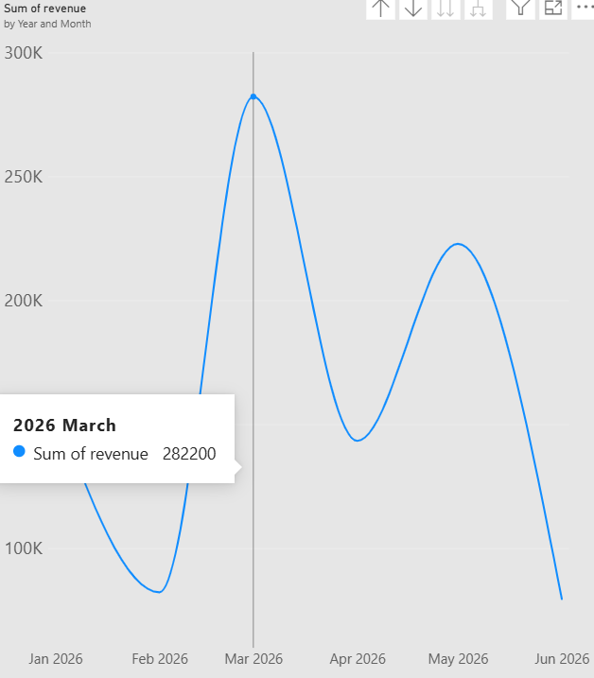
Result & Visuals
2026
Top Selling Products
Bar chart showing top 5 products by units sold.
Insight: Certain products dominate overall sales.
Monthly Revenue Trend
Line chart showing revenue across months.
Insight: Seasonal fluctuations and growth/decline patterns.
.

Slide 7
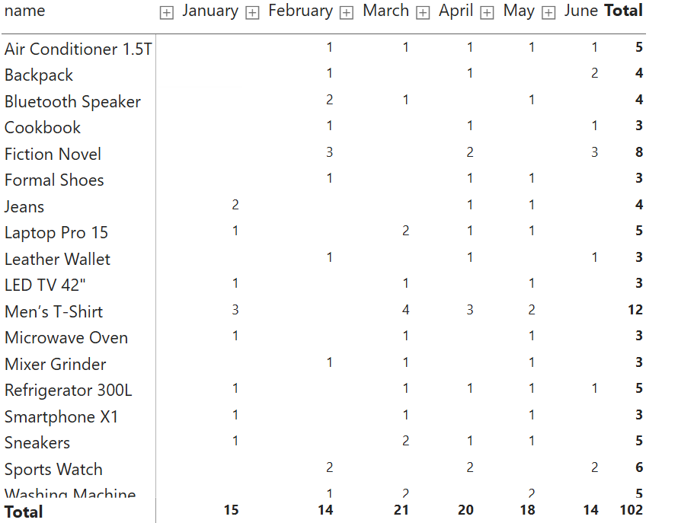
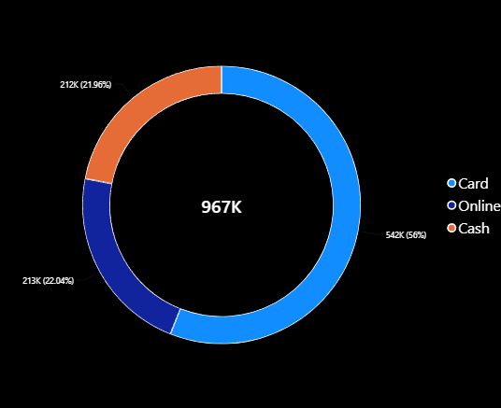
Result & Visuals
2026
Declining Sales
Line chart highlighting products with downward trends.
Insight: Products requiring marketing intervention or discontinuation.
Payment Distribution
Pie chart showing share of UPI, Card, Cash, etc.
Insight: Customer payment preferences..

Slide 8

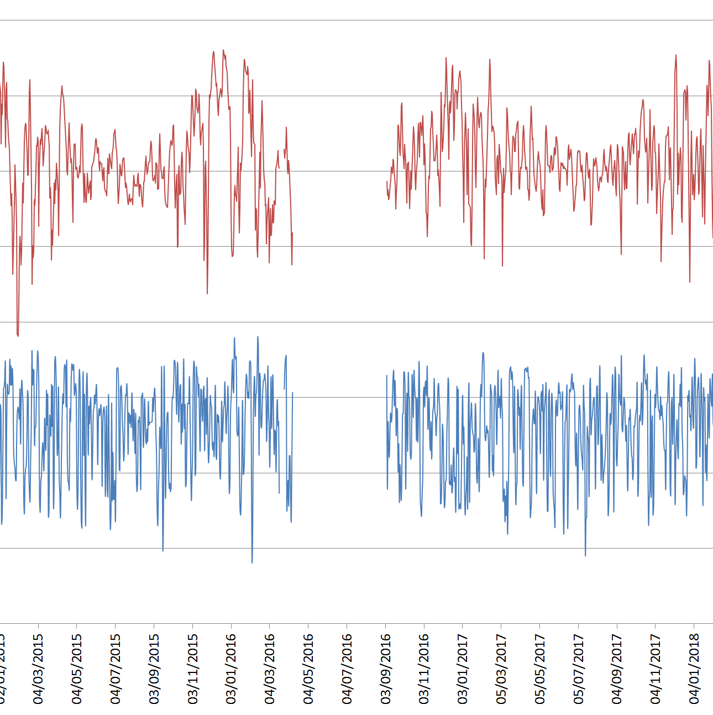
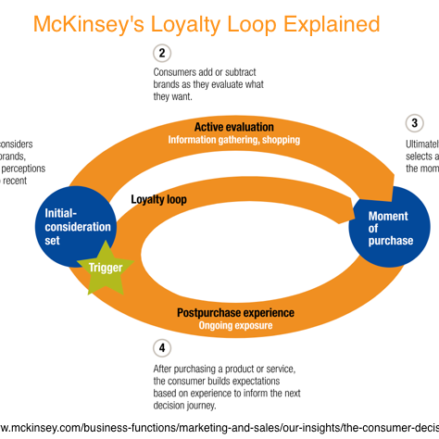

Key Insights
2026
Top Products Drive Sales
High-Value Customers
Seasonal Revenue Trends
A small group of products account for the majority of total units sold, showing strong product concentration.
A handful of customers contribute disproportionately to overall revenue, highlighting the importance of customer retention.
Monthly revenue shows clear fluctuations, suggesting seasonal demand patterns that can guide inventory and marketing.
Repeat Buyers Are Critical
Declining Products Identified
Payment Preferences Matter
This Photo by Unknown Author is licensed under CC BY-SA-NC
This Photo by Unknown Author is licensed under CC BY-SA-NC
Loyal customers who purchase multiple times generate consistent revenue and should be prioritized for engagement campaigns.
Several products show downward sales trends, signaling the need for marketing intervention or possible discontinuation.
Customers favour certain payment methods (e.g., UPI, card), which can inform checkout optimization and promotions.

Slide 9
Conclusion
End-to-End Pipeline Success Built a complete workflow integrating SQL, Python, and Power BI for e‑commerce analytics.
Clean & Reliable Data Raw datasets were transformed into structured, accurate, and analysis‑ready tables.
Automated Insights Python scripts streamlined query execution and CSV exports, reducing manual effort.
Interactive Dashboards Power BI visuals provided clear KPIs and trends for decision‑makers.
Business Value Enabled identification of top products, high‑value customers, seasonal revenue patterns, and declining sales.
2026

