Slide 1
LONDON AIRBNB
Market Analysis
A Data Analyst Portfolio Project
Kaushiki

Slide 2
Agenda
1
Objective
What questions this analysis answers
2
Data & Methodology
Source, tools, and cleaning process
3
Pricing Analysis
Borough-level and room-type pricing patterns
4
Market Structure
Listing distribution, availability, hosts
5
Key Insights
What the data reveals
6
Recommendations
Practical takeaways
2

Slide 3
Objective
This project analyzes London's Airbnb listings to understand pricing behavior, market structure, and host activity across the city.
Which boroughs command the highest prices, and which have the most supply?
How does room type (entire home vs private room) influence pricing?
Does pricing relate to how often a listing is booked or reviewed?
Is the market dominated by individual hosts or large-scale operators?
3

Slide 4
Data Source & Methodology
Source
Dataset
Tools
Environment
Inside Airbnb
(insideairbnb.com)
London listings.csv
92,799 raw records
Python, Pandas,
Matplotlib, Seaborn
Google Colab
(Jupyter notebook)
Methodology: raw listings were loaded, cleaned of missing/invalid values, capped for extreme price outliers, then explored through univariate and bivariate visual analysis.
4

Slide 5
Data Cleaning Summary
Raw Dataset
Cleaned Dataset
92,799 rows
19 columns
61,774 rows
17 columns
– Removed neighbourhood_group (100% empty)
Every remaining column is fully populated or intentionally left blank where a listing genuinely has no reviews. This is the dataset used for all analysis in this deck.
– Removed license (100% empty)
– Dropped rows with missing price (~30,400)
– Capped price at the 99th percentile
– Converted last_review to date format
5

Slide 6
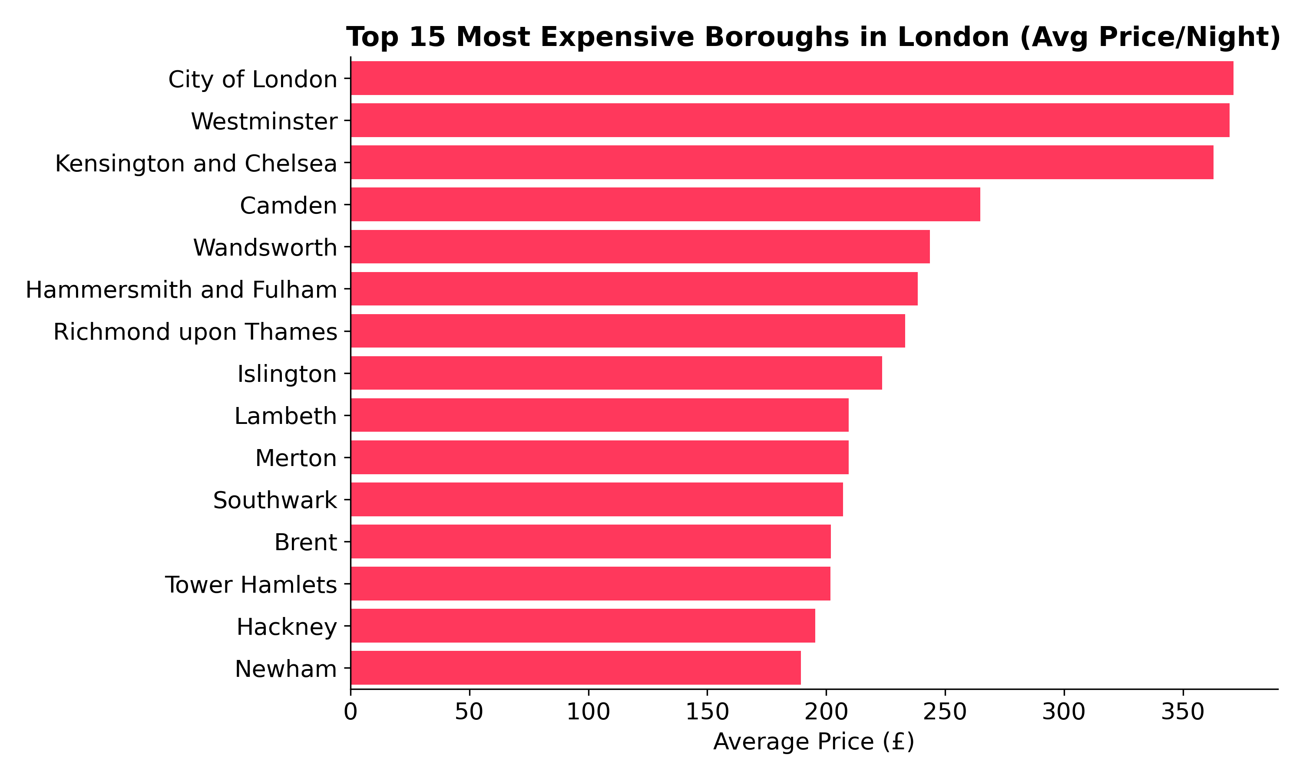
Most Expensive Boroughs
£371
Highest avg. price
Insight
City of London tops pricing at roughly £371/night on average, more than double the citywide median — driven by its financial-district, corporate-stay demand.
6

Slide 7
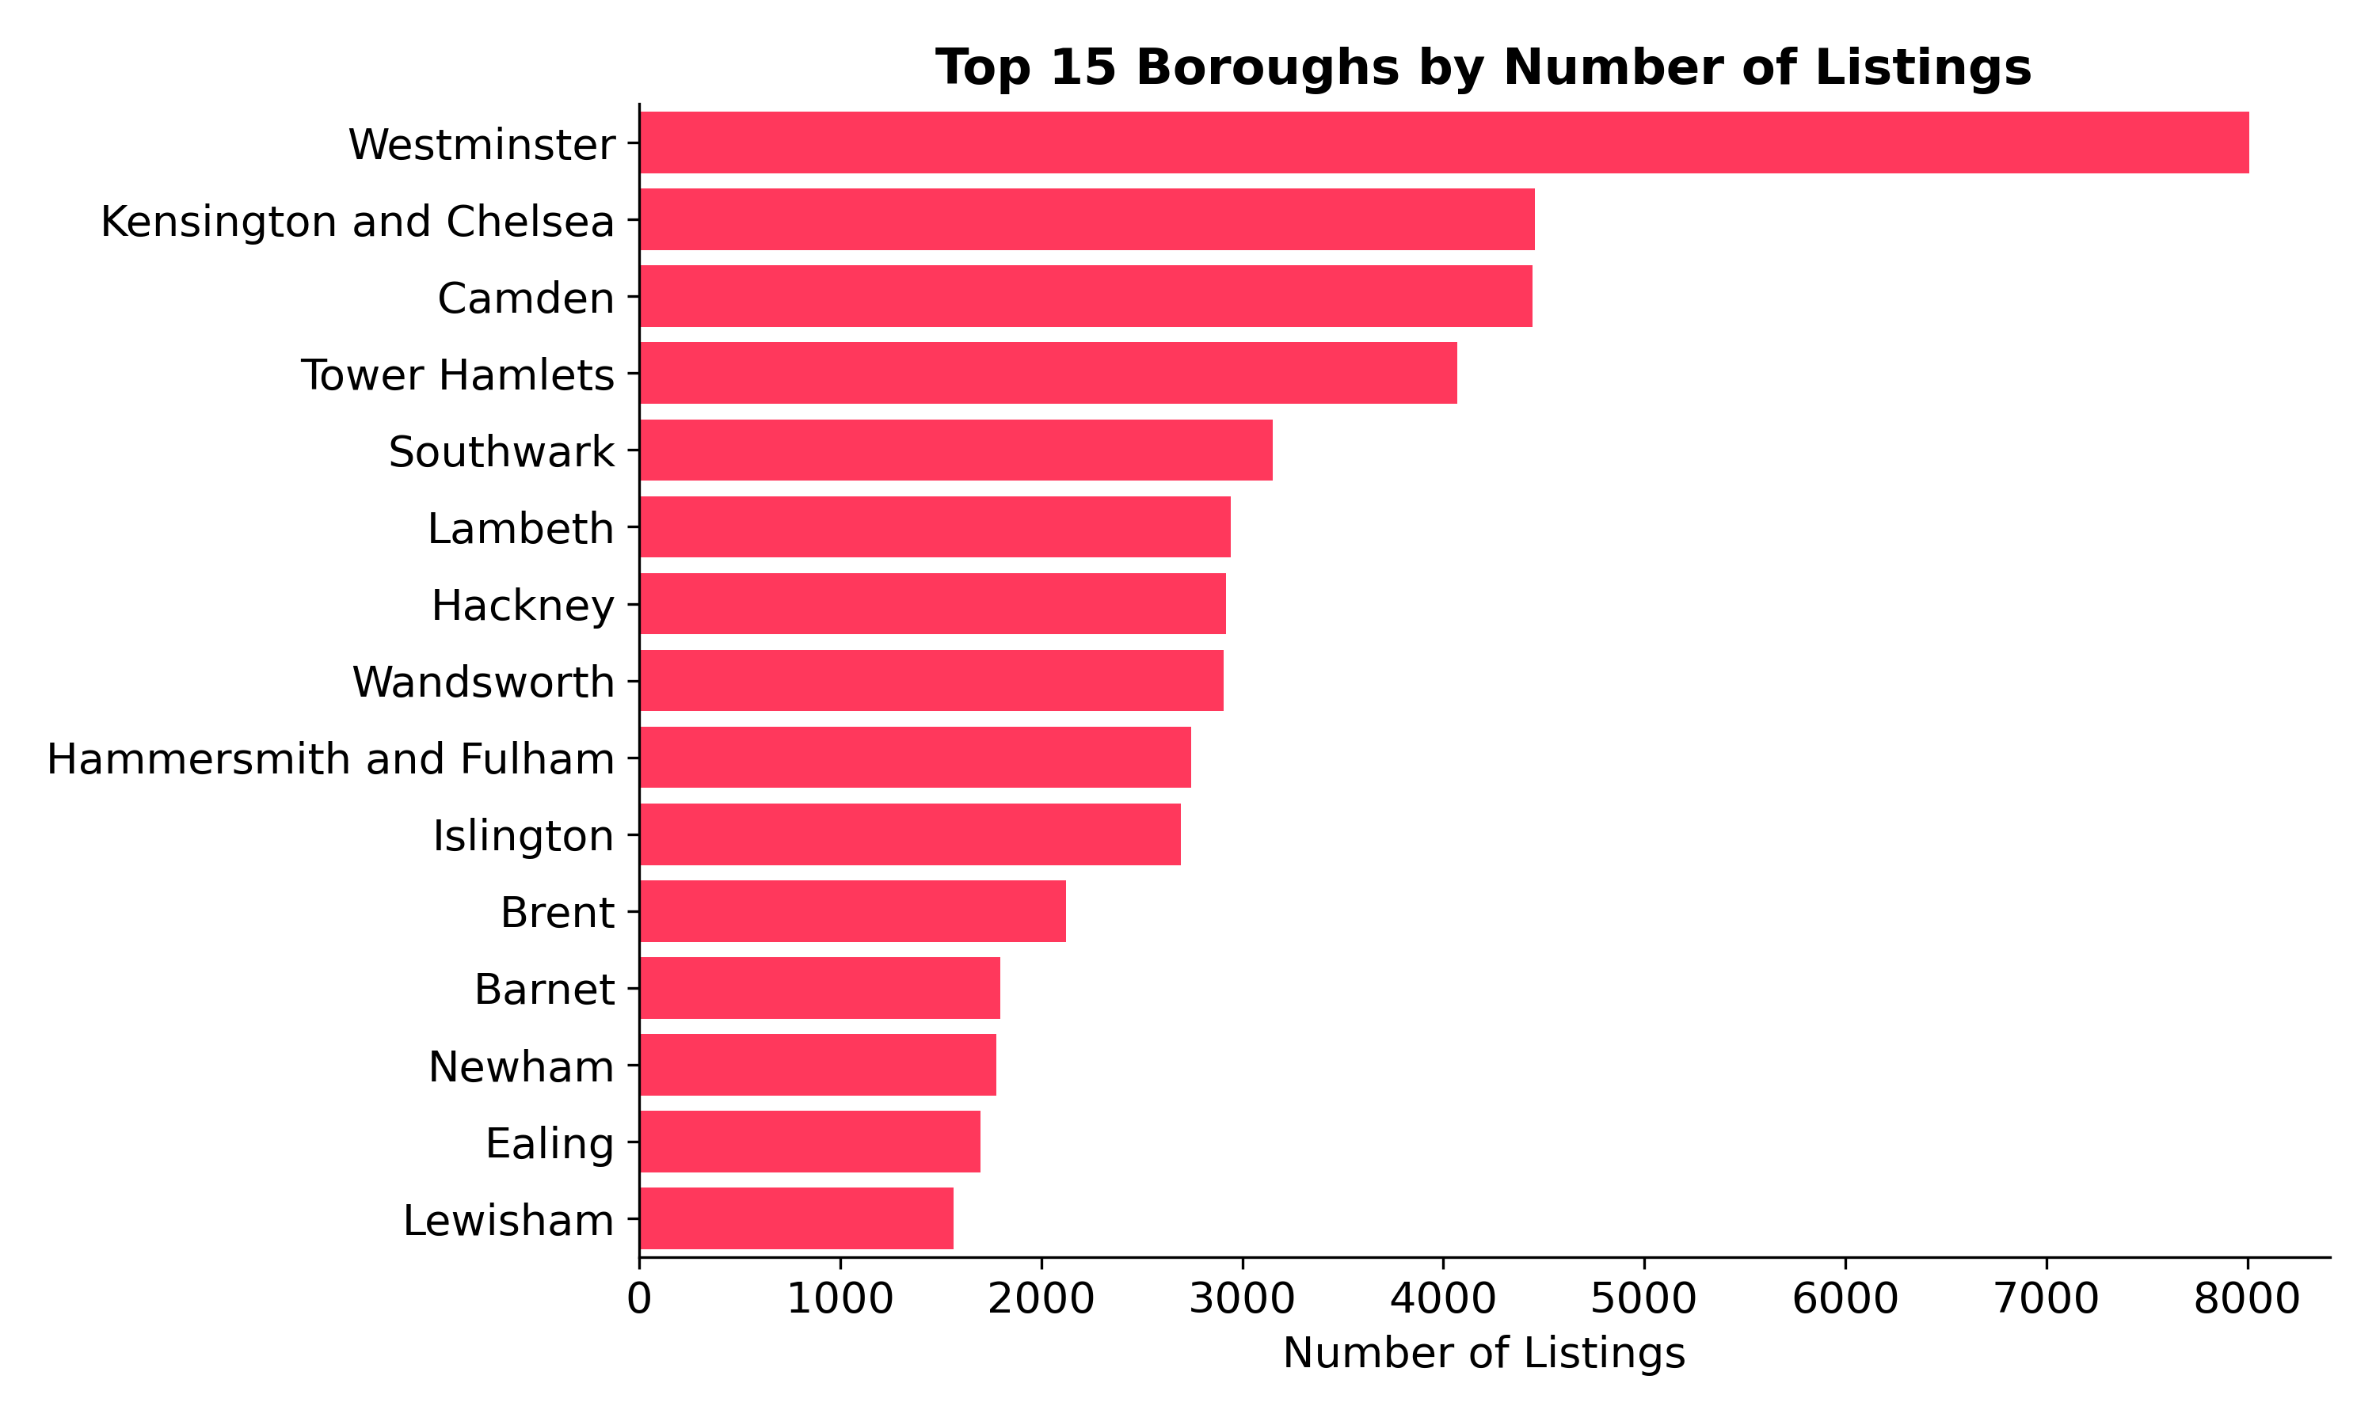
Supply by Borough
Westminster
Most listed borough
Insight
Westminster leads supply with 8,000+ listings — but it isn't the priciest borough, showing that high listing volume doesn't always mean the highest rates.
7

Slide 8
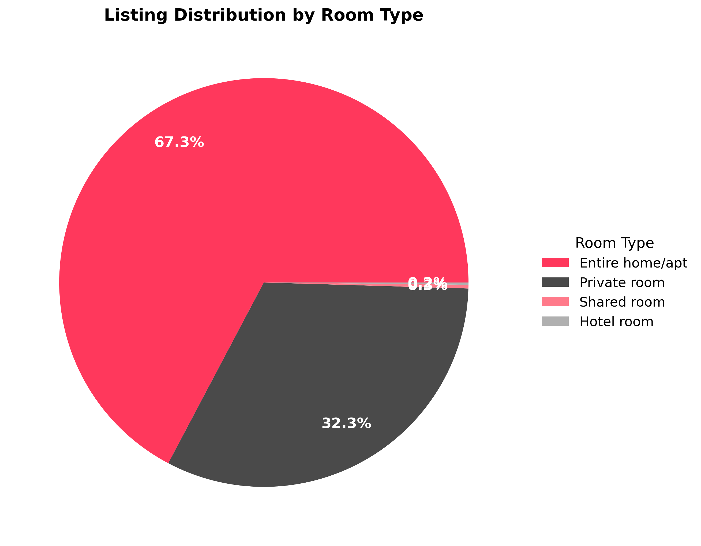
Room Type Distribution
67.3%
Entire home/apt share
Insight
Entire homes/apartments dominate at 67.3% of all listings, while shared and hotel rooms together make up under 1% — London's Airbnb market is overwhelmingly whole-property rentals.
8

Slide 9
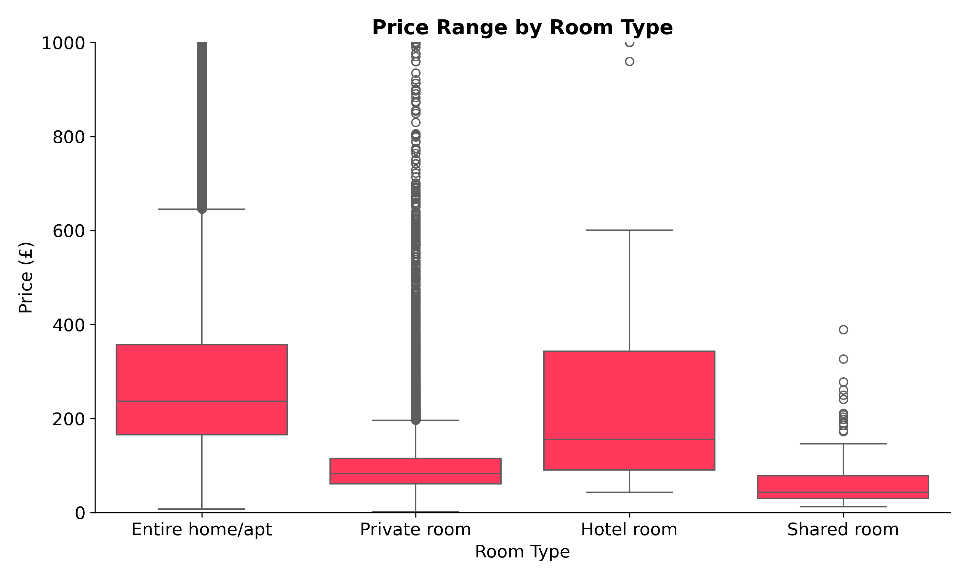
Price by Room Type
Insight
Entire homes carry both a higher median price and a wider price spread than private rooms, confirming room type is one of the strongest price drivers in this market.
9

Slide 10
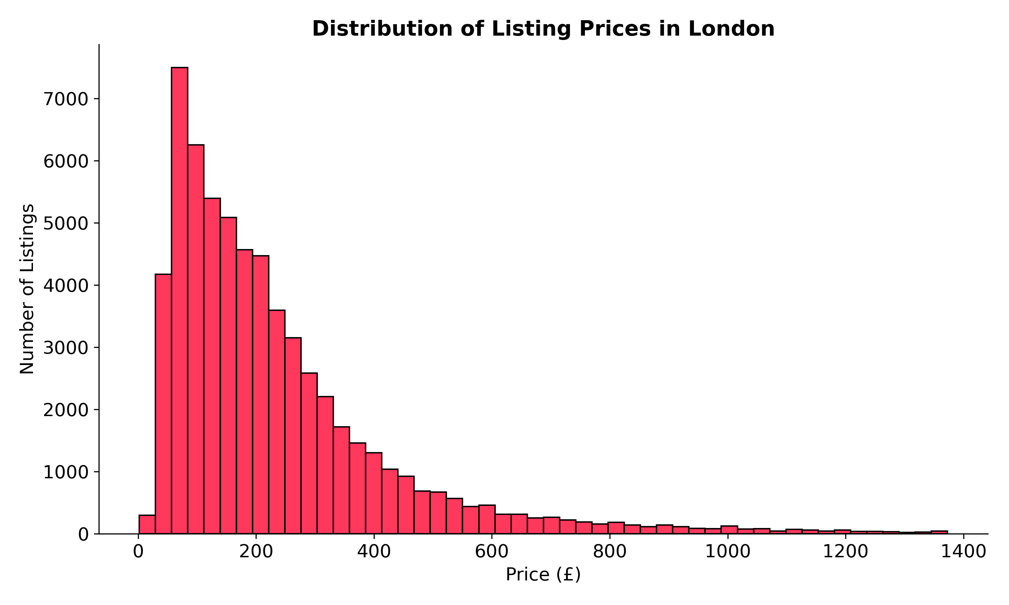
Price Distribution
£179
Median nightly price
Insight
Prices are heavily right-skewed: most listings cluster between £80–£300/night, with a long tail of premium listings pulling the average above the median.
10

Slide 11
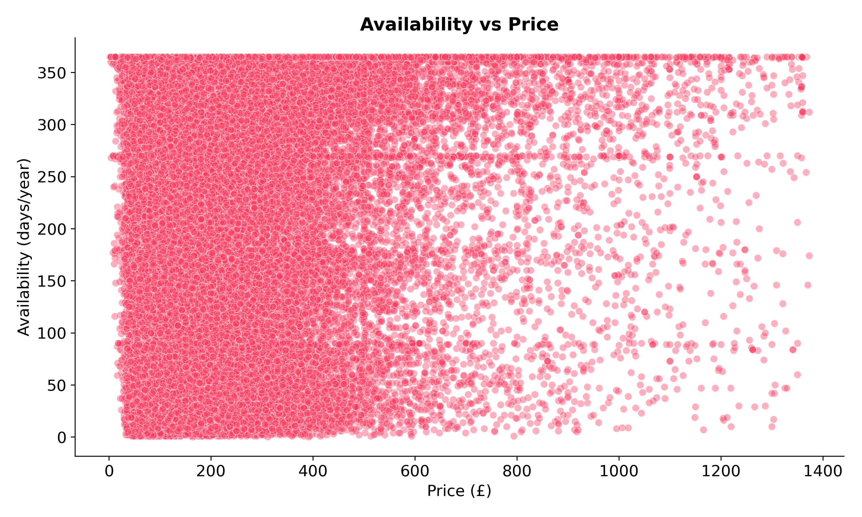
Availability vs Price
215 days/yr
Avg. availability
Insight
There is only a very weak positive relationship (r ≈ 0.07) between price and yearly availability — pricing alone does not explain how often a listing is open for booking.
11

Slide 12
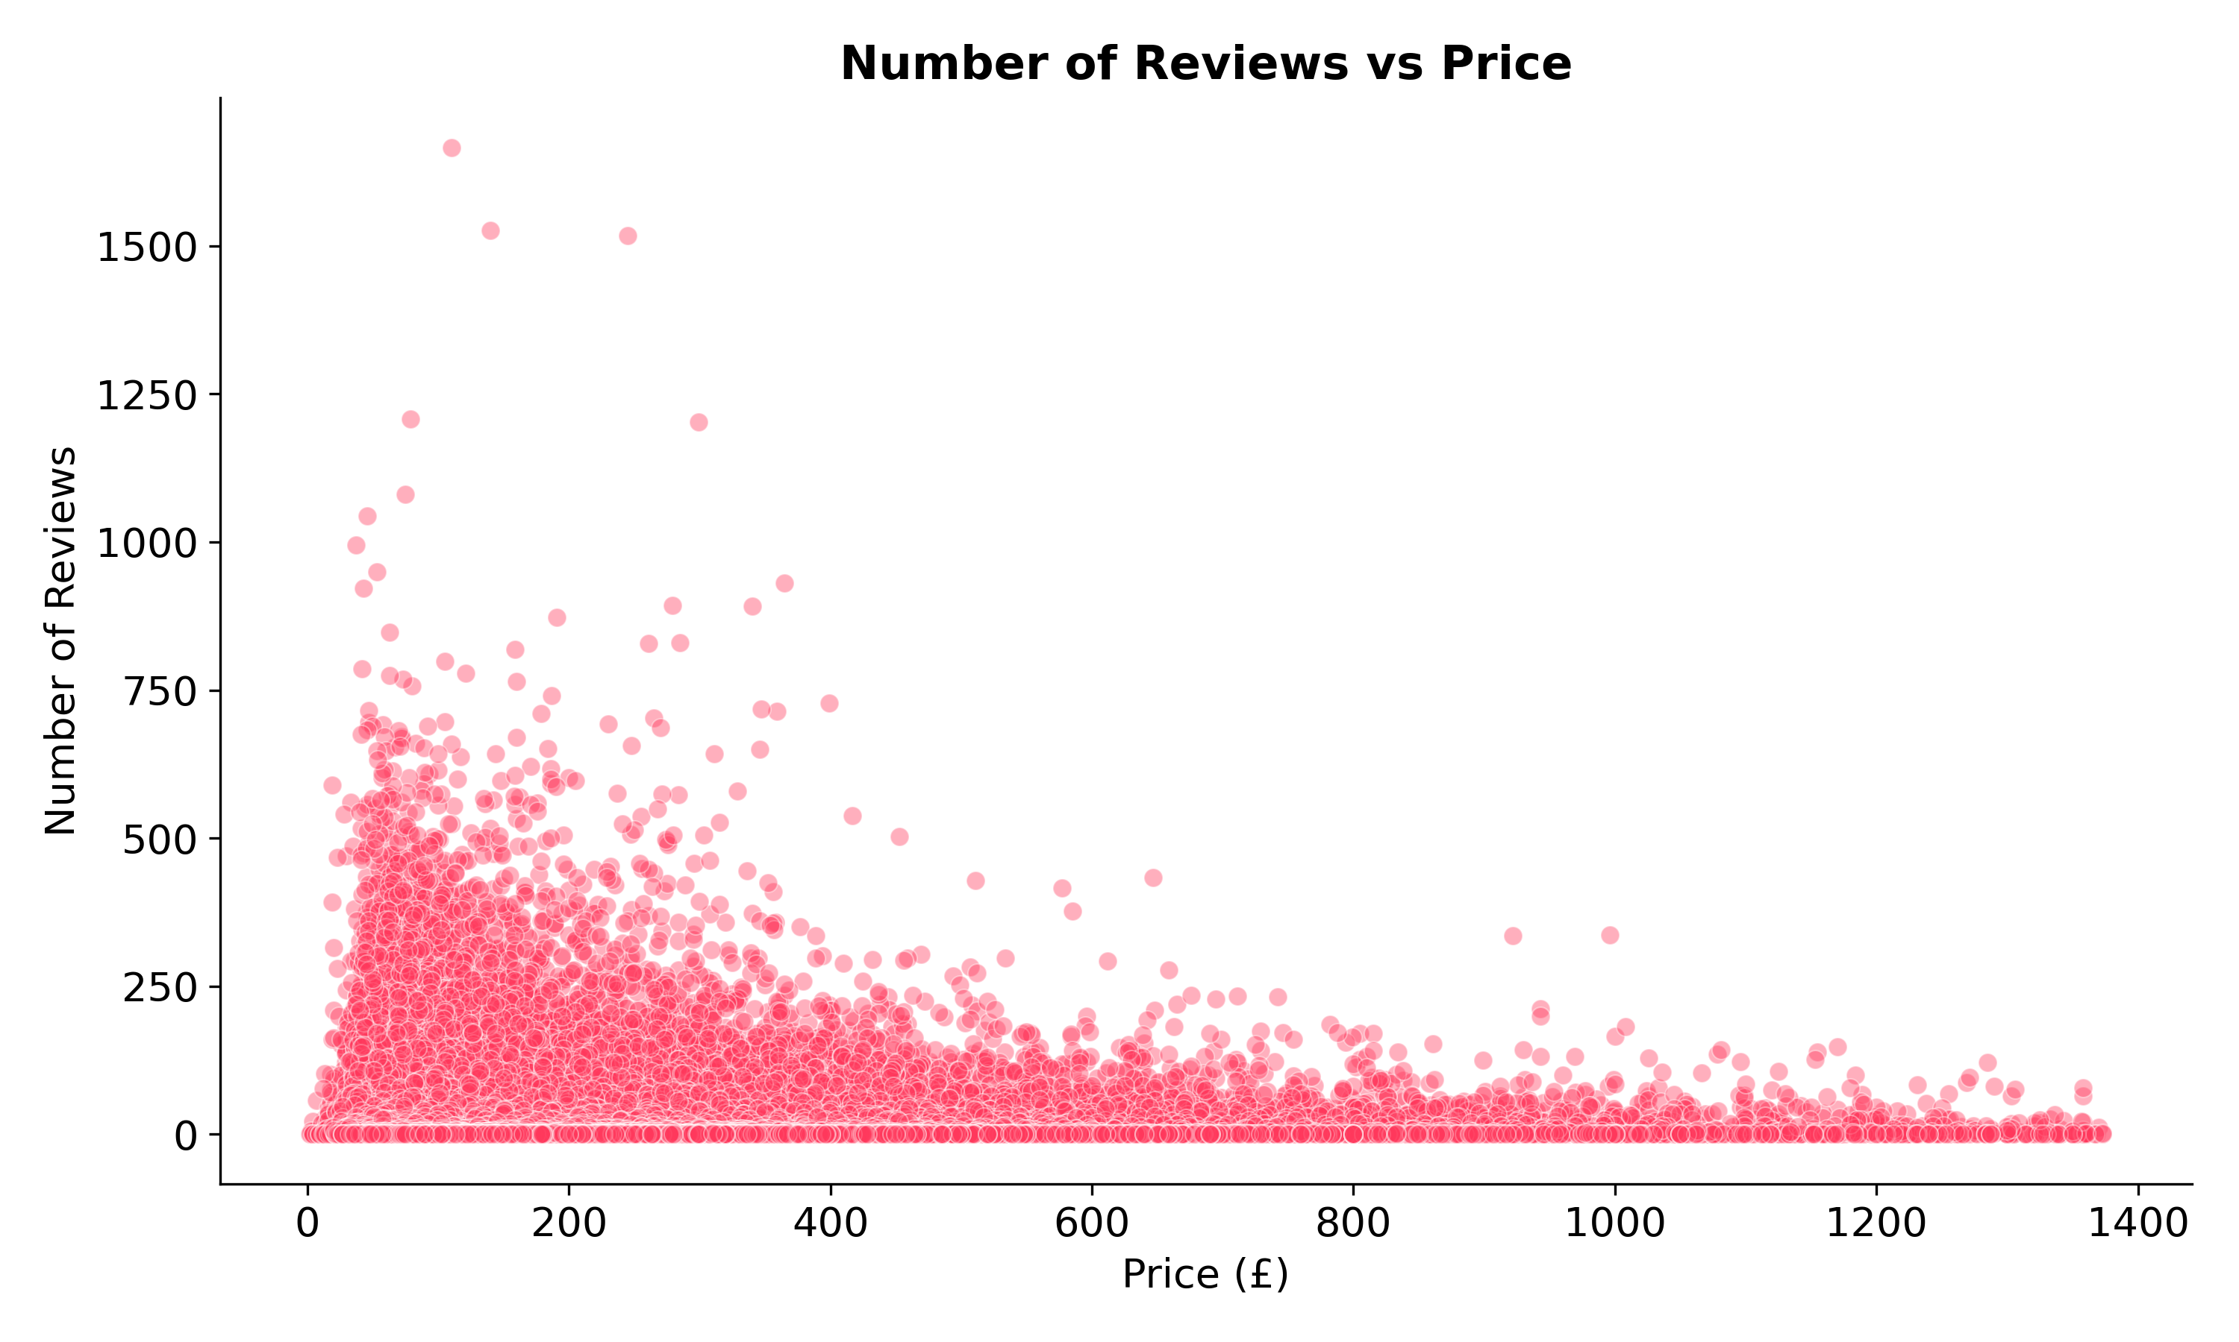
Reviews vs Price
Insight
A weak negative correlation (r ≈ -0.09) suggests cheaper listings tend to accumulate slightly more reviews — likely reflecting higher booking frequency at lower price points.
12

Slide 13
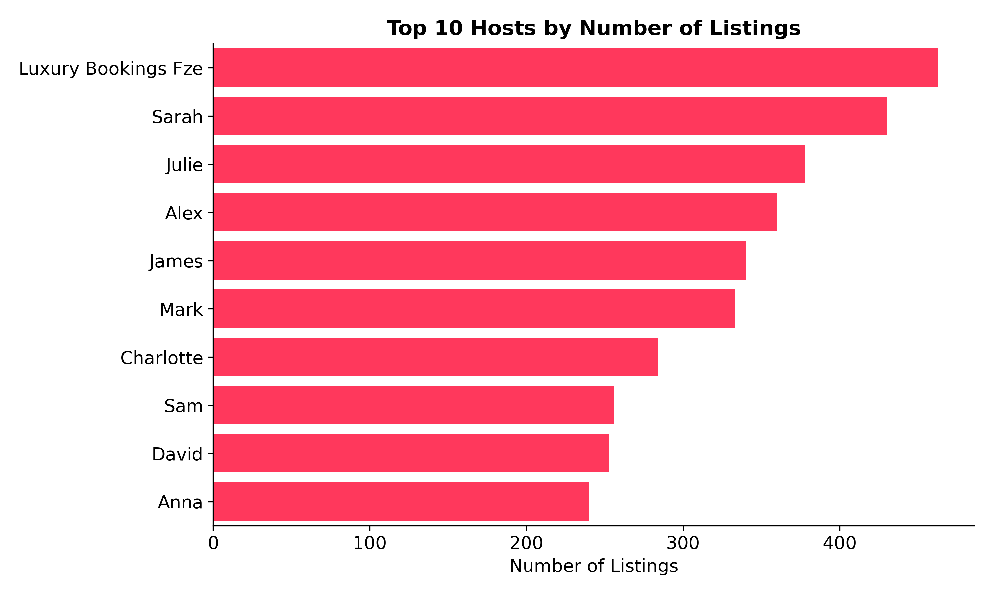
Top Hosts by Listings
463
Top host's listings
Insight
The top host manages 463 listings — a clear sign that part of London's Airbnb supply comes from professional, large-scale property management rather than individual hosts.
13

Slide 14
Key Insights
1
Location drives price more than volume — City of London is priciest, Westminster has the most supply, and they aren't the same borough.
2
Room type is a major price lever — entire homes command higher and more variable prices than private rooms.
3
The market is whole-property dominated — 67.3% of listings are entire homes; shared/hotel rooms are negligible.
4
Price weakly relates to booking activity — availability and reviews both show only weak correlation with price.
5
Professional hosting is present at scale — a top host manages 463 listings, pointing to commercial property management, not just individual homeowners.
14

Slide 15
Conclusion & Recommendations
For Hosts
Position entire-home listings in high-demand boroughs like City of London or Westminster to maximize pricing power.
For Investors
Evaluate boroughs on both price AND supply — high-price, low-supply boroughs may signal underserved demand.
For Platforms
Weak price-to-booking correlation suggests other factors (photos, reviews, location) drive bookings more than price alone — worth deeper study.
Thank you

