Slide 1


Slide 2
MICROSERVICES
HANDLING DATA
COMMUNICATION

Slide 3
HANDLING DATA IN MICROSERVICES
Database per Microservice
Data Synchronization
Event Sourcing
Data Ownership and Consistency
Caching
API Gateway

Slide 4
HOW DO MICROSERVICES COMMUNICATE?
TYPES OF COMMUNICATION
SYNCHRONOUS BLOCKING
ASYNCHRONOUS NON-BLOCKING

Slide 5
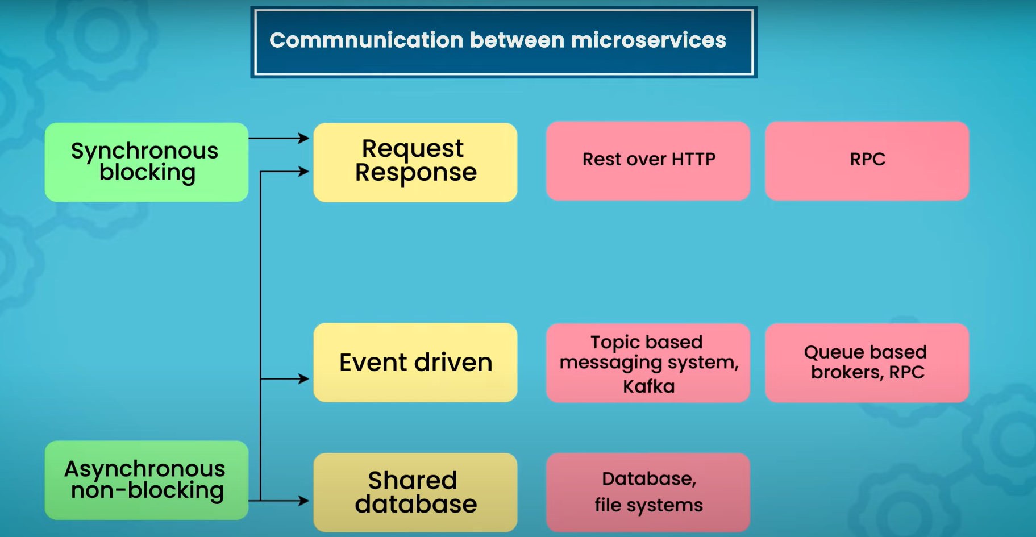

Slide 6
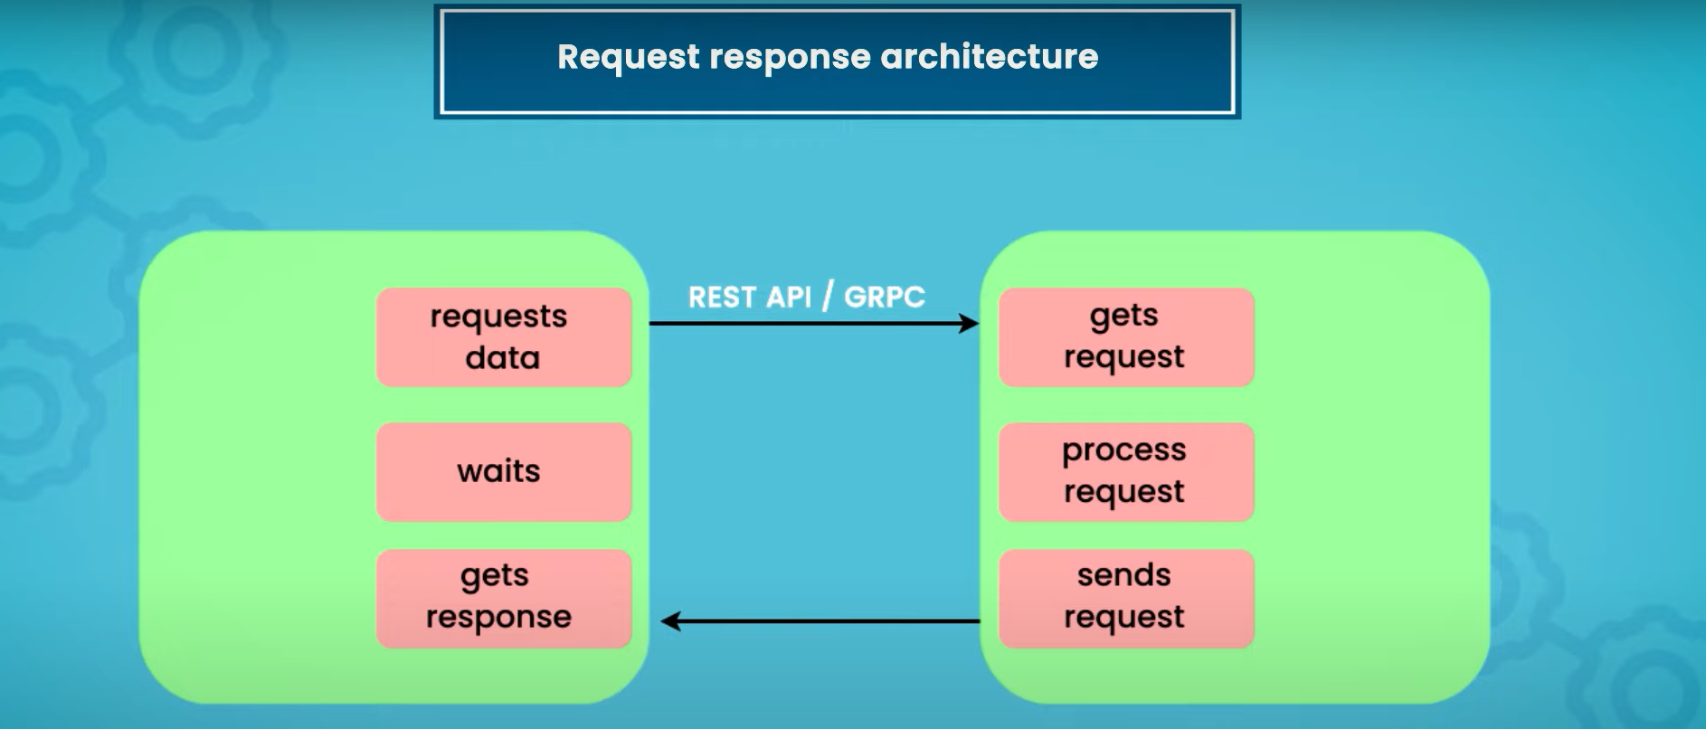
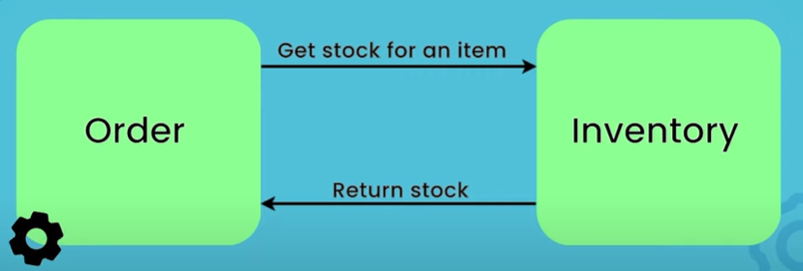
SYNCHRONOUS BLOCKING

Slide 7
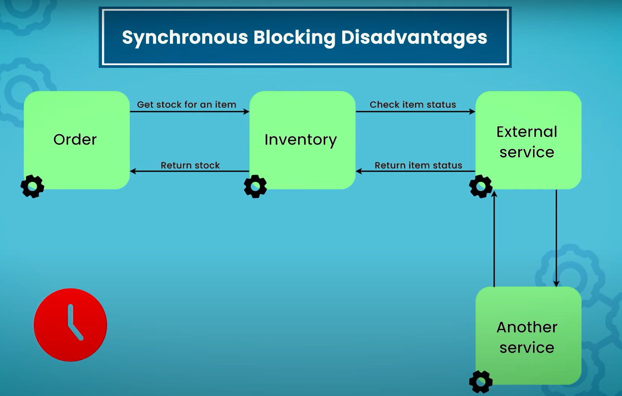

Slide 8
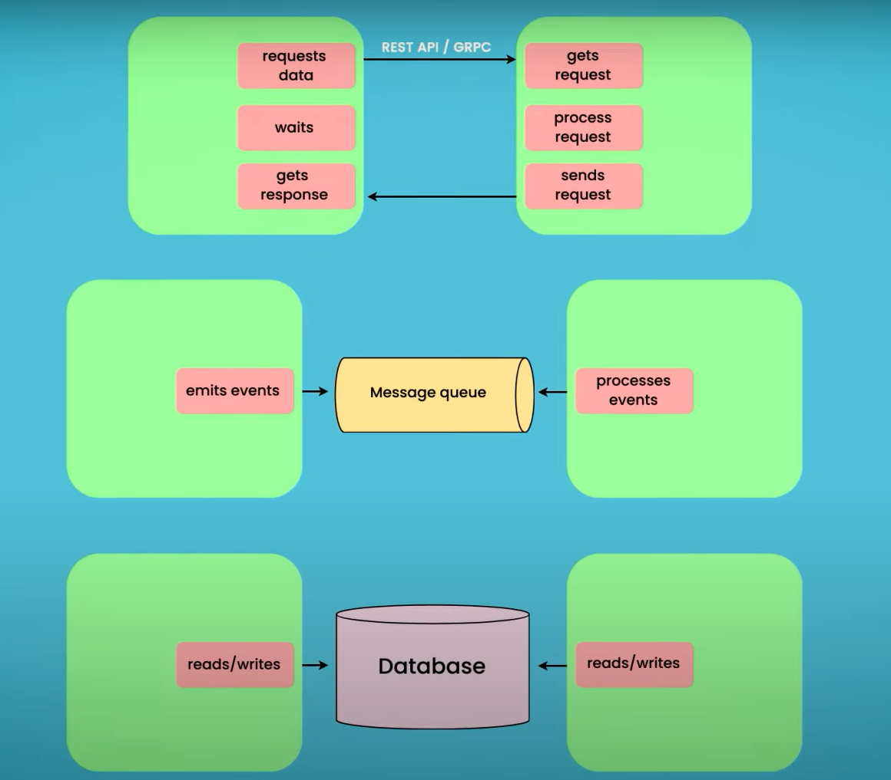
ASYNCHRONOUS NON-BLOCKING

Slide 9
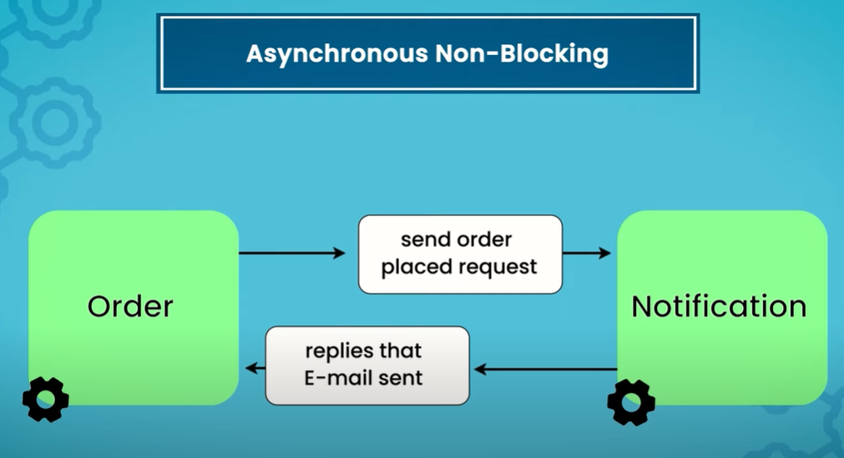
REQUEST RESPONSE ARCHITECTURE

Slide 10
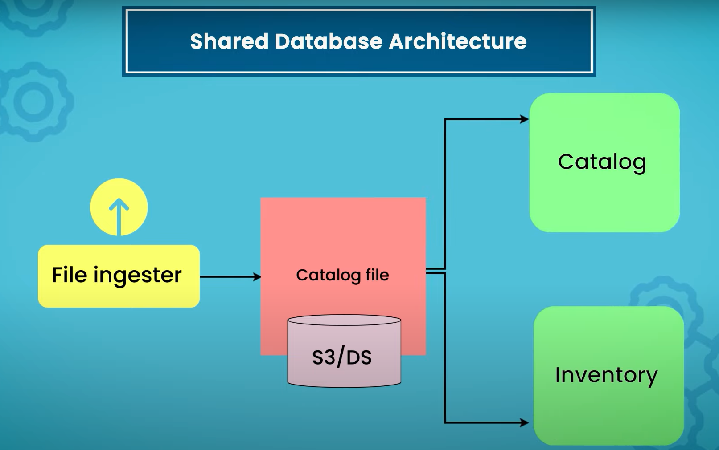
ASYNCHRONOUS NON-BLOCKING

Slide 11
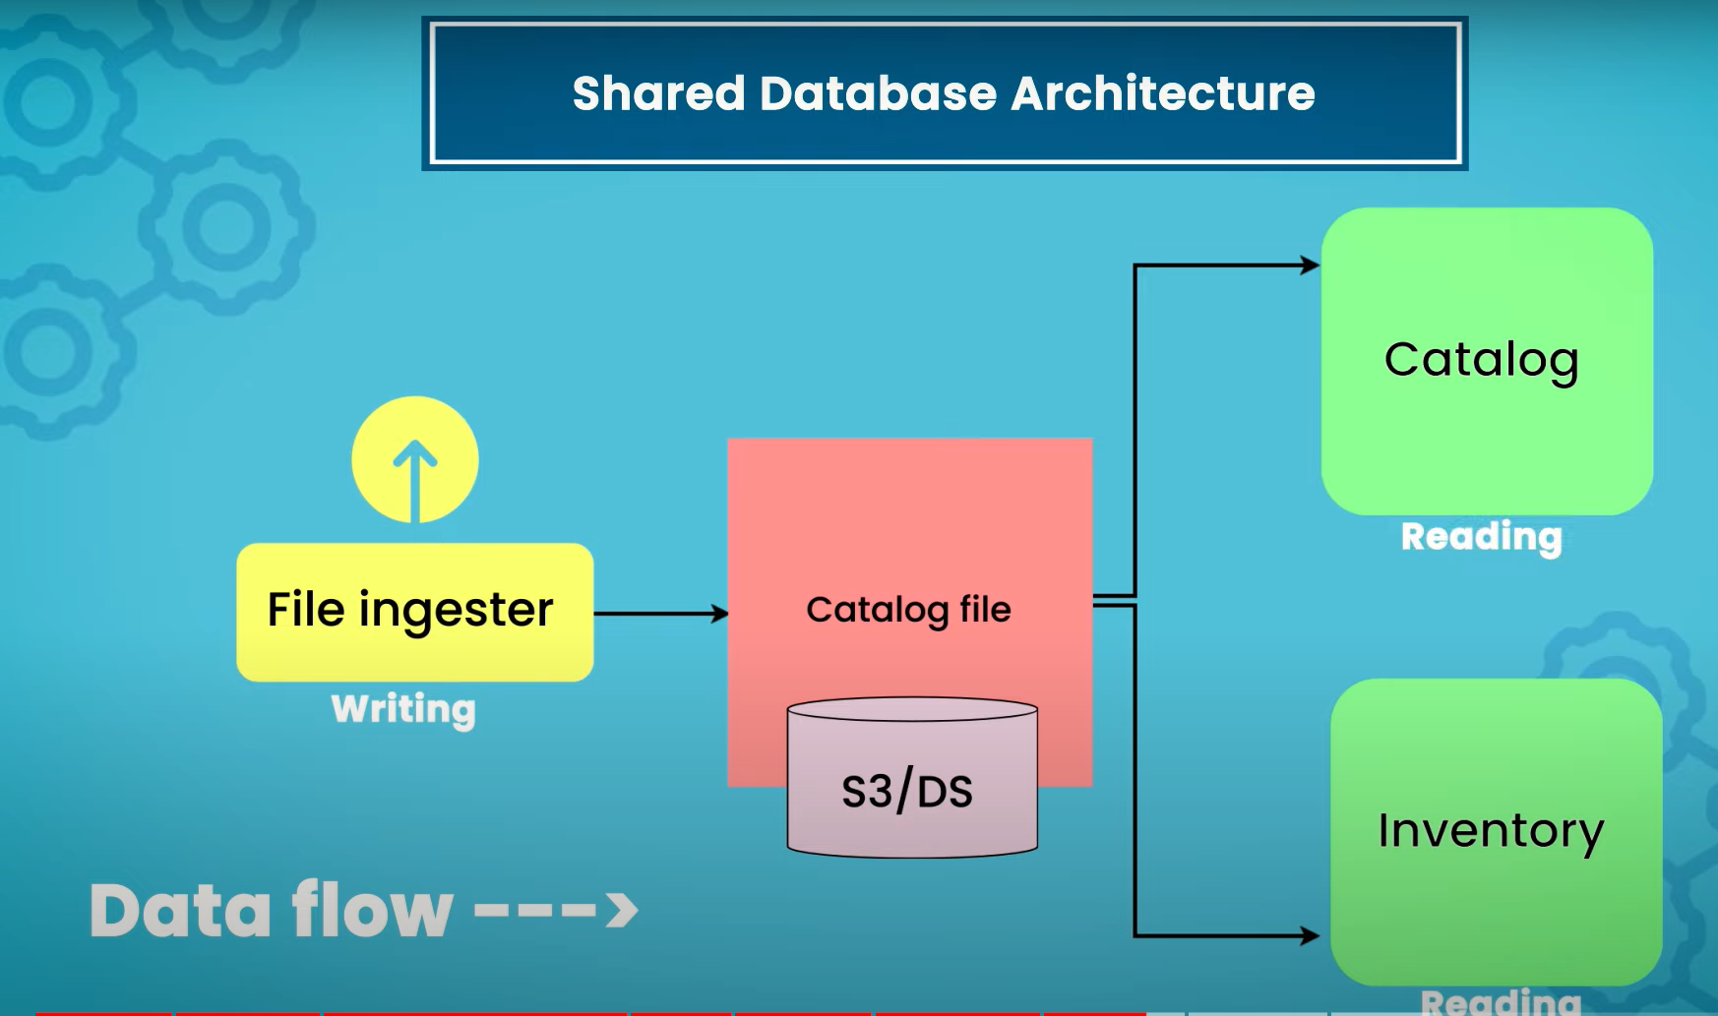
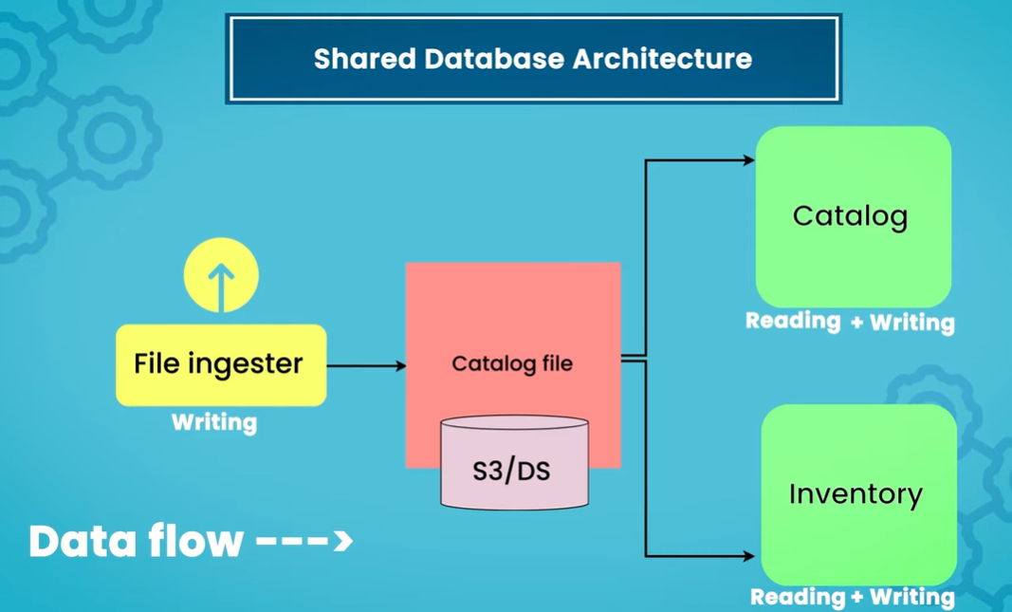
COMPARISON

Slide 12
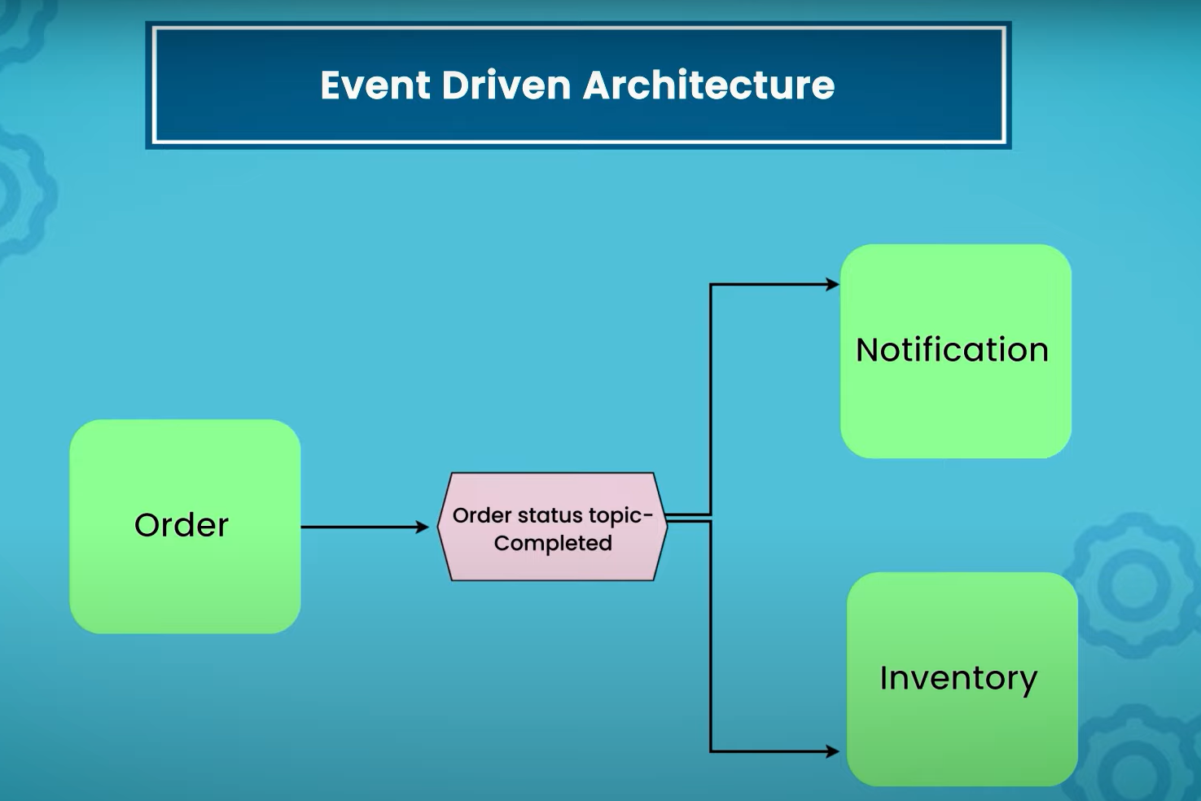
ASYNCHRONOUS NON-BLOCKING

Slide 13

THANK YOU

