Slide 1

Code Complexity Measuring Tool
IT16178700 D.I.K. Rajapakshe
IT17018760 M.P.P. Shamil
IT17056212
P.M.C.P. Paththinisekara
IT17152938
S.K. Liyanage

Slide 2
Introduction
Tool measure,
Code size, Type and the nesting level of control structure, Inheritance and Recursion.
Developed for C++ and JAVA Language.
Reduce complicated manual work by computerize code complexity and code details.
Developed a web application for code complexity measuring tool.
Shows measure details using tables attach with lines.
Shows measure details using chart.

Slide 3
previously introduced tool
Developed separate tools for C++ and JAVA
E.g.:- Verifysoft
Tools: testwell CMT++ (for C and C++) testwell cmtjava (for java)
Consider about many other factors.
Estimated number of errors
Difficulty level, error proneness
Implementation time / time to understand

Slide 4
proposed tool
Single tool for both Language.
Consider about code factors.
Code size, Type and the nesting level of control structure, Inheritance and Recursion.
Simple UI for upload to code.
Formatting the source code
Removing white spaces
Removing comments
Measuring total complexity of the code

Slide 5
Proposed tool cont.
Complexity Chart to display complexity details under various factors.
Export complexity table under various formats.
Print complexity table feature.

Slide 6
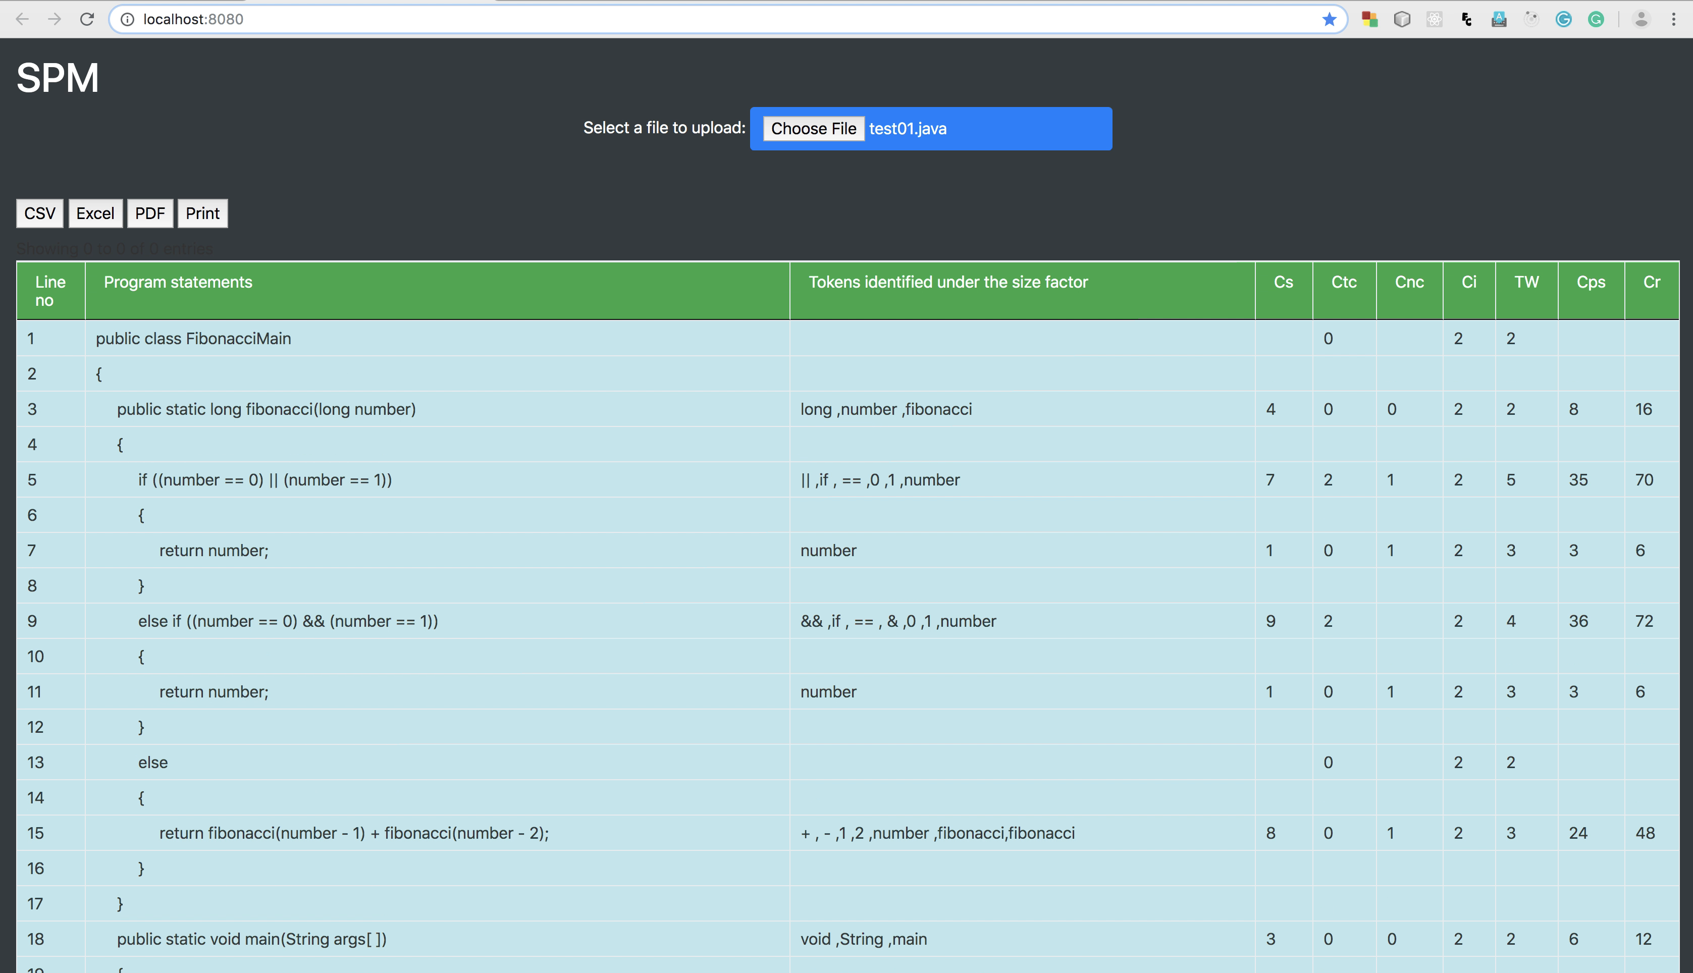
Proposed Tool Table View UI

Slide 7
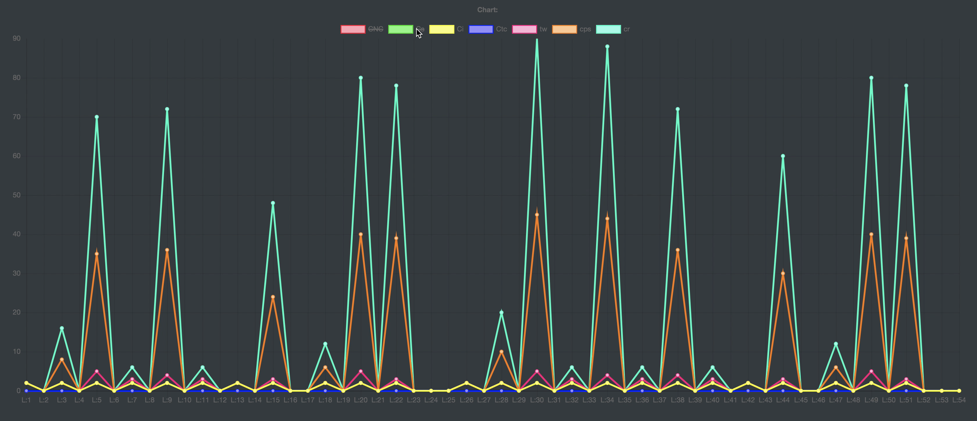
Proposed Tool Chart View UI

Slide 8
METHODOLOGY
Used Technologies :-
Java runtime environment 8
Tomcat server version 8.5
Intellij IDEA
Chart.js JavaScript library

Slide 9
METHODOLOGY cont.
Used Tools :-
SonarQube for inspect code quality.
Selenium for automated testing of the web application.
Targetprocess for manage project.
Git for version control.

Slide 10
METHODOLOGY cont.
Derive the complexity of a program due to size factor:-
Various java functions to measure operators, keywords, manipulators, text inside double quotes, classes, methods, objects, variables, array names and numeric values by reading the code line by line.
Some operators like (*) sign had to be disregard in c++ pointers because it’s not a deference operator there.

Slide 11
METHODOLOGY cont.
Derive the complexity of a program due to Type of control structures factor:-
Checked whether an ‘If’ condition exists in a line.
Checked whether iterative control structure such as a ‘for’, ‘while’, or ‘do-while’ loop exists in a line.
Count of logical (‘&&’ and ‘||’) or bitwise (‘&’ and ‘|’) operators found in that particular condition or loop.

Slide 12
METHODOLOGY cont.
Derive the complexity of a program due to nesting level of control structures factor:-
Check for outer most level nesting.
Check for inner most level nesting.
The complexity of each statement will be increased according to each level of nesting by one.

Slide 13
METHODOLOGY cont.
Derive the complexity of a program due Inheritance factor:-
Complexity of a class due to its inheritance (CCi) = Number of ancestor classes of the class + 1

Slide 14
METHODOLOGY cont.
Derive the complexity of a program due recursion factor:-
Total complexity of a program statement (Cps) and multiply it by two

Slide 15
RESULTS AND DISCUSSION
Regex patterns are a very efficient way to identify keywords.
When implementing most of the features specially feature that require to locate specific Strings it wasn’t convenient to use regex patterns because in cases such as keywords become parts of Strings.

Slide 16

RESULTS AND DISCUSSION cont.
Some research papers shows inheritance as a size factor. They use number of children in a class to measure size.
Instead taking complexity of each statement in order to get the final result some research papers take the a class complexity using another equations such as,

Slide 17
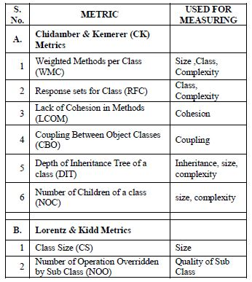
Metrics with respect to their use according to research articles

Slide 18
Thank You

