Slide 1

Exploring Machine Learning Models for Duplicate
Question Detection in Online Communities
TEAM 01
DEVAREDDY SPOORTHI KEYA CH.EN.U4AIE20013
DUGGIRALA GOWTHAM SRI MANI SAI CH.EN.U4AIE20015
HARIHARAN KAUSHIK CH.EN.U4AIE20019
SHAIK ATHEEQ RASOOL CH.EN.U4AIE20059
VALAVALA DRUVA VEER CH.EN.U4AIE20071
01

Slide 2
Table of contents
Introduction
Literature survey
System architecture and design
Experiments and Results
Conclusion and future work
References
03

Slide 3
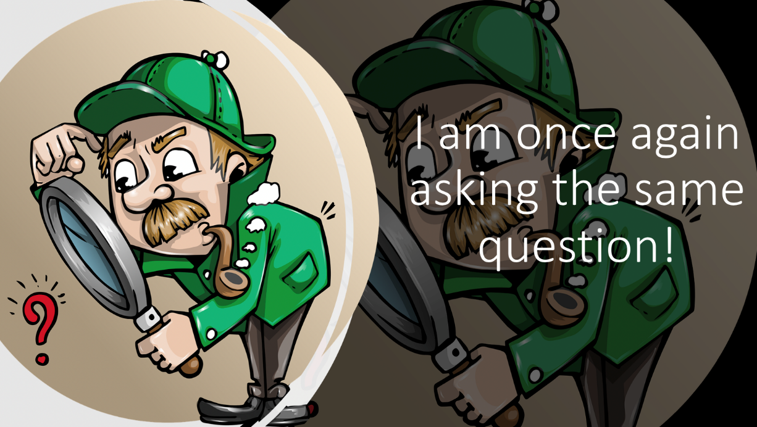
Problem Statement
The problem statement revolves around the task of identifying duplicate questions on the Quora platform. However, it often happens that users ask questions that have already been asked before, resulting in duplicate content and redundant answers.
For example,
'How do I read and discover my Facebook comments?’
and 'How can I see all my Facebook comments?' are two examples of duplicate questions.
04

Slide 4
Proposed Solution
To achieve this, the project will involve applying natural language processing (NLP) techniques and machine learning algorithms to analyze and compare the textual content of question pairs. The model will learn patterns and similarities in the questions to determine whether they are duplicates or not.
05

Slide 5
Objective
The objective of the project is to minimize the cost of misclassification in the task of duplicate question pair detection. The cost associated with misclassification refers to the negative consequences or impact that arises when the model incorrectly predicts whether a pair of questions are duplicates or not.
03

Slide 6
Literature Survey
S.No | Title | Methodology
01 | Imtiaz, Zainab, et al. "Duplicate questions pair detection using siamese malstm." IEEE Access 8 (2020): 21932-21942. | Siamese MaLSTM (”Ma” for Manhattan distance) Neural Network is another popular model used for detecting duplicate question pairs. This model compares the similarity between two questions by calculating the Manhattan distance between their respective embeddings.
02 | Babu, Jameer, and S. Thara. "Finding the duplicate questions in stack overflow using word embeddings." Procedia Computer Science 171 (2020): 2729-2733. | One commonly used technique in duplicate question pair detection is the utilization of word embeddings. Word embeddings capture semantic information and represent words as dense vectors. In this context, Google news vector embedding, FastText crawl embedding, and FastText crawl subwords embedding have been widely employed for vectorizing questions and training models.
06

Slide 7
Literature Survey
S.No | Title | Methodology
03 | Xu, Zhuojia, and Hua Yuan. "Forum duplicate question detection by domain adaptive semantic matching." IEEE Access 8 (2020): 56029-56038. | Convolutional Neural Networks (CNNs) have shown promising results in this domain. By leveraging pre-trained word embeddings and Siamese Neural Networks for comparison, the model achieves a high accuracy of 79%.
04 | Ansari, Navedanjum, and Rajesh Sharma. "Identifying semantically duplicate questions using data science approach: A quora case study." arXiv preprint arXiv:2004.11694 (2020). | Attentional mechanisms play an important role in these models, allowing for relevant information and improved interpretability.
06

Slide 8
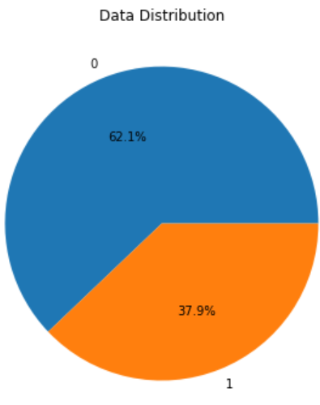
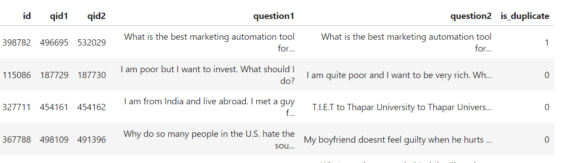
System architecture and design
Dataset Description: The dataset used in this project is a collection of pairs of questions from the Quora platform, specifically curated for the task of duplicate question pair detection.
14

Slide 9
System architecture and design
Text Pre-processing
Tokenization: Tokenization refers to the process of splitting text into individual units called tokens.
Stop word Removal: Stop words are commonly used words that do not carry significant meaning in the context of a sentence or text. Examples of stop words include "the," "is," "and," "in," etc.
Lemmatization/Stemming: Lemmatization and stemming are techniques used to reduce words to their base or root forms, reducing inflectional and derivational variations. Lemmatization involves converting words to their base form (lemma) using morphological analysis and dictionary lookups. For example: Word: "running", Lemma: "run"
14

Slide 10
System architecture and design
Text Pre-processing
4. Handling Special Characters, Symbols, Capitalization and Abbreviations: Text data often contains special characters, symbols, or punctuation marks that may not contribute much to the meaning or context. These characters can introduce noise and hinder the analysis. Capitalization and abbreviations can introduce variations in the text, and treating them consistently can improve the accuracy and comparability of the data.
14

Slide 11
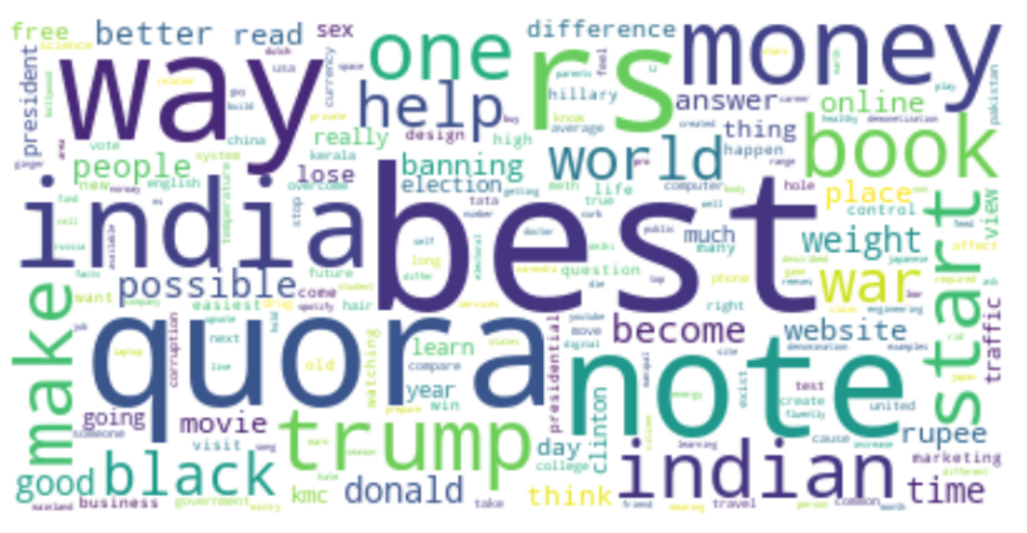
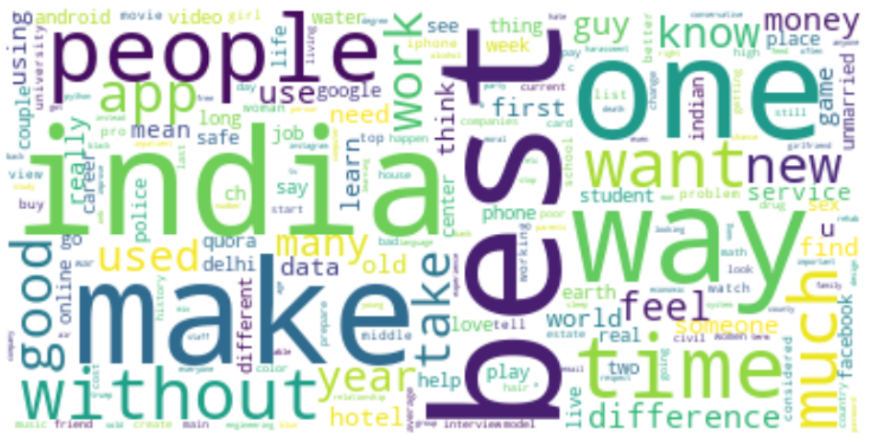
System architecture and design
Text Pre-processing
14

Slide 12
System architecture and design
Feature Engineering
TF-IDF Representation: TF-IDF (Term Frequency-Inverse Document Frequency) assigns weights to words based on their frequency in a document and their rarity in the entire corpus.
Word Embeddings: Word embeddings capture the semantic meaning of words by representing them as vector representations in a continuous vector space. Word2Vec models learn word embeddings by predicting the context words given a target word or predicting the target word given the context words.
Similarity Metrics: Similarity metrics are used to quantify the similarity between question pairs.
14

Slide 13
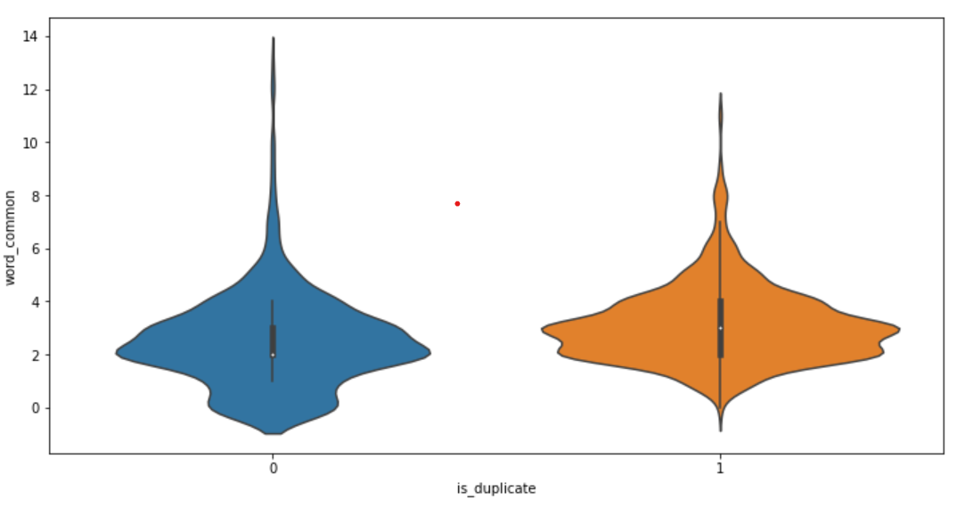
System architecture and design
Feature Engineering
14

Slide 14
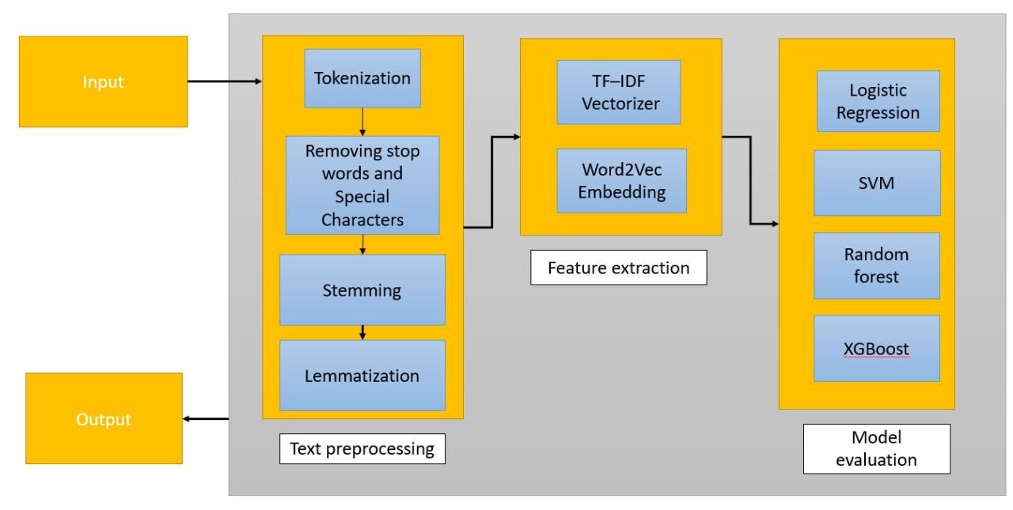
System architecture and design
14

Slide 15
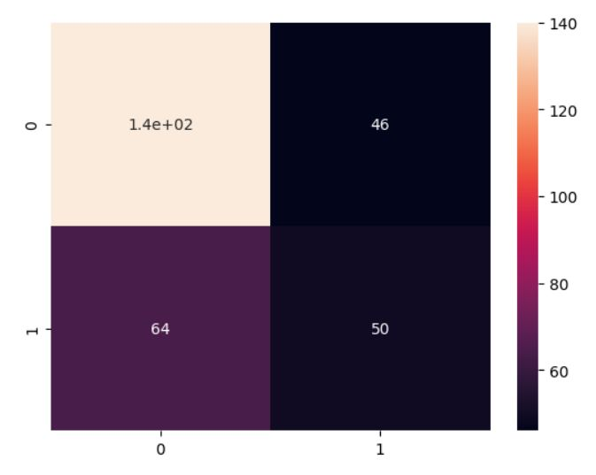
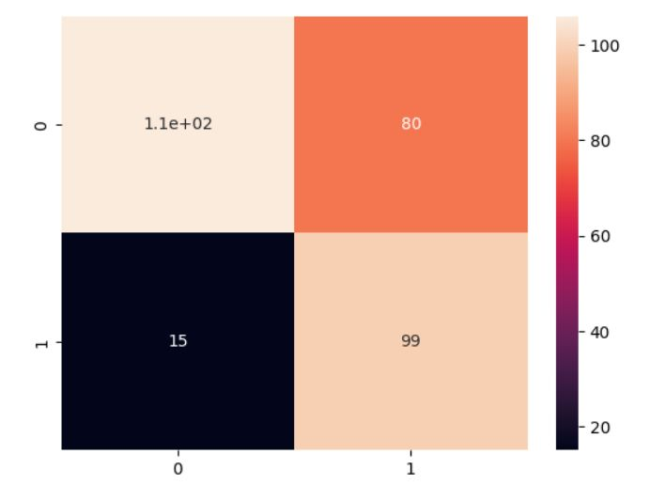
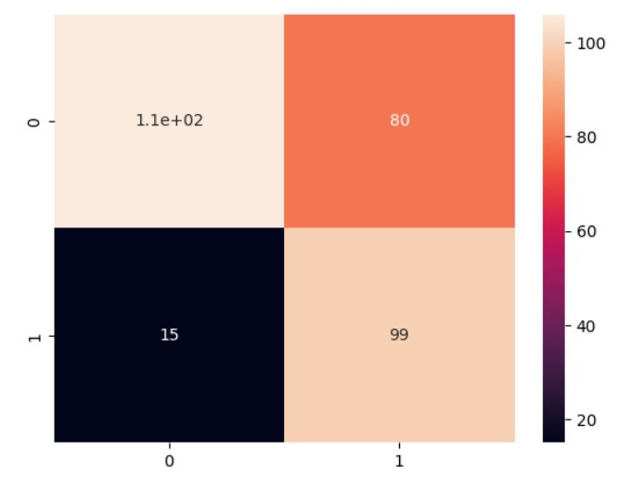
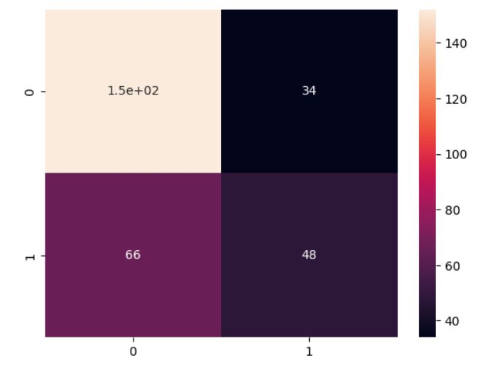
Experimental Results
16

Slide 16
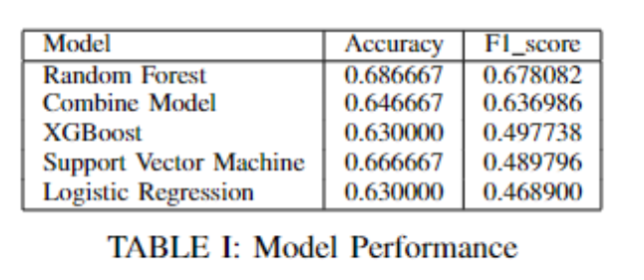
Experimental Results
16

Slide 17
Conclusion
In conclusion, this project aimed to tackle the task of duplicate question pair detection on the Quora platform using natural language processing (NLP) techniques and machine learning algorithms. Through exploratory data analysis, text pre-processing, feature engineering, and model building, we developed models capable of predicting whether a pair of questions are duplicates or not. However, it is important to acknowledge the limitations and potential for future work in this study. Additionally, the research can be extended by considering larger and more diverse datasets. Collecting data from multiple question-and-answer platforms or incorporating external knowledge sources could help create more robust and generalizable models for duplicate question pair detection.
22

