Slide 1
ISDA - 2023
International Conference on Intelligent Systems Design and Applications

Slide 2
BIOMEDICAL LITERATURE NAMED ENTITY RECOGNITION
Authors,
R.Shanthakumari
E.M.Roopa Devi
S. Vinoth Kumar
N. Asifaa Sulthana
B. Fahima Begum
G. Kaushik
Track Name: ISDA
Paper ID: #246

Slide 3
OBJECTIVE
Identification of medical conditions, diseases, symptoms, and anatomical entities.
To detect drug names, dosage, and other medication-related information.
Recognition of medical procedures, surgical techniques, and treatment methods.

Slide 4
Problem Description
NAMED ENTITY RECOGNITION (NER) -is a natural language processing that involves identifying and classifying entities within a text into predefined categories.
In medical field, NER place a crucial role in extracting a valuable information from clinical documents, research paper electronic health records and other medical texts.
When dealing with complex text manually, it may cause confusion and so our primary objective is to train a model to automatically identify and classify relevant named entities into predefined categories when a corpus of medical text is given.
‹#›

Slide 5
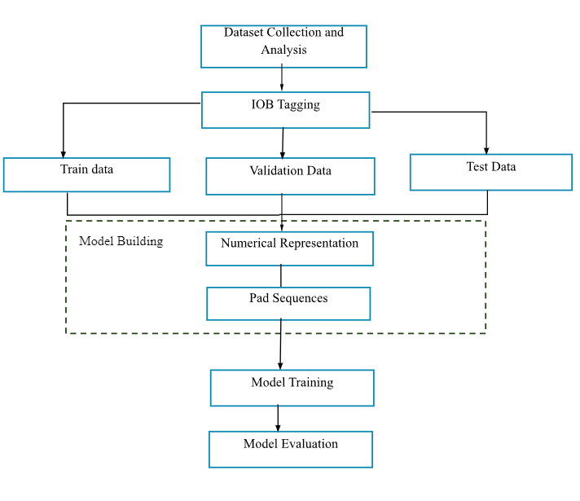
Proposed Methodology
‹#›

Slide 6
Dataset Collection
"MACCROBAT2018" data corpus is freely available on figshare.com.
It comprises 200 source documents and 200 annotated documents with PubMed document IDs.
These documents contain clinical case report information from PubMed Central.
Annotations are manually added to highlight specific data in the text.
Data pre-processing/Analysis :
Unlocking data insights with EDA and visualization used for analysis
‹#›

Slide 7
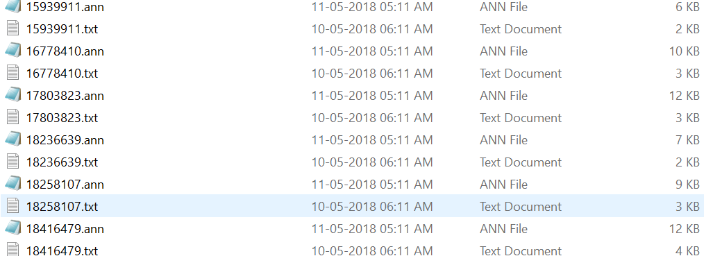
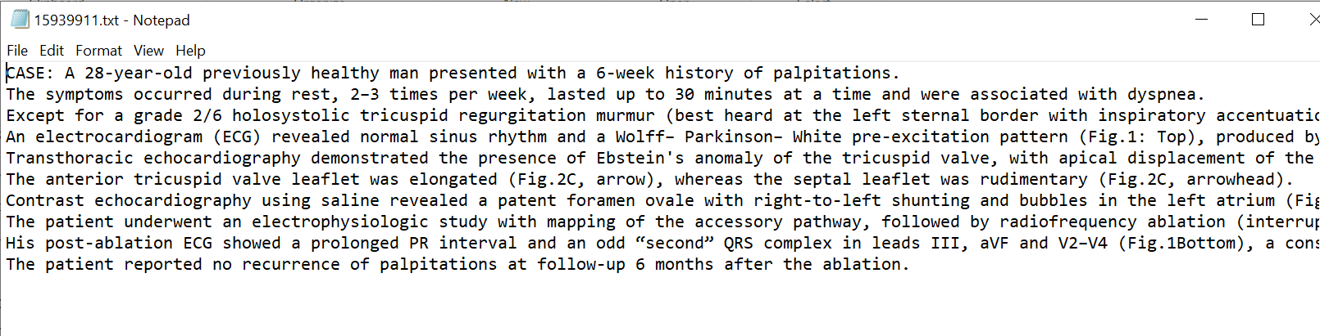
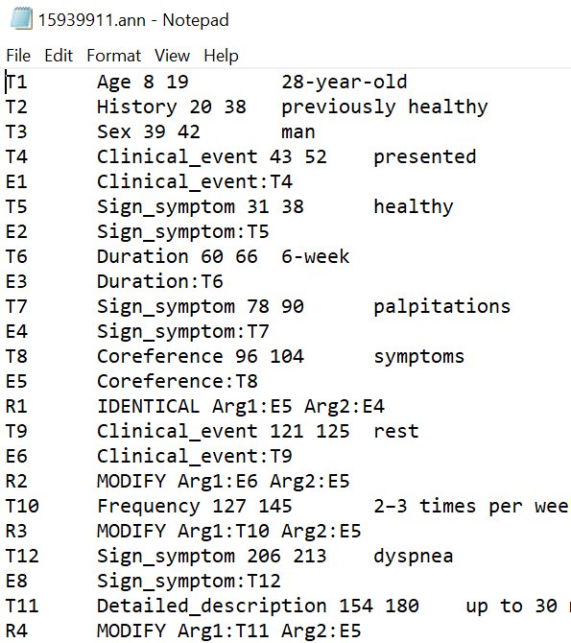

Slide 8
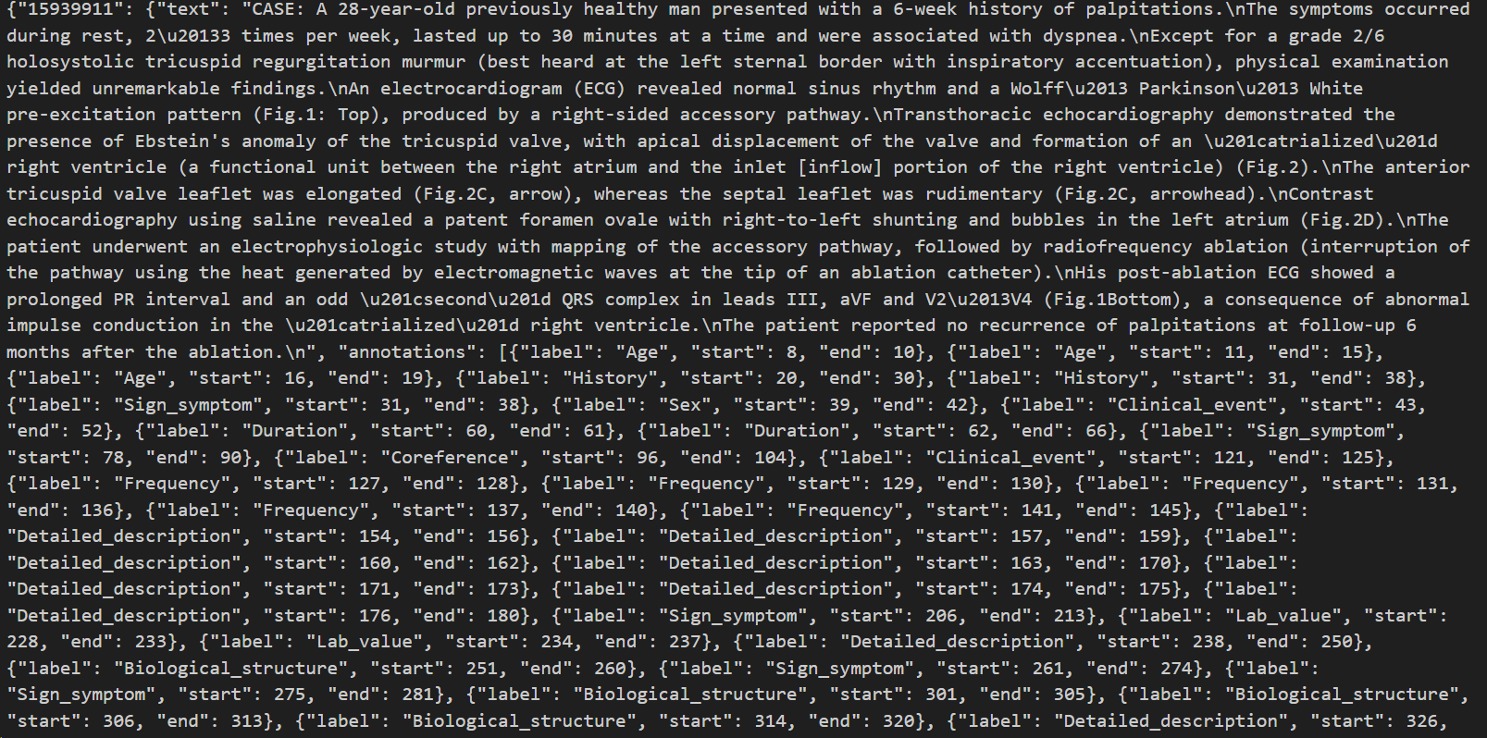
IOB Tagging
IOB Tagging Process : Create a single JSON file by .
‹#›

Slide 9
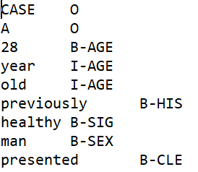
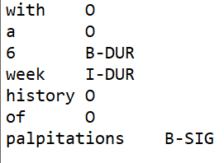
Create BIO Files : Prepare for Named Entity Recognition.
B-TAG:For defining the beginning of the entity
I-TAG:For defining entities inside
O-TAG: For defining stop word or unwanted words
Process BIO Files : Clean, lemmatize, and refine the .bio files to find whether there is stop word being marked with ‘B tag’ if so change it into ‘O tag’.

Slide 10
Data Splitting
In the BIO dataset, 4341 sentences are divided into a 70:10:20 ratio
training data-70
validation data-10
testing data-20
with respective sentences labels also follows the same split.

Slide 11
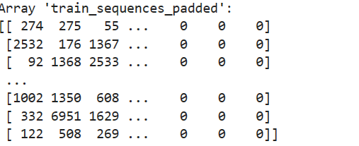
Numerical Representation
After the formation of bio file now, converting them into numerical format is important since the computer cannot understand the texts. The process involves creating label-index dictionaries, converting text to numerical format, and one-hot encoding labels for effective model training and reduction, resulting in a compressed .npz file.
Numerical Representation of Text :
Convert sentences to numerical format with tokenization.
Maintaining uniform sequence lengths:we pad each sentences by setting maximum length for smooth model training and evaluation.

Slide 12
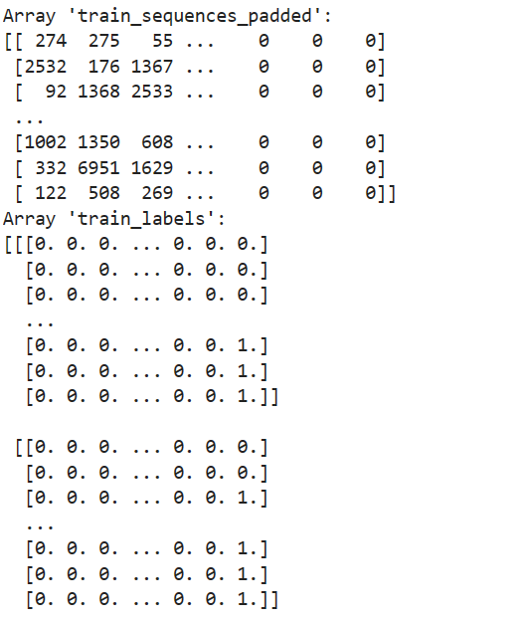
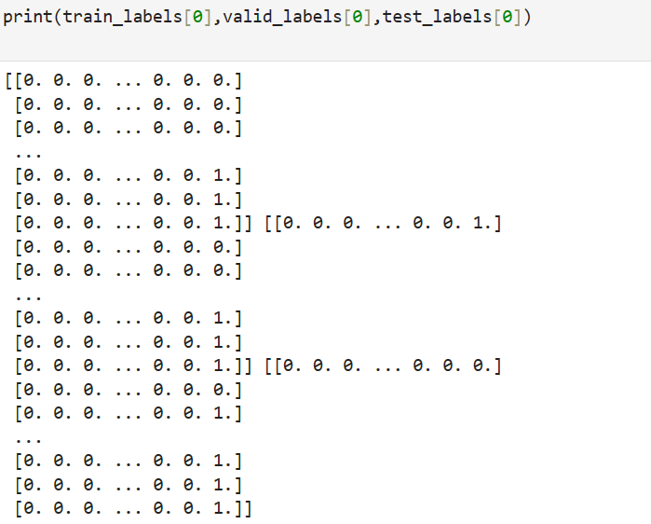
Label Encoding
Entity : [[Age, Loc, previously healthy, ..]]
One-hot Encoding : [[1,0, 0, ...] [0,1,0, ...] [0,0, 1...]]
1 - presence 0 - absence

Slide 13
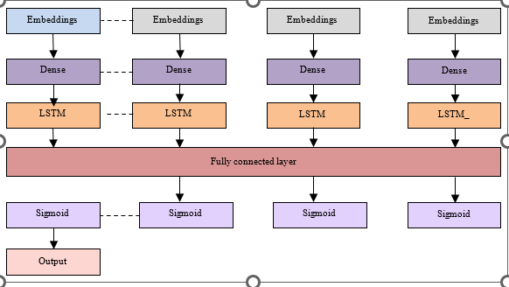
MODEL BUILDING

Slide 14
Model Building
Embedding Layers:
INPUT_DIM: Specify the vocabulary size.
EMBEDDING_DIM: Defines the dimensionality of word embeddings, impacting the richness of semantic information captured.
INPUT_LENGTH: Specifies the uniform length for input sequences through padding or truncation, ensuring consistency in neural network input.

Slide 15
Model Building
Dense Layers:
`Dense(DENSE_DIM, activation='relu')` is a layer for feature extraction with ReLU activation.
`Dense(NUM_CLASSES, activation='softmax')` is the output layer for multi-class classification, providing class probabilities.

Slide 16
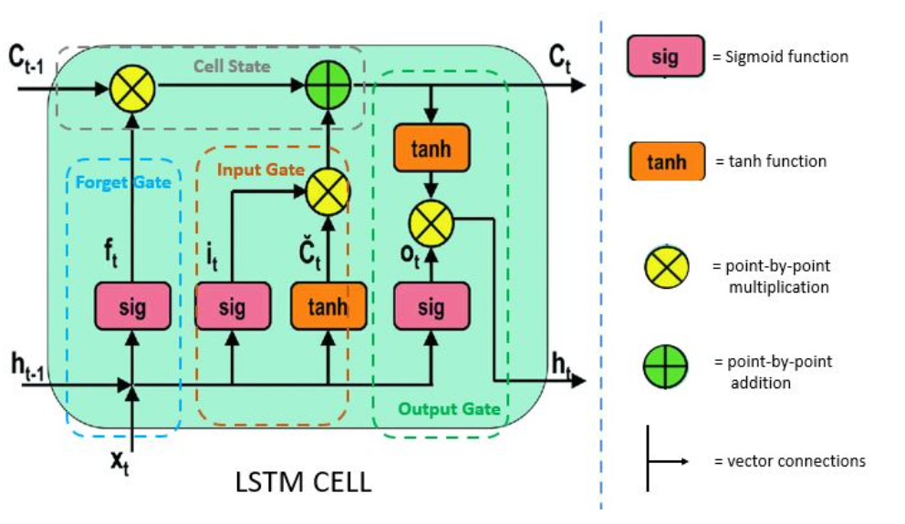

Slide 17
Model Building
Bi-LSTM Layers:
Process text sequences in both forward and backward directions.
Configure them with `LSTM(units, return_sequences=True)` and stack for complex sequence analysis.

Slide 18
Model Fitting
Training Objective: Train the model to minimize categorical cross-entropy loss through backpropagation and gradient descent.
Validation Check: After each epoch, assess the model's ability to generalize and watch for overfitting by evaluating its performance on the attestation set.

Slide 19
Proposal of the output
Once the model is trained, highlighting the important entities is an essential task.
For this spacy model is used, in which spacy model provides the ability to integrate custom models and pipelines, allowing for additional functionalities like text classification or sequence labeling.
With the help of spacy’s displacy modules, assign each entity with certain desired colour.
When the inferred text is given, based on the entity and the entity colour those text will be coloured or highlighted which could be necessary and or a medical related term.

Slide 20
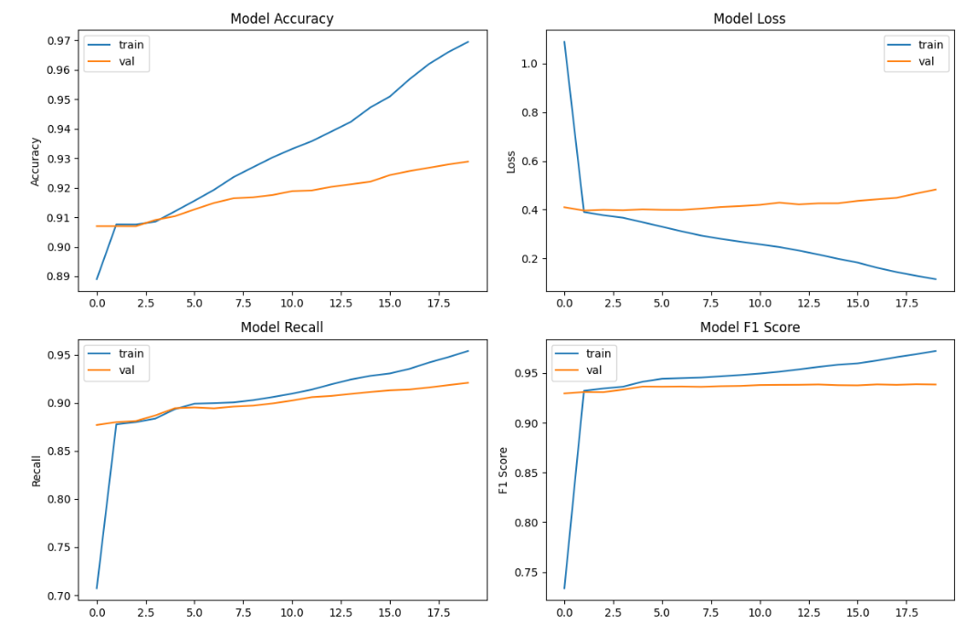
Graphical Representation Of Train And Validation Set

Slide 21
Model Evaluation
 | Precision | F1 score | Recall | Loss | Accuracy in %
Training set | 0.99 | 0.97 | 0.96 | 0.11 | 96.94
Validation set | 0.95 | 0.93 | 0.92 | 0.48 | 92.89
Test set | 0.95 | 0.93 | 0.91 | 0.48 | 92.89

Slide 22
Conclusion
Thus we have successfully built a rnn based BiLSTM model for classification of medical named entity recognition.
The notable achievement indicates that our modal is not only well-trained but also highly efficient in accurately predicting positive instances while minimizing false positives and false negatives.

Slide 23
Literature Review
S.No. | TITLE OF THE PAPER | JOURNAL DETAILS | TECHNIQUES USED | REMARKS
1. | Multilayer ToI Detection Approach for Nested NER | IEEE Access, vol. 7, pp. 186600-186608, 2019, | Text-of-Interest (ToI) detection with dual transformer encoders (ToI-CNN + DTE) model. | The experimental results show that ToI-based detection approach obtains the best performance only on the ACE datasets. This experiment might be applied to medical datasets in future since this may have a major scope.

Slide 24
Literature Review
S.No. | TITLE OF THE PAPER | JOURNAL DETAILS | TECHNIQUES USED | REMARKS
2. | Chinese NER Using Dynamic Meta-Embeddings | IEEE Access, vol. 7, pp. 64450-64459, 2019,. | The meta-embeddings created by our method are dynamic, data-specific, and task-specific. | Can evaluate the model on the sequence labeling tasks such as Part-of-Speech Tagging and Chinese Word Segmentation which is the major thing the changes can be done with NER models.
3. | Fine Grained Named Entity Recognition via Seq2seq Framework | IEEE Access, vol. 8, pp. 53953-53961, 2020 | seq2seq with BiLSTM model. | There is a scarcity of efforts in this regard for other languages.

Slide 25
Literature Review
S.No. | TITLE OF THE PAPER | JOURNAL DETAILS | TECHNIQUES USED | REMARKS
4. | A Bidirectional Iterative Algorithm for Nested Named Entity Recognition | IEEE Access, vol. 8, pp. 135091-135102, 2020, doi: 10.1109/ACCESS.2020.3011598. | Bi-directional Long Short-Term Memory (LSTM) Networks with CRF model. | Competitive for tasks involving mostly flat mentions with occasional nesting, as well as tasks with a large number of complex nested structures.
5. | A Neural Named Entity Recognition and Multi-Type Normalization Tool for Biomedical Text Mining | IEEE Access, vol. 7, pp. 73729-73740, 2019, doi: 10.1109/ACCESS.2019.2920708. | BioBERT | Can use multi-task NER model for higher NER performance. Develop a novel entity type decision model that uses transfer learning to consider the entity types and probabilities of overlapping entities but also the deeper contextual meaning of a text.

Slide 26
Thank you

