Slide 1
Colloquium
Kaushik Puttaswamy
Matriculation No: 321150196
Enhancing Transparency in Medical Text Transcription Classification:
Assessing BERT Pre-trained Language Model Performance
and Decision-Making Using Explainable AI (XAI) Techniques
Berlin and 19th August 2024

Slide 2
CONTENT LIST
INTRODUCTION |  | 3 - 4 |  | 00:04 h
LITERATURE REVIEW OVERVIEW |  | 5 |  | 00:03 h
METHODOLOGY |  | 6 – 7 |  | 00:03 h
RESULTS |  | 8 - 12 |  | 00:03 h
CONCLUSION |  | 13 |  | 00:01 h
LIMITATIONS AND RECOMMENDATIONS |  | 14 |  | 00:01 h
REFERENCES |  | 15 |  | 00:01 h

Slide 3
INTRODUCTION
Background:
The rapid advancement in medical text transcription through BERT models enhances the accuracy of classification but poses challenges in interpretability (Talebi et al., 2024, pp. 2). This study aims to integrate BERT models with Explainable AI (XAI) techniques like SHAP to improve transparency and trust in clinical decision-making.
Research Field:
This field focuses on advancing medical text classification through AI models like BERT and integrating Explainable AI (XAI) techniques to address transparency challenges. It aims to improve the accuracy and trustworthiness of AI in healthcare by tackling the complexities of clinical language.
Problem Statement:
Research in medical text transcription and classification is crucial for improving patient care and optimizing clinical workflows. However, existing AI models like BERT and its variants often lack interpretability, which hinders their practical application in healthcare (Lundberg & Lee, 2017, p. 3).

Slide 4
cont.
Aim & Objective:
To evaluate BERT-based models' performance in classifying medical text and enhance model transparency using Explainable AI (XAI) techniques.
Integrate SHAP with BERT models to improve interpretability and address medical text classification challenges through advanced NLP methods.
Research Question:
How do BERT-based models compare to traditional algorithms in medical text classification, and how does integrating SHAP improve their interpretability and address transcription challenges? Additionally, what ethical and practical issues arise in deploying these models in clinical settings?
Significance of the Study:
This study bridges cutting-edge NLP techniques with real-world clinical needs, enhancing medical text classification through advanced BERT-based models and explainable AI (XAI) methods. By increasing model transparency and addressing key issues like data privacy and terminology variability, it improves the accuracy and reliability of AI in healthcare (Fehr et al., 2024, p. 2).

Slide 5
LITERATURE REVIEW OVERVIEW
Advancements in Machine Learning for Medical Text: Recent advancements in machine learning, including deep learning models and BERT, have dramatically improved the accuracy and efficiency of medical text classification. The integration of explainable AI techniques further enhances model interpretability and trust in AI-driven decisions (Prabhakar & Won, 2021, p, 3).
Role of BERT and Pre-trained Language Models: BERT and similar pre-trained language models have transformed NLP by leveraging bidirectional training and self-attention mechanisms for superior contextual understanding. Their ability to learn from extensive data and fine-tune on specific tasks has greatly advanced medical text classification (Devlin et al., 2019, p, 4174).
Explainable AI (XAI) Techniques in Healthcare: XAI techniques like SHAP, LIME, and Grad-CAM enhance AI interpretability by providing insights into decision-making processes. These tools help clinicians understand and trust AI recommendations, detect biases, and ensure the reliability of healthcare applications (Chakrobartty & El-Gayar, 2021, p. 3).
Integration of BERT and XAI Techniques: Integrating BERT with Explainable AI techniques combines advanced contextual understanding with interpretability, leading to improved accuracy and transparency in medical text classification. This synergy fosters better clinical decisions and enhances patient outcomes (Binder et al., 2022, p. 2124).
Ethical and Regulatory Considerations: AI in healthcare requires stringent ethical oversight to ensure transparency, fairness, and accountability, preventing biases and safeguarding patient safety. Adhering to regulatory frameworks like GDPR and FDA guidelines is essential, though these regulations must evolve to keep pace with technological advancements (Schöffer, 2023, p. 8).

Slide 6
METHODOLOGY
Research Approach & Design: The research methodology involves using BERT-based models to categorize medical text transcriptions, integrating data analysis and model tuning for enhanced accuracy. It emphasizes explainable AI techniques to ensure model reliability and detect biases.
Data Collection
Exploratory Data Analysis
Validity & Reliability Analysis of Results & Discussion
Data Preprocessing
Model Selection
Model Development & Evaluation
Integration of XAI Technique for Validation and Error Analysis
Figure 1. Design of thesis research methodology
Data Collection & Preprocessing: The data collection process involved acquiring a comprehensive dataset from mtsamples.com, comprising 4,999 medical transcription records. Following this, the data underwent extensive preprocessing, including cleaning, normalization, and text enrichment, resulting in a refined dataset of 2,324 records optimized for effective machine learning model training.

Slide 7
cont.
Model Selection & Development: The process of model selection involves choosing between classical machine learning algorithms, like Random Forest and SVM, and advanced deep learning models such as BERT, BioBERT, ClinicalBERT, RoBERTa. Development includes fine-tuning these models through techniques like tokenization, SMOTE for balancing, and performance evaluation with metrics like accuracy and F1 score to ensure optimal predictive performance.
Evaluation & Comparison: We assessed baseline and advanced models using precision, recall, and weighted average F1 scores to evaluate their performance across various medical specialties. This approach ensures a balanced assessment of model effectiveness.
Explainable AI (XAI) Integration: SHAP was integrated with BioBERT to clarify token contributions to model predictions, enhancing transparency. This involved visualizing token importance, performing perturbation tests, and validating results across medical specialties.
Ethical Considerations & Validity: To uphold ethical standards, we ensured rigorous anonymization and adherence to data handling guidelines to protect patient privacy. Transparency about data sources and using SHAP for explainability supported model accountability and research integrity.

Slide 8
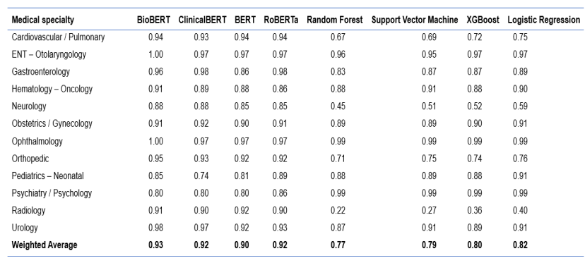
COMPARISON OF RESULTS BETWEEN BASELINE
AND ADVANCE MODEL
The advanced models (BioBERT, ClinicalBERT, BERT, and RoBERTa) achieved weighted average F1 scores of 0.93, 0.92, 0.90, and 0.92, respectively, outperforming the baseline models.
Traditional ML models like random forest, SVM, XGBoost, and logistic regression had lower F1 scores of 0.77, 0.79, 0.80, and 0.82, highlighting the advancements in pre-trained BERT models.
Pre-trained BERT models significantly surpass traditional machine learning approaches in accuracy, as reflected by their higher F1 scores.
Table 1. A comparison between baseline and advanced models of medical specialty categories F1 scores

Slide 9
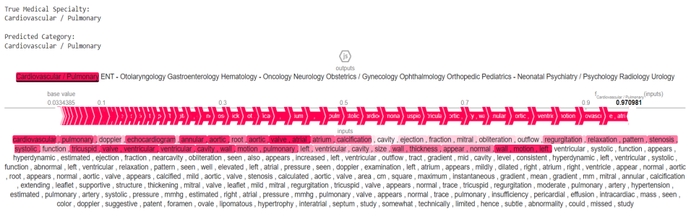
RESULTS ANALYSIS OF THE INTEGRATION OF
XAI WITH THE BIOBERT MODEL
Figure 2. Dataset samples with SHAP values visualization and BioBERT model prediction
Domain-Specific Accuracy: The model's predictions for the Cardiovascular/Pulmonary specialty are validated by domain-specific terms like "ventricular," "mitral," "ejection fraction," and "doppler," indicating strong accuracy.
SHAP Values: With a base value of 0.033 and a SHAP value of 0.971, the model shows high confidence and precision in Cardiovascular/Pulmonary predictions, highlighting the significance of key cardiac terms.
Model Interpretability: SHAP visualizations confirm that the model’s predictions are relevant and consistent across medical specialties, enhancing the model's reliability and interpretability.

Slide 10
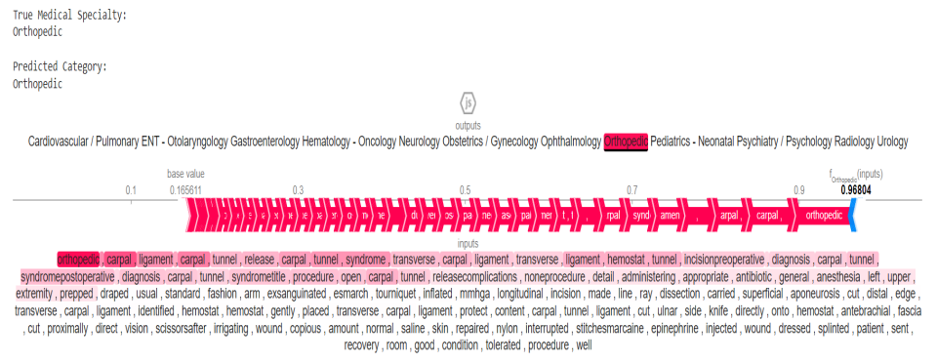
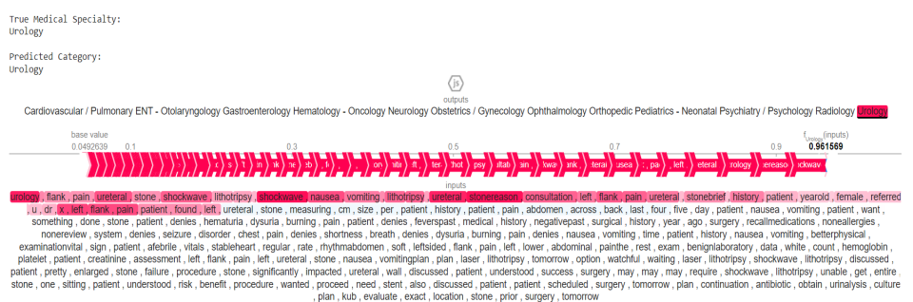
RESULTS OF CONSISTENCY ANALYSIS FOR XAI
INTEGRATION WITH BIOBERT MODEL ACROSS MULTIPLE SAMPLES
Figure 3. Dataset samples with SHAP values visualization for consistency analysis of integration of XAI with BioBERT
1. Consistent SHAP Values:
2. Field-Specific Terms:
SHAP values consistently highlight key terms like "carpal tunnel" in Orthopedics, and "flank pain" in Urology, demonstrating the model's reliability across different samples.
The persistent identification of domain-specific terms across multiple samples underscores the model’s robustness in recognizing and prioritizing significant features within each medical specialty.

Slide 11
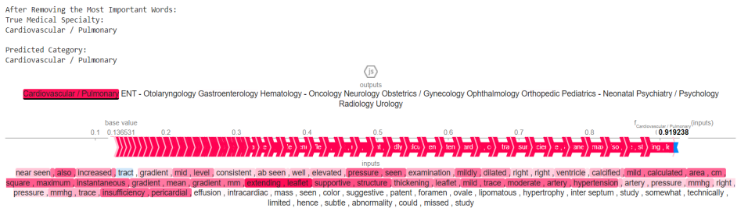
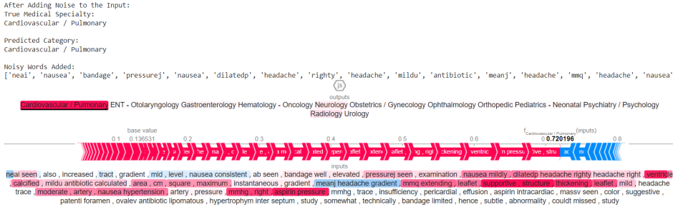
RESULTS OF ROBUSTNESS TESTING OF
THE INTEGRATION OF XAI WITH THE BIOBERT MODEL
Figure 4. SHAP values visualization of removing the most important words
Figure 5. SHAP values visualization of adding noisy words
Model Robustness and Performance: The model maintained accurate predictions even after removing crucial SHAP-identified terms, with SHAP value decreasing from 0.970981 to 0.919238. This indicates the model's ability to remain reliable despite missing key information.
Handling Noisy Data: Introducing noisy words and misspellings reduced SHAP value to 0.720196 but did not significantly affect its ability to predict the category accurately. This demonstrates the model’s resilience against irrelevant or distorted data.
Contextual Understanding: The model’s performance showed that it effectively understands the overall context of medical texts, ensuring robust and dependable predictions even in the presence of noise or absent important terms.

Slide 12
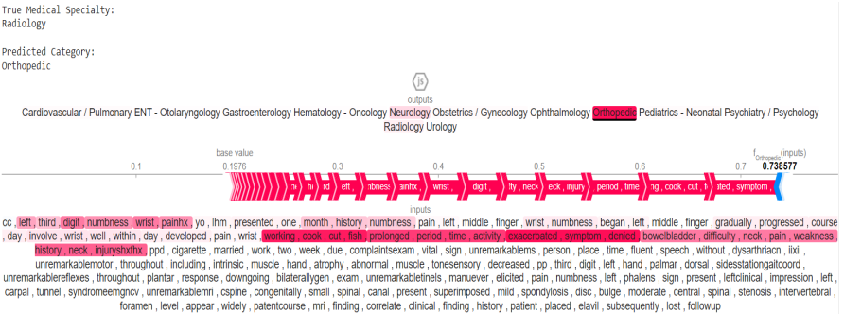
RESULTS OF ERROR ANALYSIS FOR
THE INTEGRATION OF XAI WITH THE BIOBERT MODEL
Misclassification Insights:
Example: Correct Label "Radiology," Model Prediction "Orthopedic ".
SHAP values reveal influential terms ("left," "digit," "numbness") led to the incorrect prediction by focusing on specialized terms without sufficient context.
2. Model Limitations and Recommendations:
Issue: Model struggles with contextual understanding across specialties.
Recommendations: Enhance training data with diverse examples and include contextual features like patient history to improve accuracy.
3. Impact of SHAP Values:
Figure 6. Error analysis of a misclassified instance using SHAP values visualization
Provides transparency into model predictions and highlights areas for improvement in both model training and feature engineering.

Slide 13
CONCLUSION
Enhanced Accuracy
Error Identification
Advancing AI in Healthcare
BERT-based models significantly improve medical text transcription accuracy and reliability.
SHAP helps identify and correct biases, fostering continuous improvement in AI models.
The combination of advanced NLP and XAI paves the way for more trustworthy and effective AI applications in healthcare.
Increased Transparency
Improved Patient Care
Integrating SHAP enhances model transparency, making AI decisions more interpretable for healthcare professionals.
Better medical text categorization boosts patient care quality and safety by reducing clinical errors.

Slide 14
LIMITATIONS AND RECOMMENDATIONS
Limitations of the Study:
Sample Size: Dataset may not capture all medical transcription scenarios.
Data Quality: Quality issues could affect model performance.
Generalizability: Domain-specific models may lack versatility.
Complexity: SHAP values are hard to interpret and computationally demanding.
Ethical Concerns: Data privacy and bias may impact fairness.
Recommendations:
Integrate XAI: Use SHAP with attention mechanisms and LIME for clarity.
Benchmarking: Compare with medical experts to evaluate accuracy.
Expand Data: Use larger and more varied datasets.
Simplify Explanations: Create user-friendly interfaces for clinicians.
Clinical Trials: Conduct studies to validate real-world effectiveness.

Slide 15
REFERENCES
Talebi, S., Tong, E., Li, A., Yamin, G., Zaharchuk, G., & Mofrad, M. R. K. (2024). Exploring the performance and explainability of fine-tuned BERT models for neuroradiology protocol assignment. BMC Medical Informatics and Decision Making, 24(1), 40. https://doi.org/10.1186/s12911-024-02444-z
Lundberg, S. M., & Lee, S.-I. (2017). A Unified Approach to Interpreting Model Predictions. Advances in Neural Information Processing Systems, 30. https://papers.nips.cc/paper_files/paper/2017/hash/8a20a8621978632d76c43dfd28b67767-Abstract.html
Fehr, J., Citro, B., Malpani, R., Lippert, C., & Madai, V. I. (2024). A trustworthy AI reality-check: The lack of transparency of artificial intelligence products in healthcare. Frontiers in Digital Health, 6, 1267290. https://doi.org/10.3389/fdgth.2024.1267290
Prabhakar, S. K., & Won, D.-O. (2021). Medical Text Classification Using Hybrid Deep Learning Models with Multihead Attention. Computational Intelligence and Neuroscience, 2021(1), 9425655. https://doi.org/10.1155/2021/9425655
Devlin, J., Chang, M.-W., Lee, K., & Toutanova, K. (2019). BERT: Pre-training of Deep Bidirectional Transformers for Language Understanding. In J. Burstein, C. Doran, & T. Solorio (Eds.), Proceedings of the 2019 Conference of the North American Chapter of the Association for Computational Linguistics: Human Language Technologies, Volume 1 (Long and Short Papers) (pp. 4171–4186). Association for Computational Linguistics. https://doi.org/10.18653/v1/N19- 1423
Chakrobartty, S., & El-Gayar, O. (2021). Explainable Artificial Intelligence in the Medical Domain: A Systematic Review. Americas Conference on Information Systems. https://www.semanticscholar.org/paper/Explainable-Artificial-Intelligence-in-the-Medical-Chakrobartty-El-Gayar/4e405e87a55611328d2f408ae9d4164373454296
Binder, M., Heinrich, B., Hopf, M., & Schiller, A. (2022). Global reconstruction of language models with linguistic rules – Explainable AI for online consumer reviews. Electronic Markets, 32(4), 2123–2138. https://doi.org/10.1007/s12525-022-00612-5
Schöffer, J. (2023). On the Interplay of Transparency and Fairness in AI-Informed Decision-Making. https://doi.org/10.5445/IR/1000164741

Slide 16
Thank you

