Slide 1
PSG HACKATHON
WIND FALCONS
KAUSHIK S - 20I224
MOHAMED FAZIL Z - 21I437
JANATHSRI KRISHNAN K – 21I433

Slide 2
P2. Data Science: Crime Analysis & Safety recommendation
Overview
First we perform exploratory data analysis on the given crime data then this data will be exported into the database for querying purposes. Then we use a standard navigation api to get the start (A) and end (B) destination thus we get the route from the point A to B. Now we get the reverse latitude from the points present in between A and B. For each and every point we perform caching so as to increase performance. Now that we got the latitude for every intermediate point we also have to get the crime’s location’s latitude. We perform K nearest neighbors for each point then display the results and ask for the user to change route if the route found has more crime as compared to other paths.

Slide 3
Implementation details
The major features are that the analysis obtained can be further be displayed to the user like each crime in the intermediate area sorted based upon the recent to the oldest one. Tips for user to prevent the crime. Re-route if crime are less in alternative route. As we use K nearest neighbor instead of dijkstra for decreasing complexity. We use caching for every route until the database is updated/added by the admin. So this reduces complexity by a lot

Slide 4
Tools & Technologies
Python as the implementation language. Openrouteservice’s api for getting the Direction between two points (i.e) source and destination. openstreetmap and requests for the location to latitude and longitude conversion. K nearest points’s Algorithm for finding the closest crime for each intermediate point. Flask is to be used for web based application.

Slide 5
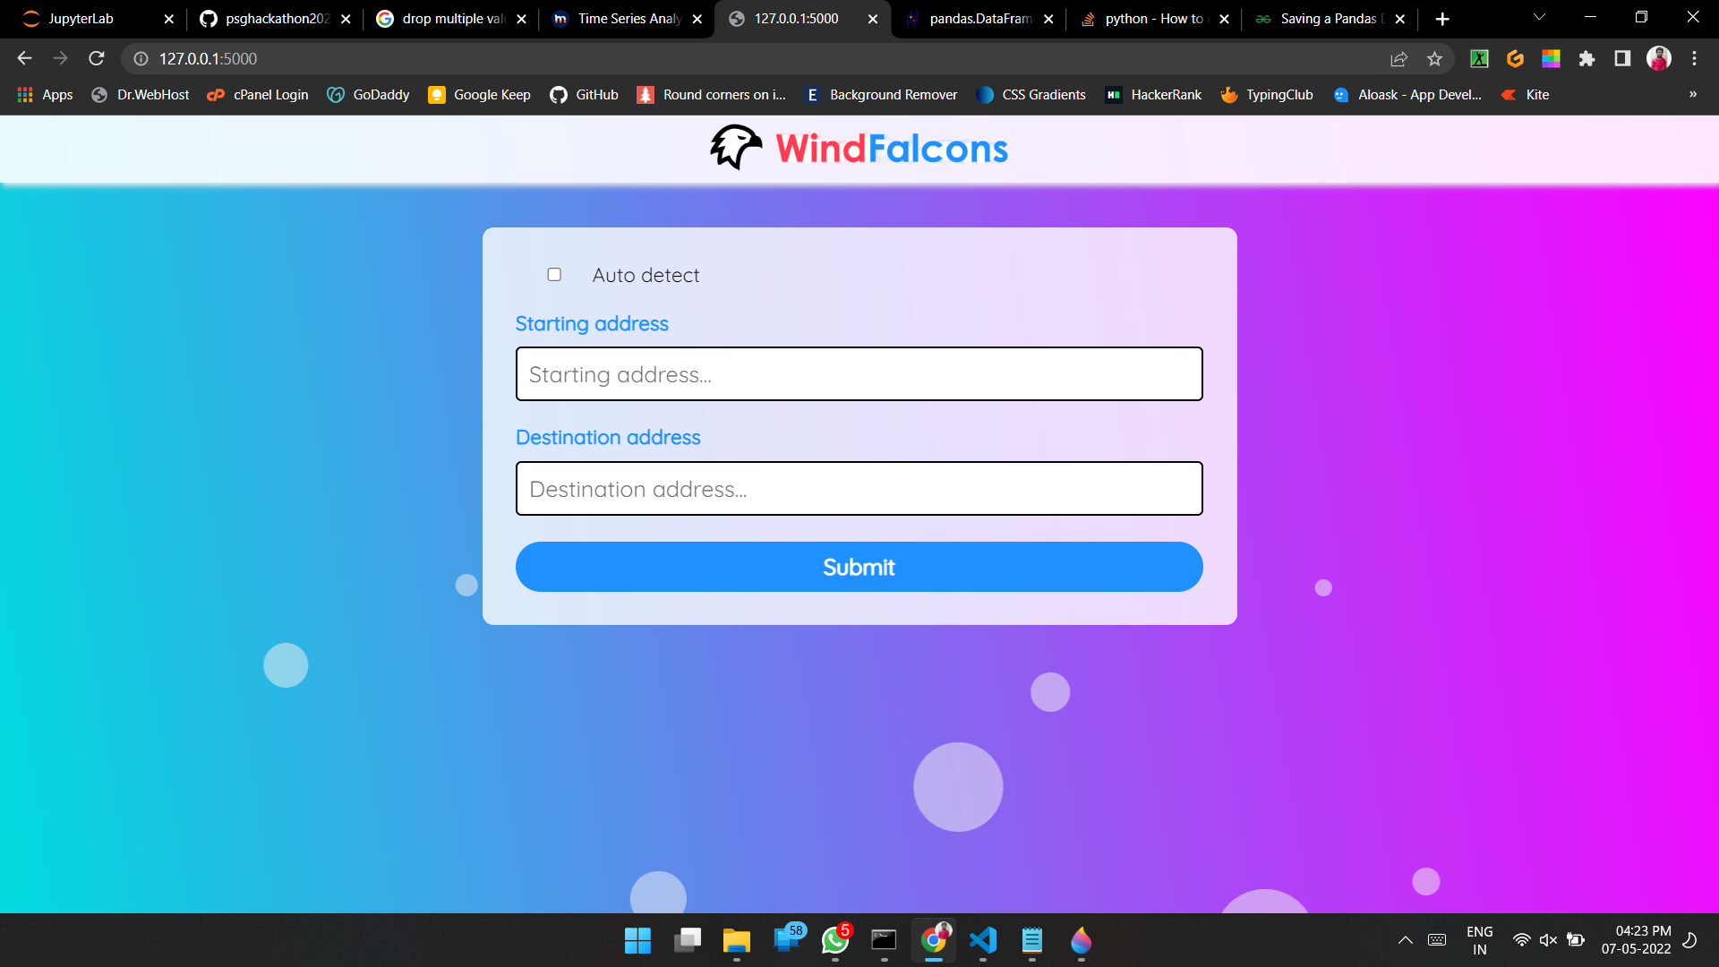
Product
Start page of the user interface

Slide 6
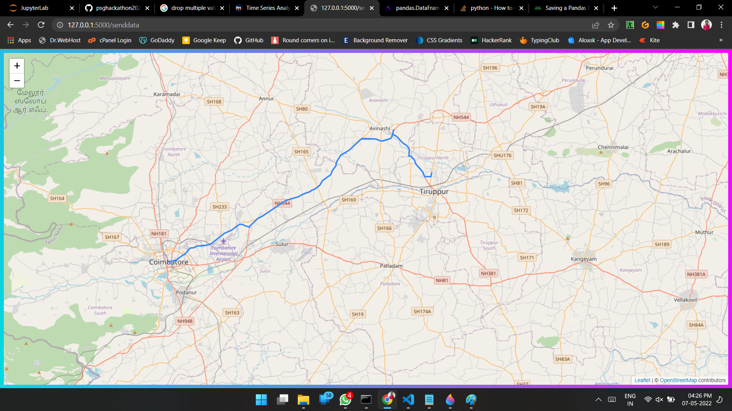
Showing route between two location

Slide 7
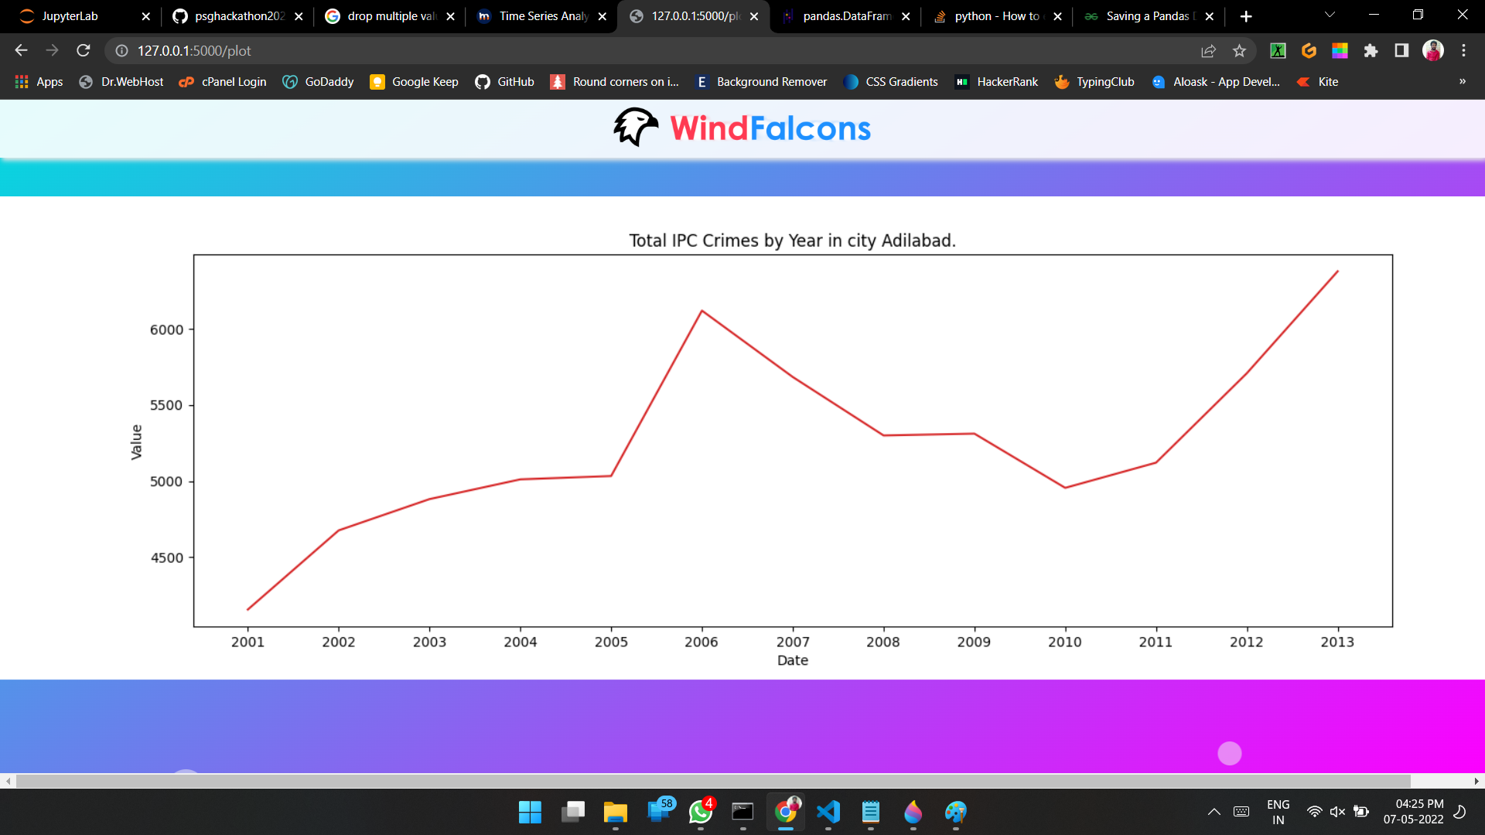
Ploting crime rate for given city

