Slide 1
Cat Checker – Elimination Classification
Case Study
Confidential
DD-MMM-YYYY
John Smith

Slide 2
Topics
01
｜
Background and Objective
02
｜
Data Preparation
03
｜
Exploratory Data Analysis
04
｜
Feature Engineering
05
｜
Modelling

Slide 3
01
Background and Objective

Slide 4
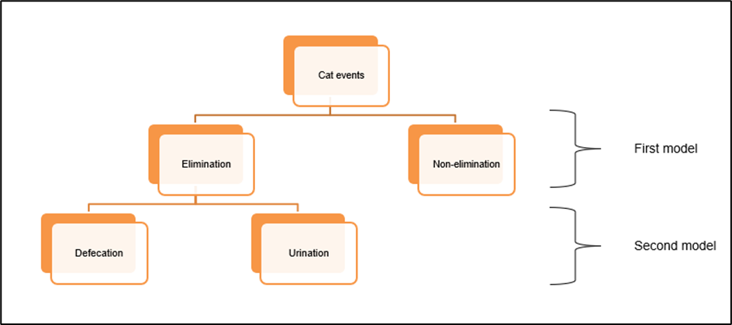
Background and Objective
Background
Objective
The Smart Litter System is a smart cat litter system that is equipped with four load sensors capturing any load disturbance happening on the litter box. The device functions at 40 Hz frequency rate which means it records 40 samples per second.
The cat interaction events are as shown below:
Elimination
Defecation
Urination
Non-Elimination
The objective of this project is to develop a solution approach to correctly classify the events as elimination or non-elimination and further classify the elimination events into urination and defecation.

Slide 5
02
Data Preperation

Slide 6
Data Preparation
Data Sufficiency
Data selection
Event Load Sensor Data: Event named load sensor data containing timesteps and Load Sensor values.
Tags Data: Event named label/tag data containing the information about the event such as cat name, event tags, free text etc.
Total number of files given 26150, 13075 files containing sensor data, 13075 containing Tags Data, so in total we have 13075 unique events.
Missing Values:
Tags Data
Name_of_cat – 246 values missing
Tare_Weight – 1013 values missing
Activity – 3 values missing
We have aggregated Sensor Data together with Tags Data, it represents 1 row in a final dataset.
We have used Device_ID, Event_ID, Event_start_time, tags, Name_of_cat, Weight_of_cat.
We have not used Free_text and Tare_weight.
We have calculated Tare_Weight from Sensor Data.
We got activity label from Tags.
We got cat_in_box label from Tags.
We got Synapse_Labeled label from Tags.

Slide 7
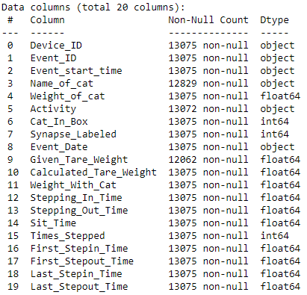
Data Preparation
Merging the data
Target variable
We have joined joined Load Sensor Data and Tags Data on Event ID.
For each Event_Id we have a sensor data that contains multiple rows, so we have aggregated them and created multiple features from them.
By project’s objective we have 2 models to create:
To identify if a given activity is Elimination or Non-Elimination.
If its Elimination, it is Urination or Defecation.
So we will have two Target Variable, one for each model.
For first model Elimination column will be target variable, it will have 1 as value in case of Elimination and 0 in case of Non-Elimination.
For second model Urination/Defecation column will be target variable, it will have 0 in case of Urination and 1 in case of Defecation

Slide 8
03
Exploratory Data Analysis

Slide 9
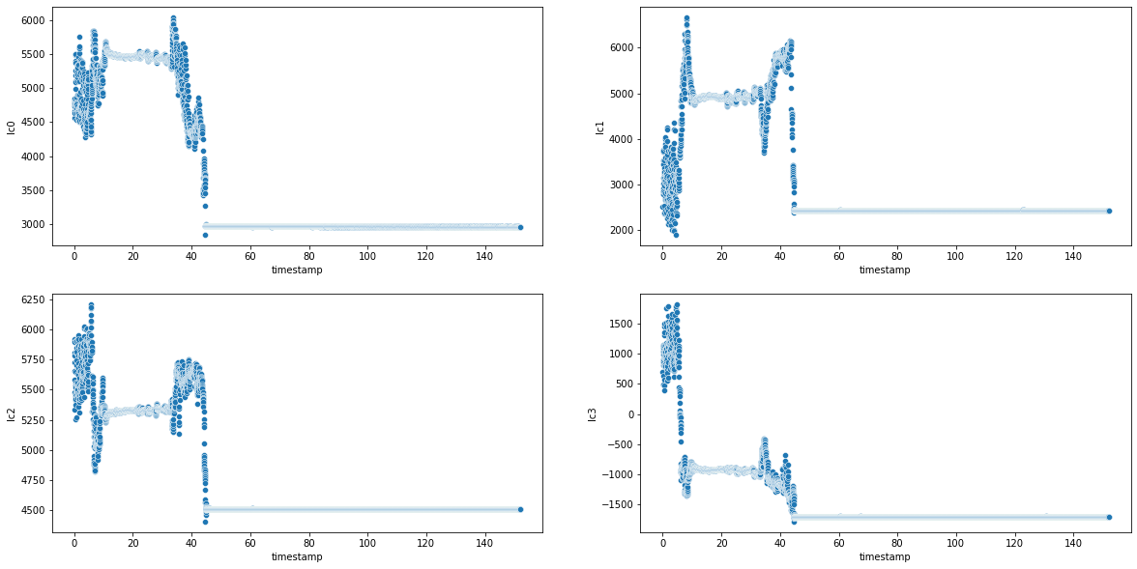
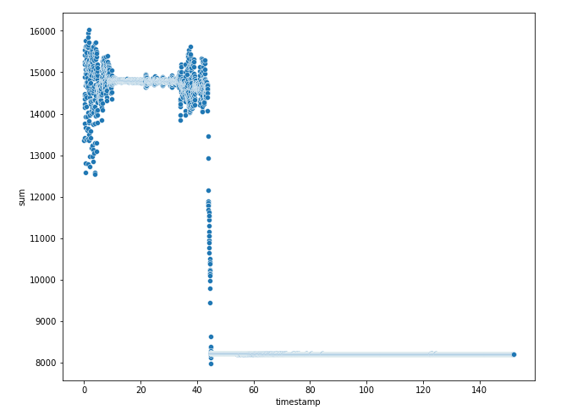
Sensor data
Noise in sensor value at start and end is because of cat digging the litter.
Individual sensors
Sum of reading of all sensors
Insights
All sensors have different Tare Weight.
Peak in all load sensors starts and end at the same time.
Insights
Sum of sensors gives better picture of cat activity
Total increase in weight = weight of cat

Slide 10
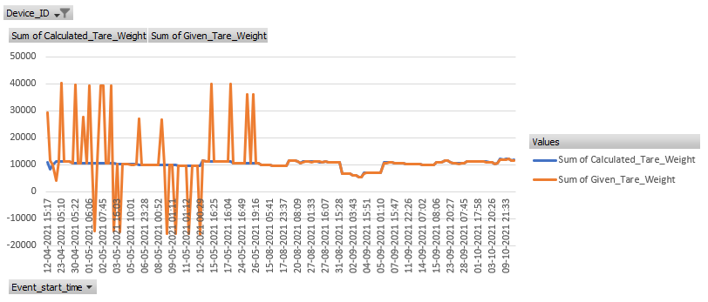
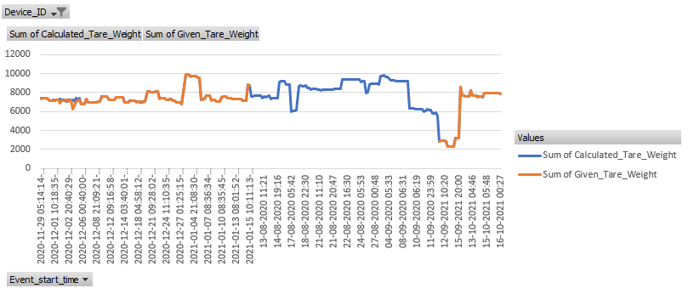
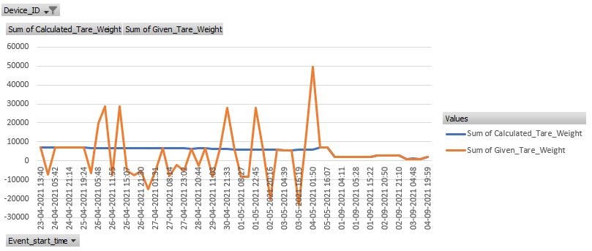
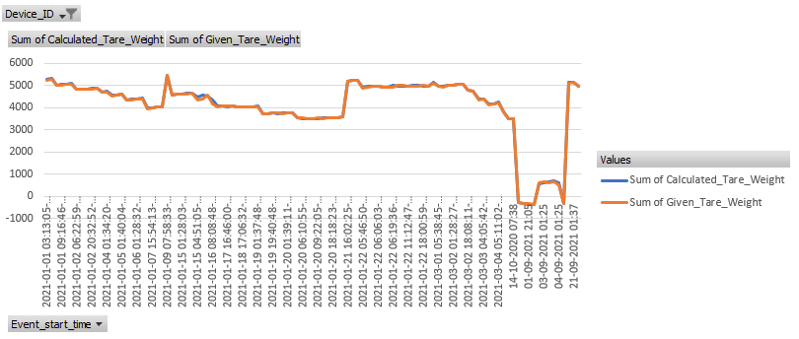
Tare Weight
Insights
There were few devices whose Tare Weight sensor was showing wrong tare weight.
7 devices doesn’t had any Tare Weight value.
We will use calculated Tare Weight as its showing correct Tare Weight even when given Tare Weight seems faulty.
Example of Faulty Tare Weight Device
Perfect Tare Weight Device

Slide 11
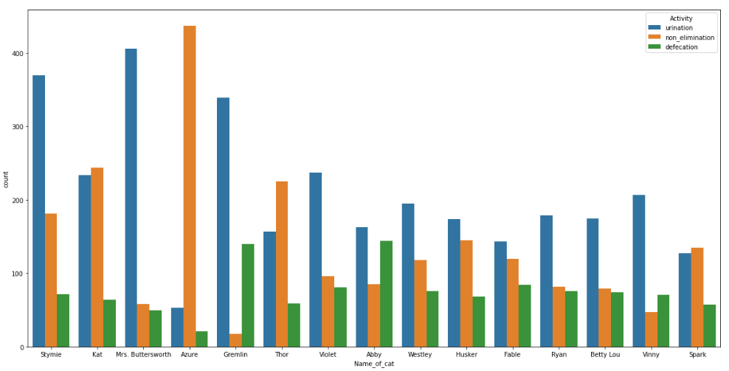
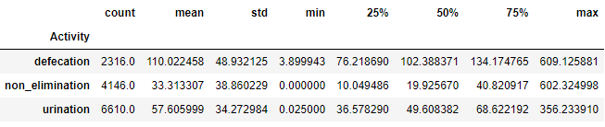
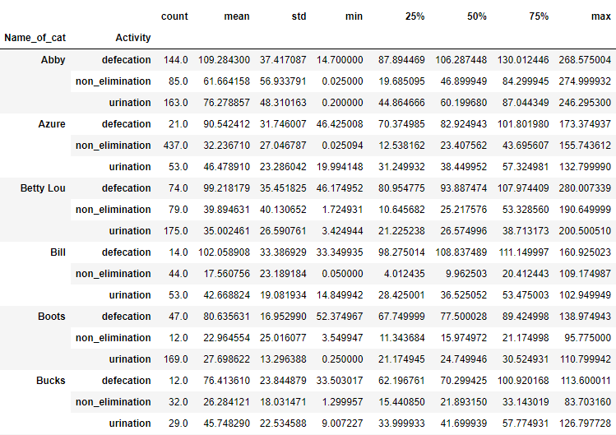
Activity – Non-Elimination, Urination, Defecation
Count of different activities for each cat
Cat Activity relation with sitting time on device
Different cats shows different behaviour.
All cats Urinates more than Defecates.
Cat name Azure has more non-elimination because for device VB00000000000171 has only non-elimination.
Different Activity has different cat sitting time in device.
Elimination has significantly more time than Non-Elimination.
Defecation has significantly more time than Urination.

Slide 12
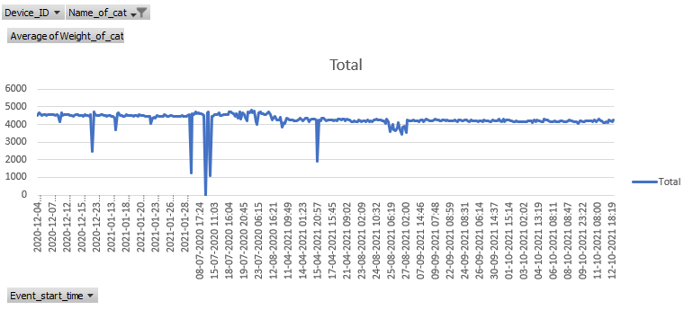
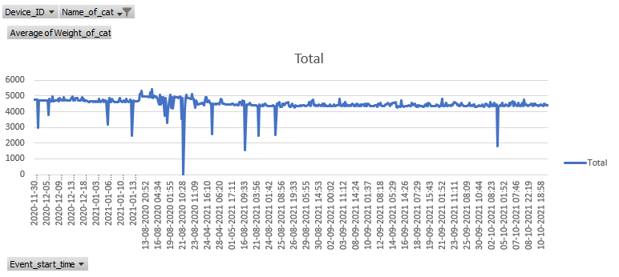
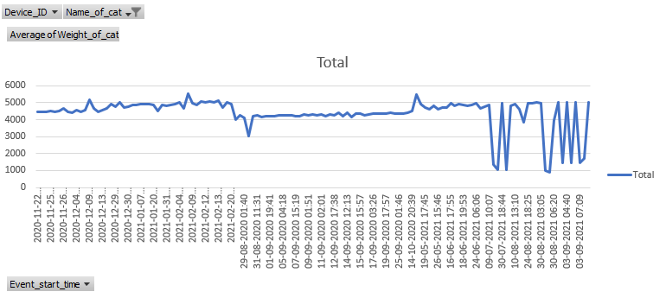
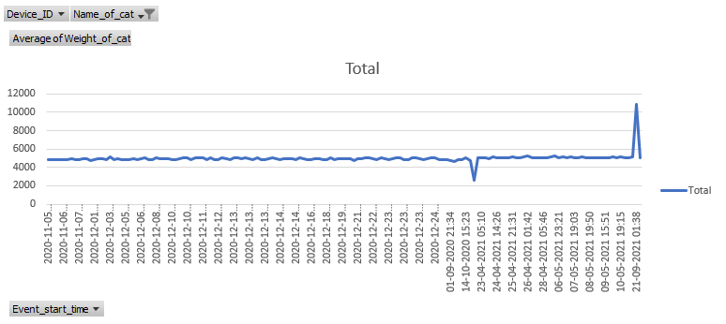
Cat Weight
Sudden spikes in cat weight are outliers, will impute this outliers by mean of cat weight near that time.
Fixing outliers in cat weight will improve model accuracy as cat weight is used to generate other features.

Slide 13
Miscellaneous
We have data starting from 29-06-2020 to 16-10-2021, for total of 474 days.
Some devices got used only for few months, this can be mostly observe on those devices which doesn’t have tare weight.
Device ‘VA00000000000050’ has only 3 activities and ‘VA00000000000113’ has only 14 activities while 163.43 is the average of activities per device.

Slide 14
04
Feature Engineering

Slide 15
Feature Engineering
Activity – To Identify type of Activity and will be used as target Variable. Taken from Tags Data, each tags contains a tag of Activity.
Elimination – To identify if cat is doing elimination. 0 if Activity is non-elimination, else 1.
Urination – To identify if cat is doing urinating. 1 if Activity is urinating, else 1.
Cat_In_Box – To Identify if cat was in box while Activity. Taken from Tags Data, each tags contains a tag of ‘cat in box’, except of few exceptions.
Given_Tare_Weight – Weight of box and litter. Sum of tare_weight values from 4 sensors from Tags Data.
Calculated_Tare_Weight – Weight of box and litter after cat steps out, calculated by taking mean of sensor data for last 5 sec.
Activity_Duration – Total time for what Sensor Data we have, Taken last timestamp from load sensor data.
Weight_With_Cat – Load Sensor reading while cat is in box. Taken sum of Tare_Weight and Weight_of_cat.
First_Stepin_Time – Time when cats step-in for first_time, when load sensor reading crosees 98% of Weight_With_Cat for first time.
First_Stepout_Time – Time when cats step-out for first_time, , when load sensor reading crosees 103% of tare_weight for first time after cat stepped in.
Last_Stepin_Time – Time when cats step-in for last_time. when load sensor reading crosees 98% of Weight_With_Cat for last time.
Last_Stepout_Time – Time when cats step-out for last_time, when load sensor reading crosees 103% of tare_weight for last time after cat stepped in.
Stepping_In_Time – Time when cats step-in when it will sit there for longest time.
Stepping_Out_Time – Time when cats step-out when it will sit there for longest time.
Sit_time – Longest period of time when cat was in box, difference of Stepping_Out_Time and Stepping_In_Time
Times_Stepped – Number of times cat stepped in and out, total number of times load sensor reading crosees 98% of Weight_With_Cat and then again comes back to tare_weight.

Slide 16
05
Modelling

Slide 17
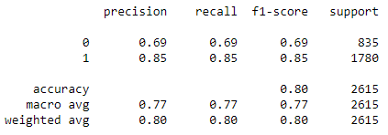
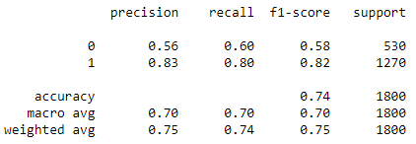
Modelling
This is a prototype model.
We have used Random Forest Classifier to train model.
We have used Name of cat, and calculated sit time as independent variable to train model.
Results of the first model is used in second model before training second model.
First Model (Elimination or Non-Elimination)
Second Model (Urination or Defecation)
Dependent Variable – Elimination.
Train set – 10457 rows.
Test set – 2615 rows
tn, fp, fn, tp – 577, 258, 261, 1519
Accuracy – 80.15%
Confusion Matrix – 577 258
261 1519
Dependent Variable – Urination.
Train set – 7197 rows.
Test set – 1800 rows
tn, fp, fn, tp – 320, 210, 250, 1020
Accuracy – 74.44%
Confusion Matrix – 320 210
250 1020

Slide 18
Thank You
Do you have any questions?
Name
kaushik.agrawal@tigeranalytics.com
8429461355

