Slide 1
Cat Checker – Elimination Classification
Case Study
Confidential
05-Dec-2022
Kaushik Agrawal

Slide 2
Topics
01
｜
Problem Understanding and Objective
06
｜
Business Insights
02
｜
Data Preparation
07
｜
Conclusion
03
｜
Feature Engineering
04
｜
Exploratory Data Analysis
05
｜
Modelling

Slide 3
01
Problem Understanding and Objective

Slide 4
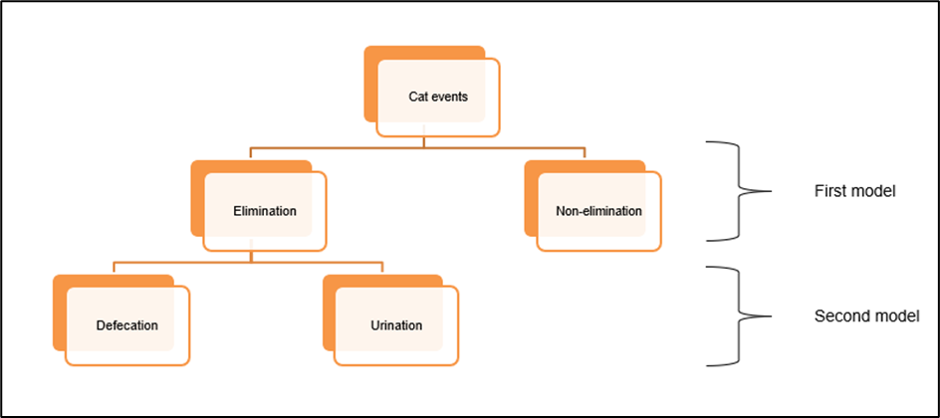
Problem Understanding and Objective
Problem Understanding
Objective
The Smart Litter System is a smart cat litter system that is equipped with four load sensors capturing any load disturbance happening on the litter box. The device functions at 40 Hz frequency rate which means it records 40 samples per second.
The cat interaction events are as shown below:
Elimination
Defecation
Urination
Non-Elimination
The objective of this project is to develop a solution approach to correctly classify the events as elimination or non-elimination and further classify the elimination events into urination and defecation.

Slide 5
How to use solution
Please visit this Git-Hub Repository, to access the project:
https://github.com/Kaushik002-git/PIP_Case_Study/
Go through Read_Me.docx file inside repository for instructions to use this project.
This project contains a pre trained model, which can classify Elimination or Non-Elimination activity, it can further classify Elimination into Urination and Defecation.
User’s just need to run notebooks, they don’t need to change anything in code.
It will give a output ‘result.csv’ file while will have activity predictions.

Slide 6
02
Data Preperation

Slide 7
Data Preparation
Data Sufficiency
Data selection
Event Load Sensor Data: Event named load sensor data containing timesteps and Load Sensor values.
Tags Data: Event named label/tag data containing the information about the event such as cat name, event tags, free text etc.
Total number of files given 26150, 13075 files containing sensor data, 13075 containing Tags Data, so in total we have 13075 unique events.
We have data of 51 cats across 82 devices, for 474 days (29-06-2020 - 16-10-2021)
Missing Values:
Tags Data
Name_of_cat – 246 values missing
Tare_Weight – 1013 values missing
Activity – 3 values missing
We have aggregated Sensor Data together with Tags Data, it represents 1 row in a final dataset.
We have used Device_ID, Event_ID, Event_start_time, tags, Name_of_cat, Weight_of_cat.
We have calculated Tare_Weight from Sensor Data.
We got activity label from Tags.

Slide 8
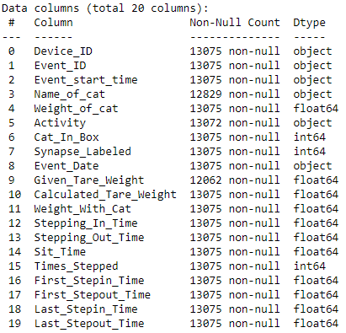
Data Preparation
Merging the data
Target variable
We have joined joined Load Sensor Data and Tags Data on Event ID.
For each Event_Id we have a sensor data that contains multiple rows, so we have aggregated them and created multiple features from them.
By project’s objective we have 2 models to create:
To identify if a given activity is Elimination or Non-Elimination.
If its Elimination, it is Urination or Defecation.
So we will have two Target Variable, one for each model.
For first model Elimination column will be target variable, it will have 1 as value in case of Elimination and 0 in case of Non-Elimination.
For second model Urination/Defecation column will be target variable, it will have 0 in case of Urination and 1 in case of Defecation

Slide 9
03
Feature Engineering

Slide 10
Feature Engineering
Activity – To Identify type of Activity and will be used as target Variable. Taken from Tags Data, each tags contains a tag of Activity.
Elimination – To identify if cat is doing elimination. 0 if Activity is non-elimination, else 1.
Urination – To identify if cat is doing urinating. 1 if Activity is urinating, else 1.
Cat_In_Box – To Identify if cat was in box while Activity. Taken from Tags Data, each tags contains a tag of ‘cat in box’, except of few exceptions.
Given_Tare_Weight – Weight of box and litter. Sum of Tare_Weight values from 4 sensors from Tags Data.
Calculated_Tare_Weight – Weight of box and litter after cat steps out, calculated by taking mean of sensor data for last 1 sec.
Activity_Duration – Total time for what Sensor Data we have, Taken last timestamp from load sensor data.
Weight_With_Cat – Load Sensor reading while cat is in box. Taken sum of Tare_Weight and Weight_of_cat.
First_Stepin_Time – Time when cats step-in for first time, when load sensor reading crosees 70% of Weight_of_cat + Tare_Weight for first time.
First_Stepout_Time – Time when cats step-out for first time, , when load sensor reading crosees 70% of Weight_of_cat + Tare_Weight for first time after cat stepped in.

Slide 11
Last_Stepin_Time – Time when cats step-in for last_time. when load sensor reading crosees 70% of Weight_of_cat + Tare_Weight for last time.
Last_Stepout_Time – Time when cats step-out for last_time, when load sensor reading crosees 70% of Weight_of_cat + Tare_Weight for last time after cat stepped in.
Stepping_In_Time – Time when cats step-in when it will sit there for longest time.
Stepping_Out_Time – Time when cats step-out when it will sit there for longest time.
Sit_time – Longest period of time when cat was in box, difference of Stepping_Out_Time and Stepping_In_Time
Times_Stepped – Number of times cat stepped in and out, total number of times load sensor reading crosees 70% of Weight_of_cat + Tare_Weight and then again comes back to tare_weight.
Points_Count – Points Count is the number Data Points(from sensor data) which has weight value more than 70% of Cat Wight + Tare Weight.
Points_Percentage – Points Percentage is the percentage of Points Count divided by Total Points, for a activity. It shows for the duration of Activity, how much percentage of time cat was in the box.
Weight_Variance – Weight Variance is the spread in points which is more than Cat Weight + Tare Weight. It shows the digging activity, more the Variance means more the digging.

Slide 12
04
Exploratory Data Analysis

Slide 13
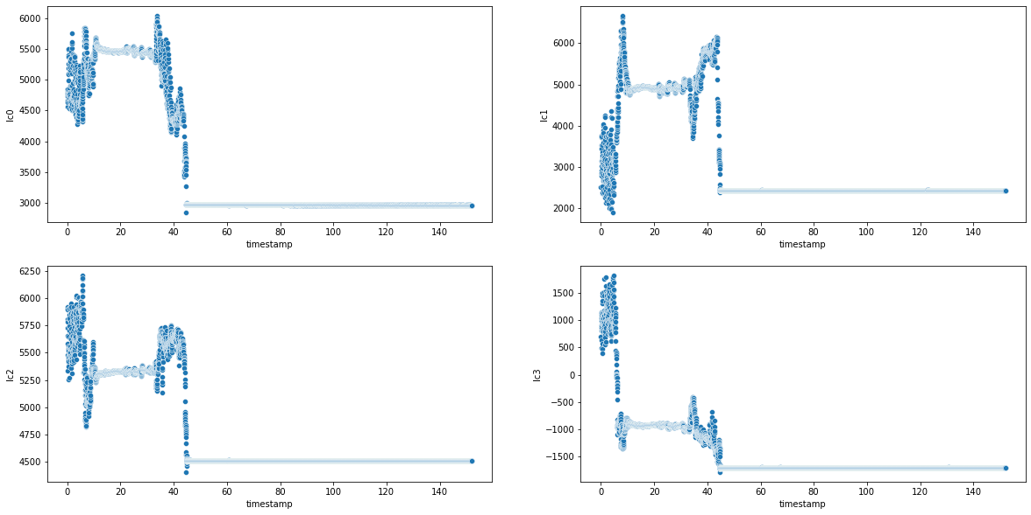
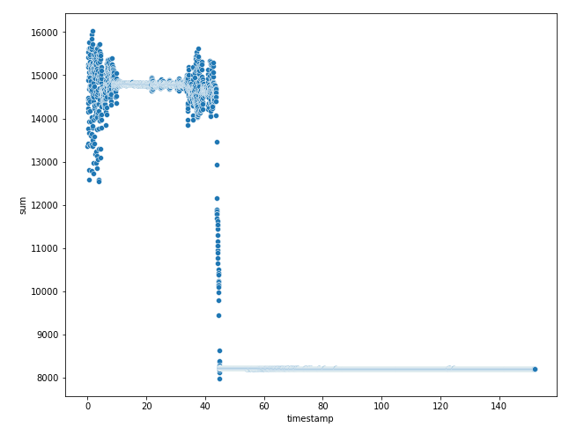
Sensor data
Noise in sensor value at start and end is because of cat digging the litter.
Individual sensors
Sum of reading of all sensors
All sensors have different Tare Weight for each and every activity.
Peak in all 4 load sensors starts and end at the same time for each activity.
Sum of sensors gives better picture of cat activity
Total increase in weight = weight of cat
Sensor starts to record data whenever there is a disturbance in load sensor

Slide 14
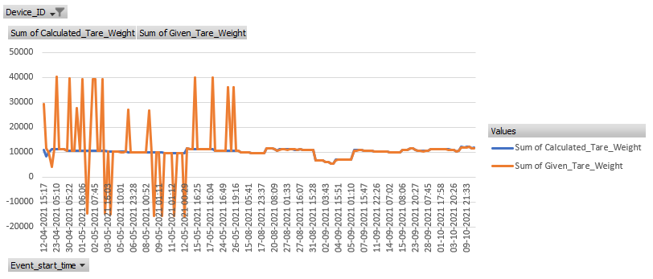
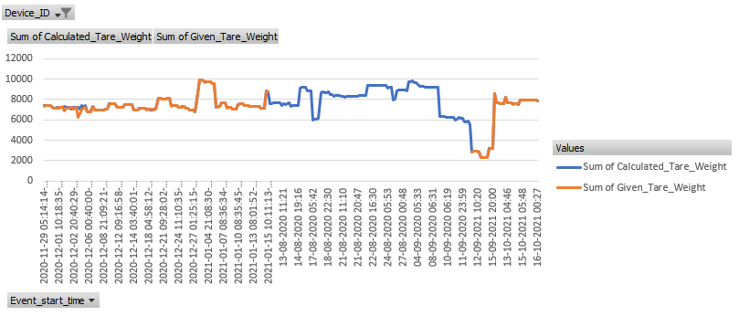
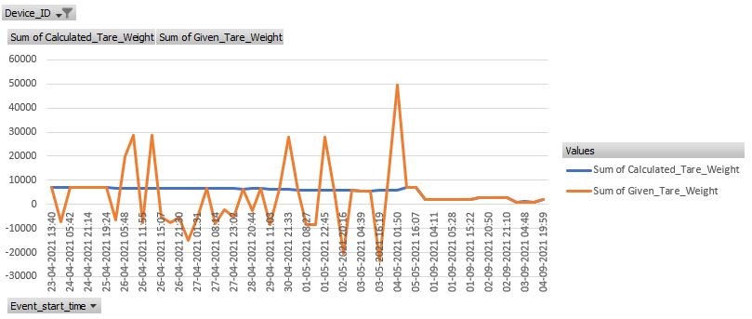
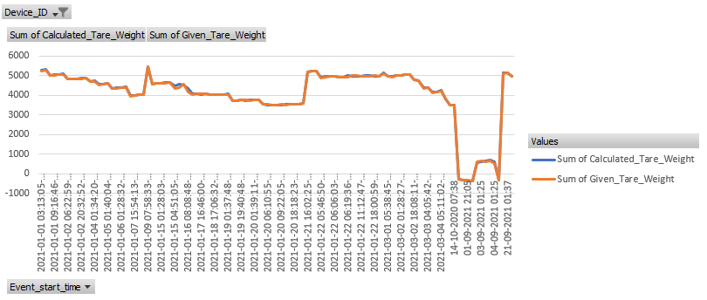
Tare Weight
It Weight reading of box without cat.
There were few devices whose Tare Weight sensor was showing wrong tare weight.
In few devices Tare Weight.
24 Devices had missing Tare Weight values.
7 devices doesn’t had any Tare Weight value.
We will use calculated Tare Weight as its showing correct Tare Weight even when given Tare Weight seems faulty.
Example of Faulty Tare Weight Device
Perfect Tare Weight Device

Slide 15
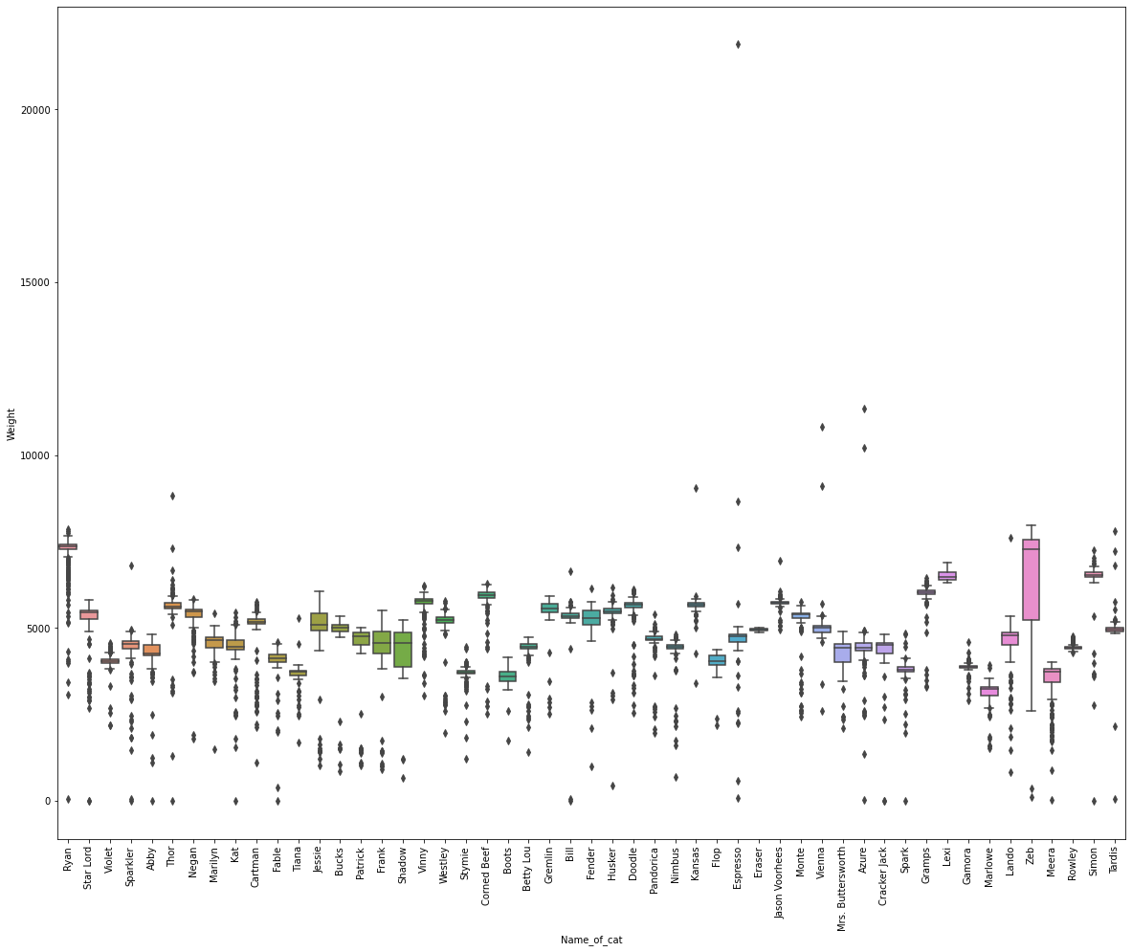
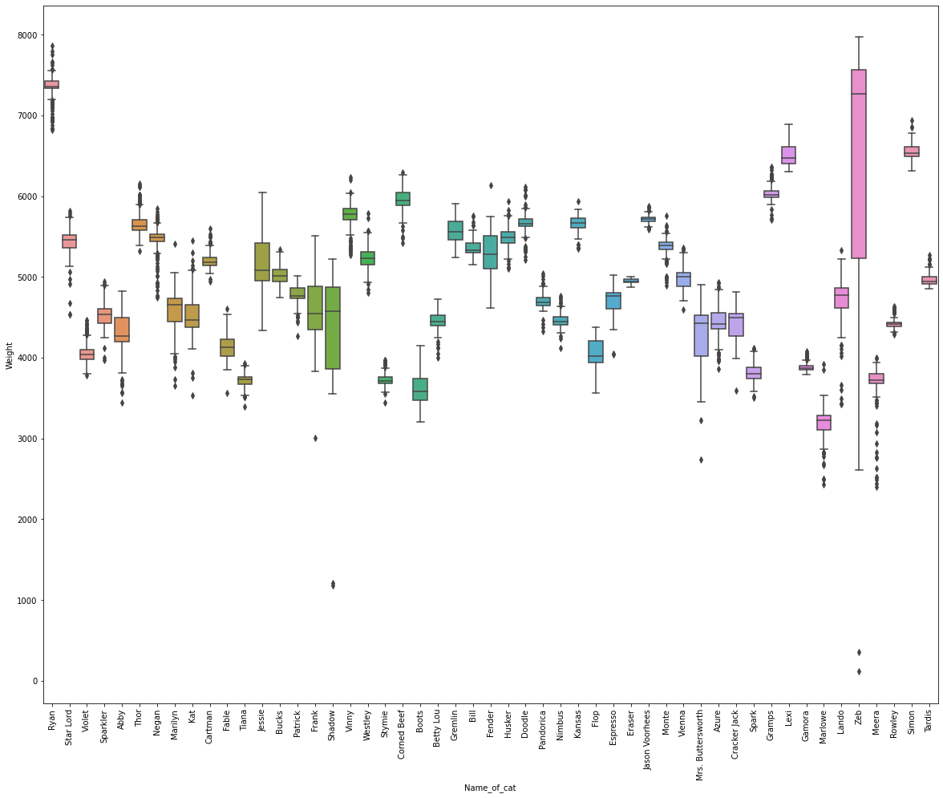
Cat Weight
It is the only cat Morphological feature we got from data.
There were many Outliers in Weight_of_cat.
We have detected those Outliers by IQR method, we have used 3 times IQR range for this problem.
We have imputed those outliers with median of Weight_of_cat for each cat.
Before Treating Outlier
After Treating Outlier

Slide 16
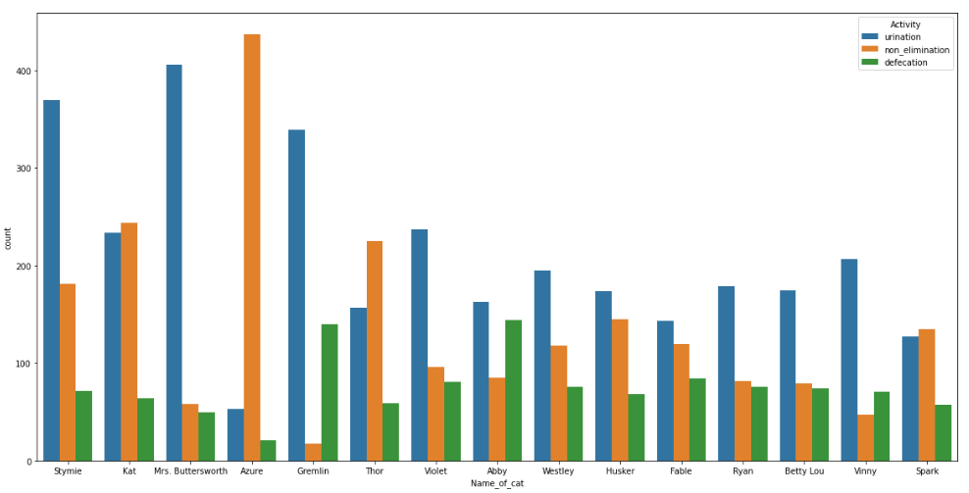
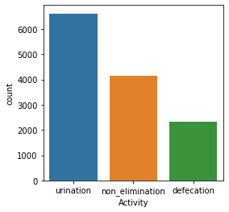
Activity – Non-Elimination, Urination, Defecation
Count of different activities
Count of different activities for each cat
Total Elimination Activities = 8926
Total Non-Elimination Activities = 4146
Total Urination Activities = 6610
Total Defecation Activities = 2316
Elimination Activities is 215.29% more than Non-Elimination Activities.
Urination Activities is 285.40% more than Defecation Activities.
Different cats shows different behaviour.
All cats Urinates more than Defecates.
Cat name Azure has more non-elimination because for device VB00000000000171 has only non-elimination.

Slide 17
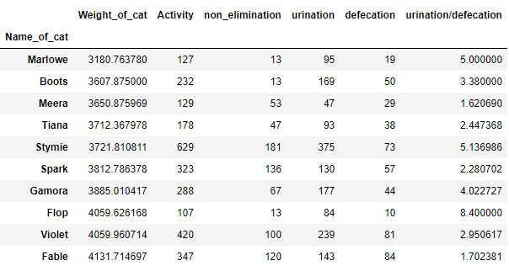
Cat Behaviour Across different Cat Morphology
Cat Weight is the only cat Morphological feature we have given in data, so we can classify cats based on their weight.
On Average cat Urinates 328% more than it Defecates, but this varies greatly across different cats.
Cat Urination/Defecation ratio has no significant relation with Cat Weight.
Urination/Defecation ratio sorted by cat weight

Slide 18
Cat Name
Total number of cats is 51.
Most of the cat used more than one device.
246 Activities has missing Cat Name.
Out of 82 devices, 53 devices has missing Cat Name.
We have imputed missing cat names in the devices which was used by only one cat.
By this method we have added cat name in 102 activities, and fixed missing cat name in 32 devices.

Slide 19
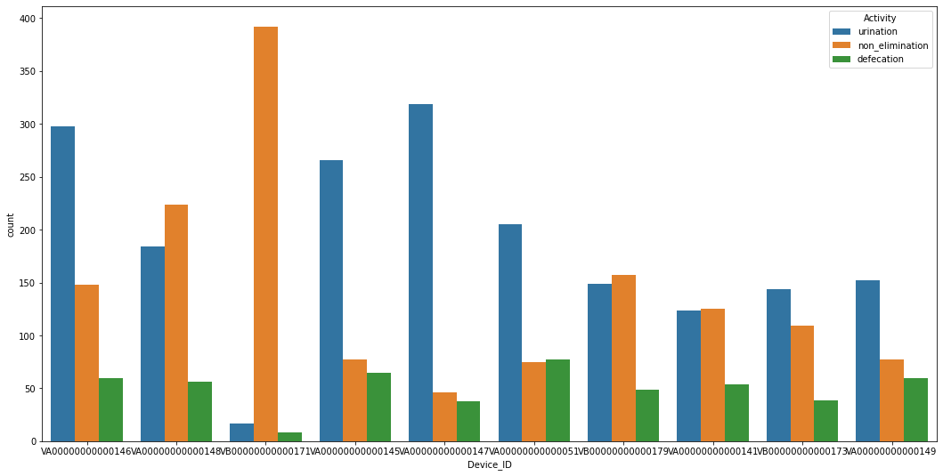
Device_ID
Total number of devices is 82.
Most of the devices is used by only one cat.
Some devices got used only for few months, this can be mostly observe on those devices which doesn’t have tare weight.
On average a device is used for more than 6 months.
Device_ID: VA00000000000050 is used for only 1 day, which is shortest duration.
Device_ID: VA00000000000037 is used for only 1 year and 2 months, which is maximum duration.
Activities on each device

Slide 20
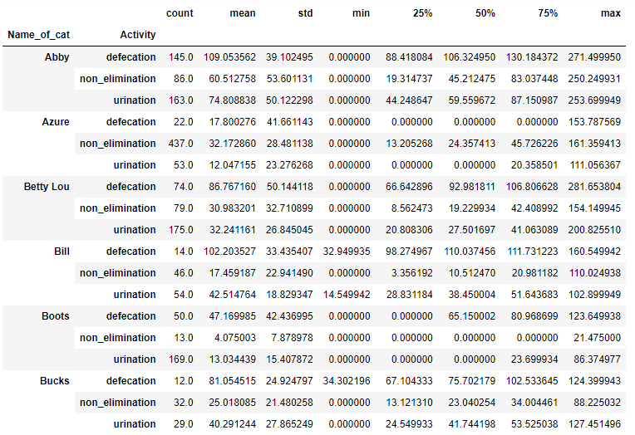
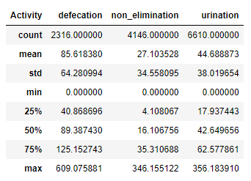
Sit Time
Sit Time is the duration for which cats sits in the box.
Sit Time mean is significantly different on different activity.
Sit Time mean for Elimination Activities is Significantly more than Non-Elimination.
Sit Time mean for Defecation is significantly more than Urination.
Sit Time on different Activities
Sit Time for different cats on different Activities

Slide 21
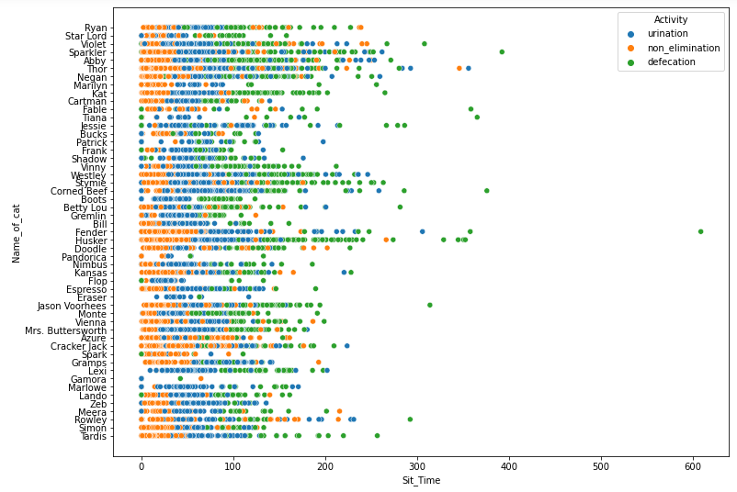
Sit Time Scatter Plot for different cats on different Activities
We can clearly observe the sit time difference pattern for different activities

Slide 22
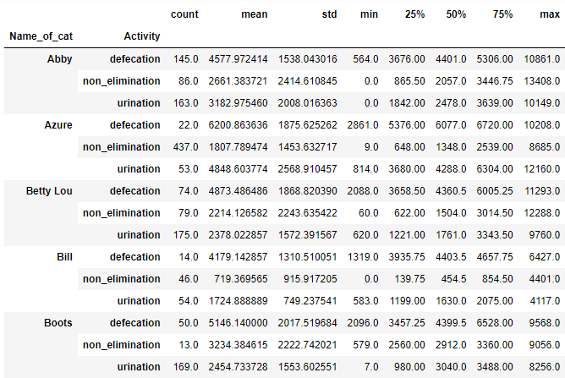
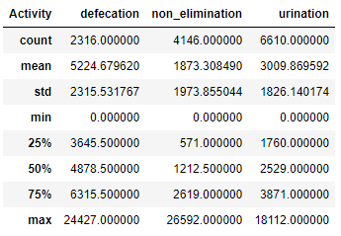
Points Count
Points Count is the number Data Points(from sensor data) which has weight value more than Cat Wight + Tare Weight.
Device Functions at 40 Hz, it means 40 data points recorded in 1 second.
Points Count mean is significantly different on different activity.
Points Count mean for Elimination Activities is Significantly more than Non-Elimination.
Points Count mean for Defecation is significantly more than Urination.
Points Count on different Activities
Points Count for different cats on different Activities

Slide 23
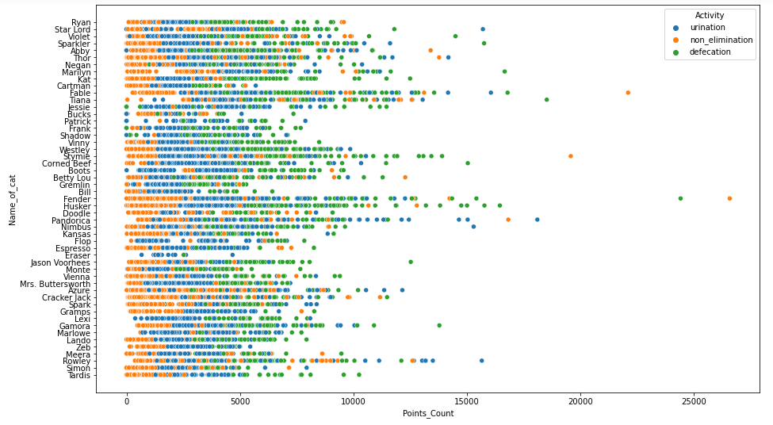
Points Count Scatter Plot for different cats on different Activities
We can clearly observe the Points Count difference pattern for different activities

Slide 24
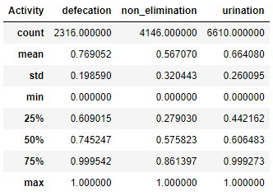
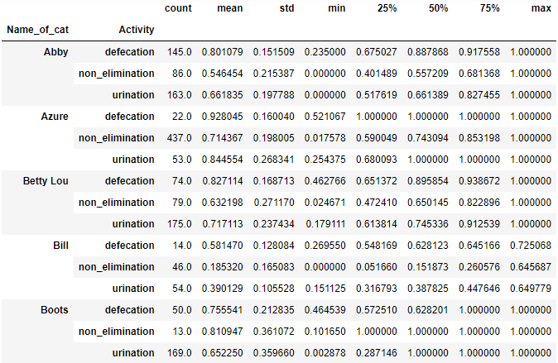
Points Percentage
Points Percentage is the percentage of Points Count divided by Total Points, for a activity.
It shows for the duration of Activity, how much percentage of time cat was in the box.
Points Percentage on different Activities
Points Percentage for different cats on different Activities

Slide 25
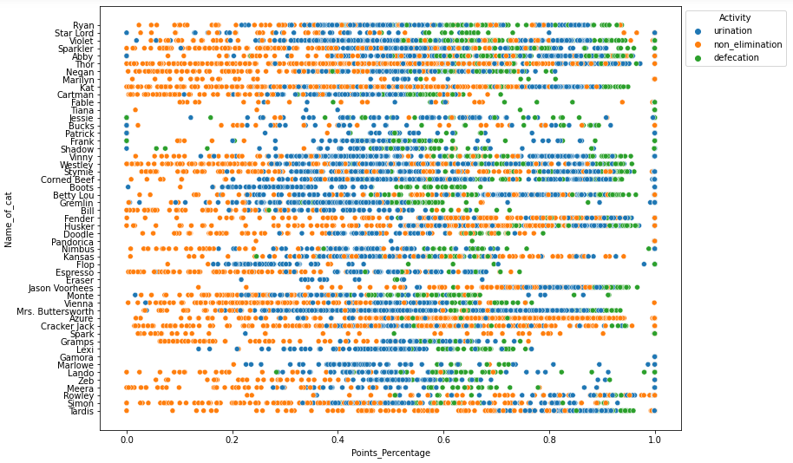
Points Percentage Scatter Plot for different cats on different Activities

Slide 26
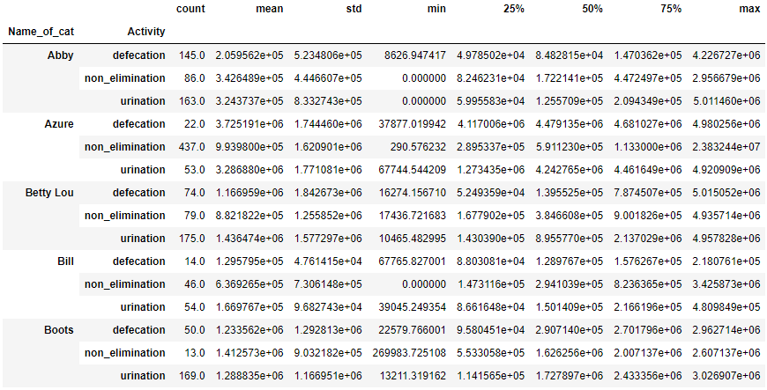
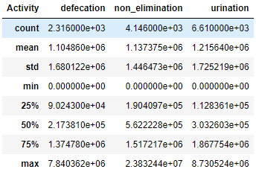
Weight Variance
Weight Variance is the spread in points which is more than Cat Weight + Tare Weight
Weight Variance gets increased because of digging the little.
Non-Elimination has higher Weight Variance as compared to Elimination, means cats digs more for Non-Elimination activity.
Urination has higher Weight Variance as compared to Defecation, means cats digs more for Urination activity.
Weight Variance on different Activities
Weight Variance for different cats on different Activities

Slide 27
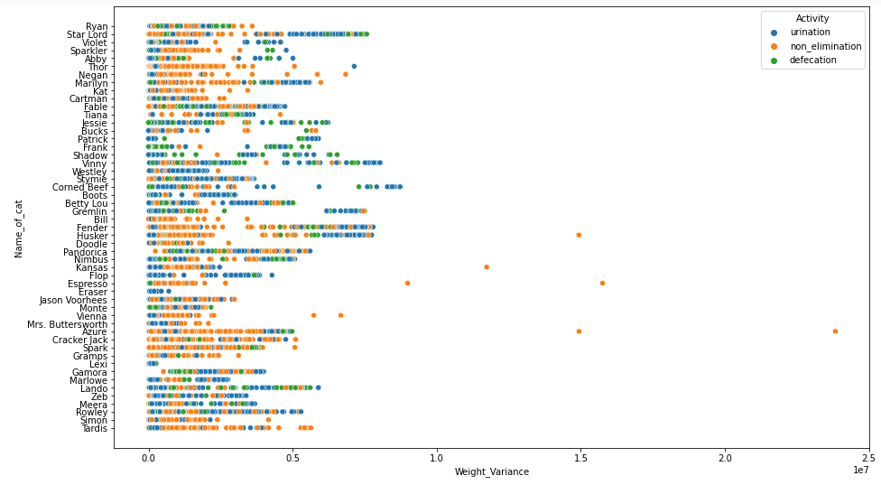
Weight Variance Scatter Plot for different cats on different Activities

Slide 28
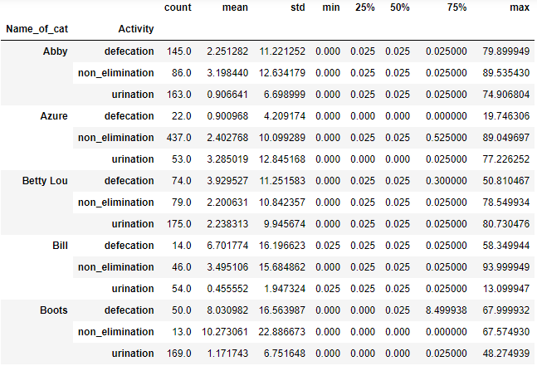
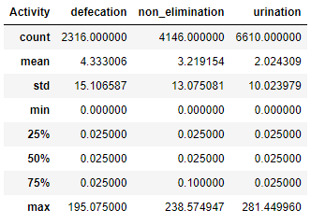
Stepping In Time
It is the timestamp at which cat steps in the box.
It indicates different pattern in cat behaviour for different activities.
Stepping In Time on different Activities
Stepping In Time for different cats on different Activities

Slide 29
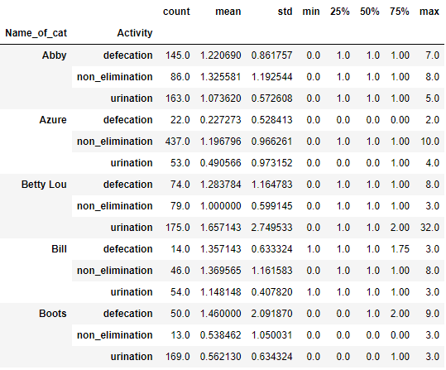
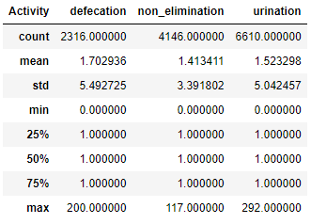
Time Stepped
It is the number of times cat steps in and then steps out of the box.
It is observed in some activities that cats steps in and steps out of the box multiple times.
Time Stepped on different Activities
Time Stepped for different cats on different Activities

Slide 30
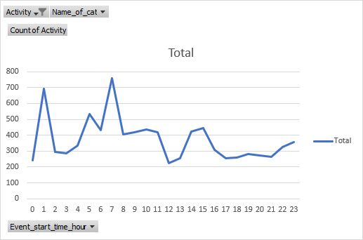
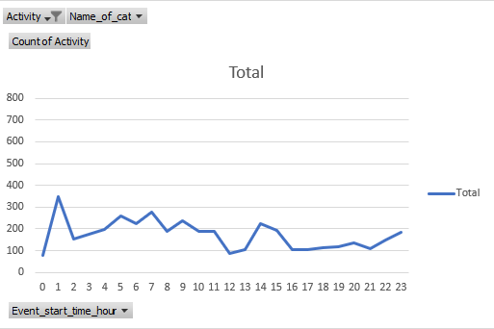
Event Start Time(Hours)
It is the Hour of the day at which Activity starts.
This variable helps in capturing cat daily behaviour
Sudden Peaks can be observed at some specific hours of day.
Cat does Elimination Activity mostly between 01:00 - 02:00 at night and 07:00 - 08:00 in morning.
Event Start Time(Hours) for Elimination Activity
Event Start Time(Hours) for Non-Elimination Activity

Slide 31
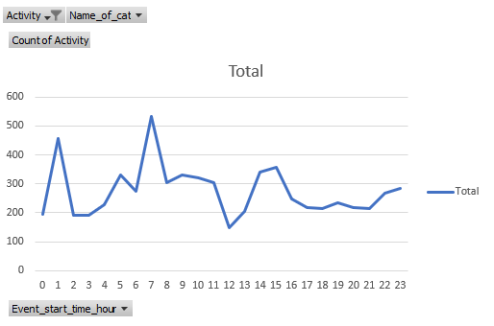
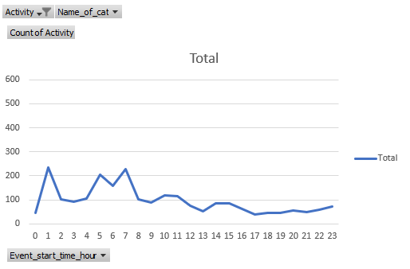
Sudden Peaks can be observed at some specific hours of day.
Cat does Elimination Activity mostly between 01:00 - 02:00 at night and 07:00 - 08:00 in morning.
Event Start Time(Hours) for Urination Activity
Event Start Time(Hours) for Defecation Activity

Slide 32
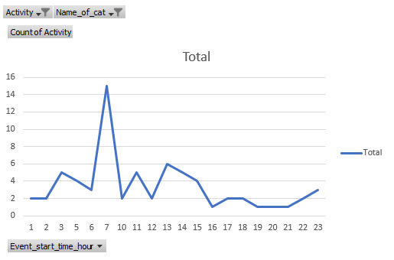
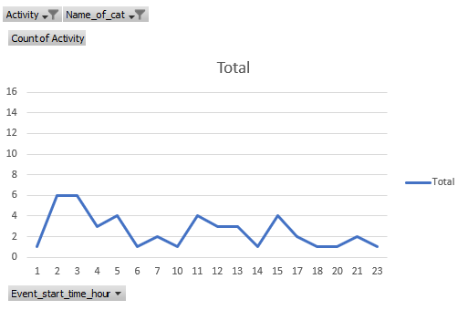
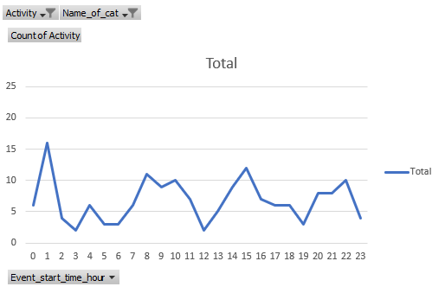
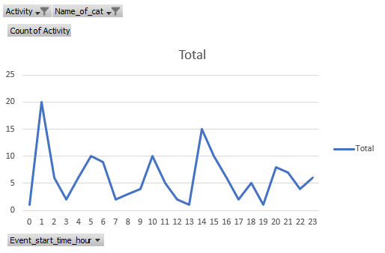
Event Start Time(Hours) for Elimination activity for a cat
Event Start Time(Hours) for Non-Elimination activity for a cat
Event Start Time(Hours) for Urination activity for a cat
Event Start Time(Hours) for Defecation activity for a cat

Slide 33
05
Modelling

Slide 34
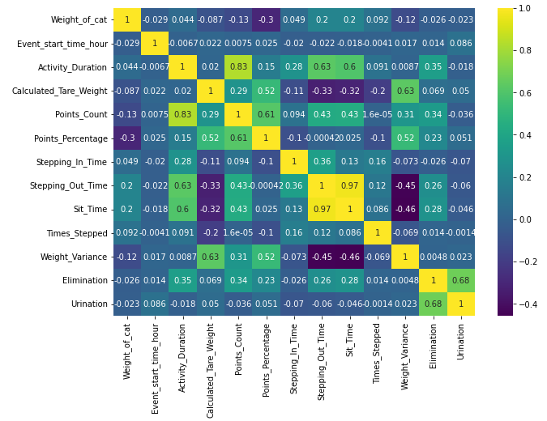
Filters
Removed rows with Activity name missing.
Removed data of Device_ID: VB00000000000171 of cat Azure, as it was all non-elimination for 375 acticities
Removed rows with Activity name missing.
Removed data of Device_ID: VB00000000000171 of cat Azure, as it was all non-elimination for 375 acticities
Correlation Heat Map
Shows the correlation of variation numerical variable with each other.
No two variable which is highly correlated each other is used in Model.

Slide 35
FIRST MODEL - To classify Elimination and Non-Elimination
Feature Selection
IDVs (Independent Variables) - Sit_Time, Points_Count, Points_Percentage, Weight_Variance, Weight_of_cat, Stepping_In_Time, Times_Stepped, Event_start_time_hour.
DV (Dependent Variable) - Elimination.
Event_start_time_hour is treated as categorical variable to capture cat activity behavior throughout the day
Device_ID is not used in the model, because by problem understanding device has no significance in determining cat activity.
Cat Name is not used in the model, because we wanted to create a model which will work on any cat, not only for the cats whose data we used to train model.
Encoding Categorical Variable
One Hot Encoder is used to Encode categorical variable.
In this model we have only Event_start_time_hour as categorical variable.
Event_start_time_hour had 24 unique values, each representing a different hours of the day.
Each Unique value is converted in a column with 0 and 1 as possible values.
Removed one column from encoded 24 columns.

Slide 36
Splitting Train and Test set
Train set and Test set has been splited in the ratio of 80% and 20% randomly.
Count of 0 and Count of 1 in Train Set is stored to treat class imbalance while training model.
Training Model
We have tried various Classifiers for the model, and Random Forest Classifier fits best for our use case.
Number of trees used in model = 100
Max Depth of a tree = 20
Class Weight is given to model.
Model is trained for 10014 activities.
K Fold Cross Validation
Cross validated model for 10 different samples of test and train.
Mean accuracy for all 10 samples is 84.22% with standard deviation of 1.03%.
Accuracies –

Slide 37
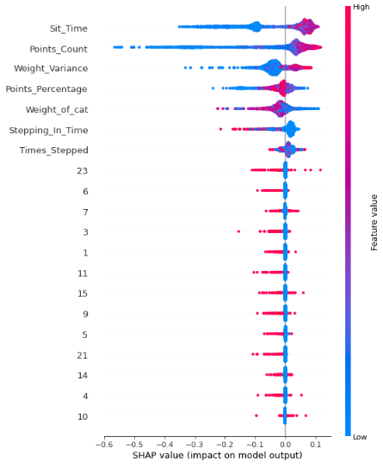
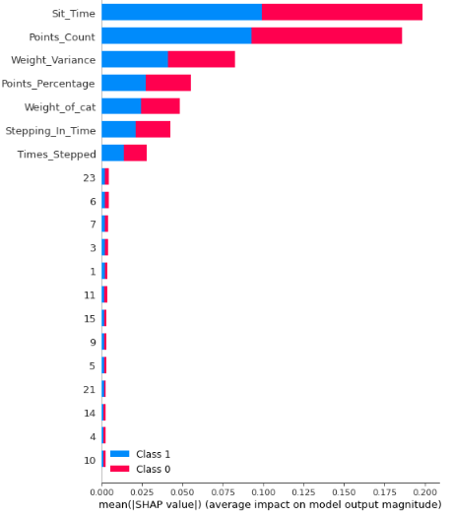
Features impact on Model Output
Feature importance in model is measured by SHAP values.
Sit_Time has the most impact on model Output.
With increase in Weight_of_cat and Stepping_In_Time, probability of predicting 0 (Non-Elimination) is increasing

Slide 38
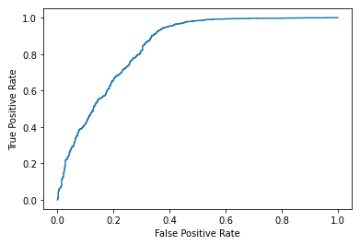
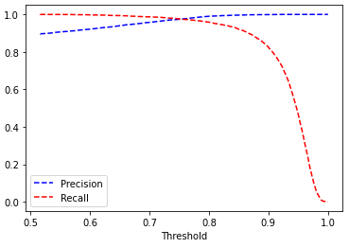
ROC Curve
ROC curve shows the trade-off between False Positive Rate and True Positive Rate.
Models that give curves closer to the top-left corner indicate a better performance.
Precision-Recall Curve
The precision-recall curve shows the tradeoff between precision and recall for different threshold.
Point of Intersection of Precision and Recall lines will be used as threshold to classify and 0 and 1 from predicted probabilities from model.

Slide 39
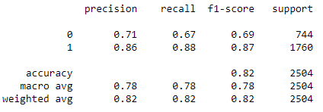
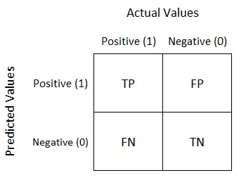
Model Report on Test Set
Precision and Recall for predicting 1 is higher.
Model is designed to predict 1 better than 0 by problem understanding.
Confusion Matrix
1553
246
207
498
Overall accuracy of model on test set = 81.90%

Slide 40
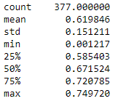
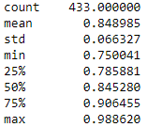
Misclassification Analysis on 0 (Non-Elimination)
On both Train and Test set combined, there are 377 activities where 0 was predicted but actual value was 1.
Based on this analysis we have tuned some parameters of model which resulted in better accuracy.
Probabilities description for Misclassification of 0 -
Misclassification Analysis on 1 (Elimination)
On both Train and Test set combined, there are 433 activities where 1 was predicted but actual value was 0.
Based on this analysis we have tuned some parameters of model which resulted in better accuracy.
Probabilities description for Misclassification of 1 -

Slide 41
SECOND MODEL - To classify Urination and Defecation
Predicting Elimination from first model
Predicted if a activity is Elimination or Non-Elimination for whole dataset.
If a activity is predicted to be Elimination, than it will be used in second model, to predict if that Elimination is Urination or Defecation.
Feature Selection
IDVs (Independent Variables) - Sit_Time, Points_Count, Points_Percentage, Weight_Variance, Weight_of_cat, Stepping_In_Time, Times_Stepped, Event_start_time_hour.
DV (Dependent Variable) - Urination.
Event_start_time_hour is treated as categorical variable to capture cat activity behavior throughout the day
Device_ID is not used in the model, because by problem understanding device has no significance in determining cat activity.
Cat Name is not used in the model, because we wanted to create a model which will work on any cat, not only for the cats whose data we used to train model.
Encoding Categorical Variable
One Hot Encoder is used to Encode categorical variable.
In this model we have only Event_start_time_hour as categorical variable.
Event_start_time_hour had 24 unique values, each representing a different hours of the day.
Each Unique value is converted in a column with 0 and 1 as possible values.
Removed one column from encoded 24 columns.

Slide 42
Splitting Train and Test set
Train set and Test set has been splitted in the ratio of 80% and 20% randomly.
Count of 0 and Count of 1 in Train Set is stored to treat class imbalance while training model.
Training Model
We have tried various Classifiers for the model, and Random Forest Classifier fits best for our use case.
Number of trees used in model = 100
Max Depth of a tree = 15
Class Weight is given to model.
Model is trained for 7105 activities.
K Fold Cross Validation
Cross validated model for 10 different samples of test and train.
Mean accuracy for all 10 samples is 78.65% with standard deviation of 1.3%.
Accuracies –

Slide 43
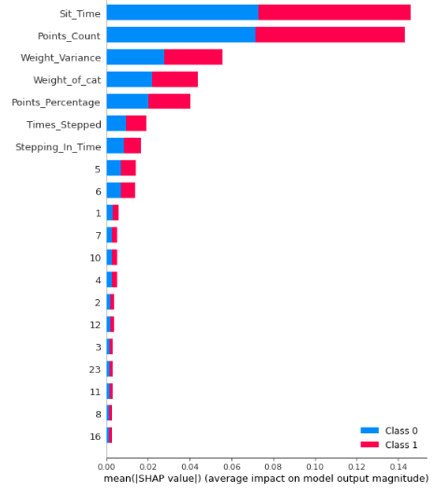
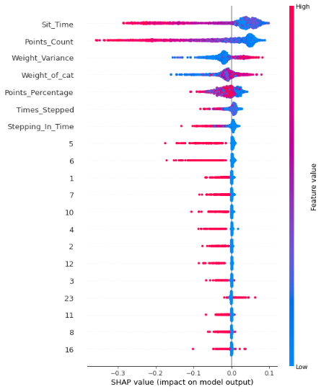
Features impact on Model Output
Feature importance in model is measured by SHAP values.
Sit_Time has the most impact on model Output.
With increase in Weight_of_cat and Weight_Variance, probability of predicting 1 (Defecation) is increasing

Slide 44
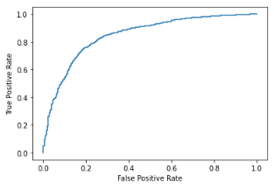

ROC Curve
ROC curve shows the trade-off between False Positive Rate and True Positive Rate.
Models that give curves closer to the top-left corner indicate a better performance.
Precision-Recall Curve
The precision-recall curve shows the tradeoff between precision and recall for different threshold.
Point of Intersection of Precision and Recall lines will be used as threshold to classify and 0 and 1 from predicted probabilities from model.

Slide 45

Model Report on Test Set
Confusion Matrix
1045
168
183
381
Overall accuracy of model on test set = 80.24%

Slide 46


Misclassification Analysis on 0 (Defecation)
On both Train and Test set combined, there are 488 activities where 0 was predicted but actual value was 1.
Based on this analysis we have tuned some parameters of model which resulted in better accuracy.
Probabilities description for Misclassification of 0 -
Misclassification Analysis on 1 (Urination)
On both Train and Test set combined, there are 420 activities where 1 was predicted but actual value was 0.
Based on this analysis we have tuned some parameters of model which resulted in better accuracy.
Probabilities description for Misclassification of 1 -

Slide 47
06
Business Insights

Slide 48
Business Insights
Smart cat litter box sensors should be checked periodically to fix any malfunction.
Litter over the box should be cleaned periodically to avoid any potential health issue for cat.
Cat’s other Morphological Features (e.g. - Cat Breed ) should be included in Tags Data, which can potentially enhance model’s performance even further.
Company should provide guidance to users of Smart cat litter box, so that they can make best use of the product.

Slide 49
07
Conclusion

Slide 50
Conclusion
‘Cat Chekr – Elimination Classification’ is a Machine Learning model which can predict Elimination and Non-Elimination performed by cats.
This Machine Learning model can further classify Elimination Activity in Urination and Defecation.
Model takes Event Load Sensor Data and Tags Data as input to predict activity by cat.
Model is trained from data of 13075 different activities extracted from 82 devices.
Training data had Activity data of 51 different cats starting from 29-06-2020 to 16-10-2021.
Model can predict activities with accuracy of 80%.
‘Read_Me.docx’ contains all instructions to use this project.

Slide 52
Thank You
Do you have any questions?
Name
kaushik.agrawal@tigeranalytics.com
8429461355

