Slide 1

INTERNATIONAL INSITITUTE OF MEDICAL SCIENCE AND TECHNOLOGY
Indian Social Institute, 24, Benson Rd, Byadarahalli, Benson Town, Bengaluru, Karnataka 560046
Mini Project
AQUAGUARD COMMUNITY
MONITORING SYSTEM
Presented by: cohort 05

Slide 2
Introduction
Access to clean and safe water is essential for public health, environmental sustainability, and overall community development. With growing urbanization and population, maintaining water quality and infrastructure has become increasingly challenging. Technology can play a significant role in enabling better monitoring and communication between citizens and authorities. This project explores the use of a web-based system to improve transparency and community participation in water management.

Slide 3
Problem Statement
Despite the importance of water quality management, there is no centralized platform that allows structured reporting and transparent tracking of water-related issues. Existing complaint systems lack verification mechanisms, real-time updates, and public visibility, leading to delayed resolution and reduced accountability. The absence of a reliable monitoring system creates gaps in communication between citizens and authorities, highlighting the need for a validated and transparent reporting platform.

Slide 4
Sustainable Development Goal (SGD) - 6
Clean Water and Sanitation:
Objectives of SDG 6
• Safe drinking water for every community • Proper sanitation and hygiene access • Reduced pollution and waste discharge • Sustainable groundwater and surface water use
Objectives of SDG 6
• Safe drinking water for every community • Proper sanitation and hygiene access • Reduced pollution and waste discharge • Sustainable groundwater and surface water use

Slide 5
Proposed Solution
The proposed system introduces a community-driven approach to monitor water quality and infrastructure issues. Through validation, real-time tracking, and authority notification, AquaGuard enhances transparency and accountability.
Innovation
Approach
Advantages
AquaGuard introduces a community-driven water monitoring platform with moderator validation to ensure reliable reporting. It combines public transparency, real-time tracking, and severity-based authority notifications to improve accountability.
Users submit water-related issues with location details and evidence. Reports are reviewed by moderators before being published on the dashboard, and critical cases are forwarded to authorities for action.
Verified and authentic reporting
Faster authority response
Real-time issue tracking
Improved transparency and accountability

Slide 6
Objectives
01
02
Community-Based Reporting
Report Validation Mechanism
To create a platform that enables citizens to report water quality and infrastructure issues easily with proper location details and supporting evidence.
To implement a moderator-based verification process that ensures authenticity and prevents fake or misleading reports.
03
04
Transparent Issue Tracking
Efficient Authority Communication
To provide real-time tracking of issues from submission to resolution through a public dashboard for improved accountability.
To establish a structured system that notifies concerned authorities about critical issues and helps reduce response time.

Slide 7


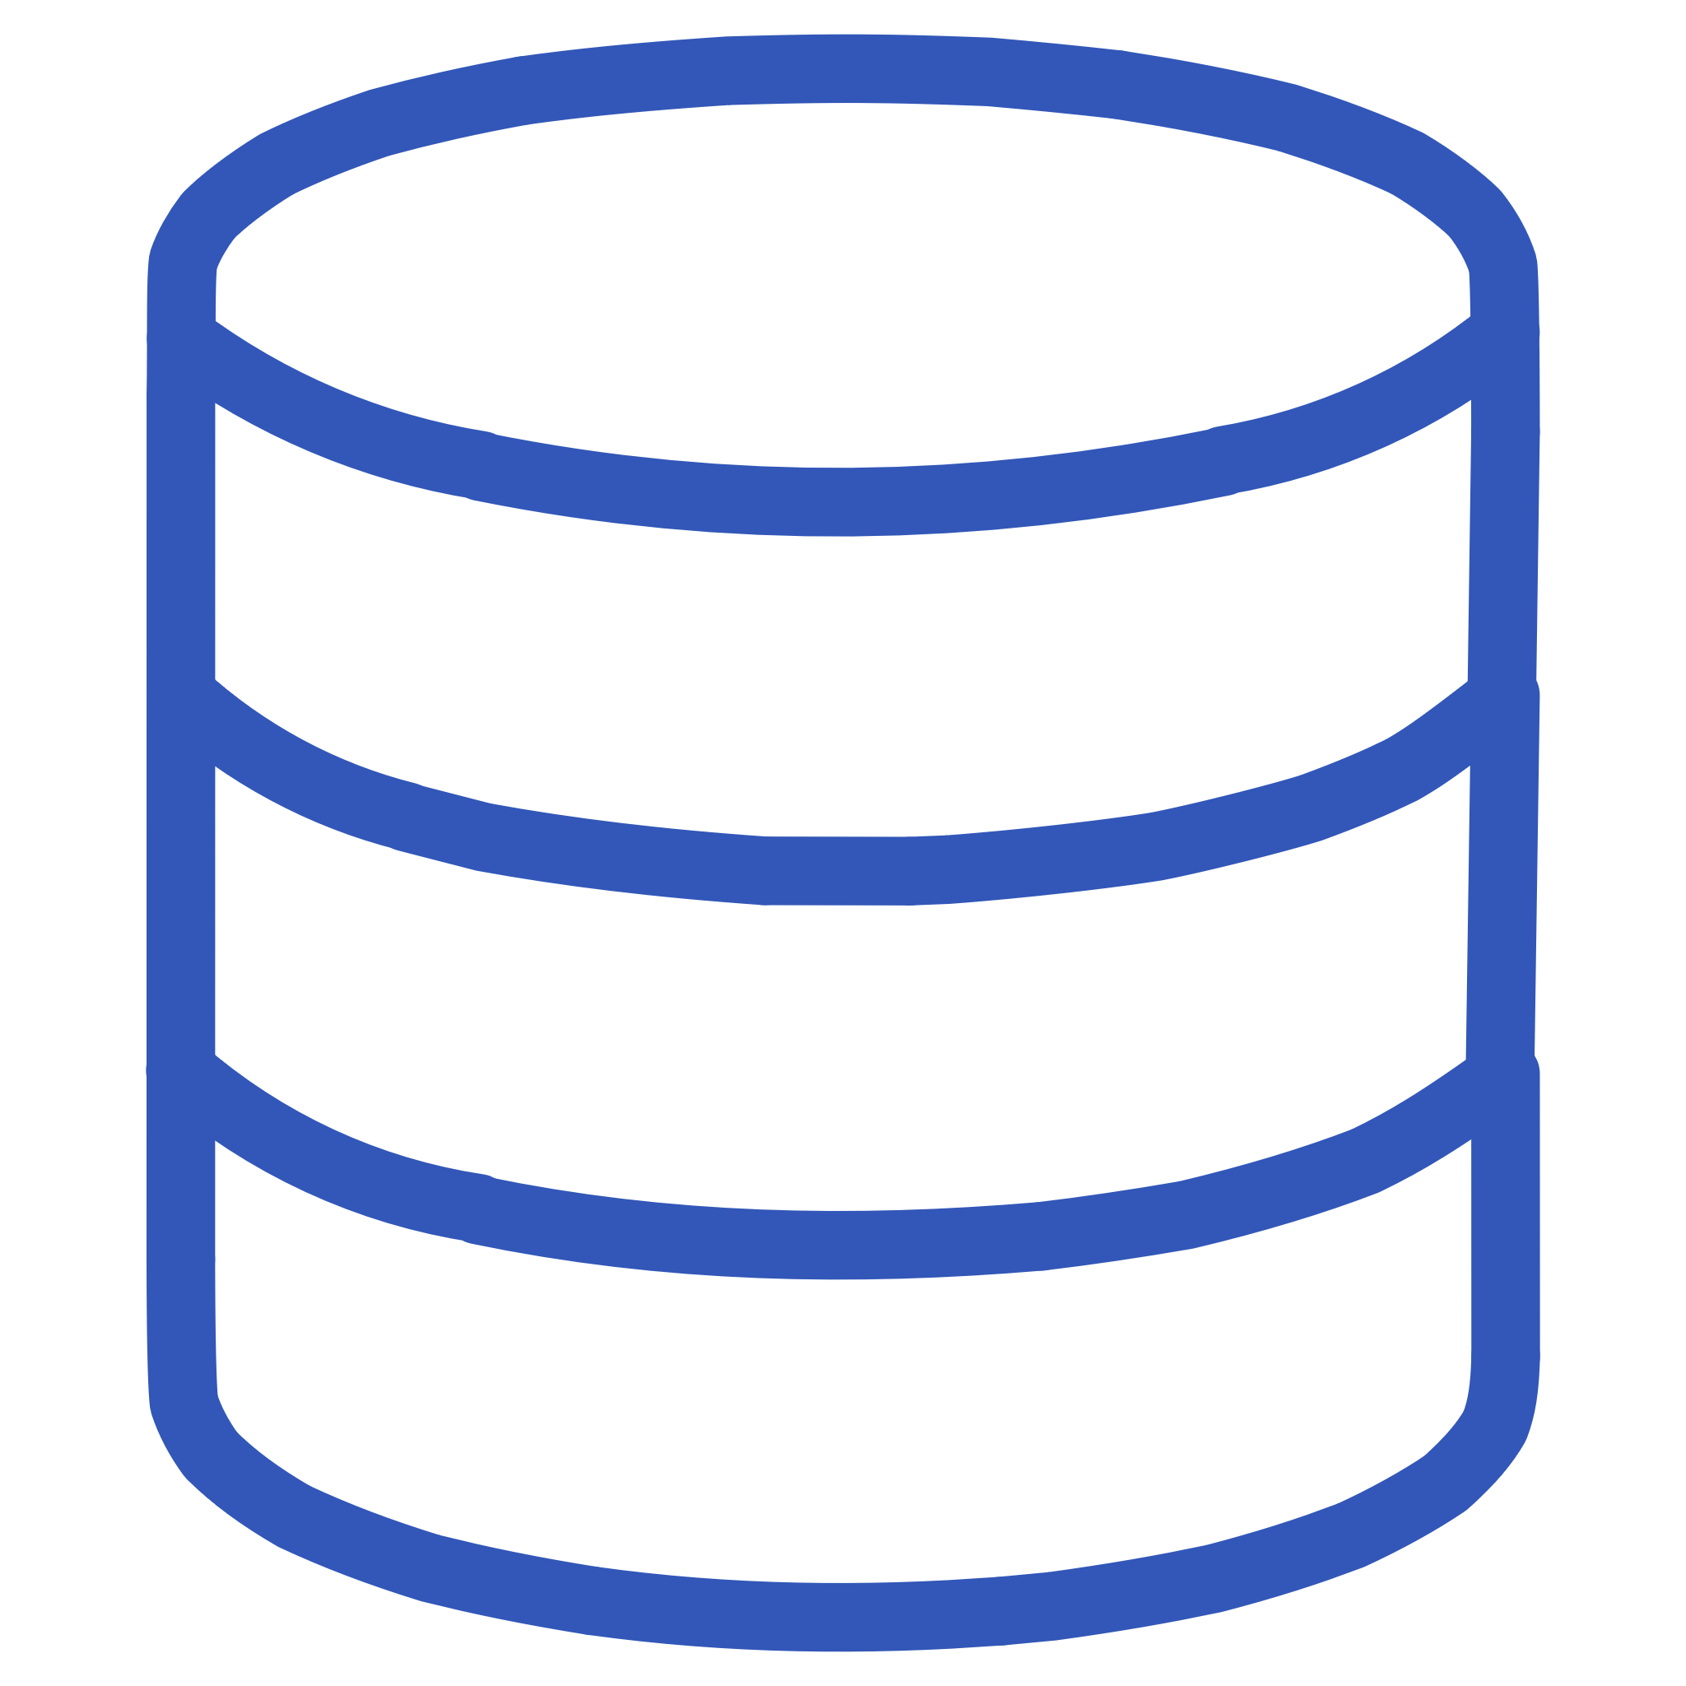
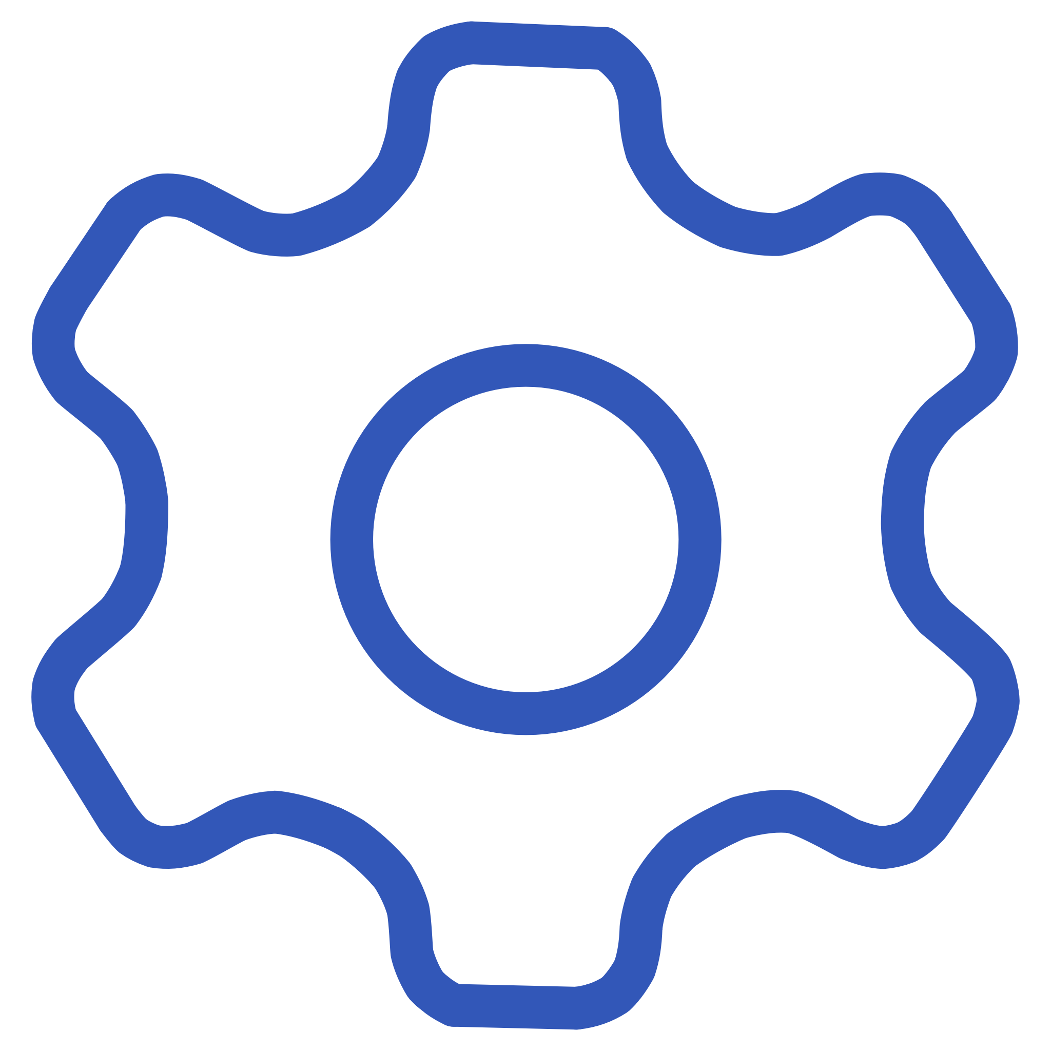
Technology Stack
Frontend
Backend
React.js – Used to build dynamic and responsive user interfaces.
Node.js – Server-side runtime environment.
Express.js – Framework for handling routing and server logic.
Database
Development Tools
MongoDB – NoSQL database for storing users, reports, and forum data.
VS Code – Code editor, Git & GitHub – Version control, Figma – UI/UX design

Slide 8
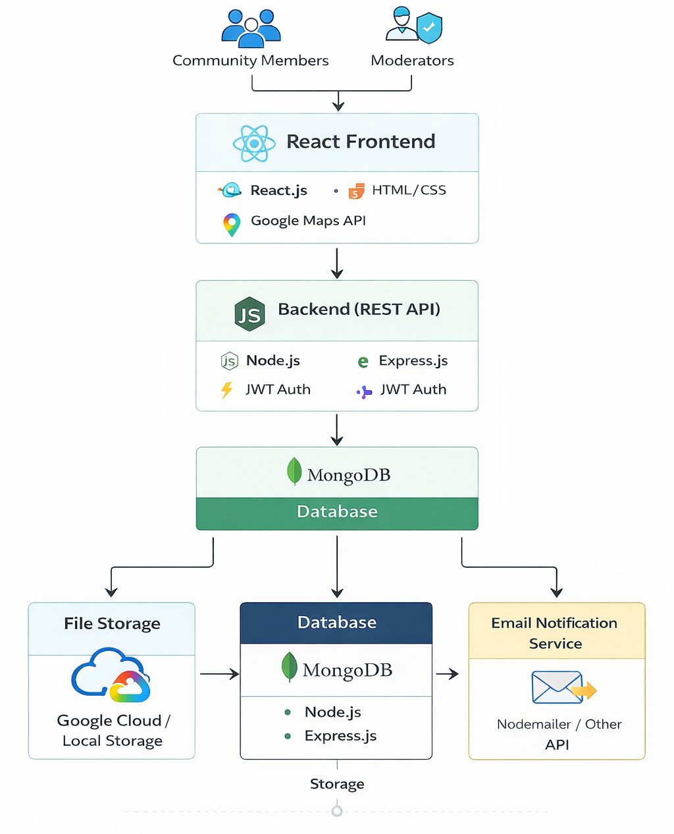
System Architecture

Slide 9
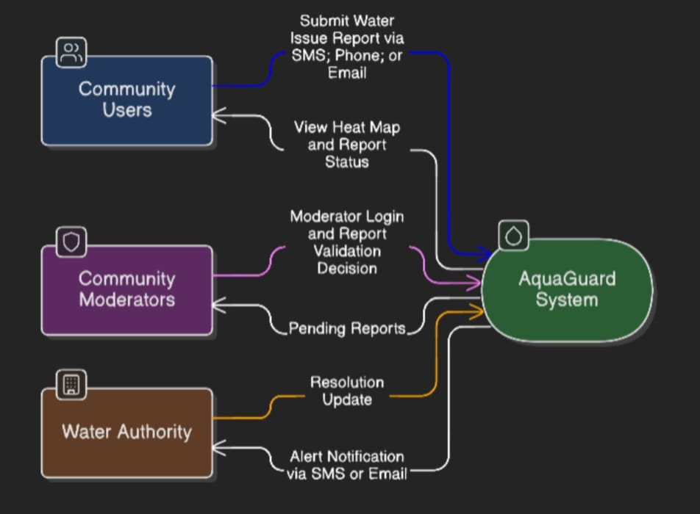
Implementation
Data Flow Diagram

Slide 10
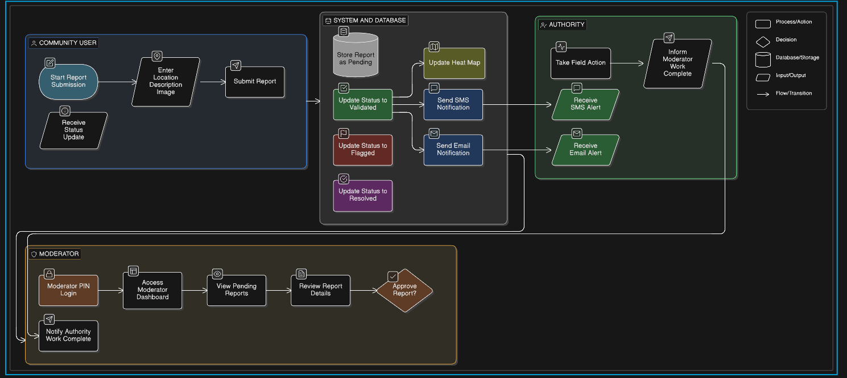
Flow Chart

Slide 11
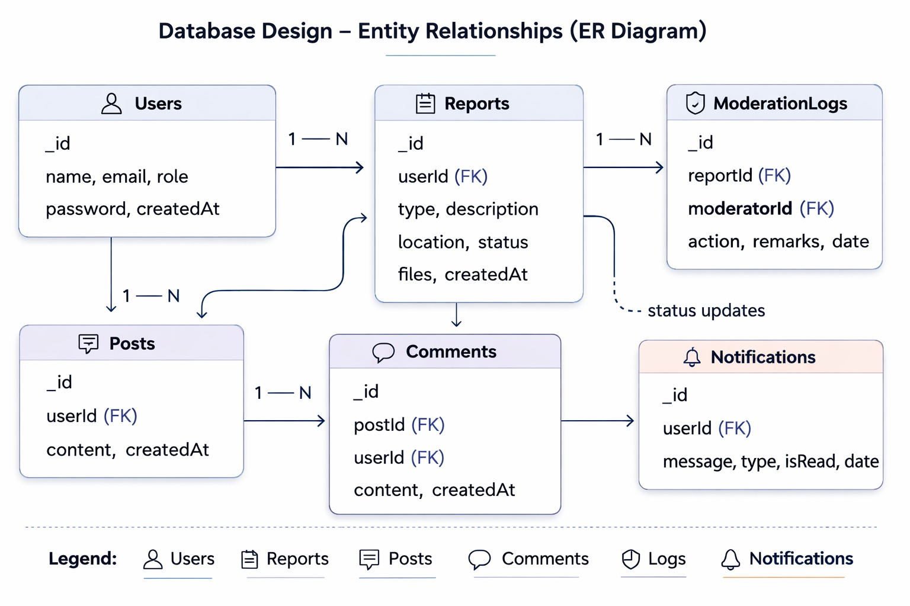
Database Design

Slide 12
Future Enhancements
AI-Based Fake Report Detection
IoT Sensor Integration
Implement machine learning algorithms to automatically detect duplicate, misleading, or suspicious reports to improve system reliability.
Integrate real-time water quality sensors to automatically collect data such as pH, turbidity, and contamination levels.
Mobile Application Development
Government Portal Integration
Develop an Android/iOS mobile app to increase accessibility and allow users to report issues instantly.
Connect the system with official municipal or water department
portals for faster and more structured authority response.
Advanced Data Analytics & Prediction
Enhanced Security Mechanisms
Use data analytics to identify contamination patterns, high-risk areas, and predict future water-related issues.
Implement multi-factor authentication, encrypted data storage, and
stronger role-based access control for improved system security.

Slide 13
Conclusion
AquaGuard proposes a structured and transparent platform for monitoring water quality and infrastructure issues through community participation. By integrating moderator validation, real-time tracking, and authority notification within a MERN-based architecture, the system aims to improve accountability and response efficiency. The proposed solution lays a strong foundation for building a reliable and scalable water monitoring ecosystem.

Slide 14
Thank You

