Slide 1

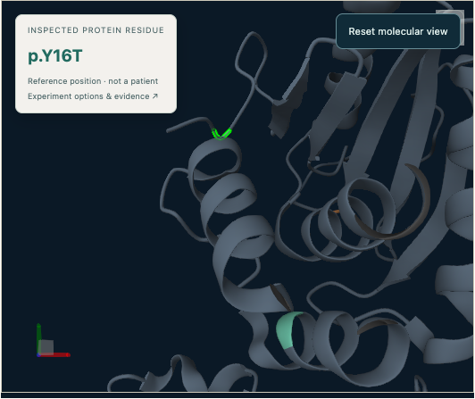
EVIDENCE THAT LEADS SOMEWHERE
Bramha Atlas
Which mutation should
we investigate next,
and why?
Reviewable research, connected to evidence.
OPEN THE PTEN DEMO →
ACTUAL REFERENCE WORKSPACE / PTEN · 1D5R
BRAMHA ATLAS / 25 OCTOBER 2026
01
Notes:
OPEN (20 seconds). Which mutation should we investigate next, and why? Bramha Atlas connects existing measurements, source evidence and reference structure into a research decision a scientist can inspect and reproduce. This is a computational research prototype. The frame is an actual saved PTEN workspace, not an animated simulation.
Opening demo: use the button to My Research and select “Inspect saved baseline”. Walk through the 90-second script in DEMO.md. Recorded evidence is the reliable default; do not call it a live Argon run. If the local app is unavailable, use the supplied frames and continue on slide 4.
SOURCES / EVIDENCE
Production emblem: frontend/public/branding/bramha-emblem.png; source/reference-check.json; assets/linked-structure-results.png.
Evidence reviewed: 25 October 2026. Saved artifacts are historical observations, not a fresh live-provider certification.

Slide 2
THE PROBLEM
The next experiment starts with an evidence decision
One researcher.
Competing explanations.
Limited lab capacity.
MEASUREMENTS
What did each assay measure?
STRUCTURE
Can this position be mapped?
LITERATURE
Does the cited passage apply?
The proposed job: assemble a research decision with evidence and explicit unknowns.
BRAMHA ATLAS / 25 OCTOBER 2026
02
Notes:
25 seconds. Imagine a small functional-genomics team with several variant explanations and limited experimental capacity. A public activity score, an abundance observation, a structure and a paper each tell only part of the story. The working hypothesis is that the expensive handoff is connecting those sources to a defensible next question. We have not measured the frequency or cost of this pain with customers yet.
SOURCES / EVIDENCE
Customer scenario is an illustrative workflow hypothesis; no measured time savings or customer traction claimed.
Evidence reviewed: 25 October 2026. Saved artifacts are historical observations, not a fresh live-provider certification.

Slide 3
THE PRODUCT
From a question to a brief you can check
01
02
03
04
Ask
Inspect
Investigate
Review
→
→
→
Declare the question
and selected records.
Check identity, assay
meaning and coverage.
Run applicable tools
and scoped reviews.
Inspect evidence,
limits and follow-up.
THE OUTPUT
A checked research brief + reproducible artifacts + unresolved questions
BRAMHA ATLAS / 25 OCTOBER 2026
03
Notes:
25 seconds. The unit of value is a reviewable investigation, rather than an isolated chat response. Data and numerical operations retain inputs and versions. The researcher checks the result and chooses a follow-up. The diagram describes the supported investigation workflow; it does not mean every step invokes a model. The quantitative mission runs deterministic Python without an LLM.
SOURCES / EVIDENCE
docs/EXPERIMENT_EXECUTION_AUDIT.md; docs/EXPERIMENT_ANALYSIS_DELIVERY.md; backend/app/analysis_execution.py; backend/app/analysis_results.py.
Evidence reviewed: 25 October 2026. Saved artifacts are historical observations, not a fresh live-provider certification.

Slide 4
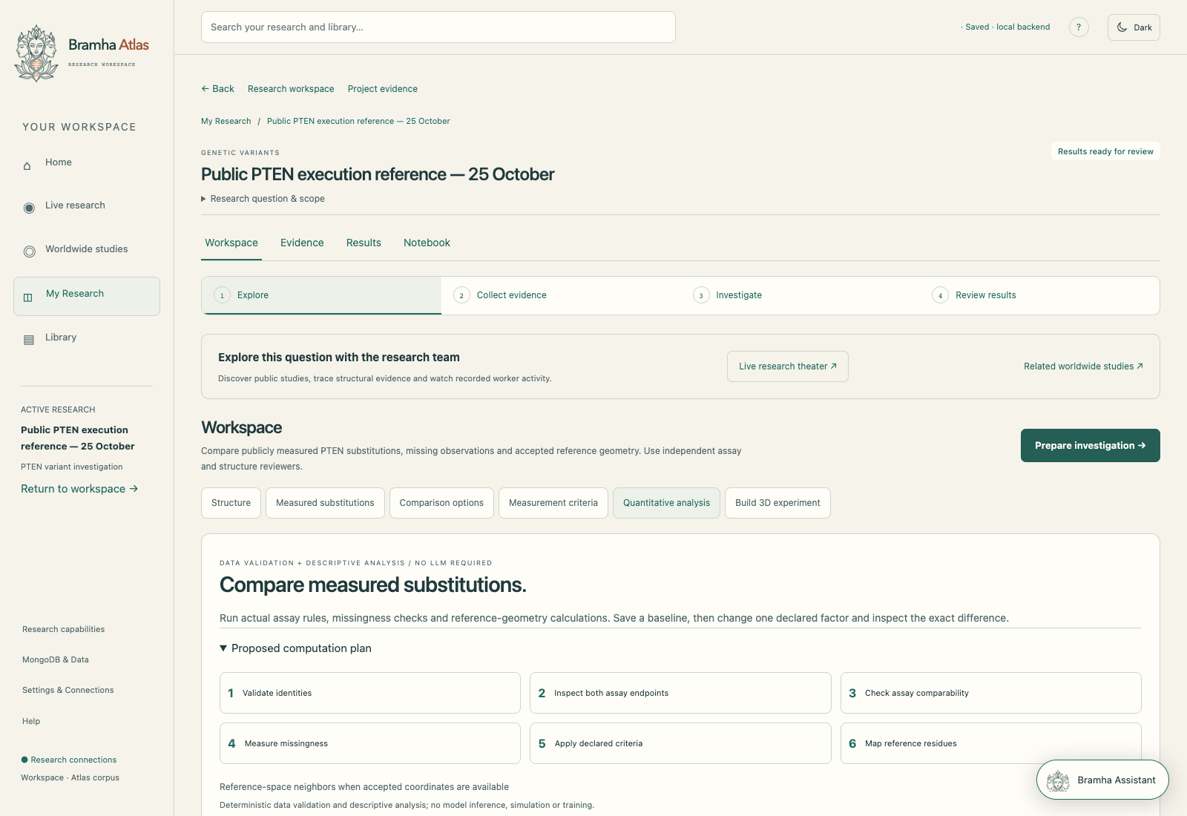
THE PTEN DEMONSTRATION
Three real substitutions. One bounded question.
C124S
R172H
Y16T
Paired measurements
A missing observation
A different profile
Activity and abundance
are both available.
Activity is available;
abundance is missing.
Paired measurements;
excluded by baseline rule.
Which profiles meet our rule?
What remains unresolved?
BRAMHA ATLAS / 25 OCTOBER 2026
04
Notes:
40 seconds. Open the saved baseline, not the model execution screen. The three selected substitutions are C124S, R172H and Y16T. These are human PTEN protein substitutions against canonical P60484, not uniquely inferred DNA alleles. The snapshot combines two distinct public MaveDB score sets and accepted reference mappings. All three selected positions map; this case does not demonstrate missing coordinates. The missingness is R172H abundance. Ask: which selected variants meet the assay-specific criteria, what structural context is available, and what remains unresolved? Show the saved inputs and the missing row.
Local baseline: http://localhost:8500/research/project-c5786c930ae040d693910c78a4a548eb/workspace?view=analysis&analysis_run=research-4df547659b0949898f8ec40e00ee071c
SOURCES / EVIDENCE
source/reference-check.json; source/assay-dictionary.json; source/source-manifest.json. Original records: https://www.mavedb.org/score-sets/urn:mavedb:00000054-a-1 and https://www.mavedb.org/score-sets/urn:mavedb:00000102-0-1. Dataset pten-transform-1.0-97b699d687c8.
Evidence reviewed: 25 October 2026. Saved artifacts are historical observations, not a fresh live-provider certification.

Slide 5
MEASUREMENTS, WITH THEIR MEANING
Two assays answer different questions
Variant
Activity
Abundance
C124S
-4.896
1.047
R172H
-0.090
Missing
Y16T
-0.282
0.879
2 of 3 have both values.
Missing stays unknown.
Public MaveDB measurements · pinned PTEN snapshot · no cross-assay normalization
BRAMHA ATLAS / 25 OCTOBER 2026
05
Notes:
40 seconds. The x axis is published enrichment/fitness in a humanized yeast model; it is not a direct clinical activity score. The y axis is the native VAMP-seq abundance score, not a probability and not clamped to 0–1. The chart contains only the two paired profiles. R172H remains visible in the accompanying table, but is not plotted with an invented y value. Values on the slide are rounded for readability; the workbook and reference JSON preserve full precision. The displayed boundaries are exploratory analytical rules. Native activity/abundance values cannot be subtracted or treated as a common scale. Reported uncertainty metadata is retained in the source; no inferential conclusion is drawn here.
SOURCES / EVIDENCE
source/reference-check.json; source/assay-dictionary.json; source/source-manifest.json. Original records: https://www.mavedb.org/score-sets/urn:mavedb:00000054-a-1 and https://www.mavedb.org/score-sets/urn:mavedb:00000102-0-1. Dataset pten-transform-1.0-97b699d687c8.
Evidence reviewed: 25 October 2026. Saved artifacts are historical observations, not a fresh live-provider certification.

Slide 6
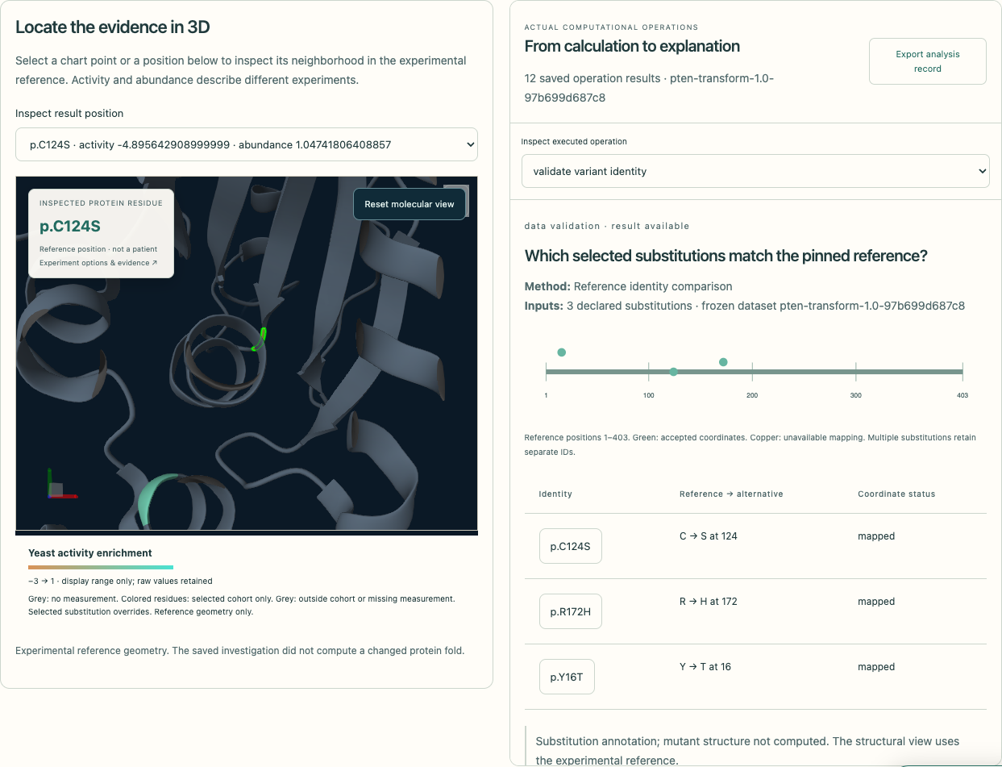
REFERENCE STRUCTURE
A mapped position gives context, not causation
P60484 → 1D5R
Identity checked
Accepted reference-to-chain mapping.
Coordinates inspected
All three selected positions are mapped.
Boundary preserved
The mutant structure was not computed.
BRAMHA ATLAS / 25 OCTOBER 2026
06
Notes:
30 seconds. These are experimental reference coordinates from 1D5R. The mapping checks sequence identity and observed C-alpha correspondence. It is a precomputed audited reference-to-construct alignment, not a new alignment every time the viewer opens. All three chosen substitutions are mapped in this saved report. A selected side chain or colored residue is a substitution annotation; it does not compute a mutant fold. Distances are reference-coordinate Euclidean distances when coordinates are available; proximity alone does not establish a shared mechanism.
SOURCES / EVIDENCE
source/reference-check.json; source/assay-dictionary.json; source/source-manifest.json. Original records: https://www.mavedb.org/score-sets/urn:mavedb:00000054-a-1 and https://www.mavedb.org/score-sets/urn:mavedb:00000102-0-1. Dataset pten-transform-1.0-97b699d687c8. Reference coordinates: https://www.rcsb.org/structure/1D5R ; UniProt: https://www.uniprot.org/uniprotkb/P60484/entry .
Evidence reviewed: 25 October 2026. Saved artifacts are historical observations, not a fresh live-provider certification.

Slide 7
A REPRODUCIBLE FOLLOW-UP
Change one rule. See exactly what changes.
BASELINE
FOLLOW-UP
C124S
→
C124S + Y16T
Activity ceiling −1.11
Activity ceiling 10
ENTERED
LEFT
UNCHANGED
Y16T
None
C124S
EXPLORATORY CRITERION CHANGE · 0 MODEL REQUESTS
BRAMHA ATLAS / 25 OCTOBER 2026
07
Notes:
40 seconds. This is a saved analytical sensitivity check, separate from the model-backed investigation. The activity ceiling changes from -1.11 to 10. The abundance boundary remains 0.6121866579147568. Selection, source versions, mapping policy and the paired-measurement requirement remain fixed. A ceiling of 10 is deliberately permissive, not an established biological threshold. C124S remains selected and Y16T enters. R172H stays unresolved because its abundance value is absent. This changed analytical set does not demonstrate a new biological effect, a causal mechanism or an agent-generated hypothesis revision. Baseline and follow-up made zero model requests.
Saved follow-up: http://localhost:8500/research/project-c5786c930ae040d693910c78a4a548eb/workspace?view=analysis&analysis_run=research-6be0a905e61a40eda99c4bcce147da1d
SOURCES / EVIDENCE
source/reference-check.json; source/assay-dictionary.json; source/source-manifest.json. Original records: https://www.mavedb.org/score-sets/urn:mavedb:00000054-a-1 and https://www.mavedb.org/score-sets/urn:mavedb:00000102-0-1. Dataset pten-transform-1.0-97b699d687c8. Baseline research-4df547659b0949898f8ec40e00ee071c; follow-up research-6be0a905e61a40eda99c4bcce147da1d.
Evidence reviewed: 25 October 2026. Saved artifacts are historical observations, not a fresh live-provider certification.

Slide 8
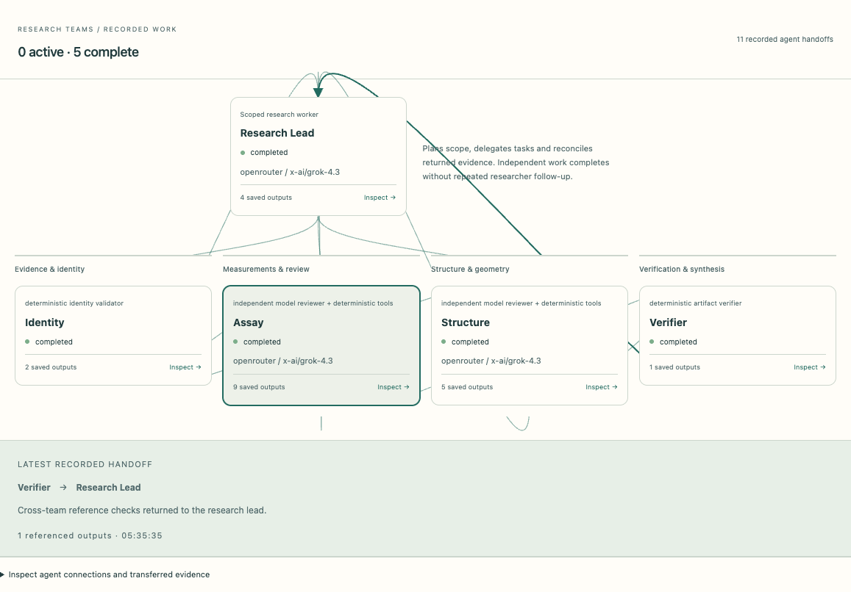
RECORDED AGENT INVESTIGATION
Scoped reviews, inspectable handoffs
Research lead
5
model orchestrator
model requests
Identity
Assay
Structure
Python
model + tools
model + tools
10
deterministic tool calls
Verifier
mechanical checks
RECORDED RUN · ARGON UNVERIFIED
BRAMHA ATLAS / 25 OCTOBER 2026
08
Notes:
45 seconds. This diagram reflects one actual saved completed-with-limitations run. There is one model research lead and four delegated workers: a deterministic identity validator, an independent model assay reviewer, an independent model structure reviewer, and a deterministic artifact verifier. Both independent model reviews began after identity validation and their saved intervals overlap. There were five model requests, ten deterministic tool calls and eleven saved messages. This proves this saved task network and artifact handoffs, not external A2A protocol interoperability or unrestricted replication. It used OpenRouter / x-ai/grok-4.3; do not attribute this run to Argon. Argon is the intended integration and remains unverified. No private reasoning traces are displayed.
Open saved recorded result: http://localhost:8500/research/project-c5786c930ae040d693910c78a4a548eb/investigations/research-00f7ec8b7690404db6f033a509507c8c
SOURCES / EVIDENCE
source/agent-run.json; backend/app/orchestration/agent_network.py; assets/agent-network.png. Actual provider: OpenRouter / x-ai/grok-4.3. Argon remains unverified; source/argon-check.json.
Evidence reviewed: 25 October 2026. Saved artifacts are historical observations, not a fresh live-provider certification.

Slide 9
THE RESEARCH OUTCOME
The useful result includes the unknowns
Still unresolved
SUPPORTED BY THE BASELINE
C124S meets the declared
paired-measurement rule.
R172H: abundance is missing.
Mechanism and disease relevance
are not established here.
A descriptive shortlist for scientific review.
NEXT QUESTION
What additional applicable evidence could distinguish the competing explanations?
BRAMHA ATLAS / 25 OCTOBER 2026
09
Notes:
35 seconds. The baseline supports a descriptive statement: C124S meets this declared paired rule. It does not establish the biological reason. R172H cannot be evaluated with that paired rule because abundance is missing. The follow-up adds Y16T only after the criterion is changed. The next research question is whether additional applicable evidence can distinguish functional loss from abundance-related explanations. That is a research proposal, not a reported result or causal conclusion. A genuine autonomous limitation-driven revision is not established by this artifact set; the deterministic criterion change must not be sold as that behavior.
SOURCES / EVIDENCE
source/reference-check.json; source/assay-dictionary.json; source/source-manifest.json. Original records: https://www.mavedb.org/score-sets/urn:mavedb:00000054-a-1 and https://www.mavedb.org/score-sets/urn:mavedb:00000102-0-1. Dataset pten-transform-1.0-97b699d687c8. source/agent-run.json. Adaptive limitation-driven model revision is not verified by this threshold comparison.
Evidence reviewed: 25 October 2026. Saved artifacts are historical observations, not a fresh live-provider certification.

Slide 10
SYSTEM ARCHITECTURE
Connected evidence, explicit storage boundaries
Public sources
Validated Python tools
Researcher review
Measurements · papers · structures
Identity · filtering · mapping
Inspect results · decide follow-up
MongoDB Atlas corpus
Lead + scoped reviewers
Local project state
Source versions · passages · assets
Model review + artifact verification
Investigations · events · results
Contextual assistant: source-linked guidance alongside the investigation.
BRAMHA ATLAS / 25 OCTOBER 2026
10
Notes:
35 seconds. The public corpus is persisted in MongoDB Atlas; project questions, investigations and operation results remain in the configured local store. Deterministic Python tools execute numerical analysis. The lead and scoped model reviewers interpret bounded evidence, with artifact checks. The contextual Bramha Assistant is distinct from investigation agents. The stored passage vectors use a local pretrained multilingual embedding model. A recorded ready Atlas vector index does not by itself certify a full hybrid retrieval query; that integration must be separately verified. This is a conceptual architecture diagram, not a claim that every source is always queried for every run.
SOURCES / EVIDENCE
docs/MONGODB_DATA_CONSOLE.md; source/storage-check.json; backend/app/analysis_execution.py; backend/app/corpus_store.py; backend/app/research_hub.py; frontend/src/workspace/ResearchHub.tsx.
Evidence reviewed: 25 October 2026. Saved artifacts are historical observations, not a fresh live-provider certification.

Slide 11
DEMONSTRATED SCOPE
A prototype with evidence you can inspect
Capability
Evidence in hand
Status
PTEN analysis
Pinned baseline + one-factor follow-up
Demonstrated
Independent reviews
Saved model-backed team run
Recorded; with limits
Public corpus
Atlas connection + stored records
Snapshot verified
Argon scientific run
Connectivity attempt timed out
Unverified
Clinical or causal validity
No qualifying validation in this case
Not established
480 studies / 4,784 passages
Recorded Atlas snapshot · 25 Oct 2026, 05:47 UTC
BRAMHA ATLAS / 25 OCTOBER 2026
11
Notes:
35 seconds. These rows distinguish demonstrated and pending work. The numerical mission has an audited saved baseline and follow-up. The independent agent team has a successful saved fallback-provider run, completed with limitations. Atlas has a connected public-corpus snapshot with 480 studies and 4,784 passages, distinct from project-state persistence. Supplied-model alignment also exists but is not the core pitch demonstration. Argon scientific execution, a verified end-to-end hybrid retrieval claim, autonomous limitation-driven revision in this case, and clinical validation are not established by these artifacts. Repository software checks do not validate biology.
SOURCES / EVIDENCE
source/reference-check.json; source/agent-run.json; source/storage-check.json; source/argon-check.json; docs/EXPERIMENT_ANALYSIS_DELIVERY.md. Counts are the recorded 25 October 2026 snapshot.
Evidence reviewed: 25 October 2026. Saved artifacts are historical observations, not a fresh live-provider certification.

Slide 12
INITIAL CUSTOMER
Start with teams making variant research decisions
01
02
Academic genomics labs
Small biotech teams
Review variant evidence before
choosing a follow-up experiment.
Connect measurements, structure
and source review in one record.
FIRST PILOT JOB
A reviewed shortlist and a traceable next research question.
BRAMHA ATLAS / 25 OCTOBER 2026
12
Notes:
30 seconds. Start with academic functional-genomics labs and small biotech research teams already interpreting public or internally reviewed variant evidence. The first job is a reviewable computational shortlist and an explicit list of missing evidence. The proposal is a small design-partner pilot using scoped, nonclinical research questions. We have not established customer demand, procurement fit or willingness to pay. Use expert feedback to narrow the workflow before expanding genes or organization-wide use.
SOURCES / EVIDENCE
Proposed customer segmentation and pilot design are hypotheses; no signed pilots or validated willingness to pay claimed.
Evidence reviewed: 25 October 2026. Saved artifacts are historical observations, not a fresh live-provider certification.

Slide 13
COMPETITIVE CONTEXT
A focused workflow in an established ecosystem
Existing tool
Established focus
$3.65B
Benchling
R&D workflows, context and agents
2024 global drug-discovery
informatics estimate
Galaxy
Reproducible computational workflows
MaveDB
Variant-effect datasets and interpretation
Broad category context
Grand View Research
Not our addressable market
Europe PMC
Life-science literature discovery
Our proposed focus: one inspectable decision, from declared criteria to unresolved evidence.
BRAMHA ATLAS / 25 OCTOBER 2026
13
Notes:
40 seconds. These products overlap with parts of the workflow and should be treated fairly. Benchling describes agentic R&D workflows and scientific context, so do not claim that competitors lack agents. Galaxy provides reproducible computational workflows. MaveDB provides variant-effect data; its related interfaces already expose multi-assay and structural interpretation. Europe PMC enables life-science literature discovery and reading. Our proposed distinction is a narrowly scoped investigation record that connects declared criteria, actual tool artifacts, source coverage and explicit unknowns; uniqueness and superiority are not established. Grand View Research estimates the broad global drug-discovery-informatics category at $3.65 billion in 2024. That is market context, not Bramha Atlas TAM, valuation, attainable revenue or a primary-source measurement. We do not sum overlapping markets.
SOURCES / EVIDENCE
Official pages checked 25 October 2026: Benchling https://www.benchling.com/ ; Galaxy https://galaxyproject.org/ ; MaveDB https://mavedb.org/docs/mavedb/index.html and https://www.mavedb.org/docs/mavedb/mavemd/variant-page.html ; Europe PMC https://europepmc.org/about . Market context: Grand View Research https://www.grandviewresearch.com/horizon/outlook/drug-discovery-informatics-market-size/global .
Evidence reviewed: 25 October 2026. Saved artifacts are historical observations, not a fresh live-provider certification.

Slide 14
BUSINESS MODEL HYPOTHESIS
Charge for a bounded research workspace
Individual researcher
Small laboratory
US$30 / month · proposed
Bounded usage; validate with pilots.
US$300 / month · proposed
Shared review workflow; bounded usage.
20 labs × $300 / month × 12
ILLUSTRATIVE · NOT TRACTION
= $72,000 / year
BRAMHA ATLAS / 25 OCTOBER 2026
14
Notes:
30 seconds. Pricing is a hypothesis to test with the pilot participants. A research individual tier could start around $30 per month and a small-lab tier around $300 per month, with explicit execution budgets and usage limits. These prices are not current commercial offers. The illustrative calculation uses only lab subscriptions: twenty hypothetical labs at three hundred dollars monthly produce seventy-two thousand dollars of annual subscription revenue before costs, churn, discounts or taxes. It is not booked ARR or a financial forecast. The one recorded model-run cost is not enough to infer unit economics; measure support, compute, storage and model usage during pilots.
SOURCES / EVIDENCE
All prices, customer counts and revenue values on this slide are proposed assumptions. Arithmetic only: 20 labs × US$300/month × 12 = US$72,000/year; no traction, forecast, profit or valuation claim.
Evidence reviewed: 25 October 2026. Saved artifacts are historical observations, not a fresh live-provider certification.

Slide 15
ADOPTION AND EVALUATION
Pilot the decision, then earn expansion
01 Partner
02 Evaluate
03 Expand
Recruit 3–5 labs.
Agree on a bounded question.
Expert review + task success.
Measure time and errors.
Validate the next gene.
Test repeat use and lab fit.
What earns the next stage?
Traceable results. Useful unknowns.
Researchers who return.
BRAMHA ATLAS / 25 OCTOBER 2026
15
Notes:
30 seconds. Propose three to five design-partner labs, starting with agreed public or permissioned nonclinical questions. Freeze the questions and evaluation rubric before the trial. Have a domain expert score applicability, source support and error handling, while a researcher records completion time and time spent checking. Compare against each lab’s current process; do not publish an efficiency gain without the measurements and context. Expand to another gene only after source acquisition, assay interpretation and mapping checks pass. Department adoption should follow evidence of repeat use, exportability and acceptable support costs.
SOURCES / EVIDENCE
Proposed evaluation plan; pilot counts, durations and success criteria are design hypotheses, not completed customer research.
Evidence reviewed: 25 October 2026. Saved artifacts are historical observations, not a fresh live-provider certification.

Slide 16
THE ASK
Help shape a research decision worth trusting
Bring one research question.
Seeking pilot labs and scientific advisers.
01
02
03
Verify Argon execution
Evaluate with researchers
Validate gene expansion
BRAMHA ATLAS / 25 OCTOBER 2026
16
Notes:
25 seconds. The next milestones are a verified Argon scientific run, independent researcher evaluation of this bounded workflow, and validated expansion beyond the initial PTEN mission. We are seeking pilot laboratories and scientific advisers who can bring a scoped research question and challenge the evidence, assumptions and next-step usefulness. Longer-term, portable research packages and permissioned collaboration may extend the workflow, but are not required for this initial demonstration. Close on one request: bring one research question and help us test whether the resulting decision record is useful.
SOURCES / EVIDENCE
Roadmap and partner request are prospective. Argon status: source/argon-check.json. Gene expansion and independent scientific evaluation remain future milestones.
Evidence reviewed: 25 October 2026. Saved artifacts are historical observations, not a fresh live-provider certification.

