Slide 1
B KAUSHIK
ADS Batch - May

Slide 2
Definitions:
Probability: Probability is a number that reflects the chance or likelihood that a particular event will occur.
Probability ranges between 0 to 1.
0 probability means the event will not happen.
1 probability means the certainty.

Slide 3
Definitions:
Mutual exclusive: Two events are mutually exclusive or disjoint if they cannot both occur at the same time.
Mutual inclusive: When two events cannot happen independently then it is called mutual inclusive.
Independent events: Two events are independent if the outcome or occurrence of the first does not affects the outcome or occurrence of the second.
Dependent events: Two events are dependent if the outcome or occurrence of the first affects the outcome or occurrence of the second so the probability is changed.

Slide 4

Definitions:
Conditional probability: Conditional probability is a measure of the probability of an event occurring, given that another event has already occurred.
The formula for conditional probability for two events A and B is:

Slide 5
Bayes Theorem
Bayes theorem can be used to determine the conditional probability of event A, given that event B has occurred,by knowing the conditional probability of event B, given that event A has already occurred, also the probabilities of events A and B.

Slide 6
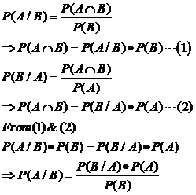

Slide 7
Questions:
What is the probability of spinning a prime number or an odd number on a spinner numbered 1 to 8?
Sample space={1,2,3,4,5,6,7,8}

Slide 8
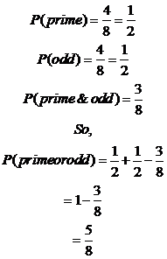

Slide 9
Question
For numbers, one to nine, get the probability of getting a number less than 4 or 2?
Sample space={1,2,3,4,5,6,7,8,9}
Let P(A)=Probability of less than 4
P(B)=Probability of less than 2.

Slide 10
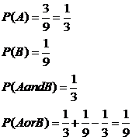

Slide 11
Questions:
Let X and Y are two independent events such that P(X)=0.3 and P(Y)=0.7. Find P(X and Y), P(X or Y).
P(X and Y)=P(X)*P(Y)
=0.3*0.7
=0.21
P(X or B)=P(X)+P(Y)
=0.3+0.7=1

Slide 12
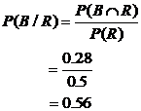
Questions:
A bag contains red and blue marbles. Two marbles are drawn without replacement. The probability of selecting a red marble and then a blue marble is 0.28. The probability of selecting a red marble on the first draw is 0.5. What is the probability of selecting a blue marble on the second draw, given that the first marble drawn was red?

