Slide 1
Name - B KAUSHIK
ADS Batch - May

Slide 2
Definitions:
Mean - Mean is the average value of the given data. Mean is indicated by
Median - Median is the mid-point value.
Mode - Mode is the most common value of the given data.

Slide 3
Definitions:
Standard deviation - S.D tells that how spread out the data is.
The low SD means the most of the numbers are close to the mean value.
The high SD means the values are spread out over a wider range.
It is indicated by
Variance - Variance is a number that indicates that how spread out the value.
SD is square root of the variance.

Slide 4

Questions:
Find Mean,median,mode and standard deviation for the data set.
(a) 7,11,16,14,11,13,19,13,13
Solution:
Step1:
First of all write the data set in increasing order:
7,11,11,13,13,13,14,16,19
As mean is the average of the given data:

Slide 5
Questions:
As median is the mid-point value.
The the number of data is odd, so the place value of 5th will be the median.
Here,
13 is the median.

Slide 6
Questions:
Mode is the most common value.
In the given dataset,
13 comes most of the times. i.e 3 times.
So, 13 is the mode.

Slide 7
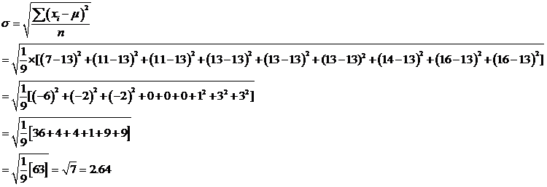
Standard deviation is:

Slide 8

Questions:
(b) Given data is:
16,15,16,17,19,12,14,9
The data in increasing order is:
9,12,14,15,16,16,17,19

Slide 9

Questions:
As the number of given data is even,i.e 8.
So, the average of data from the place values 4th and 5th will be the median.
So,

Slide 10
Questions
Mode is the most common value.
In the given dataset, 16 comes 2 times.
So, 16 is the mode

Slide 11
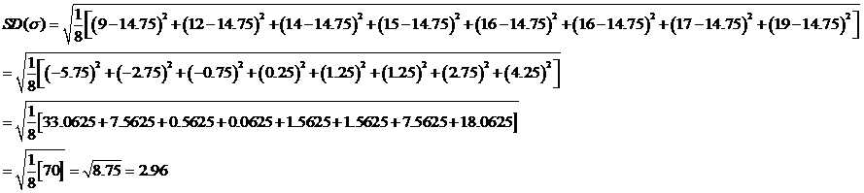
Questions:
Standard deviation:

Slide 12
Questions:
(c) Given dataset is:
27,66,24,81,50,40,74,81,97
The data set in increasing order is:
24,27,40,50,66,71,81,81,97

Slide 13
Questions:
Median:
As the dataset is odd in numbers.
So, the data in the place value 5th will be median
Hence median=66
Mode:
The value 81 comes two times in the dataset, i.e the most common value.
So, mode=81

Slide 14
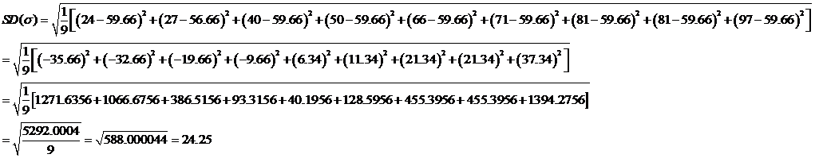
Questions:
Standard deviation:

Slide 15
Thank you

