Slide 1



Spring Boot - Actuator
Production-Ready Features in Spring Applications

Slide 2
Topics in this Session
Overview - Software Day-2 Concerns
Actuator Endpoints/Features
Spring Boot Actuator - Complex Install

Slide 3

Overview
Your greeting app was a rousing success. People are generating custom ‘Hellos’ and you’re the hero of the IT department.

Slide 4

Overview
Then…
There’s a visit from the pointy-headed boss.

Slide 5

Overview
The app works great but...
Network:
Health check endpoint for F5
Enterprise Architects:
Every configuration property exposed to your app
Production Support:
metrics:
Uptime
Heap user
GC Mark Sweep count/time
Thread dump/Heap dump on demand
Security:
every exposed app context
List of every bean in Spring context
Full trace of last 5 minutes of requests

Slide 6
Topics in this Session
Overview - Software Day-2 Concerns
Actuator Endpoints/Features
Spring Boot Actuator - Installation

Slide 7
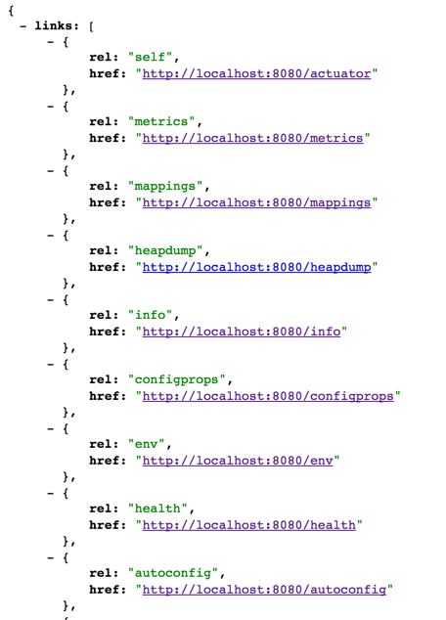
Presenting...
Actuator
health
metrics
endpoints
configuration
much much more

Slide 8
Topics in this Session
Overview - Software Day-2 Concerns
Actuator Endpoints/Features
Spring Boot Actuator - Installation

Slide 9
Highly Complex Actuator Install
This is your pom.xml
… on actuator
This is Spring Boot. What did you expect?
<dependencies>
<dependency>
<groupId>org.springframework.boot</groupId>
<artifactId>spring-boot-starter-web</artifactId>
</dependency>
</dependencies>
<dependency>
<groupId>org.springframework.boot</groupId>
<artifactId>spring-boot-starter-actuator</artifactId>
</dependency>
<dependency>
<groupId>org.springframework.hateoas</groupId>
<artifactId>spring-hateoas</artifactId>
</dependency>
Notes:
Maven is just one option. You can also use Gradle or Ant/Ivy

Slide 10
Summary
Actuator exposes every piece of data you could ever want about your app
Available out of the box with a starter in your pom.
Spring’s opinionated, DRY philosophy in action
No additional requirements

Slide 11

LAB

