Slide 1


Cloud Native Applications
Polyglot Persistence with Spring Data REST
Notes:
Resting slide on screen before you begin presenting.

Slide 2
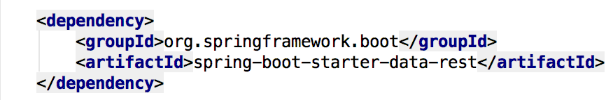
Spring Data REST
Goal is to provide a solid foundation on which to expose CRUD repositories to our repository managing entities using plain HTTP REST semantics
Add a dash of Spring Data REST starter into our pom.xml
Notes:
Provide radically faster and widely accessible “getting started” experience for all Spring development
Opinionated out of the box, but get out of the way as quickly as possible
Provide a range of non-functional features (embedded servers, metrics, health checks, externalized config)

Slide 3
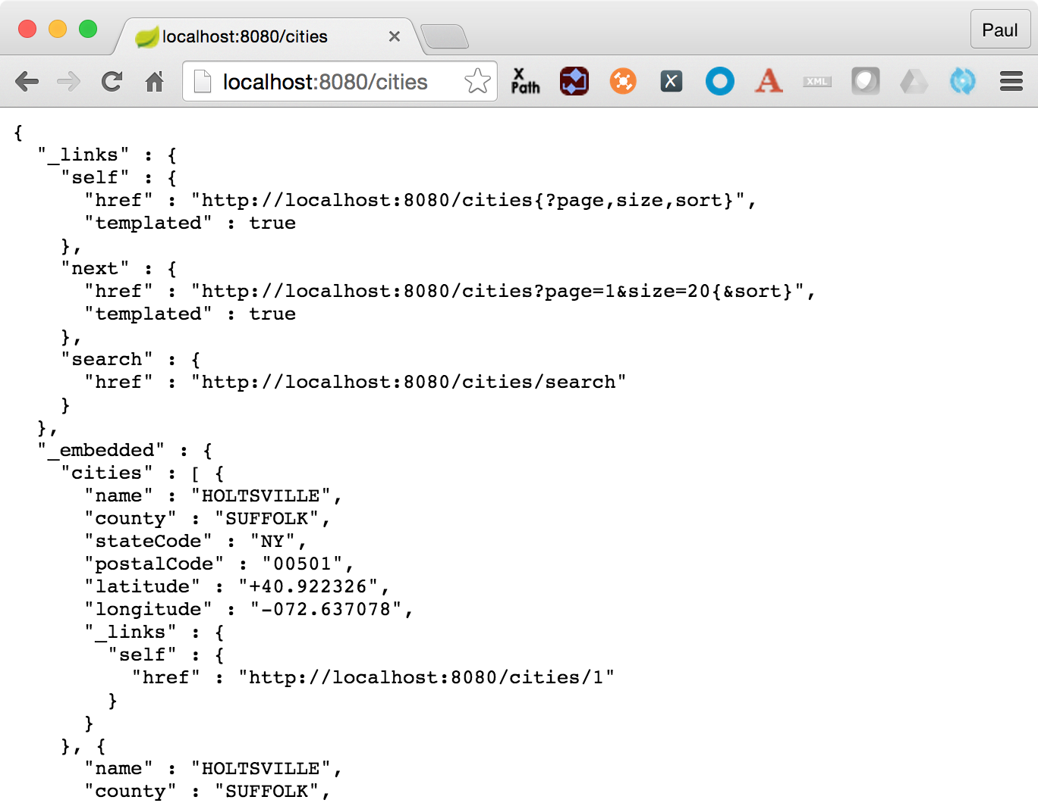
Spring Data REST, what happens
For this repository, Spring Data REST exposes a resource collection at “/cities”
Context path is derived from the un-capitalized, pluralized, simple class name of the domain class being managed
Exposes an item resource for each of these items managed by the repository under the URI template /cities/{id}

Slide 4
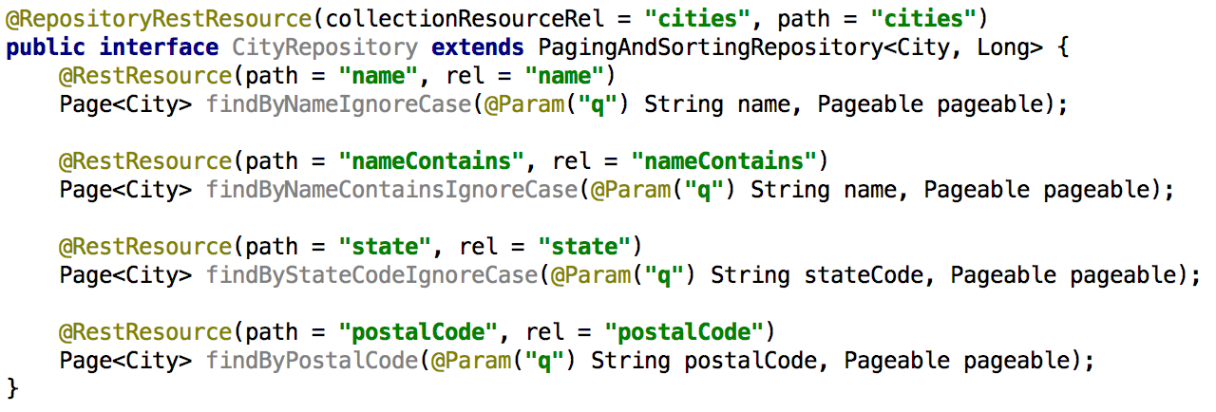
Support Search, or findBy*
Add some search methods using @RestResource to our CityRepository class

Slide 5
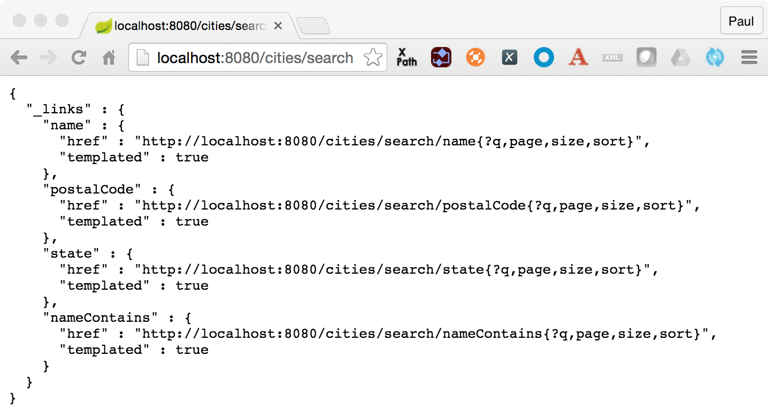
Spring Data REST, what happens?
For this repository, we now see search methods when we hit the /{repository}/search endpoint

Slide 6
Spring Data REST, Custom Queries
Add a method “findByStateCode” to our CityRepository that defines an custom query using @Query notation and takes an @Param argument for the stateCode

Slide 7
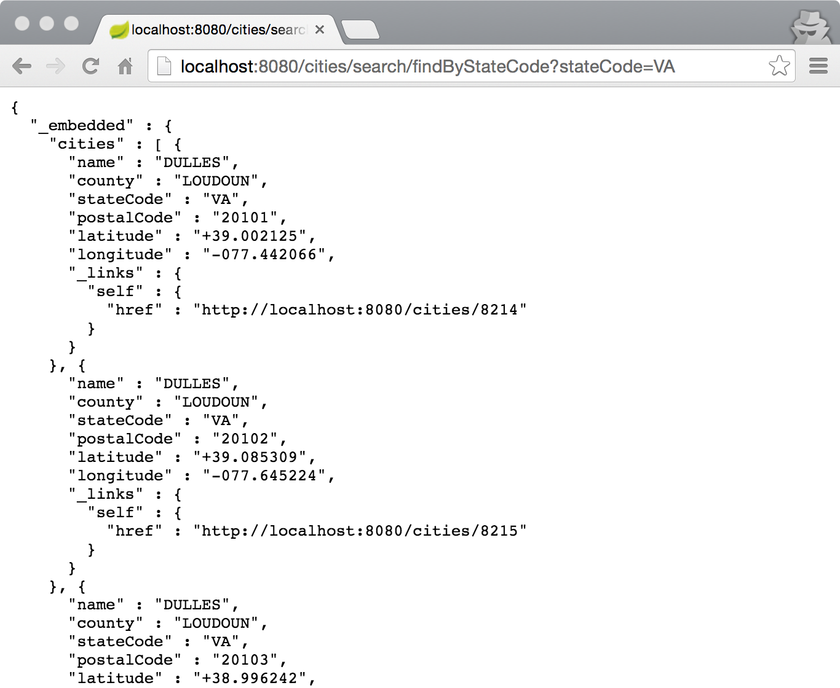
Spring Data REST, what happens?

Slide 8
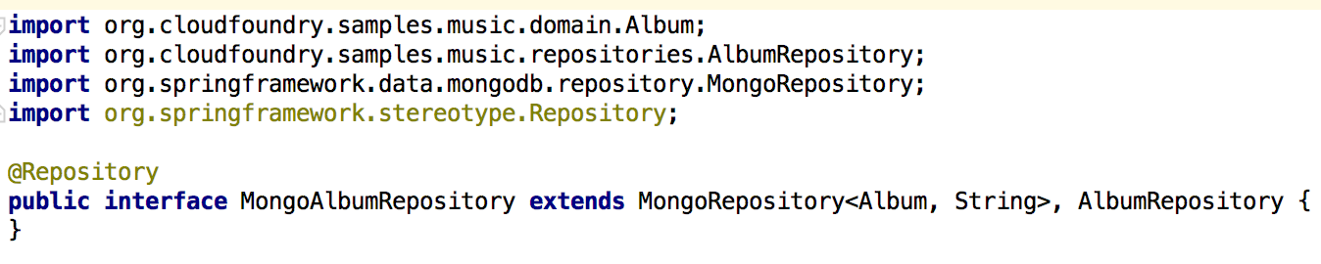
MongoRepository

Slide 9
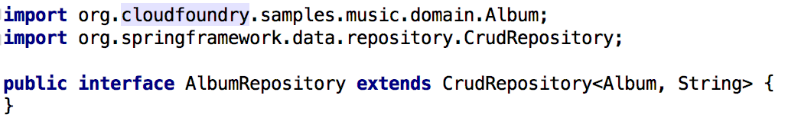
RedisRepository

Slide 10
Supported Repositories
Spring
JPA
MongoDB
Redis
Solr
GemFire
KeyValue
Community
Aerospike
Cassandra
Couchbase
DynamoDB
ElasticSearch
Neo4J

Slide 11

Lab

