Slide 1



Spring Data REST

Slide 2
Topics in this Session
Review Spring Data
Spring Data REST

Slide 3
Spring Data REST
Goal is to provide a solid foundation on which to expose CRUD repositories to your repository managed entities using plain HTTP REST semantics

Slide 4
Import the Required Dependency
Add the Spring Data REST started to the pom.xml
<dependency>
<groupId>org.springframework.boot</groupId>
<artifactId>spring-boot-starter-data-rest</artifactId>
</dependency>
Notes:
Maven is just one option. You can also use Gradle or Ant/Ivy

Slide 5
Exporting Repositories
For this repository, Spring Data REST exposes a collection resource at /orders
The path is derived from the uncapitalized, pluralized, simple class name of the domain class being managed
It also exposes an item resource for each of the items managed by the repository under the URI template /orders/{id}
Custom queries are exported to /search, e.g. /search/findByDate
public interface OrderRepository extends CrudRepository<Order, Long> {
List<Order> findByDate(@Param(“date”) Date date);
}

Slide 6
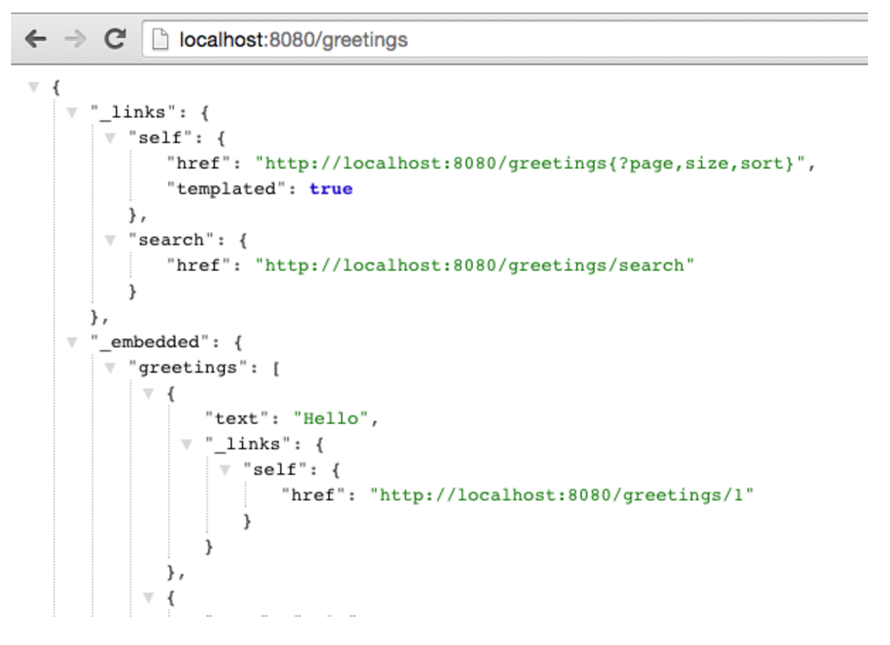
RESTful API

Slide 7
HATEOAS (Hypermedia as the engine of application state)
Provides information to navigate the REST interface dynamically by including hypermedia links with responses
Differs from SOA based systems and WSDL-driven interfaces, in that a separate fixed specification is distributed
HAL – Hypertext Application language

Slide 8

Lab

