Slide 1
BIG DATA ANALYTICS OF YOUTUBE DATASETS
DONE BY:
KAUSHIK M CB.EN.U4AIE19036
VIJAI SIMMON S CB.EN.U4AIE19068

Slide 2
TABLE OF CONTENTS
DIFFERENT FORMATS IN WHICH WE GET YOUTUBE DATASET
DATA ANALYSIS OF DATASET-TYPE 1 (BASED ON YOUTUBE CHANNELS)
ACTUAL DATASET(RAW DATASET)
THE DATASET TAKEN FOR ANALYSIS
IMPLEMENTATION AND OUTPUT IN APACHE SPARK
DATA ANALYSIS OF DATASET-TYPE 2 (BASED ON TRENDING VIDEOS IN INDIA)
ACTUAL DATASET(RAW DATASET)
THE DATASET TAKEN FOR ANALYSIS
IMPLEMENTATION AND OUTPUT IN APACHE SPARK

Slide 3
DATA ANALYSIS FOR -TYPE 1 (BASED ON YT CHANNELS)
THINGS WE WOULD LIKE TO ANALYSE:
Arranging the dataset in the ascending order of the Joining Date
The top 10 channels with most no. of videos
The 10 channels with least no. of videos
The 10 channels with most fan following
Analysing the dataset w.r.t a particular category
Analysis based on a specific Joining Date

Slide 4
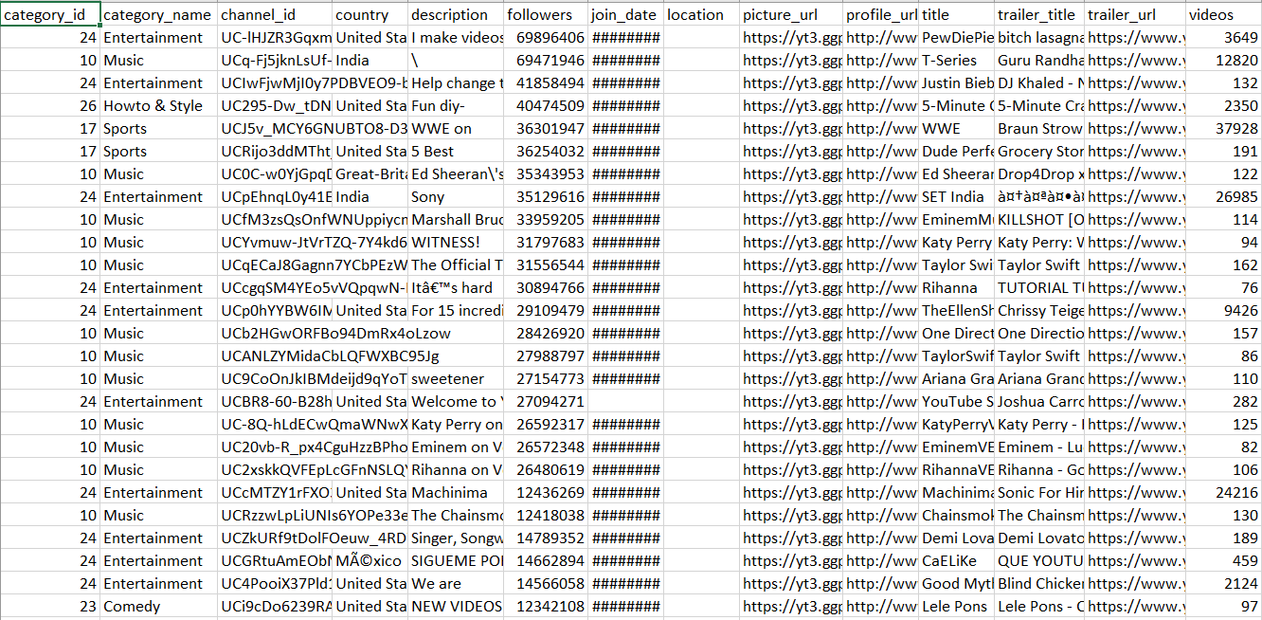
ACTUAL DATASET-TYPE 1 (BASED ON YT CHANNELS)

Slide 5
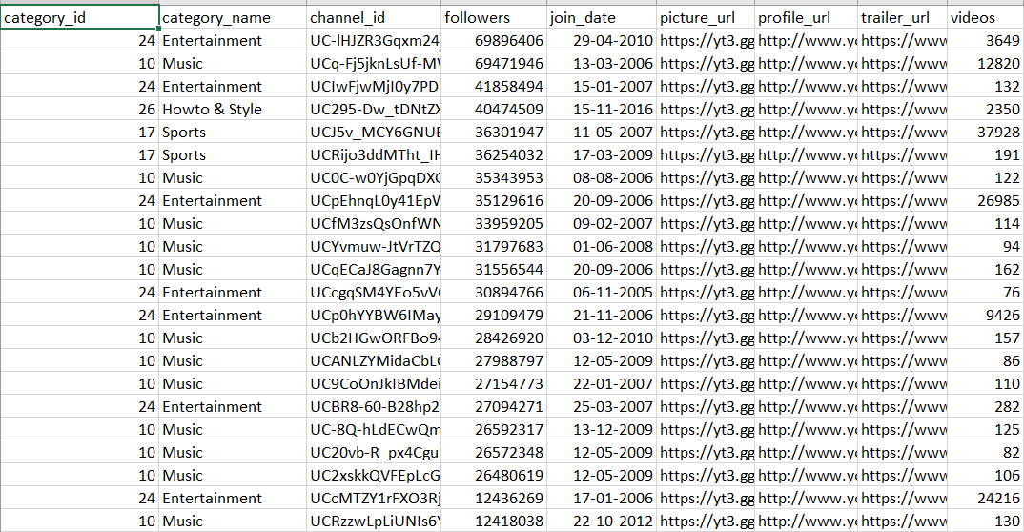
DATASET TAKEN FOR ANALYSIS-TYPE 1

Slide 6
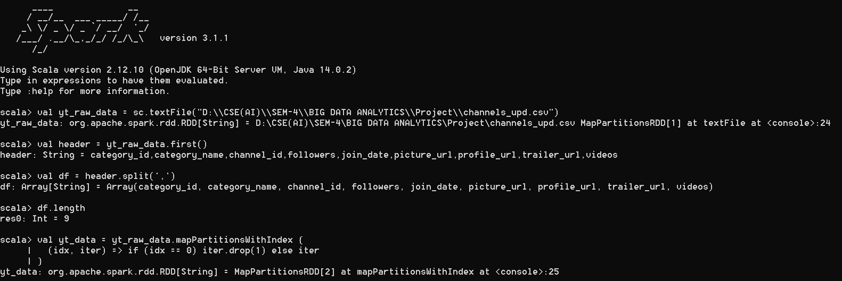
DATA ANALYSIS FOR -TYPE 1 (BASED ON YT CHANNELS)

Slide 7
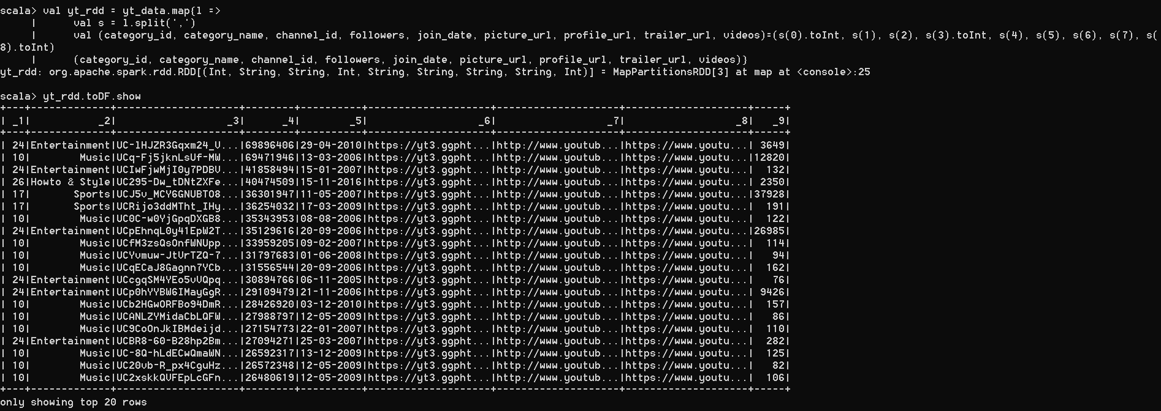
DATA ANALYSIS FOR -TYPE 1 (BASED ON YT CHANNELS)

Slide 8
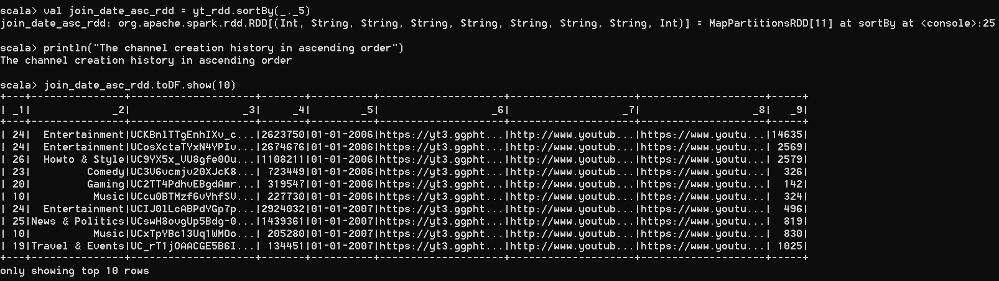
DATA ANALYSIS FOR -TYPE 1 (BASED ON YT CHANNELS)

Slide 9
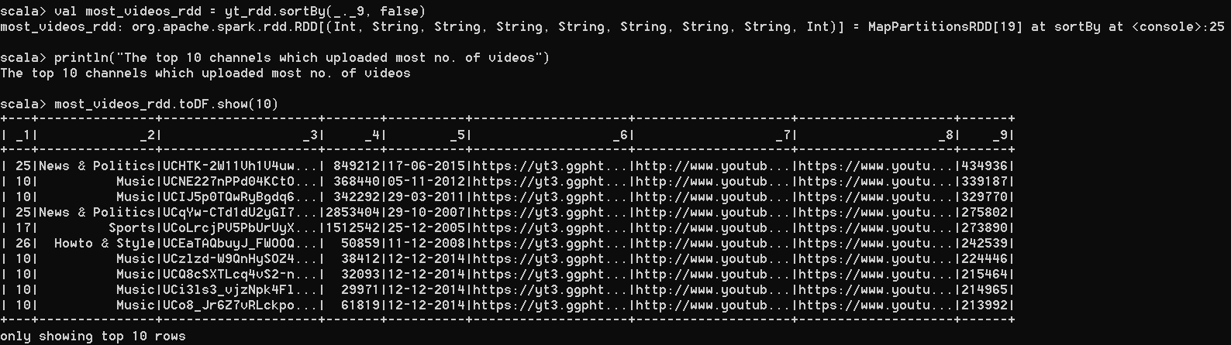
DATA ANALYSIS FOR -TYPE 1 (BASED ON YT CHANNELS)

Slide 10
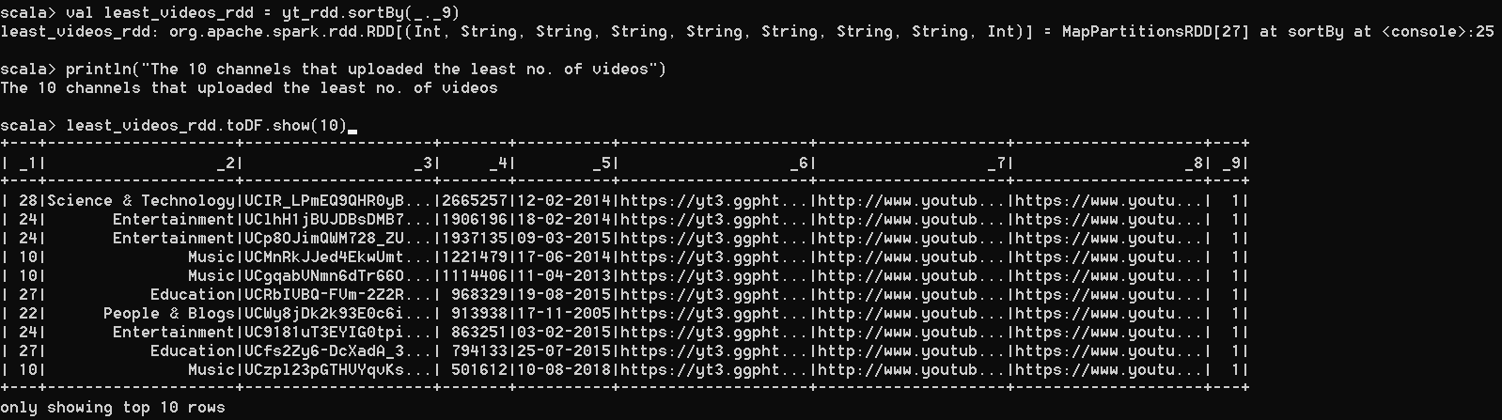
DATA ANALYSIS FOR -TYPE 1 (BASED ON YT CHANNELS)

Slide 11
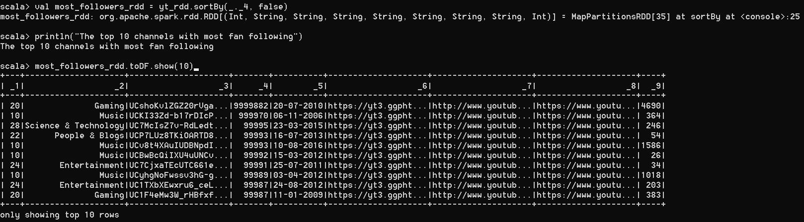
DATA ANALYSIS FOR -TYPE 1 (BASED ON YT CHANNELS)

Slide 12
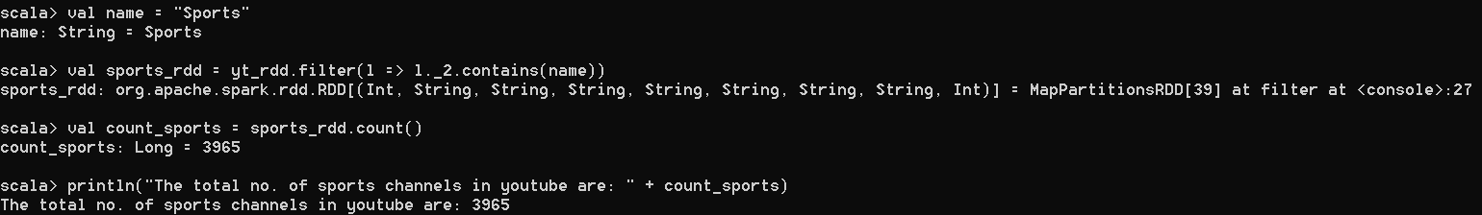
DATA ANALYSIS FOR -TYPE 1 (BASED ON YT CHANNELS)

Slide 13
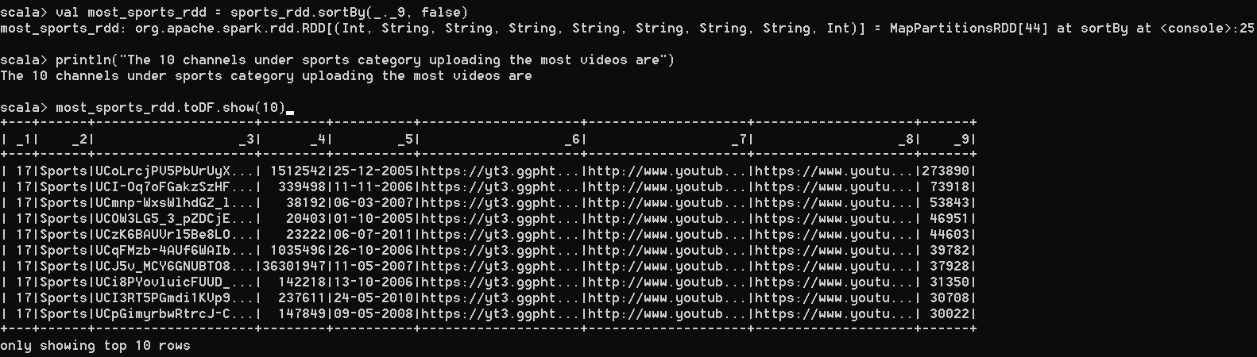
DATA ANALYSIS FOR -TYPE 1 (BASED ON YT CHANNELS)

Slide 14
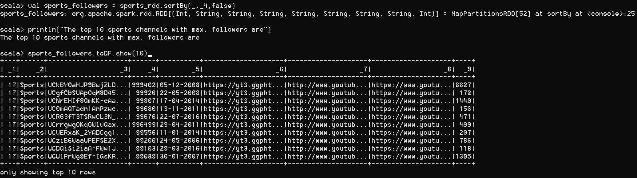
DATA ANALYSIS FOR -TYPE 1 (BASED ON YT CHANNELS)

Slide 15
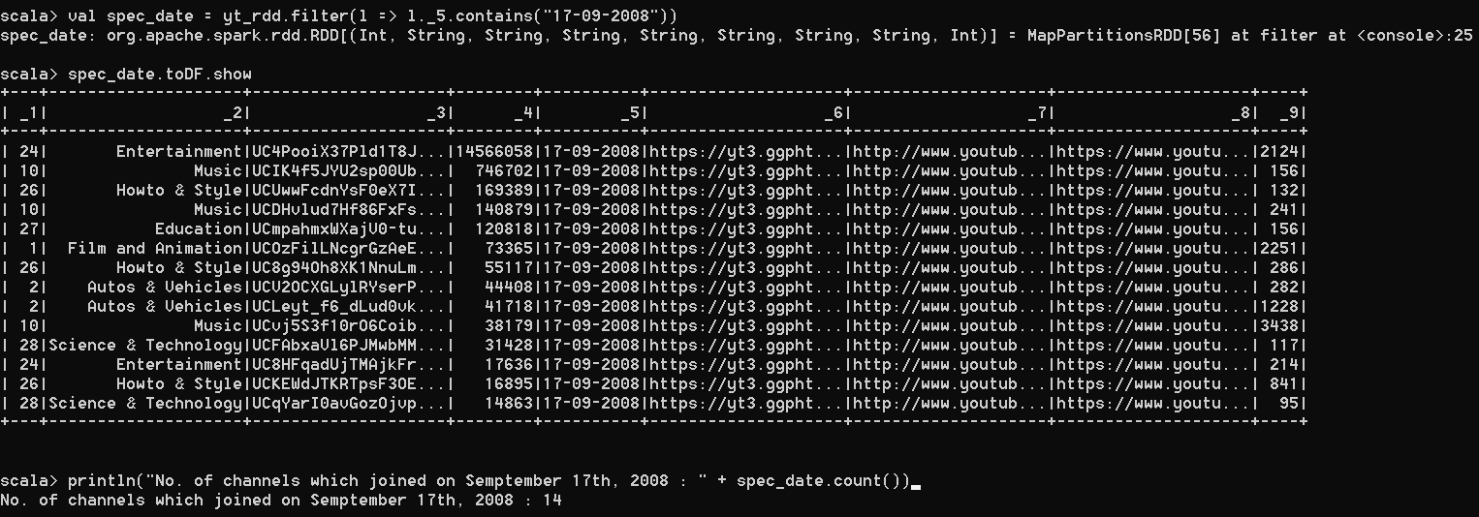
DATA ANALYSIS FOR -TYPE 1 (BASED ON YT CHANNELS)

Slide 16
DATA ANALYSIS FOR -TYPE 2 (BASED ON TRENDING VIDEOS)
THINGS WE WOULD LIKE TO ANALYSE:
The top 10 videos with most no. of likes
The 10 videos with least no. of likes
The top 10 videos with most no. of comments
The top 10 videos with most no. of views
Analysis based on a specific Trending Date
Adding additional parameters to find out the best video out of the set

Slide 17
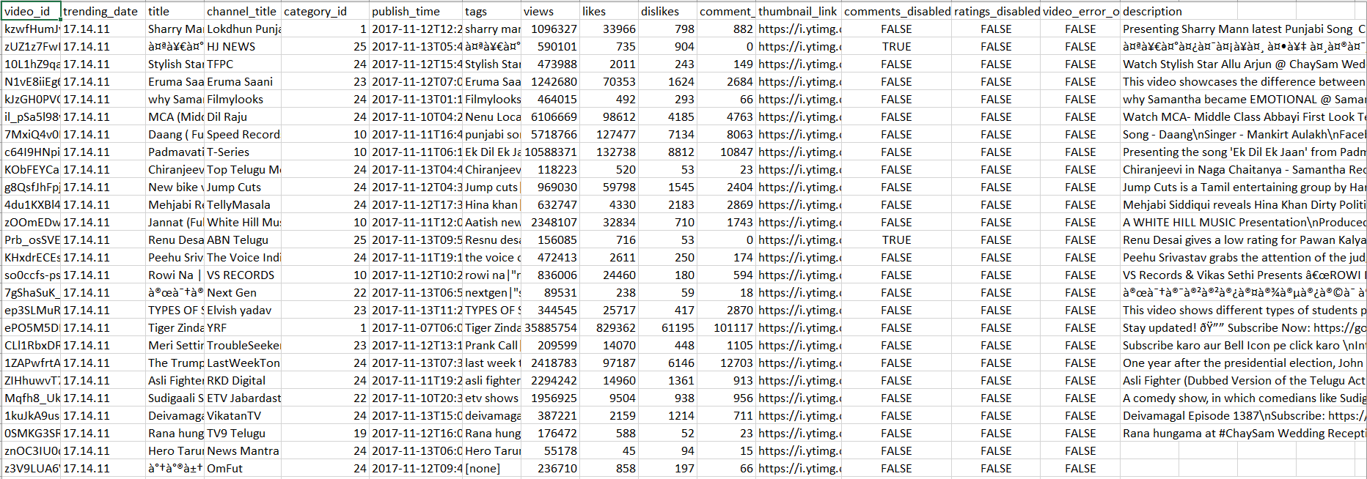
ACTUAL DATASET-TYPE 2 (BASED ON TRENDING VIDEOS)

Slide 18
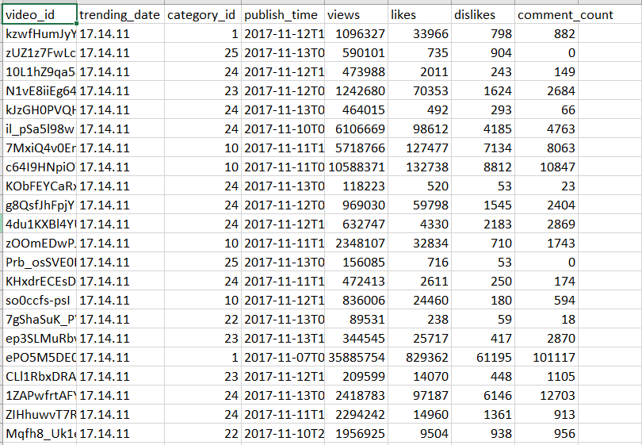
DATASET TAKEN FOR ANALYSIS-TYPE 2

Slide 19
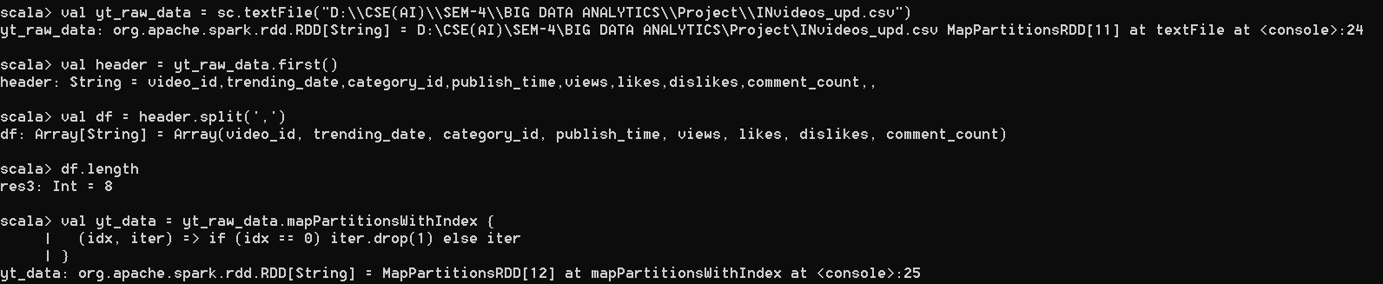
DATA ANALYSIS FOR -TYPE 2 (BASED ON TRENDING VIDEOS)

Slide 20
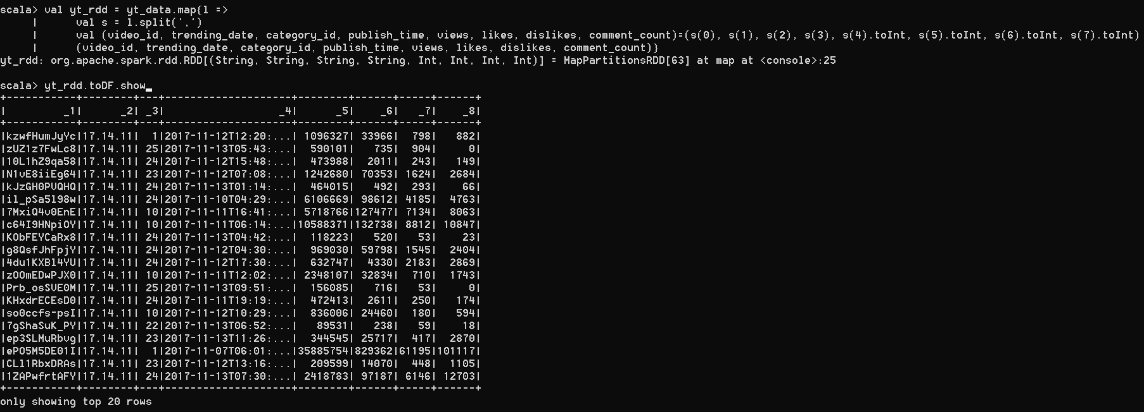
DATA ANALYSIS FOR -TYPE 2 (BASED ON TRENDING VIDEOS)

Slide 21
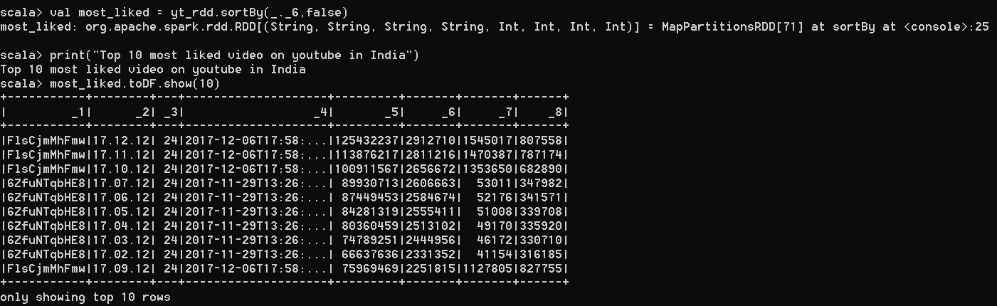
DATA ANALYSIS FOR -TYPE 2 (BASED ON TRENDING VIDEOS)

Slide 22
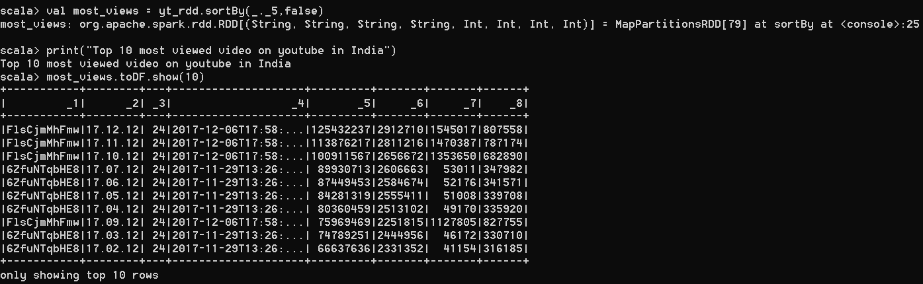
DATA ANALYSIS FOR -TYPE 2 (BASED ON TRENDING VIDEOS)

Slide 23
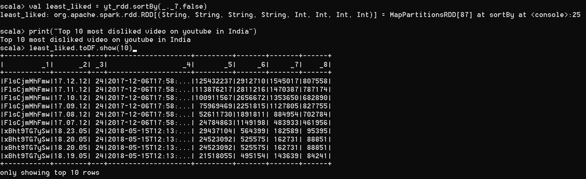
DATA ANALYSIS FOR -TYPE 2 (BASED ON TRENDING VIDEOS)

Slide 24
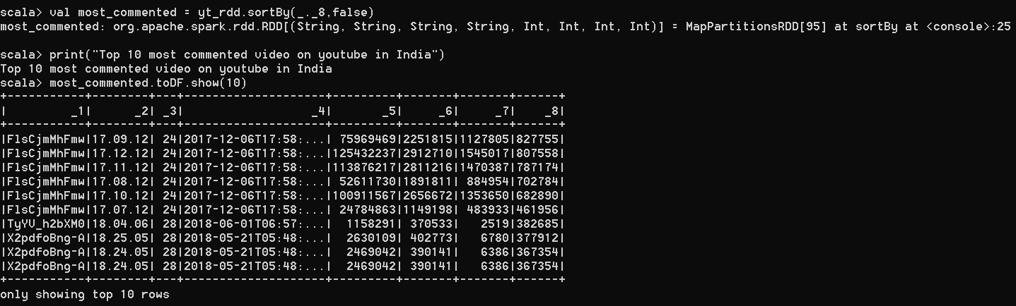
DATA ANALYSIS FOR -TYPE 2 (BASED ON TRENDING VIDEOS)

Slide 25
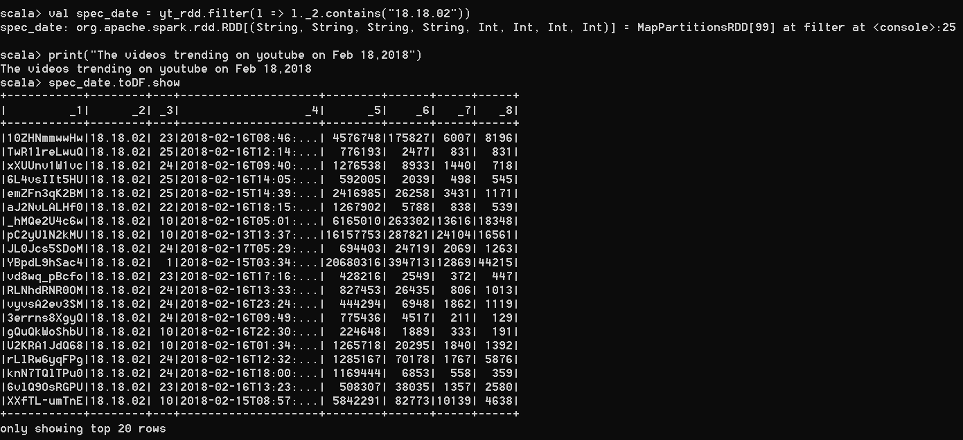
DATA ANALYSIS FOR -TYPE 2 (BASED ON TRENDING VIDEOS)

Slide 26
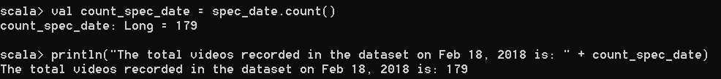
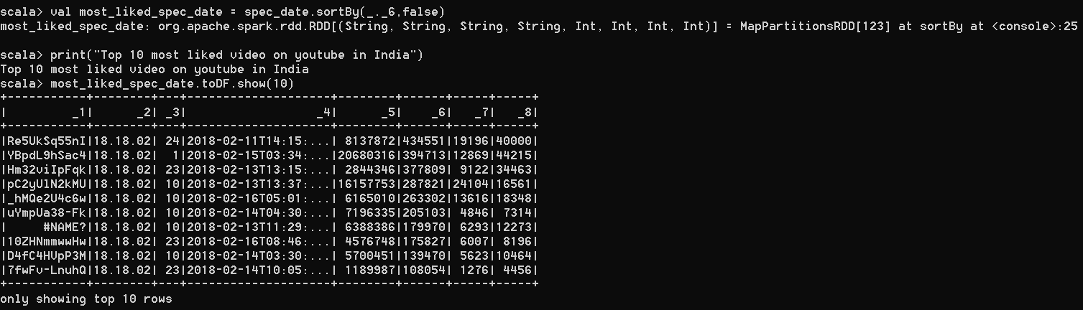
DATA ANALYSIS FOR -TYPE 2 (BASED ON TRENDING VIDEOS)

Slide 27
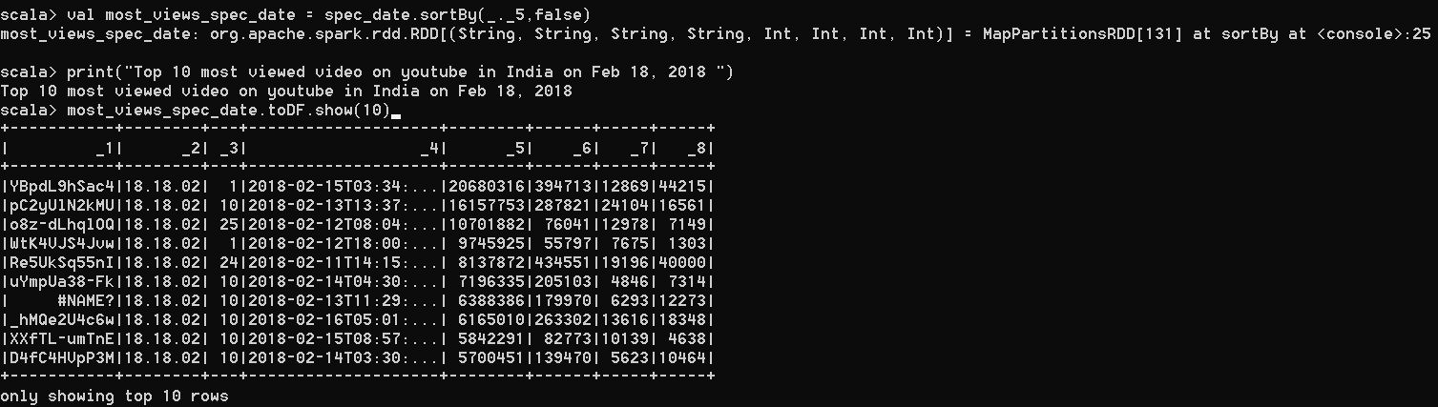
DATA ANALYSIS FOR -TYPE 2 (BASED ON TRENDING VIDEOS)

Slide 28
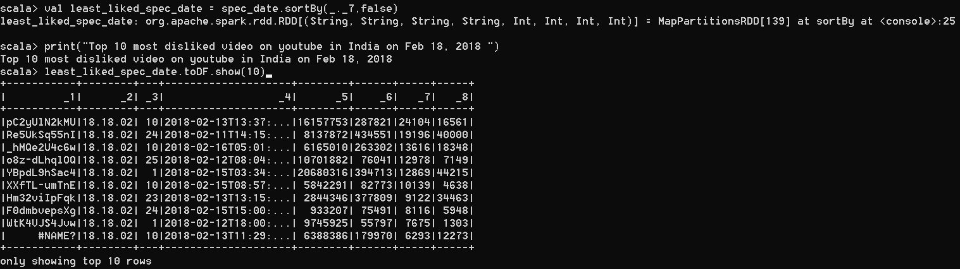
DATA ANALYSIS FOR -TYPE 2 (BASED ON TRENDING VIDEOS)

Slide 29
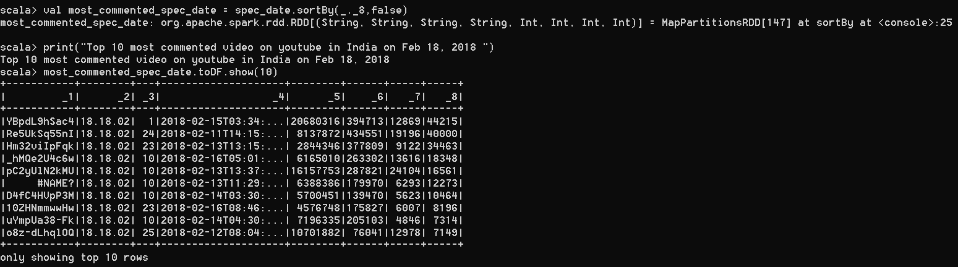
DATA ANALYSIS FOR -TYPE 2 (BASED ON TRENDING VIDEOS)

Slide 30
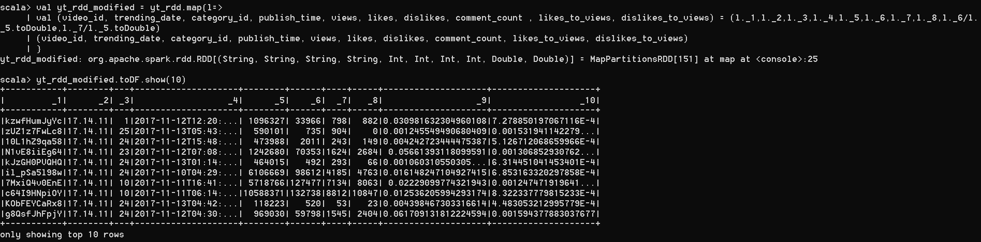
DATA ANALYSIS FOR -TYPE 2 (BASED ON TRENDING VIDEOS)

Slide 31
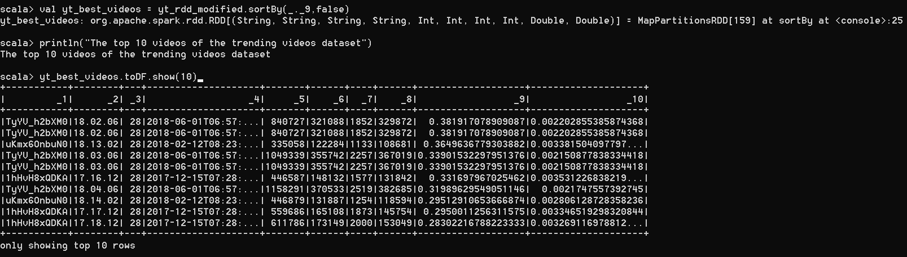
DATA ANALYSIS FOR -TYPE 2 (BASED ON TRENDING VIDEOS)

Slide 32
THANK YOU ……

