Slide 1
Data Structures and Algorithms (Huffman Algorithm) Team-7
Done by:
1)Karthik CB.EN.U4AIE19020
2)Kaushik M CB.EN.U4AIE19036
3)Prasanth S N CB.EN.U4AIE19046
4)Shankar P CB.EN.U4AIE19049
5)Vijai Simmon S CB.EN.U4AIE19068

Slide 2
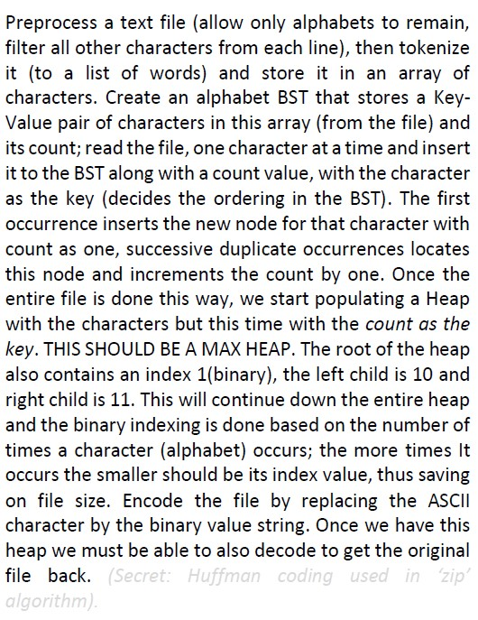
Problem

Slide 3
Work Breakdown
Karthik – Output file (Encoding in a file) and Main Class
Kaushik – Encoding and Decoding
Prasanth – Heap and Queue
Shankar – Tree Node
Vijai Simmon – Huffman Class Constructor and frequency calculation

Slide 4
Huffman Coding
It is a technique of compressing data to reduce its size without losing any of the details. It was first developed by David Huffman.
It uses character frequency to achieve this objective
Properties:
It is block code
It is instantaneous
It is uniquely decodable
Optimal Code

Slide 5
How Huffman Coding Works
Huffman coding first creates a tree using the frequencies of the character and then generates code for each character.
Once the data is encoded, it has to be decoded. Decoding is done using the same tree.
Huffman Coding prevents any ambiguity in the decoding process using the concept of prefix code i.e. a code associated with a character should not be present in the prefix of any other code. The tree created above helps in maintaining the property.

Slide 6

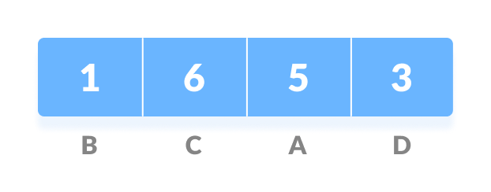
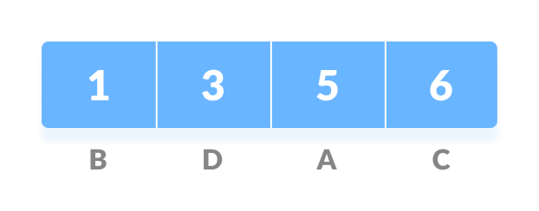
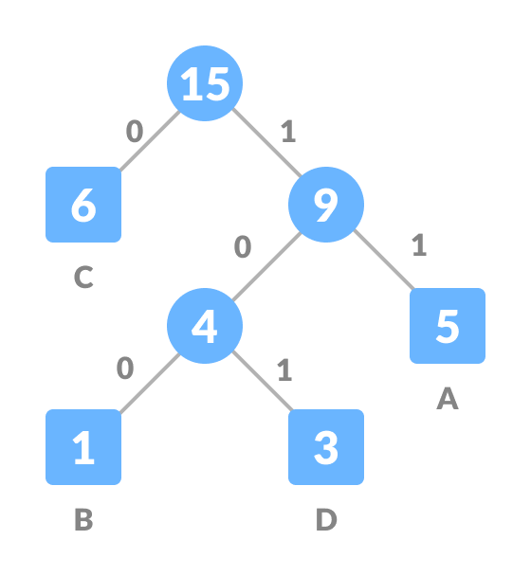
Huffman Algorithm – Pictorial Representation
Initial String
Frequency of characters
Sorted Based on the frequency
Joining each of the individual leaf nodes

Slide 7
Character | Frequency | Code | Size
A | 5 | 11 | 5*2 = 10
B | 1 | 100 | 1*3 = 3
C | 6 | 0 | 6*1 = 6
D | 3 | 101 | 3*3 = 9
 | Total bits = 15*8 = 120 bits |  | 28 bits

Slide 8
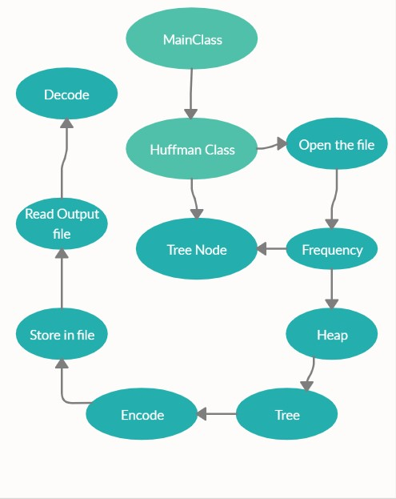
THE WORKFLOW DIAGRAM

Slide 9
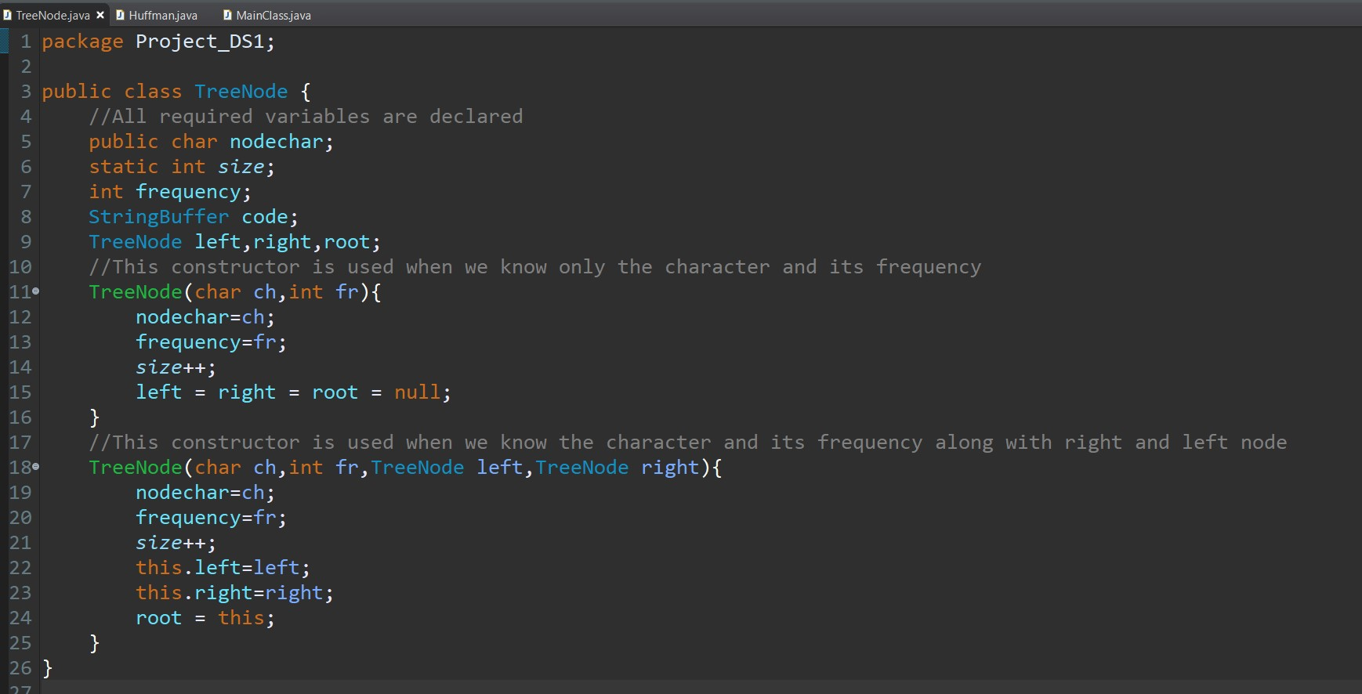
Huffman Algorithm – Implementation (TreeNode)

Slide 10
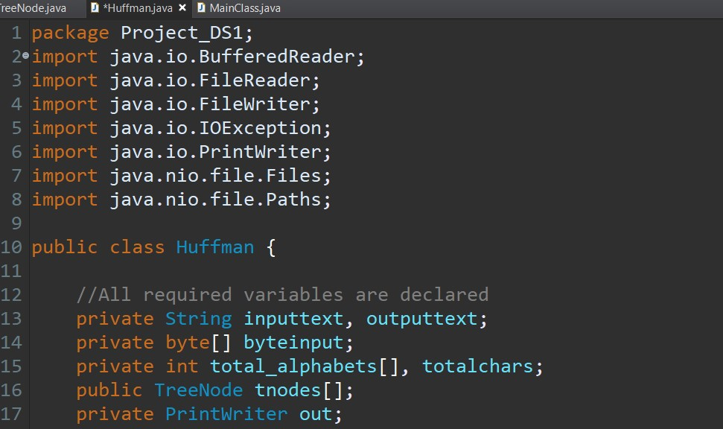
Huffman Algorithm (Huffman Class)

Slide 11
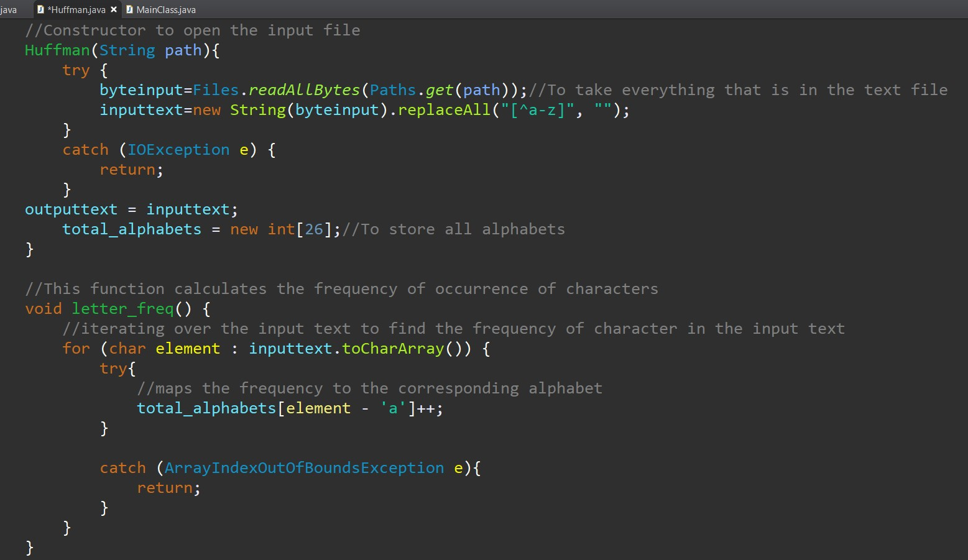

Slide 12
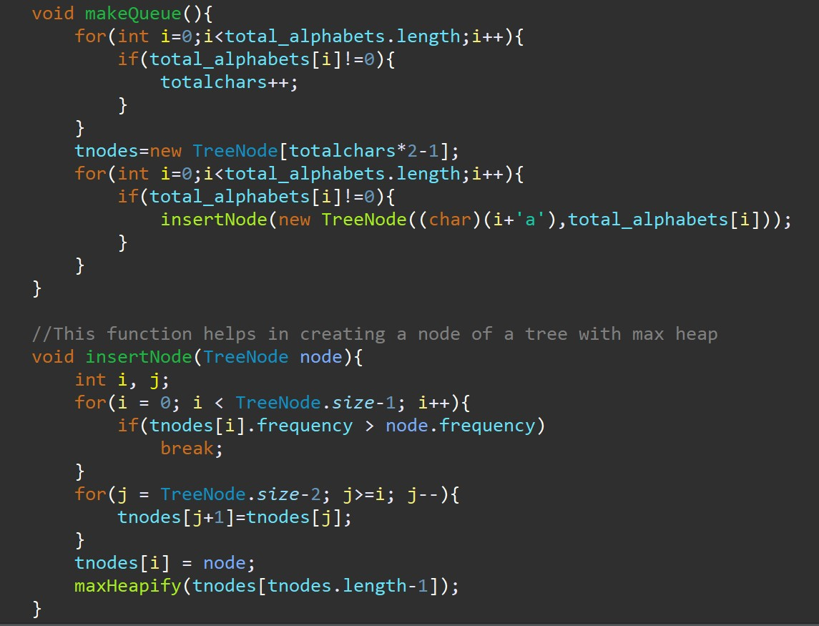

Slide 13
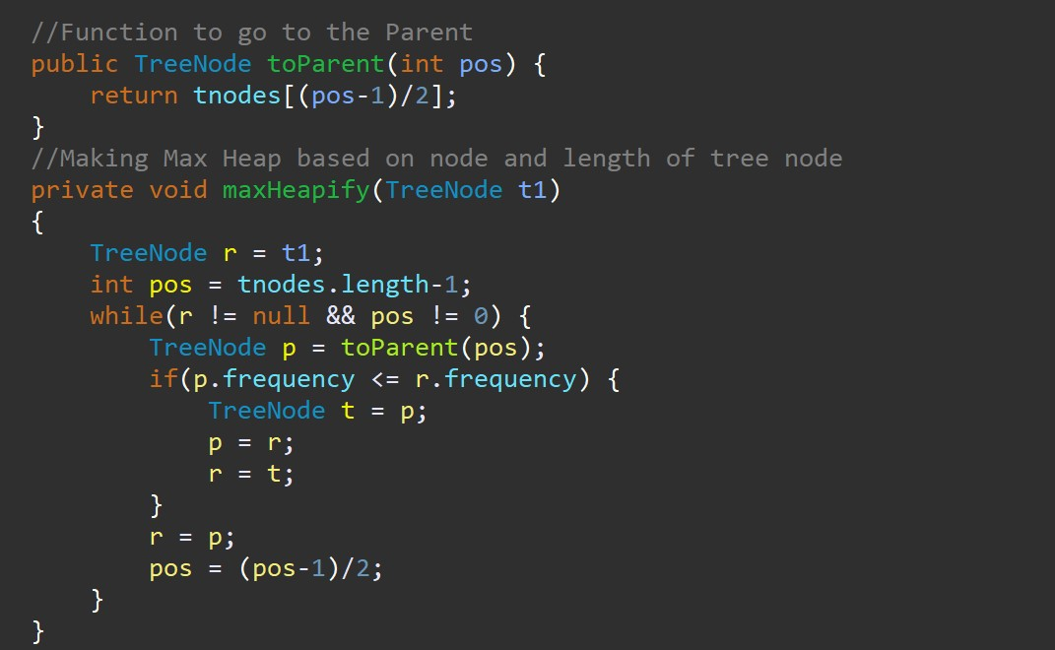

Slide 14
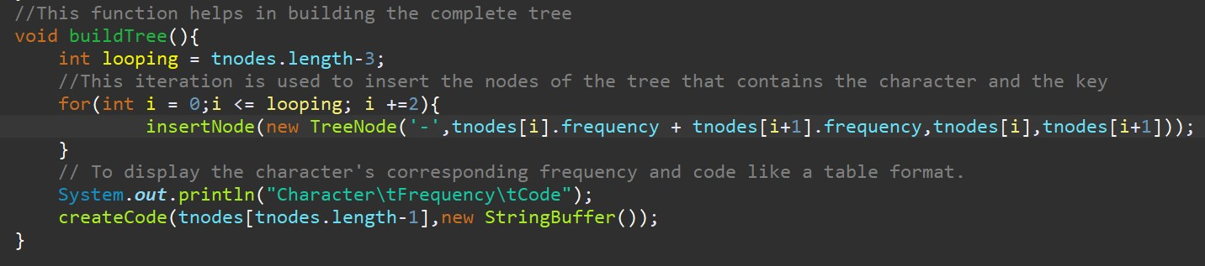

Slide 15
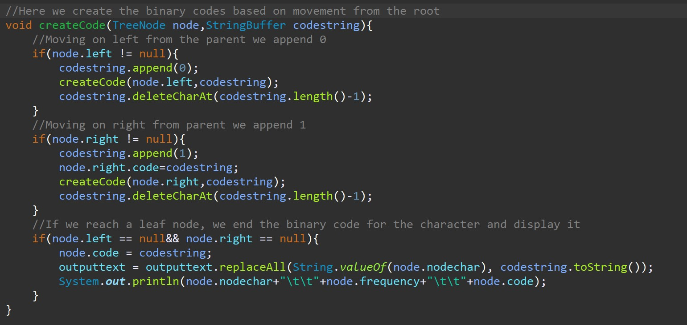

Slide 16
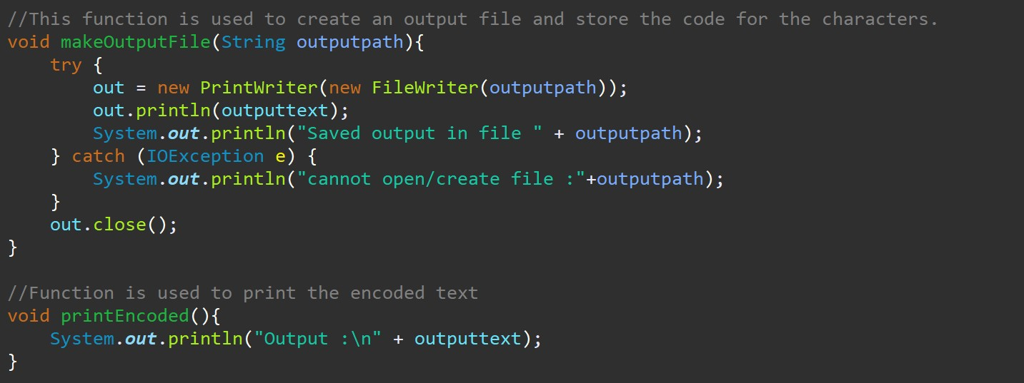

Slide 17
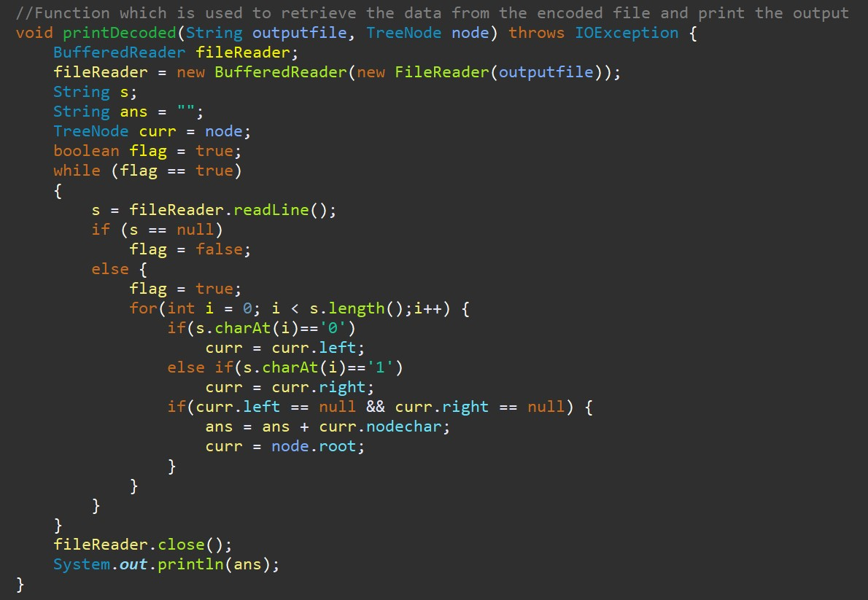

Slide 18
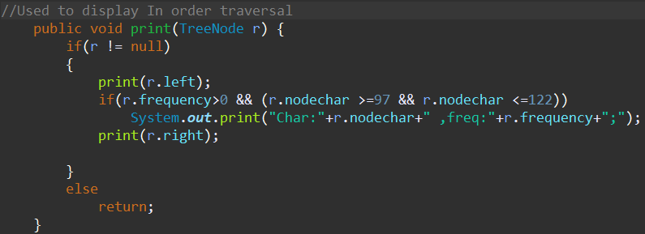

Slide 19
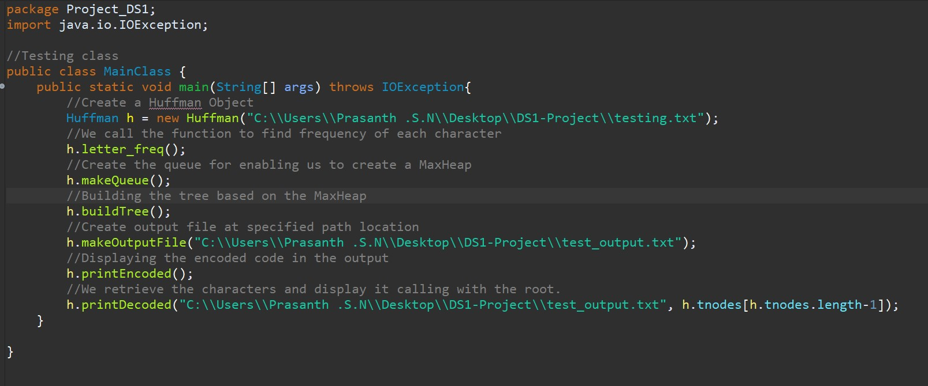
Main Class

Slide 20

Sample Input

Slide 21
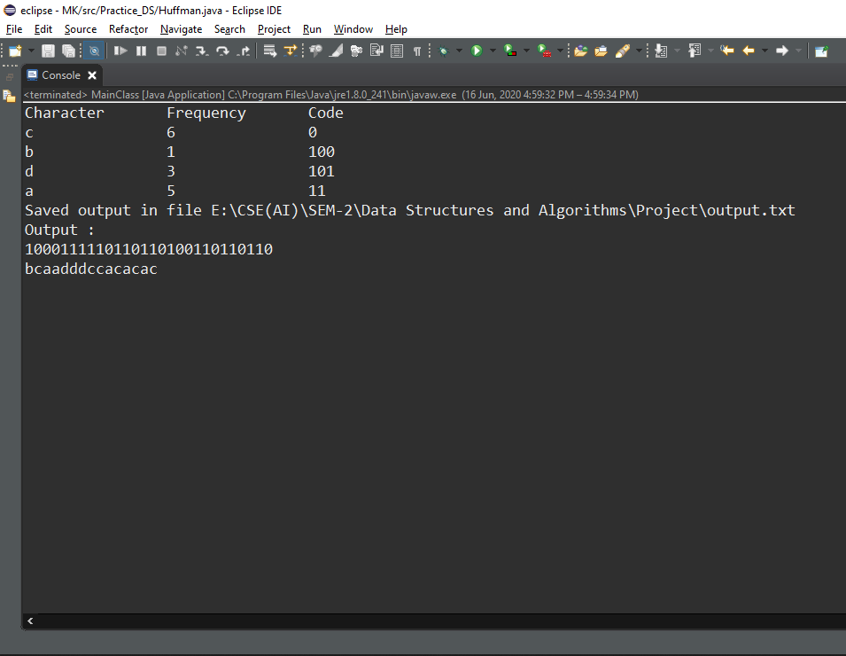
Output - Console

Slide 22
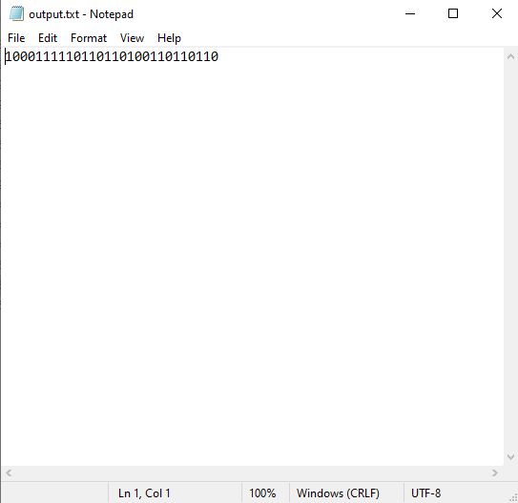
Output – Text (Encoded File)

Slide 23
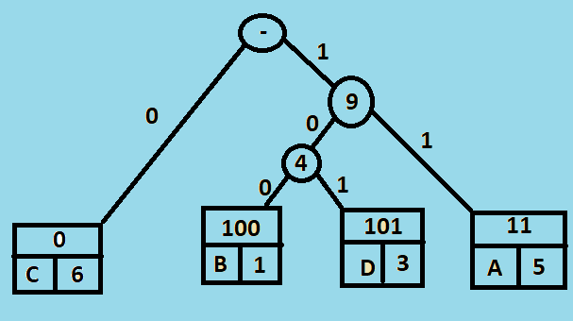
THE TREE FINAL STRUCTURE

Slide 24
Advantages and Disadvantages
Advantages
Algorithm is easy to implement
Produce a lossless compression.
Disadvantages
When a large number of symbols are to be coded, construction of Huffman code becomes very difficult
Slower technique

Slide 25
Thank you…

