Slide 1
REAL ESTATE
WEB-SCRAPING
Kaushik Murali
KXM230003
May 4, 2024

Slide 2
TABLE OF CONTENTS
1
3
PROJECT OVERVIEW
PROJECT WORKFLOW
2
4
REAL ESTATE - DATA
PROJECT DRAWBACKS
5
PROJECT DEMO

Slide 3
PROJECT OVERVIEW
1

Slide 4
PROJECT OVERVIEW
Automate data extraction from real estate websites for property listings, prices, locations, and descriptions.
Compile comprehensive databases including links for photos.
Streamline process for Real Estate brokers to automate extraction and handling the customers.
Access up-to-date information from specified source.
Save time and ensure accuracy with automated extraction for seamless integration with automated Email and WhatsApp.

Slide 5
REAL ESTATE DATA
2

Slide 6
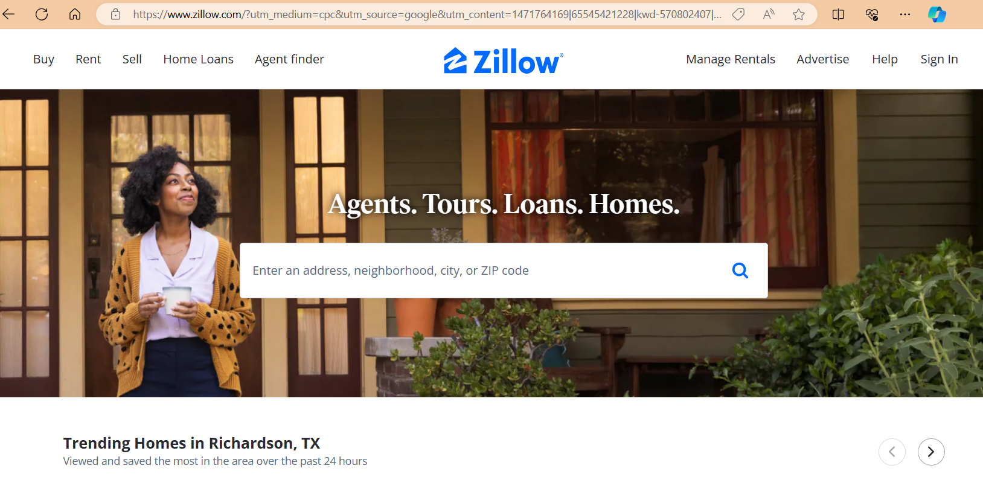
REAL ESTATE - DATA

Slide 7
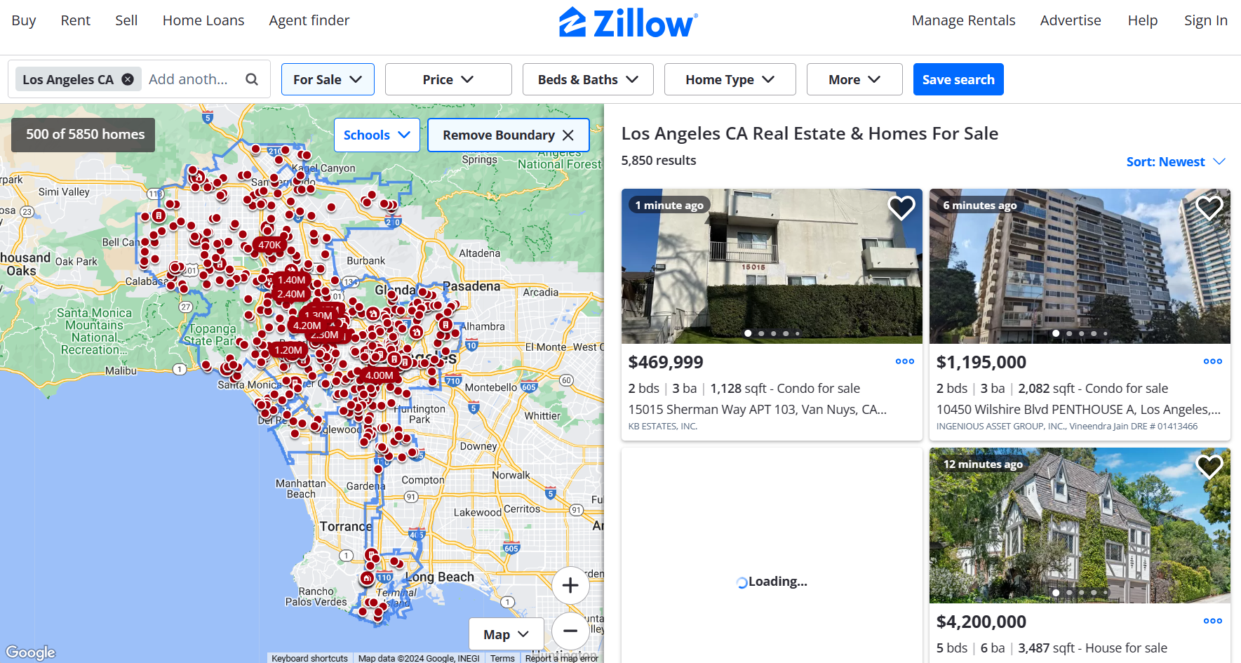
REAL ESTATE - DATA

Slide 8
PROJECT WORKFLOW
3

Slide 9
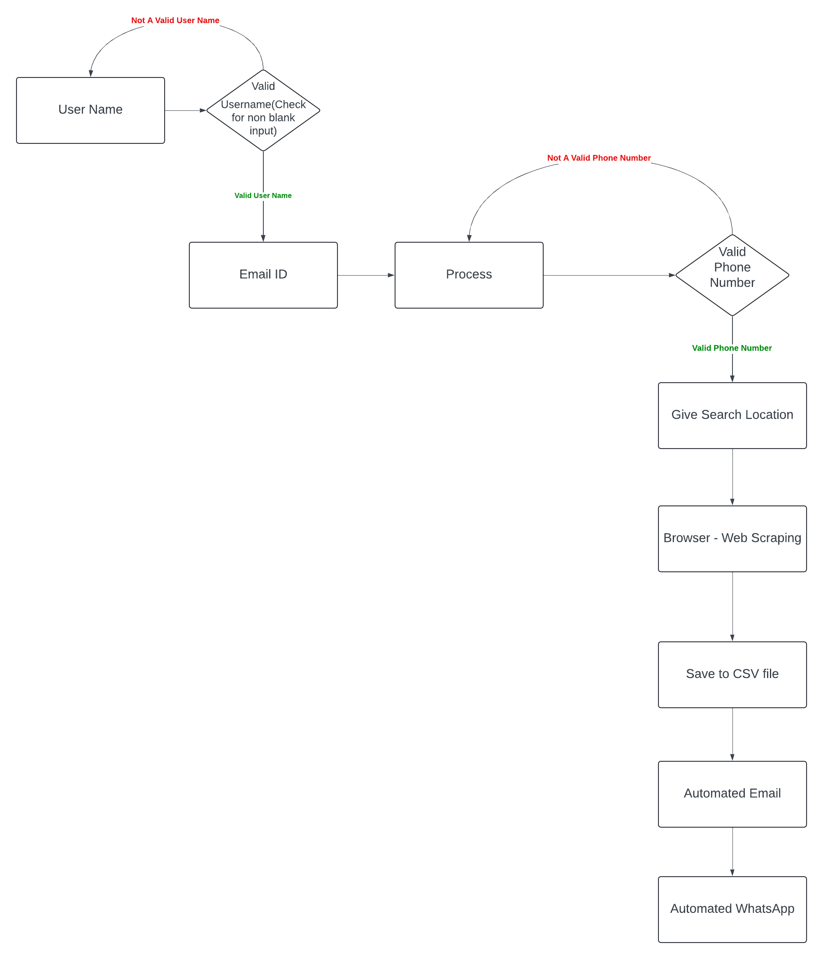
PROJECT WORKFLOW

Slide 10
PROJECT DRAWBACKS
4

Slide 11
PROJECT DRAWBACKS
User Name input and Valid place input test is only done for blank input. Example: If I give User Name as ‘X’, it will still login to next step.
WhatsApp automation works only for US numbers. (I believe it works only if I have your number saved!).
This model works with only Zillow website. If we want to check for other website, the user has to change the website in the model.

Slide 12
PROJECT DEMO
5

Slide 13
THANK YOU !!!!!

