Slide 1

Econosage | smarter finance, anywhere – ask. Calculate. Learn.
Your multilingual ai tutor for finance & economics by: Kaushik murali

Slide 2
Why EconoSage?
🌍 Finance is complex & often English-only
🤯 Theory ≠ Calculation ≠ Real-world data
🎯 EconoSage brings it all together — smart answers, real-time numbers, any language

Slide 3
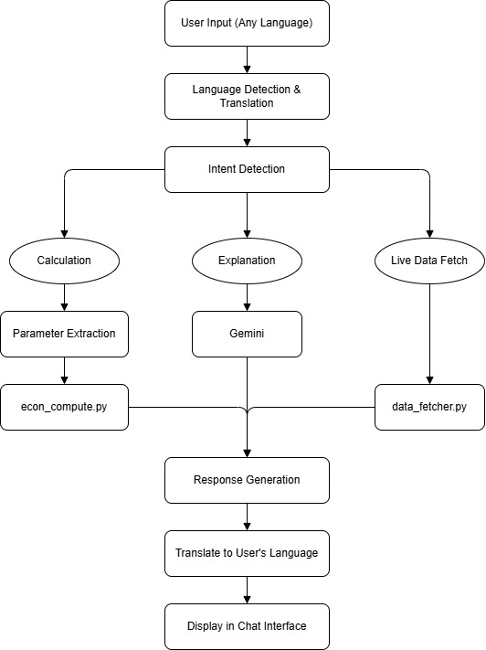
How it Works?

