Slide 1

Lab05- RAG(Retrieval-Augmented Generation)

Slide 2
About RAG(Retrieval-Augmented Generation)
What's RAG?
RAG is like having a well-read friend who loves to show off their knowledge:
Retrieval: First, it digs through its library of facts (or your database) to find just the right tidbit related to your question.
Generation: Then, it turns those facts into a smooth, engaging response, much like crafting a perfect text message.
Code Overview
Data Prep: Imagine loading your friend's brain with all sorts of books (i.e., data).
Retrieval Function: Ask a question and watch as it pulls relevant facts faster than a student cramming for exams.
Generation Function: It then chats back with an answer that’s not just correct but also sounds like it came from a wise old sage.
Example in Action
Ask, "What went down in 1066?" and RAG zips through its mental library, pulls out the best bits about the Battle of Hastings, and lays down the story like it's gossiping about old English royalty.
This way, RAG combines the speed of the best quiz team with the flair of a seasoned storyteller, making it not just smart but also delightfully eloquent!

Slide 3
Demo-01 Installation
Install Ollama from the website
ollama run llama3.2 - /bye
ollama pull hf.co/CompendiumLabs/bge-base-en-v1.5-gguf
ollama pull hf.co/bartowski/Llama-3.2-1B-Instruct-GGUF
Open your – jupyter notebook - jupyter lab
Intsall in jupyter notebook - !pip install ollama numpy

Slide 4
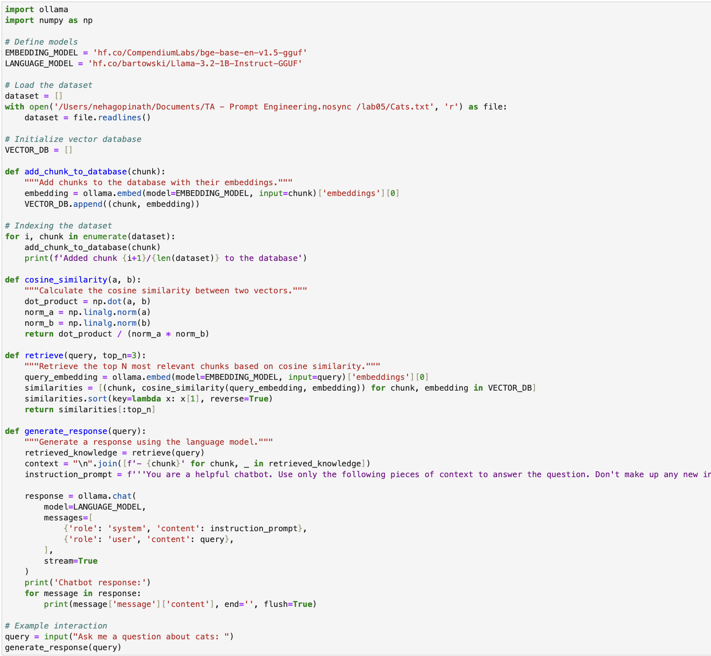
Demo-01
This Python script utilizes the Ollama platform to create a semantic search and response system focused on a dataset about cats. Here's a breakdown of its main components:
Import Modules: The script imports the ollama library for model interactions and numpy for numerical operations.
Define Models: It specifies two models from the Hugging Face platform:
  EMBEDDING_MODEL for generating vector embeddings of text.
  LANGUAGE_MODEL for generating language-based responses.
Load Dataset: The script reads a file containing text about cats into a list called dataset.
Vector Database Initialization: An empty list VECTOR_DB is set up to store text chunks alongside their embeddings.
Indexing Function: add_chunk_to_database embeds each chunk of text from the dataset using the embedding model and stores it in VECTOR_DB.
Cosine Similarity Function: This calculates the similarity between two vectors, used to find the most relevant text chunks in response to a query.
Retrieval Function: retrieve embeds a query and computes its cosine similarity with all embeddings in the database to find the top N relevant chunks.
Response Generation Function: generate_response uses the retrieved chunks as context to generate a natural language response to the query using the language model. It prints out this response.
Example Interaction: The script prompts the user for a query about cats and uses the generated response function to provide an answer.

Slide 5
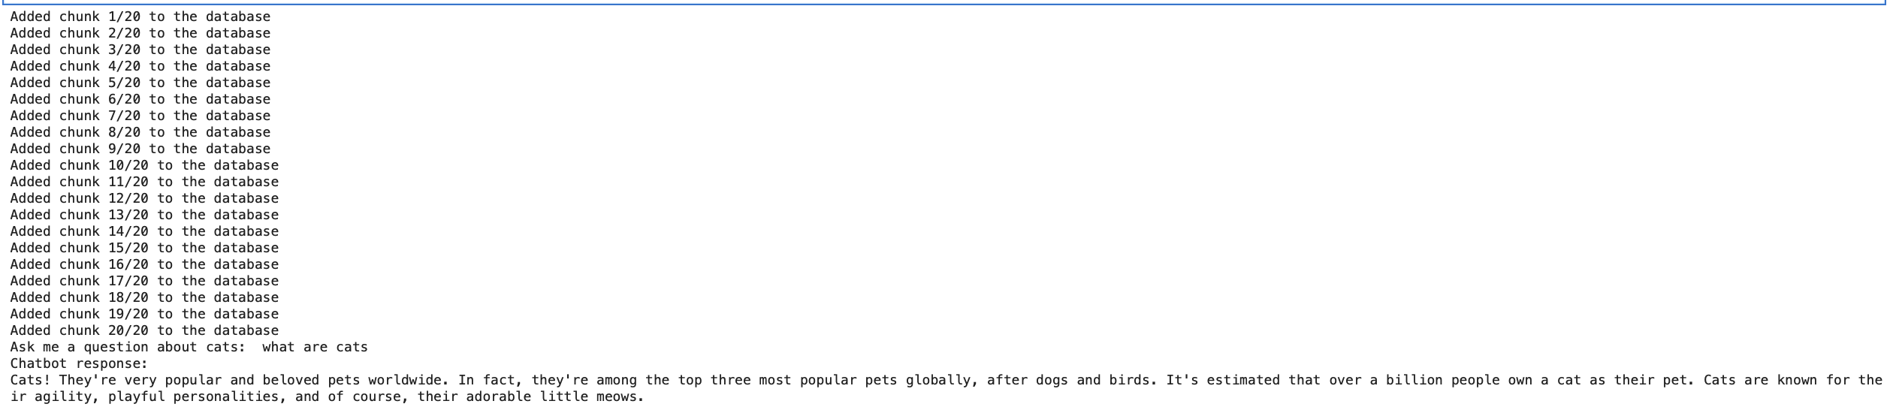
Demo-01 Output

Slide 6
Demo-02 installations
The !pip install commands upgrade and install the necessary Python packages to ensure that all dependencies required by the script are met.
numpy, scipy, scikit-learn, pandas: These are fundamental libraries for numerical computing and data handling in Python, used across various data manipulation and machine learning tasks.
transformers, sentence-transformers: These libraries provide access to pre-trained models like BERT and tools for text processing and embedding generation.
torch, faiss-cpu: PyTorch is a deep learning framework, and FAISS is used for efficient similarity searches in large databases. faiss-cpu specifies installation for systems without GPU support.
openai: The OpenAI Python client library, used to interact with OpenAI’s API for tasks like chat completions.
ipywidgets, jupyter: These enhance Jupyter notebooks with interactive widgets.
tf-keras: TensorFlow's implementation of Keras, a high-level neural networks API, used for various machine learning tasks.
!pip install --upgrade "numpy<2"
!pip install --upgrade scipy
!pip install --upgrade scikit-learn # Corrected from 'sklearn' to 'scikit-learn'
!pip install --upgrade pandas # If you use pandas
!pip install --upgrade transformers
!pip install --upgrade sentence-transformers
!pip install torch transformers sentence-transformers faiss-cpu openai
!pip install openai==0.28
pip install --upgrade pip
!pip install --upgrade jupyter ipywidgets
!jupyter nbextension enable --py widgetsnbextension
pip install tf-keras

Slide 7
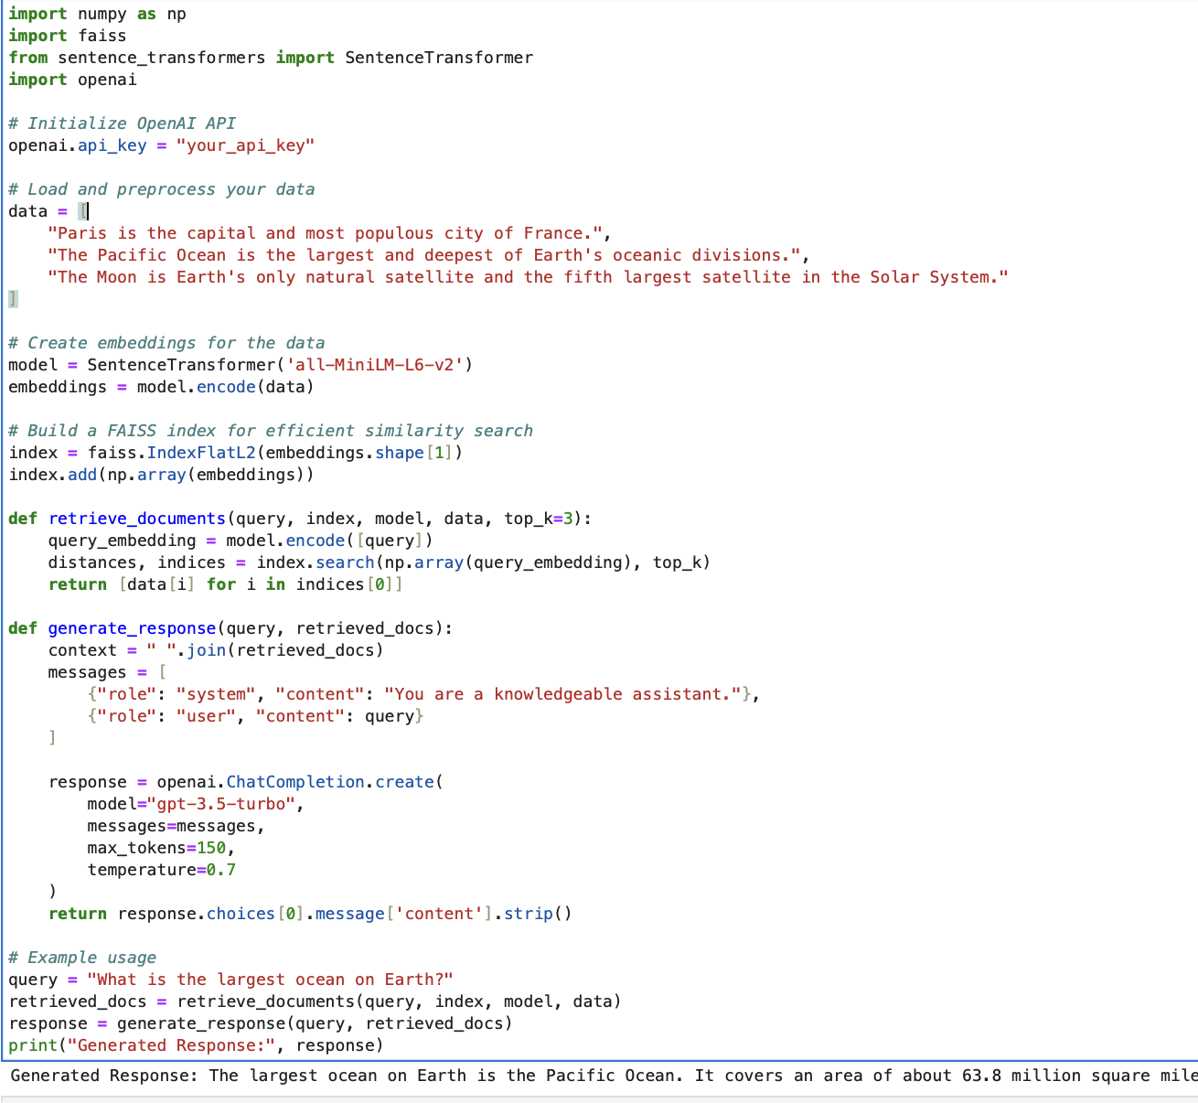
Demo-02
Import Libraries: The code imports essential libraries like numpy, faiss (a library for efficient similarity search), SentenceTransformer (for generating text embeddings), and openai (for accessing OpenAI's API).
Set Up OpenAI API: The openai.api_key is initialized with your provided API key, allowing the script to make authenticated requests to OpenAI's services.
Data Preparation: A list of sentences is prepared as the dataset for the application.
Create Embeddings: The SentenceTransformer model is used to convert the textual data into vector embeddings that capture the semantic meaning of each sentence.
Build a FAISS Index: A FAISS index is constructed to enable fast retrieval of documents (sentences) that are semantically close to a given query. This is crucial for efficiency in real-time applications.
Document Retrieval Function: retrieve_documents takes a query, encodes it, and uses the FAISS index to find the top k closest documents based on the query embedding.
Generate Response Function: generate_response crafts a context by concatenating retrieved documents and sends this context along with the query to OpenAI's model (e.g., GPT-3.5-turbo) to generate an appropriate response.
Example Usage: The script demonstrates how to use these functions to find information about the largest ocean on Earth and generate a response based on retrieved documents.

Slide 8
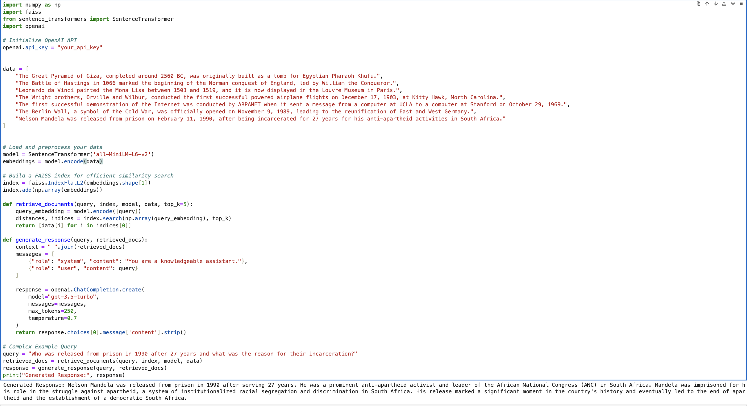
Demo-03
Library Imports: The code imports numpy, faiss, sentence_transformers, and openai, which are essential for numerical operations, efficient similarity search, sentence embedding, and interacting with OpenAI’s API, respectively.
OpenAI API Initialization: Sets the OpenAI API key, enabling authenticated requests to OpenAI’s models.
Data Preparation: A list of historical facts is defined, providing the dataset for the script.
Embedding Creation:
Uses the SentenceTransformer to transform the textual data into numerical vectors that semantically represent each sentence.
The chosen model, all-MiniLM-L6-v2, is a compact and efficient transformer model suitable for generating embeddings.
FAISS Index Construction:
Constructs an index with FAISS (IndexFlatL2), which is a basic flat index suitable for small to medium datasets. It uses L2 distance (Euclidean distance) to compute similarities between vectors.
The embeddings are added to the index to facilitate quick vector similarity searches.
Document Retrieval Function:
retrieve_documents processes a user query to find the top k documents that are most semantically similar to the query.
It encodes the query into an embedding and uses the FAISS index to retrieve indices of the closest document embeddings.
Returns the actual text of the top k closest documents.
Response Generation Function:
generate_response takes the retrieved documents, forms a context string, and constructs a conversational setup where the system is a knowledgeable assistant.
This setup, along with the user's query, is fed to OpenAI’s GPT-3.5-turbo model, which generates a conversational response that utilizes the provided context.
The response is designed to be coherent and contextually relevant, grounded in the facts retrieved from the FAISS index.
Example Interaction:
A complex query about Nelson Mandela’s release from prison is used to demonstrate the script.
The retrieve_documents function retrieves relevant context from the data, and generate_response generates a response which is then printed.

Slide 9
Demo-03
Set Query: The question is set in the query variable.
Retrieve Documents: The retrieve_documents function finds the most semantically similar documents from a predefined dataset based on the query.
Generate Response: The generate_response function uses the retrieved documents to generate a contextually informed response using OpenAI's model.
Output: The response is printed, providing an answer to the question based on historical data and semantic search.

Slide 10

Thank you!

