Slide 1
ECON M 524- FINANCIAL ECONOMETRICS FINAL PROJECT
Forecasting SENSEX Stock using ARIMA model
By KAUSHIK PARVATHANENI
Data Science Graduate Student
Indiana University Bloomington

Slide 2
Research Question:
- Forecasting the future SENSEX stock using ARIMA models.
-Used various ARIMA models to check which combination works best.

Slide 3
Introduction:
-The term Sensex(Stock Exchange Sensitive Index) refers to the benchmark index of the BSE in India.
- The Sensex is comprised of 30 of the largest and most actively traded stocks on the BSE and provides a gauge of India's economy.
- It is float-adjusted and market capitalization-weighted.
-The companies that make up the Sensex are drawn from the Bombay Stock Exchange, which is the largest in India and one of the largest stock exchanges in the world.
- Many investors throughout the world use the Sensex as a barometer of the overall state of the Indian economy, which has grown substantially in recent decades.

Slide 4
Data Description:
- It contains 5 columns and 2557 rows in total.
- Date-from 4/1/12 to 29/4/22
- Open-How much is the SENSEX value opened when the market opened.
- High-The highest SENSEX value reached during the market hours on that day.
- Low-The least SENSEX value reached on that day.
- Close-The SENSEX value when the market closed.

Slide 5
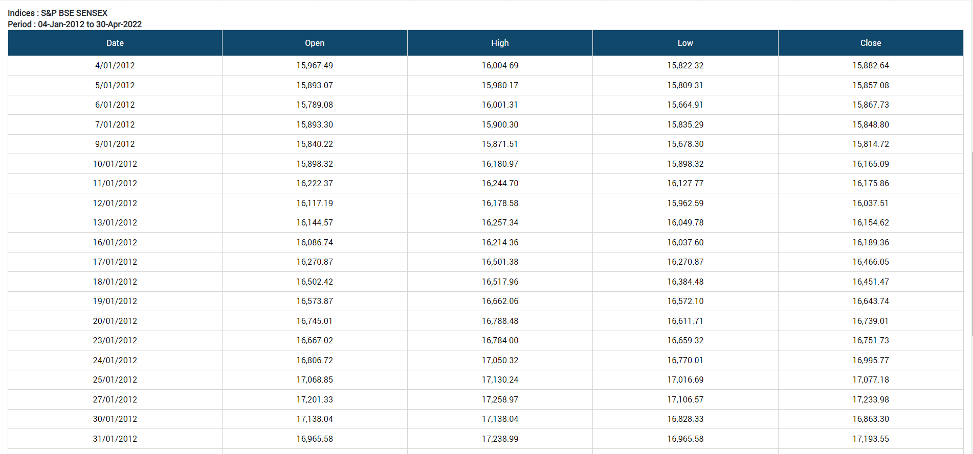
Data Source:
-https://www.bseindia.com/Indices/IndexArchiveData.html

Slide 6
Research Method: ARIMA - Autoregressive Integrated Moving Average -ARIMA models are generally denoted as ARIMA(p,d,q)

Slide 7
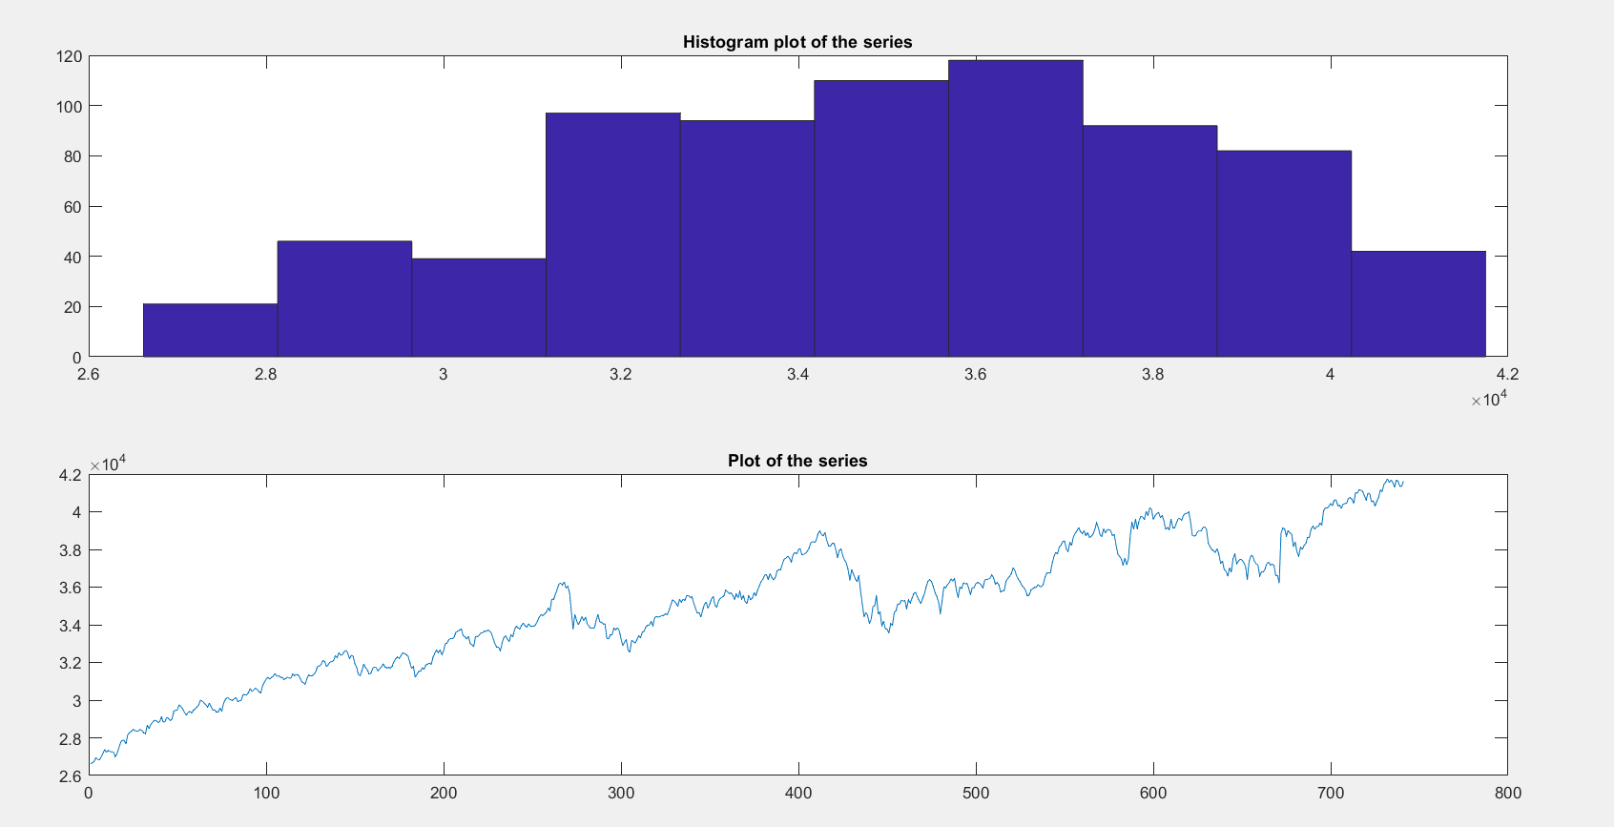
Step1:
Plotted the Open Data.

Slide 8
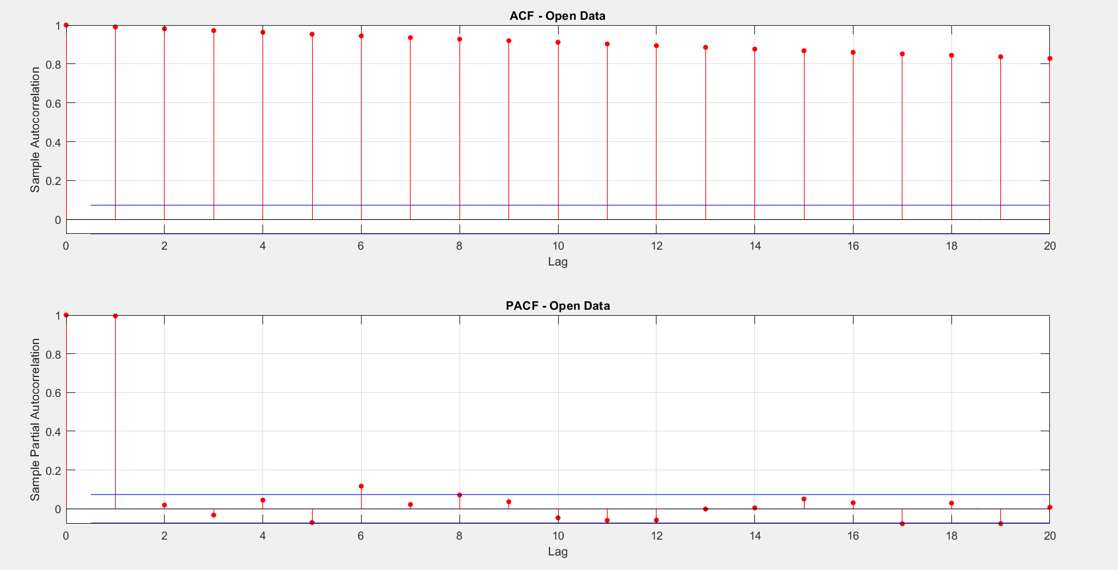
Step2:
Evaluated and plotted the autocorrelation and partial correlation of the open data.

Slide 9
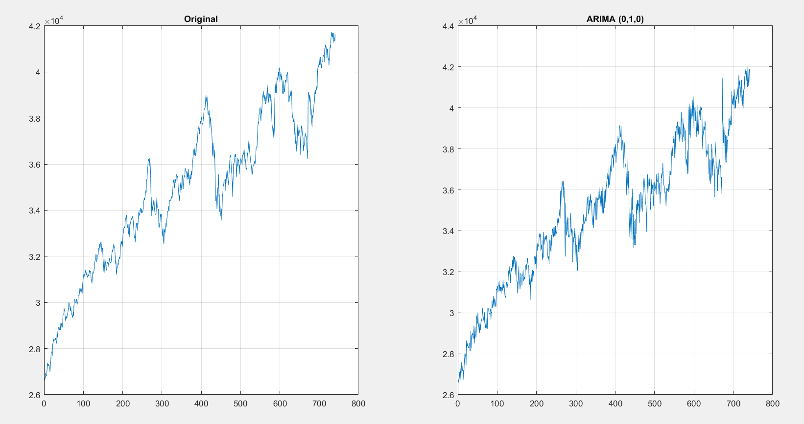
Step3:
Fitting the ARIMA model.

Slide 10
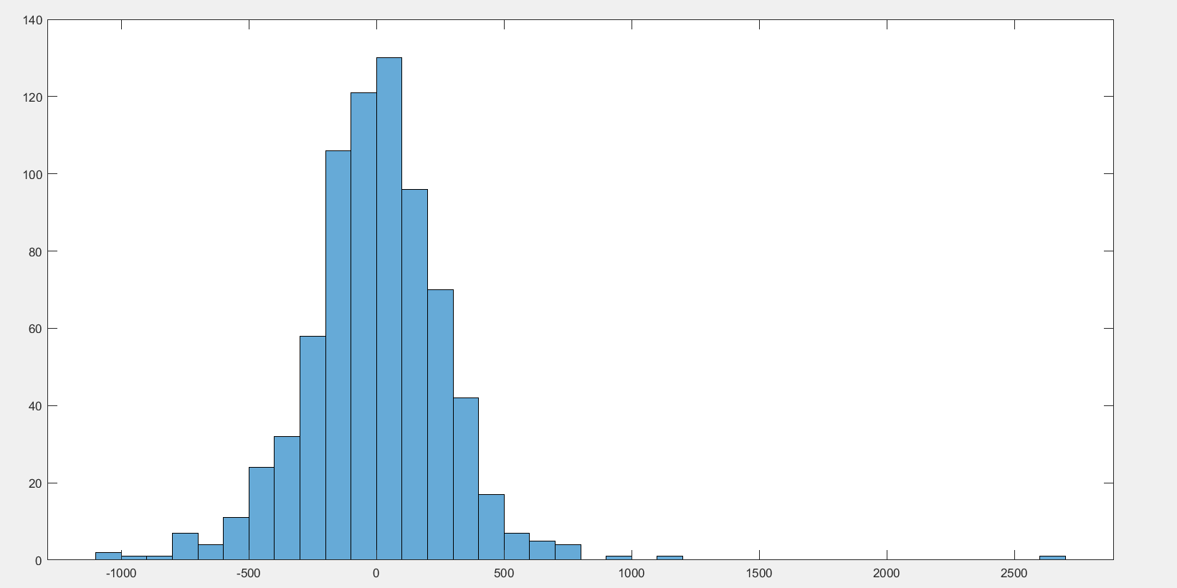
Step4:
Histogram of the residuals.

Slide 11
So how do we find how accurate our model is?
We can go for the aic(Akaike Information Criteria) and bic(Bayesian Information Criteria) values.
In short, aic tell whether the model will over fit the actual time series and
bic tell whether the model will under fit the actual time series . So, lesser is the aic and bic value the better is

Slide 12
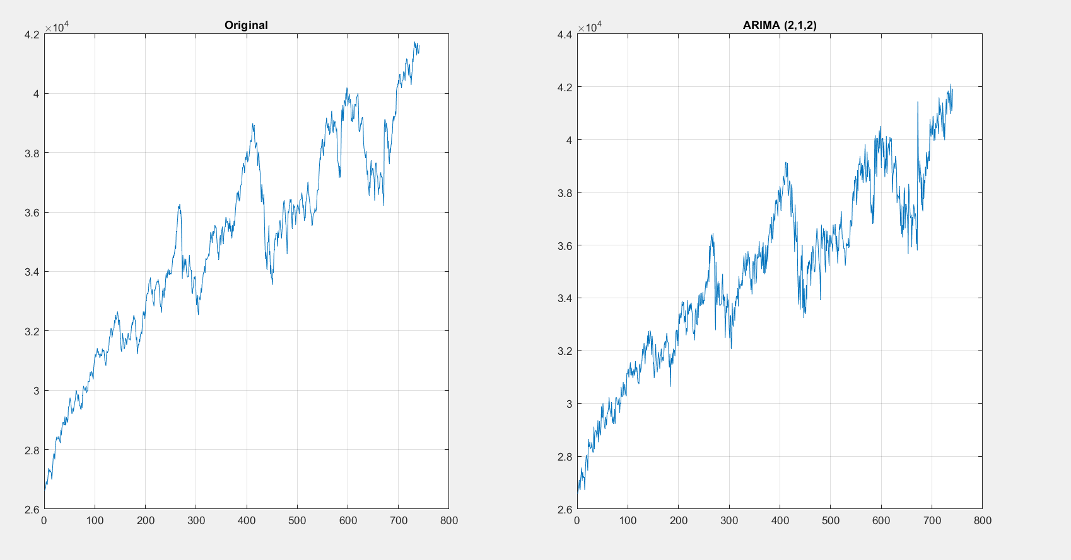
Step5:
Best fit for ARIMA model

Slide 13
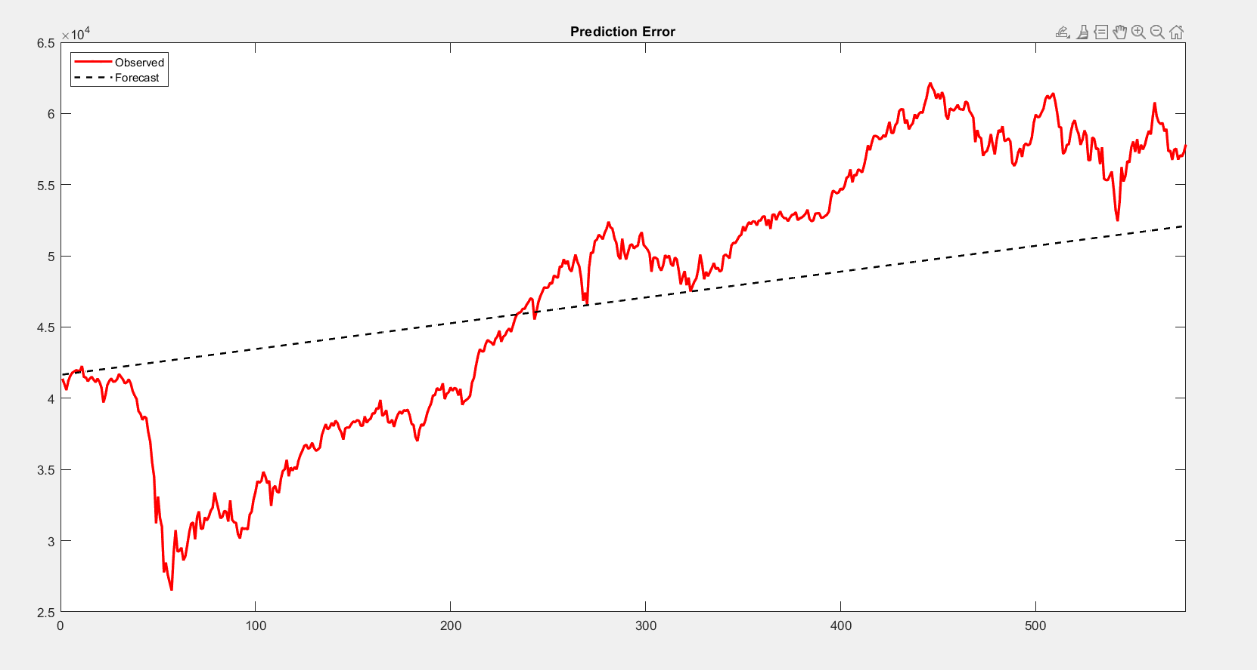
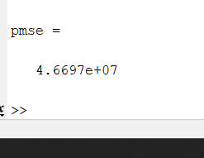
Output:

Slide 14
Conclusion:
So we got ARIMA(2,1,2) as the best fit.
To determine the best fit for the model and verify it we need to perform AIC and BIC.
When you are dealing with any financial markets whether it be Stocks or Cryptocurrency you always need to be careful as the forecasts are not accurate and anything can happen in the Future.

Slide 15
THANK YOU

