Slide 1
Principal component regression: Predicting the popularity of TV shows
ECON-M518
By
Kaushik Parvathaneni
Shiva Kumar Pendem
Sricharan Cheeti
INDIANA UNIVERSITY BLOOMINGTON

Slide 2
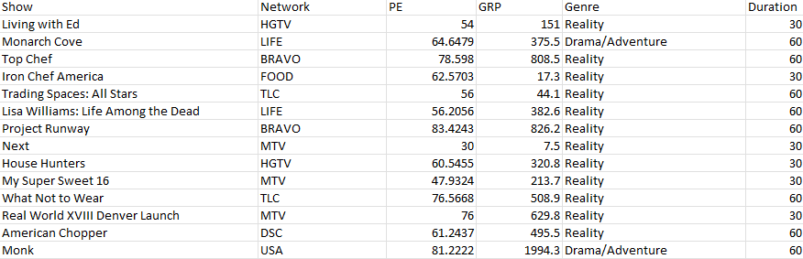
Data
NBC Show Details

Slide 3
Gross ratings points (GRP) - classic measure in the broadcast industry of how popular a show is.
PE (projected engagement) - a more subtle measure of how attentive an audience is to a show

Slide 4
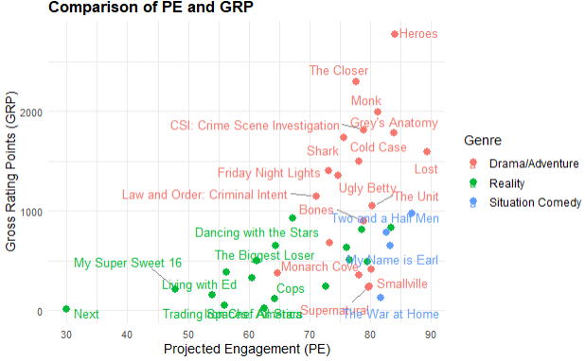
NBC Show Details

Slide 5
NBC Pilot Survey
Q1 | Q2
Attentive | Relatable
Excited | Funny
Happy | Confusing
Engaged | Predictable
Curious | Entertaining
Motivated | Fantasy
Comforted | Original
Annoyed | Believable
Indifferent | Boring
 | Dramatic
 | Suspenseful

Slide 6
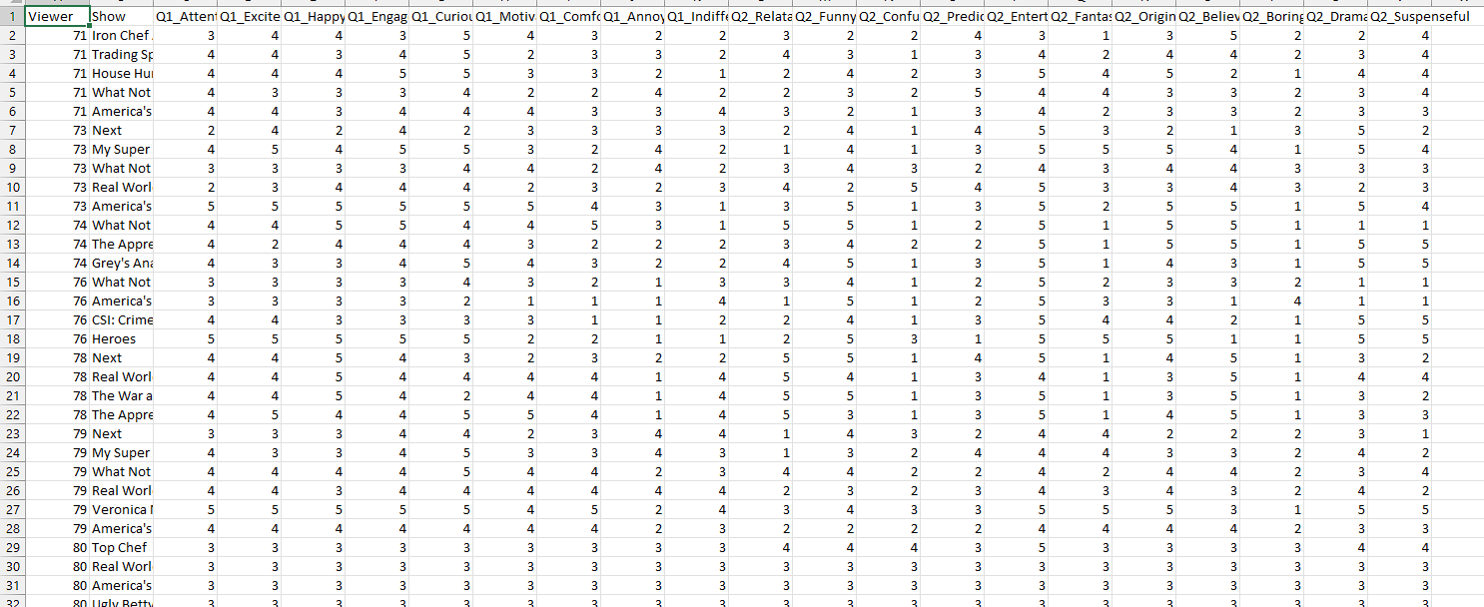
6,241observations

Slide 7
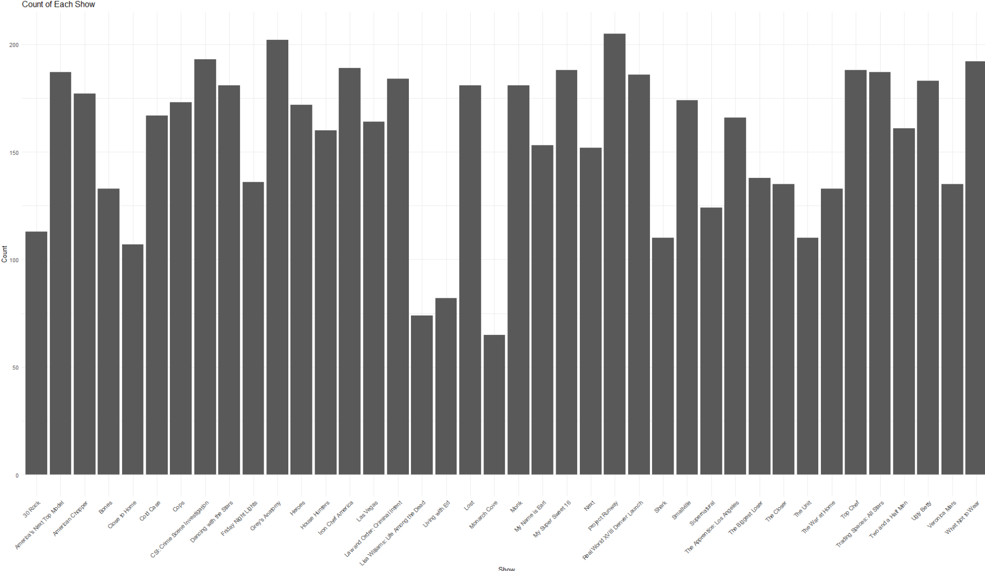

Slide 8
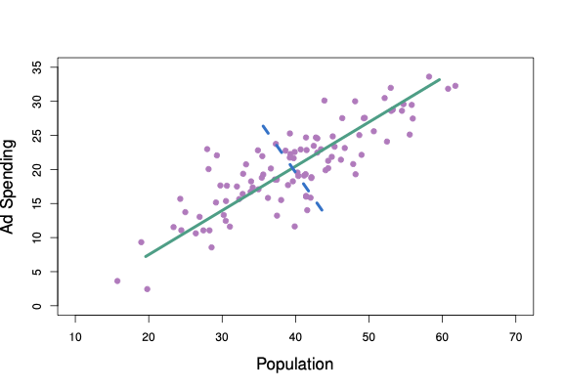
Principal Component Regression
Principal Component Regression (PCR) is a statistical technique that combines the principles of principal component analysis (PCA) and multiple linear regression. It is often used in situations where there is multicollinearity among the predictor variables, meaning that the predictor variables are highly correlated with each other. This multicollinearity can lead to unstable estimates of the regression coefficients in a traditional multiple linear regression model.
Notes:
Principal Component Regression (PCR) is a statistical technique that combines the principles of principal component analysis (PCA) and multiple linear regression. It is often used in situations where there is multicollinearity among the predictor variables, meaning that the predictor variables are highly correlated with each other. This multicollinearity can lead to unstable estimates of the regression coefficients in a traditional multiple linear regression model.

Slide 9
Basic steps involved in PCR
PCA
Multi linear regression
Selecting Principal Components
Data Standardization
Why PCR is better than traditional Regression in our case?
Notes:
1. Multiple Linear Regression:
In basic linear regression, you have a dependent variable (what you want to predict) and multiple independent variables (features that help make predictions).
The goal is to find the relationship between these variables. However, if the independent variables are highly correlated (multicollinearity), it can make the model less reliable.
2. Principal Component Analysis (PCA):
PCA is a method to transform the original variables into a new set of variables called principal components.
Principal components are created in a way that they capture the most important information in the data and are uncorrelated with each other.
The first principal component explains the most variability in the data, the second principal component explains the second most, and so on.
3. Data Standardization:
Before applying PCA, it's common to standardize your data. This involves adjusting the scale of your variables so that they all have the same weight in the analysis.
Standardization ensures that no variable dominates the principal components simply because of its scale.
4. Selecting Principal Components:
After running PCA, you choose a certain number of principal components to use in your regression. You might decide based on how much of the total variability in the data you want to retain.
For example, if you choose to retain 95% of the variability, you'd select enough principal components to reach that level.
5. Regression Modeling with Principal Components:
Now, instead of using the original variables, you use the selected principal components as predictors in your regression model.
This helps in dealing with multicollinearity because the principal components are uncorrelated.
6. Back Transformation (Optional):
If you want to interpret your results in terms of the original variables, you can transform the results back from the principal component space to the original variable space.
Why PCR is Useful:
Dealing with Multicollinearity: PCR is particularly helpful when you have predictors that are highly correlated, which can cause issues in traditional regression.
Handling High-Dimensional Data: When you have a lot of variables, PCR can help by focusing on the most important ones.
In summary, Principal Component Regression is a technique that helps improve the reliability of regression models when faced with multicollinearity. It does this by transforming the original variables into a set of uncorrelated variables called principal components, which are then used as predictors in the regression model.
Let's consider a real-world example using housing data. Imagine you're trying to predict the price of houses based on various features such as square footage, number of bedrooms, number of bathrooms, and the distance to the city center. However, you've noticed that some of these features, like square footage and the number of bedrooms, are highly correlated, leading to multicollinearity issues in a traditional regression model.
Traditional Regression Approach:
In a regular regression model, you might face challenges due to multicollinearity. For instance, if square footage and the number of bedrooms are strongly correlated, it becomes difficult for the model to distinguish their individual effects on the house price. This could lead to unstable or less reliable estimates of the coefficients.
Principal Component Regression (PCR) Solution:
Data Standardization:
You start by standardizing your data, ensuring that all variables are on the same scale.
Principal Component Analysis (PCA):
Apply PCA to transform your original features into a set of principal components.
Let's say the first two principal components capture most of the variability in your data.
Selecting Principal Components:
You decide to retain the first two principal components, which together explain 95% of the variability in your housing data.
Regression Modeling with Principal Components:
Instead of using square footage, bedrooms, bathrooms, etc., directly in your regression model, you use the first two principal components derived from PCA as your predictors.
Interpretation:
The regression coefficients now represent the relationship between these principal components and the house price.
Practical Interpretation:
Original Variables:
Original variables like square footage, bedrooms, and bathrooms were highly correlated, making it challenging for the model to give clear importance to each factor.
Principal Components:
The principal components are new variables that are uncorrelated, helping the model better capture the essence of the data without the confusion caused by multicollinearity.
Result:
The PCR model provides more stable and reliable estimates of the relationships between the principal components and house prices.
In this everyday example, PCR helps create a more robust model for predicting house prices by addressing the multicollinearity issue. It simplifies the relationships between the predictors and the response variable, making it easier to interpret and potentially improving the accuracy of the predictions.

Slide 10
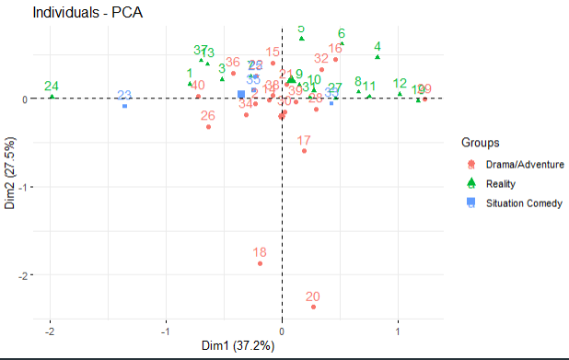
PCA

Slide 11
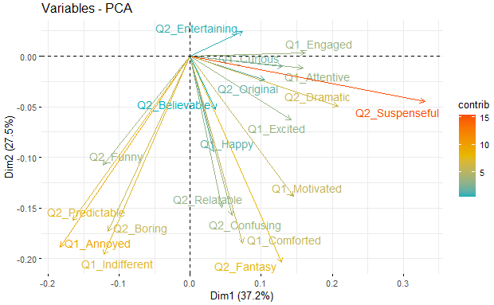

Slide 12
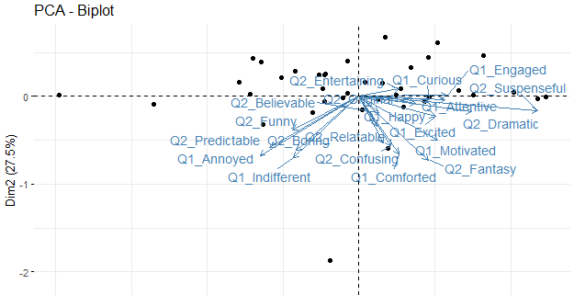

Slide 13
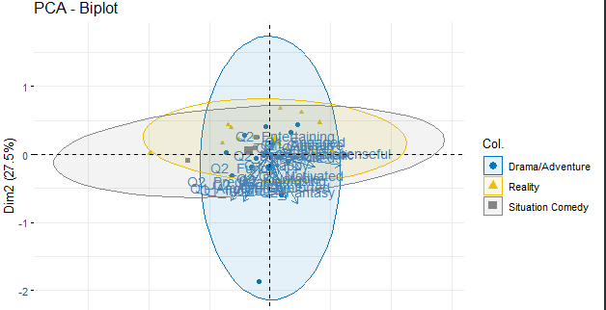

Slide 14
2 ways to choose the number of Components
Explained Variance Criterion
Scree Plot (Elbow Method)
Notes:
Explained Variance Criterion:
You choose the number of components that collectively explain a certain threshold of the total variance in the data. Common thresholds are 70%, 80%, 90%, or 95%. This method assumes that the chosen components capture most of the information in the original data.
In practice, you would look at the cumulative explained variance ratio and select the smallest number of components that get you above your chosen threshold.
Scree Plot (Elbow Method):
You examine a scree plot, which is a line plot of the eigenvalues of the principal components in descending order. You look for a point where the slope of the line changes direction sharply (the "elbow"), which typically signifies that additional components are not contributing significant variance.
This method is somewhat subjective because it requires visually inspecting the plot to determine where the elbow is.

Slide 15
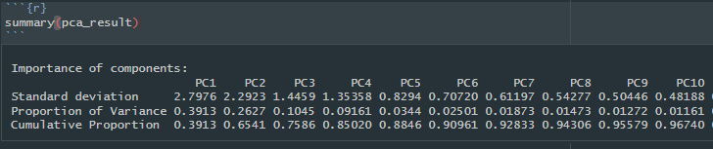
Explained Variance Criterion
Notes:
Explained Variance Criterion:
You choose the number of components that collectively explain a certain threshold of the total variance in the data. Common thresholds are 70%, 80%, 90%, or 95%. This method assumes that the chosen components capture most of the information in the original data.

Slide 16
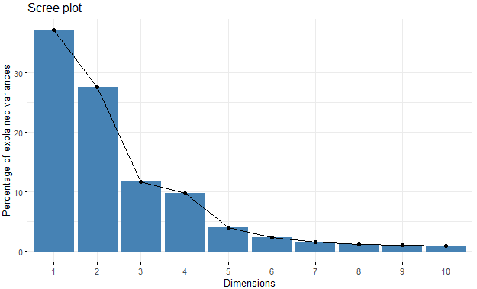
Screen Plot
Notes:
Scree Plot (Elbow Method):
You examine a scree plot, which is a line plot of the eigenvalues of the principal components in descending order. You look for a point where the slope of the line changes direction sharply (the "elbow"), which typically signifies that additional components are not contributing significant variance.
This method is somewhat subjective because it requires visually inspecting the plot to determine where the elbow is.

Slide 17
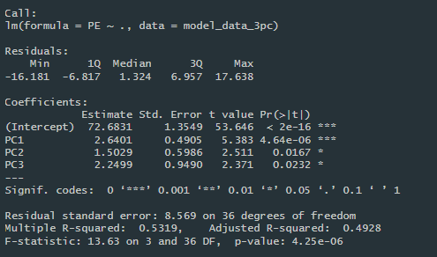
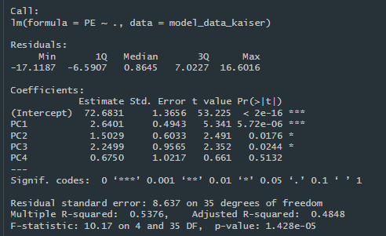
Model
Notes:
The Multiple R-squared of 0.5376 indicates that approximately 53.76% of the variability in the audience engagement (PE) is explained by the four principal components used in the model. The Adjusted R-squared of 0.4848 is a modified version of the R-squared that has been adjusted for the number of predictors in the model, providing a more accurate measure of model fit.
The F-statistic and its associated p-value test the null hypothesis that all regression coefficients are equal to zero. In this case, the F-statistic of 10.17 and a p-value of approximately 0.00001428 suggest that the model is statistically significant.

Slide 18
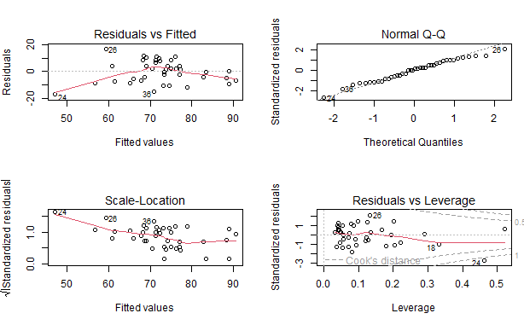
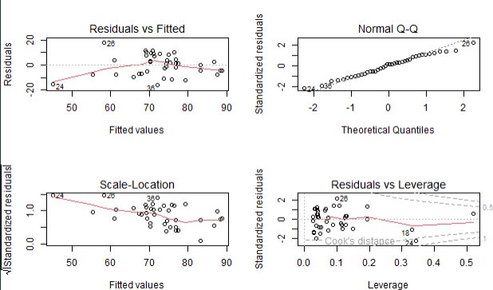
Model
Notes:
Residual Analysis:
The Residuals vs Fitted plot checks for non-linear patterns; the residuals should be randomly dispersed around the horizontal line.
The Normal Q-Q plot shows if the residuals are normally distributed; points should lie approximately along the line.
The Scale-Location (or Spread-Location) plot checks for homoscedasticity; residuals should be spread equally along the ranges of predictors.
The Residuals vs Leverage plot helps identify influential cases; points should not stand out from the bulk of the data.
Residuals vs Fitted Plots:
These plots check the assumption of linearity and homoscedasticity (equal variance) of residuals. In an ideal scenario, we expect to see a random scatter of points with no discernible pattern. In image, there seems to be a fairly random scatter, suggesting that the assumption of linearity may not be violated. However, there is a slight trend visible in the variance model, which may indicate some non-linearity or heteroscedasticity.
Normal Q-Q Plots:
These plots assess the normality of the residuals by comparing them to a theoretical normal distribution. Points following the dashed line indicate normality. The plots from both models show points that follow the line fairly well, with slight deviations at the tails. This is common and often not a cause for concern unless the deviations are severe.
Scale-Location Plots:
These plots check the homoscedasticity of residuals. The y-axis is the square root of standardized residuals, which should be evenly spread across the range of fitted values without a pattern. In your plots, there is a slight increase in the spread of residuals for higher fitted values, which may suggest some issues with equal variance (heteroscedasticity).
Residuals vs Leverage Plots:
These plots identify influential observations that might have an undue influence on the regression line. You're looking for points outside the dashed Cook's distance lines. In both models, there are no points outside the Cook's distance lines, which suggests there are no particularly influential cases.
Coefficient Plot:
This plot shows the estimated coefficients and their confidence intervals for each principal component. The fact that the confidence intervals for PC1, PC2, and PC3 do not cross the vertical line at zero suggests these variables are statistically significant predictors of audience engagement (PE). PC4's confidence interval crosses zero, indicating it's not a statistically significant predictor at the conventional 0.05 level.

Slide 19
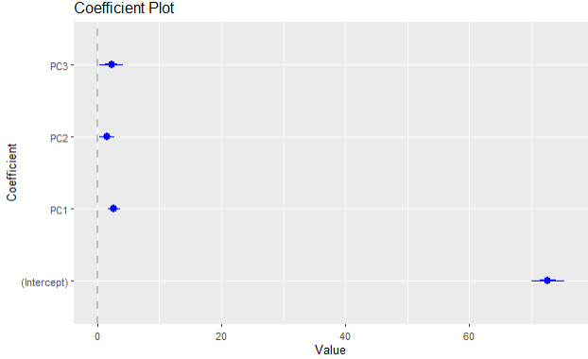
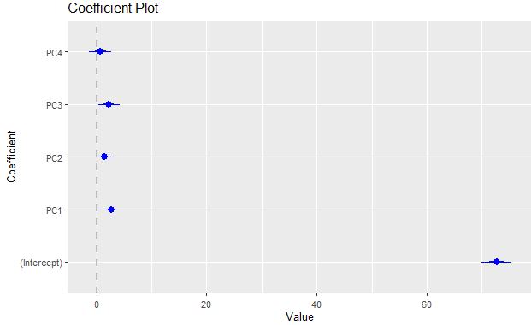
Model
Notes:
Coefficients:
For each principal component, provide the estimated regression coefficient, standard error, t-value, and p-value. In your model, PC1, PC2, and PC3 have statistically significant coefficients (p < 0.05), meaning they contribute meaningfully to the model. PC4, however, is not significant (p = 0.5132), suggesting it may not be a valuable predictor in the context of this model.

Slide 20
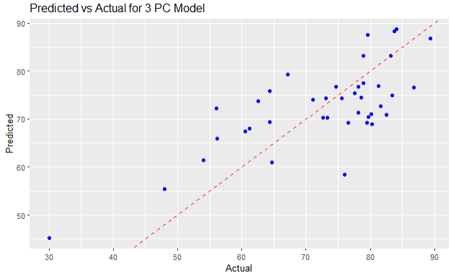
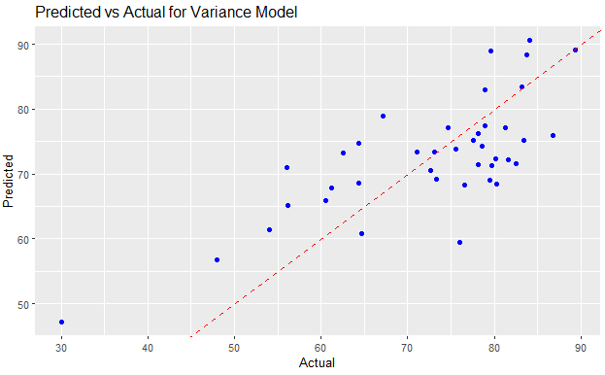
Model
Notes:
These plots compare the predicted values of audience engagement (PE) against the actual values. The closer the points are to the dashed line (which represents perfect prediction), the better the model's predictive accuracy

Slide 21
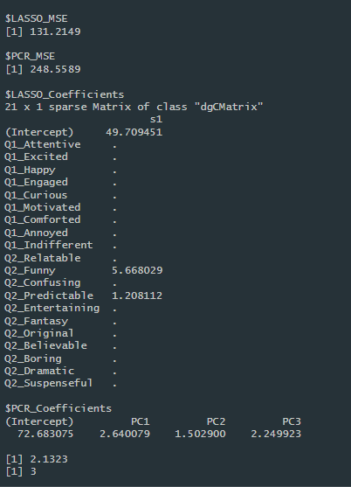
Comparing to LASSO
Notes:
LASSO Mean Squared Error (MSE):
The LASSO model has an MSE of 131.21. This value represents the average squared difference between the observed actual outcomes and the outcomes predicted by the model. A lower MSE indicates a better fit of the model to the data.
PCR Mean Squared Error (MSE):
The PCR model has an MSE of 248.56, which is higher than the MSE from the LASSO model. This suggests that the PCR model's predictions are, on average, less accurate than those from the LASSO model.
LASSO Coefficients:
The LASSO model has identified that most of the survey questions (features) are not influential in predicting audience engagement, as indicated by the dots (.) next to their coefficients, which means their coefficients have been shrunk to zero.
Only two features have non-zero coefficients: Q2_Funny and Q2_Predictable. This means that according to the LASSO model, the perceived humor (Q2_Funny) and predictability (Q2_Predictable) of a show are significant predictors of audience engagement.
PCR Coefficients:
The coefficients for the PCR model show the contribution of each of the first three principal components (PC1, PC2, PC3) to predicting audience engagement. All three components have non-zero coefficients, indicating they all have some influence on the prediction.
Number of Non-Zero Coefficients in the LASSO Model:
The LASSO model has three non-zero coefficients, including the intercept. This number indicates how many variables the LASSO model has selected as important for predicting audience engagement.
In summary, the LASSO model is more selective, choosing only two of the original survey questions as important predictors, while the PCR model uses combinations of all questions. The LASSO model also appears to predict audience engagement more accurately than the PCR model, given its lower MSE.
LASSO as the Preferred Model: LASSO (Least Absolute Shrinkage and Selection Operator) would be the preferred model when:
You have a large number of predictors and believe that only a few of them are actually important. LASSO performs both variable selection and regularization, which helps in identifying the most significant predictors while also preventing overfitting.
Interpretability is a key concern. Since LASSO can reduce the number of predictors by setting some coefficients to zero, the final model is simpler and easier to interpret.
You are dealing with a dataset where multicollinearity might not be a significant issue, or you are specifically interested in which individual variables are most predictive.
PCR as the Preferred Model: PCR (Principal Component Regression) would be more suitable when:
The predictors are highly correlated with each other, a condition known as multicollinearity. PCR deals with this by transforming the correlated variables into a set of linearly uncorrelated components.
You want to capture the underlying structure of the data and you're less concerned about the interpretability of individual variables.
Dimensionality reduction is desired or necessary due to computational constraints or to simplify the model.
In comparing two approaches to predict TV show engagement based on audience survey responses, we found that the LASSO model, which focuses on individual questions, was more accurate than the PCR model, which combines all the survey questions into broader factors. LASSO identified humor and predictability as key drivers of engagement. This is not entirely surprising, as these aspects are often critical to a show's success. On the other hand, PCR's use of combined factors makes sense when dealing with surveys that have overlapping or related questions. While the PCR model was less accurate in this case, it could still be useful for understanding broader patterns in audience feedback

Slide 22
Thank you

