Slide 1
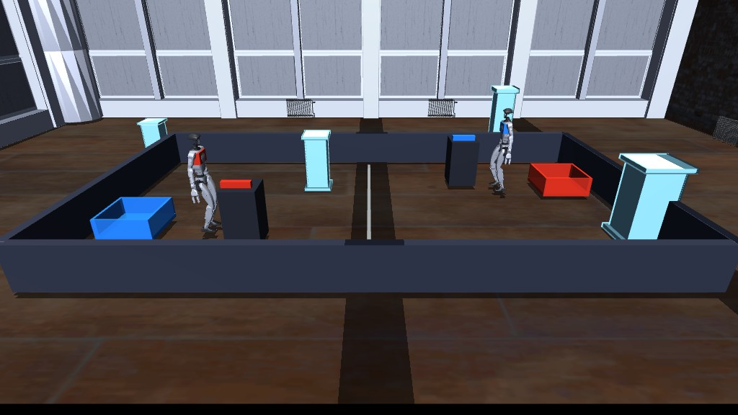
ROBOT GYM
Competitive infrastructure for embodied AI.
A live 1v1 arena where robot policies compete, humans intervene, and every action becomes evaluation evidence.
INVESTOR BRIEF • 2026
KAUSHIK SIVAKUMAR / FOUNDER
ACTUAL PRODUCT ARENA

Slide 2
THE PROBLEM
Robotics demos prove possibility. They rarely prove reliability.
The missing layer is not another model. It is a credible way to test models under pressure.
01
02
03
Success hides failure
Benchmarks lack stakes
Hardware iteration is costly
Polished demos compress retries, recoveries, latency and perception misses into one highlight.
Static leaderboards reveal scores—not how policies behave in a live, adversarial scenario.
Every physical test consumes operator time, robot time and safety margin.
Opportunity: turn evaluation into something rigorous enough for labs—and compelling enough for an audience.
ROBOT GYM / CONFIDENTIAL
PROBLEM
02

Slide 3
THE PRODUCT
What the customer gets
A live arena for robot intelligence.
Watch
A shared, browser-viewable match with live state and rationales.
Same task. Same physics. Different minds.
Control
Policies and people race Unitree G1 robots to acquire, carry and deliver a payload.
Gamepad or keyboard input beside model-driven agents.
Measure
AI
VS
AI
Trajectories, events, commands, falls and recovery attempts.
AI
VS
HUMAN
Replay
HUMAN
VS
HUMAN
An evidence package for debugging, comparison and trust.
LIVE PRODUCT CAPTURE / VLGE × MUJOCO
BUILT AND RUNNING
ROBOT GYM / CONFIDENTIAL
PRODUCT
03

Slide 4
HOW IT WORKS
One arena. A clean boundary between reasoning, control and evidence.
01
02
03
04
05
06
VLGE WORLD
PERCEPTION
PLAYER
GUARDED SKILLS
G1 CONTROL
EVIDENCE
→
→
→
→
→
Scenario, visuals, audience
Delayed camera-grounded state
Gemini • custom model • human
Navigate • grasp • release • reset
Official locomotion policy + SDK-shaped channel
Trajectory • events • outcome • replay
Models choose grounded intent; the safety and control layer owns executable motion.
KEY DESIGN CHOICE
This makes model comparison possible without pretending a language model is a motor controller.
ROBOT GYM / CONFIDENTIAL
SYSTEM
04

Slide 5
WHY NOW
Embodied AI is moving from demos to an evaluation economy.
$38B
542K
+42%
PROJECTED HUMANOID ROBOT MARKET BY 2035
INDUSTRIAL ROBOTS INSTALLED IN 2024
GROWTH IN RAAS FLEETS IN 2024
Goldman Sachs Research
International Federation of Robotics
International Federation of Robotics
MODEL SHIFT
Embodied reasoning is now API-accessible—planning and spatial understanding can be evaluated across models.
Robot Gym is the neutral arena between rapidly changing models and slow, expensive hardware.
Sources: Goldman Sachs Research (2024); IFR World Robotics 2025; Google DeepMind Gemini Robotics-ER.
ROBOT GYM / CONFIDENTIAL
MARKET
05

Slide 6
THE WEDGE
Competition turns evaluation into a product.
A race is legible to an audience—and unforgiving to a policy.
01
02
03
04
RUN
MEASURE
COMPARE
IMPROVE
Models and humans enter a shared task.
Every action becomes structured evidence.
Outcomes reveal capability and failure modes.
Teams iterate policies, prompts and controllers.
Flywheel: more scenarios → more matches → better failure data → stronger benchmarks → more teams.
ROBOT GYM / CONFIDENTIAL
WEDGE
06

Slide 7
EXECUTION PROOF
SHIPPED
The core arena is already built.
MATCH
CONTROL
EVALUATION
AI vs AI
Browser gamepad + keyboard
Camera-grounded perception
AI vs human
Official G1 locomotion policy
Latency, dropout + noise
Human vs human
500 Hz physics / 50 Hz channel
Custom HTTP policy adapter
Rematch + idle player
Guarded grasp, release + reset
Evidence and replay package
DEPLOYMENT
Mac development → RunPod GPU host → browser spectators and players
Current product scope; not a claim of real-hardware certification.
ROBOT GYM / CONFIDENTIAL
PROOF
07

Slide 8
BUSINESS MODEL
PROPOSED
Land as evaluation infrastructure. Expand through data and events.
01
PLATFORM
Annual team / enterprise subscription
Private arenas, model adapters, benchmark management and collaboration.
02
COMPUTE
Metered simulation and replay
Hosted matches, accelerated scenario runs and evidence retention.
03
PROGRAMS
Benchmarks, tournaments and services
Custom evaluation suites, partner challenges and failure analysis.
Initial buyer: robotics labs and embodied-AI teams that need repeatable cross-model evaluation.
ROBOT GYM / CONFIDENTIAL
BUSINESS
08

Slide 9
GO TO MARKET
Start with teams that feel the pain. Earn the audience after the signal.
NOW
NEXT
SCALE
DESIGN PARTNERS
PUBLIC CHALLENGE
PRIVATE ARENAS
Robotics labs + model teams
Developers + research community
Enterprises + robot OEMs
Install the arena, define one decision-critical benchmark, measure iteration time.
Publish a task season, verified match evidence and a model-neutral leaderboard.
Sell proprietary scenarios, access control, fleet evaluation and hosted compute.
North-star metric
Verified evaluation runs per active team
ROBOT GYM / CONFIDENTIAL
GTM
09

Slide 10
DEFENSIBILITY
The moat compounds across four layers.
SCENARIO GRAPH
A growing library of tasks, resets, constraints and win conditions.
01
FAILURE DATA
Comparable traces of perception, reasoning, control and recovery.
02
CONTROL BOUNDARY
Hardware-shaped channels that make policy claims more honest.
03
COMPETITION NETWORK
Models, teams, spectators and partners improve the benchmark together.
04
Each match improves the product even when the underlying models change.
ROBOT GYM / CONFIDENTIAL
MOAT
10

Slide 11
ROADMAP
From one compelling race to the evaluation layer for embodied AI.
BUILT
12 MONTHS
24 MONTHS
G1 DELIVERY ARENA
HOSTED BENCHMARK SUITE
HARDWARE-BACKED NETWORK
Three match modes
Accounts + private arenas
Real-unit adapter validation
Model + human control
Multi-task scenario library
Partner robot profiles
RunPod deployment
Verified leaderboards
Tournament seasons
Evidence capture
Design-partner pilots
Enterprise evaluation API
Milestones are proposed and subject to customer discovery, funding and hardware partner access.
ROBOT GYM / CONFIDENTIAL
ROADMAP
11

Slide 12
THE ASK
Help turn robot evaluation into a live, trusted market.
Seeking pre-seed capital and design partners.
01
PRODUCT
Hosted platform, scenario tooling and evidence UX
02
ROBOTICS
Benchmark design, controls validation and hardware bridge
KAUSHIK SIVAKUMAR
03
MARKET
Design partners, flagship challenge and community
FOUNDER / ROBOT GYM
github.com/KaushikSiva/robot-gym
LET’S BUILD THE ARENA.
ROBOT GYM / CONFIDENTIAL
CONTACT
12

