Slide 1



SMART INDIA HACKATHON 2026
TITLE PAGE
  Problem Statement ID –SIH26003
  Problem Statement Title-AI-Based Cognitive Gaming and Memory Assistance Platform for Elderly Dementia Patients in North Eastern Region (NER)
  Theme-Space Technology
  PS Category- Software
  Team ID-SIH26-A0H-T183
  Team Name (Registered on portal)-Byte Force

Slide 2
IDEA TITLE
Byte Force
PROBLEM WE ARE ADDRESSING
  Memory decline: Elderly dementia patients often experience progressive memory loss, making it difficult to remember people, objects, routines and daily activities.
  Reduced attention: Dementia can affect concentration and the ability to focus on simple tasks for extended periods.
  Difficulty with daily routines: Patients may forget medicines, hydration, activities and medical appointments.
  Limited access to cognitive care: Elderly people in remote and rural areas of the North Eastern Region may face difficulties accessing specialized neurological care and cognitive therapy.
  Confusion & social isolation: Dementia can contribute to confusion, anxiety and reduced social engagement.
  Lack of personalized support: Conventional cognitive activities do not automatically adapt to the changing cognitive performance of individual patients.
OUR SOLUTION
  AI-Powered Cognitive Gaming:Interactive games targeting memory, attention, concentration, routine recall, pattern recognition and object recognition.
  Adaptive AI: Uses patient performance such as accuracy, response time and mistakes to dynamically adjust game difficulty.
  Memory Assistance: Provides reminders for medicines, hydration, daily activities and medical appointments.
  Voice & Multilingual Support: Enables simple voice-assisted interaction and supports regional languages for elderly users.
  Caregiver Support: Provides performance history, activity progress and personalized insights to caregivers.
HOW THE SYSTEM WORKS
  Create Patient Profile:Patient preferences, language and basic cognitive-assistance requirements are configured.
  Assess Performance:The patient performs short cognitive games targeting memory, attention, pattern and recognition abilities.
  Collect Performance Data:Accuracy, response time, mistakes, hints and game completion are recorded.
  AI-Based Adaptation:The ML engine analyzes performance and predicts the appropriate difficulty level for the next activity.
  Personalized Cognitive Session:The system provides easier or more challenging activities based on individual performance.
  Daily Assistance:Medicine, hydration, activity and appointment reminders are delivered through simple visual and voice interactions.
  Caregiver Insights:Progress and performance trends are presented through a caregiver dashboard.
TECHNICAL SUPPORT
  Frontend: Next.js + React + TypeScript + Tailwind CSS
  Backend: Python + FastAPI
  ML: XGBoost + scikit-learn
  AI/Voice: OpenAI Realtime API for voice-based interaction and assistance
  Database: PostgreSQL
  Authentication: Supabase Auth
  Data: Game performance, response time, accuracy, mistakes, reminders and patient preferences
  Communication: REST API / JSON
  Inference: Server-side ML model execution
WHAT MAKES IT DIFFERENT
  Adaptive Cognitive Training: Game difficulty changes according to each patient's individual performance instead of using fixed difficulty levels.
  Multi-dimensional Assistance: Combines cognitive training with medicine, hydration, activity and appointment reminders.
  Voice-first Accessibility: Reduces dependence on typing and complex navigation for elderly users.
  NER-Centric Personalization: Regional languages, familiar visuals, sounds and cultural themes are incorporated to improve comfort and engagement.
  Patient-specific Learning: Memory, attention and pattern abilities can be tracked separately to provide targeted activities.
  Caregiver Connectivity: Converts patient activity and performance into understandable progress insights for caregivers.
@SIH Idea submission- Template
2

Slide 3
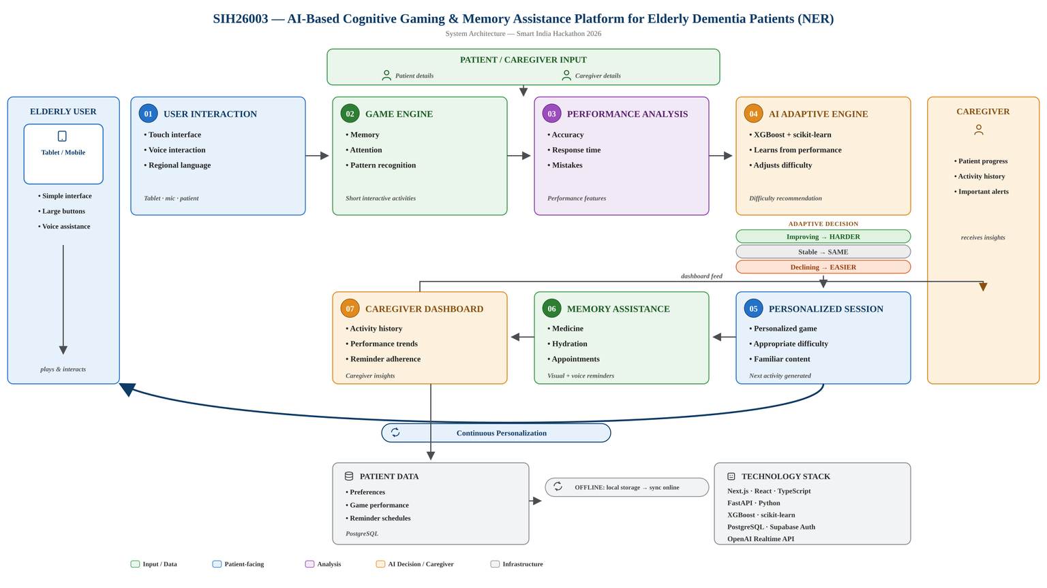
TECHNICAL APPROACH
Byte Force
  Technologies to be Used: Next.js, React, TypeScript, Tailwind CSS, Python, FastAPI, XGBoost, scikit-learn and PostgreSQL for developing the web-based cognitive assistance platform.
  Patient Interaction: A simple, accessible interface with large visual elements, touch-based cognitive games and voice-assisted interaction designed for elderly users.
  Cognitive Game Engine: Interactive games are designed around memory, attention, concentration, daily routine recall, pattern recognition and object recognition. Game performance such as accuracy, response time, mistakes and hints is recorded for every session.
  AI/ML Personalization: Performance features are processed using scikit-learn and an XGBoost model to estimate the appropriate difficulty level for each cognitive activity and personalize subsequent sessions
  Adaptive Difficulty: The system dynamically increases, maintains or reduces difficulty based on individual performance, enabling personalized cognitive training rather than fixed-level gameplay.
  Memory Assistance: A reminder engine manages medicines, hydration, daily activities and medical appointments and presents them through visual and voice-based notifications.
  Multilingual & Regional Support: The platform is designed to support multiple languages and incorporate culturally familiar NER-related visuals, sounds, themes and everyday objects.
  Caregiver Dashboard: Patient game performance, cognitive activity trends, session history and reminder adherence are presented to caregivers for continuous monitoring and support.
  Backend & Data: FastAPI provides REST APIs for patient profiles, game sessions, performance tracking, AI inference and reminders, while PostgreSQL stores application and performance data.
@SIH Idea submission- Template
3

Slide 4
FEASIBILITY AND VIABILITY
Byte Force
AREA FEASIBLITY RISK MITIGATION
Next.js, React, FastAPI, PostgreSQL and XGBoost
provide a practical stack for developing the complete platform
AI personalization may depend on the quality and quantity of patient performance data
Begin with rule-based adaptive logic and simulated/initial data, then improve the ML model as more validated data becomes available
TECHNICAL
DATA
ACCESSIBLITY
MULTILINGUAL & REGIONAL
CONNECTIVITY
PRIVACY & SECURITY
DEPLOYMENT
Game results such as accuracy, response time, mistakes and hints can be collected automatically during each session
Regional language and cultural content may require additional data and validation
Start with selected languages and expand through validated regional content and user feedback
Large visual elements, simple navigation, touch interaction and voice assistance can make the platform suitable for elderly users
Elderly users may have difficulty adapting to digital interfaces
Use minimal steps, large buttons, clear instructions, voice guidance and familiar visual content
The platform can support multiple languages and culturally familiar NER-based content
Regional language and cultural content may require additional data and validation
Start with selected languages and expand through validated regional content and user feedback
The core platform can operate through lightweight web APIs and server-side processing
Remote and rural areas may have unreliable internet connectivity
Minimize data transfer, cache essential content where possible and synchronize performance data when connectivity is restored
Patient profiles and performance records can be managed through authenticated access and controlled backend APIs
Cognitive and personal information is sensitive
Apply role-based access, secure authentication, encrypted communication and minimum necessary data collection
A modular web architecture allows the platform to be deployed initially as a prototype and expanded to multiple patients, caregivers and locations
Scaling to real-world healthcare environments requires extensive validation
Pilot the system with simulated/controlled data, validate the cognitive activities and progressively expand after appropriate evaluation
  The proposed platform is technically feasible as a web-based prototype using existing AI, ML, voice and cloud technologies, while its real-world effectiveness can be progressively validated and improved through user feedback and performance data
@SIH Idea submission- Template
4

Slide 5
IMPACT AND BENEFITS
Byte Force
SOCIAL IMPACT
➢ Improved cognitive engagement:
Regular interactive activities can encourage
elderly dementia patients to practice
memory, attention, recognition and concentration.
➢ Greater independence: Timely reminders for medicines, hydration, daily activities and appointments can help patients manage
everyday routines.
➢ Accessible cognitive support: Voice-assisted and multilingual interaction can make
cognitive activities easier to use for elderly people, including those in remote and rural areas of NER.
➢ Reduced social isolation: Familiar, engaging and culturally relevant activities can encourage interaction and continued mental engagement.
➢ Caregiver support: Performance history and activity insights help caregivers understand patient engagement and provide more personalized support.
ECONOMIC & REGIONAL BENEFITS
➢ Extends cognitive support to underserved areas: A web-based platform can provide supplementary cognitive activities where access to specialized care and therapy is limited.
➢ Lower-cost continuous support: Digital cognitive activities and reminders can complement existing caregiver and healthcare support without requiring a physical facility for every session.
➢ NER-focused personalization: Regional languages, familiar visuals, sounds and cultural themes can improve acceptance and engagement among users in the North Eastern Region.
➢ Scalable platform: The same architecture can be extended to more patients, caregivers, languages, cognitive activities and NER locations.
➢ Efficient caregiver monitoring: Digital performance records reduce dependence on manually tracking every cognitive-training session.
HEALTHCARE / CARE BENEFITS
➢ Personalized cognitive training: AI dynamically adjusts game difficulty according
to individual performance rather than providing
the same activities to every patient.
➢ Continuous performance tracking:
Accuracy, response time, mistakes and
activity completion can be recorded across sessions to identify performance trends.
➢ Early awareness of changes: Changes in game performance or routine adherence can provide useful signals for caregivers to monitor and discuss with healthcare professionals.
➢ Daily routine assistance: Automated reminders support medication, hydration,
activities and medical appointments.
➢ Reduced dependency on complex interfaces: Large visuals, simple navigation
and voice interaction make the platform more accessible to elderly users.
@SIH Idea submission- Template
5

Slide 6
RESEARCH AND REFERENCES
Byte Force
1. Dementia & Global Context
  World Health Organization (WHO) — Dementia Fact Sheet, 2026
  Provides evidence on dementia, its impact on memory, thinking, daily activities, independence and caregivers.
  WHO — Risk Reduction of Cognitive Decline and Dementia: Guidelines, 2nd Edition, 2026
  Provides updated evidence and recommendations related to cognitive training, cognitive stimulation and dementia risk reduction.
2. Cognitive Stimulation & Dementia Care
  WHO mhGAP — Non-pharmacological Interventions for People Living with Dementia
  Supports consideration of cognitive stimulation therapy and cognitive training as non-pharmacological interventions.
  NICE Guideline NG97 — Dementia: Assessment, Management and Support for People Living with Dementia and Their Carers
  Recommends tailored activities and cognitive stimulation therapy for people living with mild-to-moderate dementia.
3. Digital Cognitive Support
  Online Cognitive Stimulation Therapy for Dementia in Brazil and India — International Journal of Geriatric Psychiatry / PubMed
  Examines the feasibility and acceptability of delivering cognitive stimulation therapy online, including implementation experience in India.
  WHO Be He@lthy, Be Mobile — mDementia
  Demonstrates the use of mobile technologies to provide dementia-related health information and support carers.
4. Technical References
  XGBoost — Machine-learning framework used for adaptive difficulty prediction.
  scikit-learn — Data preprocessing and ML utilities.
  FastAPI — Python backend/API framework.
  Next.js / React / TypeScript — Web application development.
  PostgreSQL — Patient, game-performance and reminder data management.
@SIH Idea submission- Template
6

Slide 7
IMPORTANT INSTRUCTIONS
Please ensure below pointers are met while submitting the Idea PPT:
  Kindly keep the maximum slides limit up to six (6). ( Including the title slide)
  Try to avoid paragraphs and post your idea in points /diagrams / Infographics /pictures
  Keep your explanation precise and easy to understand
  Idea should be unique and novel.
  You can only use provided template for making the PPT without changing the idea details pointers (mentioned in previous slides).
  You need to save the file in PDF and upload the same on portal. No PPT, Word Doc or any other format will be supported.
  Note - You can delete this slide (Important Pointers) when you upload the details of your idea on SIH portal.
@SIH Idea submission- Template
7

