Slide 1



SMART INDIA HACKATHON 2026
TITLE PAGE
  Problem Statement ID –SIH26001
  Problem Statement Title-AI-Based early warning and landslide Risk Monitoring System in NER
  Theme-Disaster Management
  PS Category- Software/Hardware-Software
  Team ID-SIH26-A0H-T183
  Team Name (Registered on portal)-Byte Force

Slide 2
AI-Based early warning and landslide Risk Monitoring
System in NER
Byte Force
PROBLEM WE ARE ADDRESSING
  Unpredictable road failures: Landslides can suddenly disrupt mountain roads and isolate villages and essential facilities.
  Scattered evidence: Rainfall, soil moisture, terrain, road condition and field observations are usually considered separately.
  Limited prioritization: Authorities need to know which road segment requires attention first, rather than only viewing raw risk data.
  Changing ground conditions: New cracks or road deformation can provide important evidence that should update the existing risk assessment.
OUR SOLUTION
  Multi-source Evidence: Rainfall (24h/72h accumulation), soil moisture, slope & terrain, road network, historical conditions, field hazard reports, and infrastructure data.
  AI-Based Risk Prediction: Feature engineering using Python / scikit-learn and an XGBoost classifier to predict risk for every monitored road segment, producing an interpretable 0–100% risk score
  Dynamic Re-evaluation: Incorporates new crack or deformation reports as evidence, recalculating risk instead of relying only on previous scores to support Normal, Heavy, and Extreme rainfall scenarios.
HOW THE SYSTEM WORKS
  Collect Evidence-Rainfall, soil moisture, terrain, road-network data, population/infrastructure and field reports are collected for each monitored road segment.
  Prepare Features-The incoming data is validated and converted into a segment-level feature set for prediction.
  Predict Risk-The XGBoost model estimates landslide risk for each segment and assigns a 0–100% risk score.
  Rank & Assess Impact-Segments are ranked by risk and checked for affected villages, schools, hospitals, supply routes and population.
  Recommend Action-The system converts the risk level into an operational response:
  Critical → Immediate field inspection
  High → Increased monitoring
  Moderate → Routine monitoring
  Low → No immediate action.
  Feedback:New crack / deformation report → Evidence update → Risk re-scoring
TECHNICAL IMPLEMENTATION
  Frontend: Next.js + React + TypeScript + Tailwind CSS
  Maps: Leaflet
  Backend: Python + FastAPI
  ML: XGBoost + scikit-learn
  Data: Segment-level rainfall, soil, terrain, road & field-report data
  Communication: REST API / JSON
  Inference: Server-side model execution
WHAT MAKES IT DIFFERENT
  Evidence-based re-scoring: Field observations can change the risk instead of remaining as separate reports.
  Segment-level prediction: Risk is calculated for individual road segments, enabling targeted intervention.
  Impact-aware prioritization: Risk is combined with infrastructure and population dependency.
  Scenario simulation: Authorities can compare how risk changes under normal, heavy and extreme rainfall.
  Explainable decision support: Each score is associated with contributing factors and a corresponding response level.
@SIH Idea submission- Template
2

Slide 3
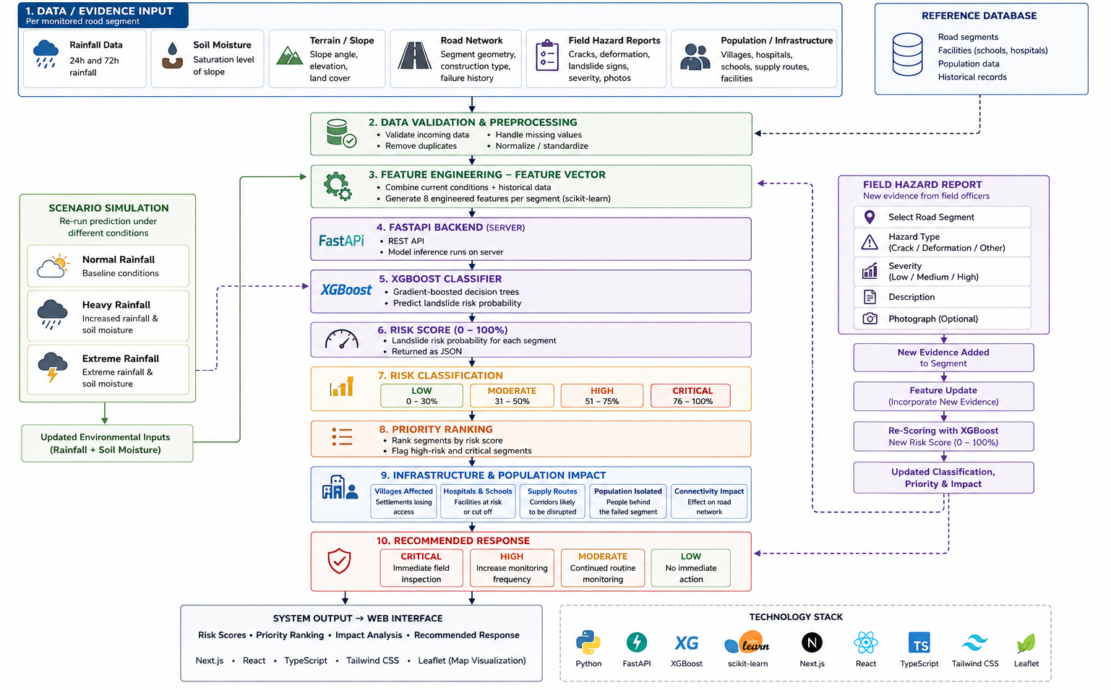
TECHNICAL APPROACH
Byte Force
  Technologies to be used: Python, FastAPI, XGBoost, scikit-learn, Next.js, React + TypeScript, Tailwind CSS and Leaflet for the web-based prototype.
  Data & Processing: Rainfall, soil moisture, terrain/slope, road-network, field-hazard reports and population/infrastructure data are combined and validated for each monitored road segment.
  AI/ML Risk Prediction: Engineered features are passed to an XGBoost classifier to generate a 0–100% landslide risk score and classify segments as Low, Moderate, High or Critical.
  Risk & Impact Analysis: Segments are ranked by risk, while road failure impact is evaluated using connected villages, hospitals, schools, supply routes and potentially isolated population.
  Dynamic Re-evaluation: Normal, Heavy and Extreme rainfall scenarios can re-run the model. New field reports such as cracks or road deformation are added as evidence and trigger risk re-scoring.
  Decision Support: Risk levels are converted into practical responses such as immediate field inspection, increased monitoring, routine monitoring or no immediate action.
@SIH Idea submission- Template
3

Slide 4
FEASIBILITY AND VIABILITY
Byte Force
AREA
FEASIBILITY
RISK
MITIGATION
Technical
Python, FastAPI, XGBoost and scikit-learn
support the complete risk-scoring pipeline
Model accuracy
depends on quality and
availability of training data.
Validate with real field-labelled landslide data as the system is deployed.
Data
Rainfall, soil moisture, terrain, road-network, fieldreports and population data can be
combined per road segment.
Missing or inconsistent
field/sensor data
Data validation, range checks and
missing-value handling before prediction.
Operational
Field officers can submit cracks and road
deformation as new evidence for re-scoring.
Delayed or incorrect field
reports may affect risk scores
Standardised reporting fields, severity selection and optional photo evidence
Prototype runs through a FastAPI backend with
a web-based interface and server side inference.
Modular architecture allows
additional road segments, data
sources and databases to be added.
Infrastructure
Scaling from simulated district
data to larger real datasets.
Deployment
Browser-based system can be accessed
by authorised users over a network.
Connectivity may be
limited in remote areas.
Keep inference server-side and design
the system for lightweight data exchange.
  Built as a working prototype with simulated district data, the system is technically feasible and designed to scale toward real-world deployment after validation with locally labelled data.
@SIH Idea submission- Template
4

Slide 5
IMPACT AND BENEFITS
Byte Force
SOCIAL IMPACT
➢ Earlier identification of risky road segments helps authorities act before landslides disrupt connectivity.
➢ Protects access to villages and essential facilities by highlighting roads that may affect hospitals, schools and supply routes.
➢ Clear risk prioritization helps field teams focus on high-risk locations instead of inspecting every road equally.
➢ Better decision support through explainable risk scores and contributing factors.
ECONOMIC BENEFITS
ENVIRONMENTAL AND
GOVERNANCE BENEFITS
➢ Reduces avoidable disruption by prioritizing inspection and preventive action on vulnerable road segments.
➢ Improves allocation of field resources by ranking roads according to predicted risk and potential impact
.
➢ Supports faster response planning using rainfall, terrain, soil and road-condition data together.
➢ Reusable system architecture can be extended to additional road networks and districts without redesigning the complete workflow.
➢ Data-driven monitoring combines rainfall, soil moisture, terrain and field observations instead of relying on a single indicator.
➢ Dynamic risk updates allow new crack or road-deformation reports to influence the existing assessment.
➢ Scenario analysis helps authorities compare risk under normal, heavy and extreme rainfall conditions.
➢ Transparent decisions through segment-level risk scores, contributing factors and traceable field evidence.
@SIH Idea submission- Template
5

Slide 6
RESEARCH AND REFERENCES
Byte Force
1. Landslide & Risk Research
  Data-Driven Landslide Nowcasting at the Global Scale — Frontiers in Earth Science
  Machine learning-based rainfall-induced landslide susceptibility model and short-term early warning assessment — Landslides, 2025
  Research on machine learning forecasting and early warning model for rainfall-induced landslides — Scientific Reports
2. Northeast India / NER Context
  Research on rainfall-induced landslides and landslide susceptibility in Northeast India
  Geological Survey of India (GSI) — landslide susceptibility and landslide-related geospatial information
3. Machine Learning / Implementation
  XGBoost — gradient-boosted decision tree framework used for risk classification
  scikit-learn — preprocessing and machine-learning utilities
  FastAPI — backend API implementation
  Leaflet — web-based geographic visualization
4. Supporting Technical Documentation
  XGBoost official documentation
  scikit-learn official documentation
  FastAPI official documentation
  Leaflet official documentation
@SIH Idea submission- Template
6

Slide 7
IMPORTANT INSTRUCTIONS
Please ensure below pointers are met while submitting the Idea PPT:
  Kindly keep the maximum slides limit up to six (6). ( Including the title slide)
  Try to avoid paragraphs and post your idea in points /diagrams / Infographics /pictures
  Keep your explanation precise and easy to understand
  Idea should be unique and novel.
  You can only use provided template for making the PPT without changing the idea details pointers (mentioned in previous slides).
  You need to save the file in PDF and upload the same on portal. No PPT, Word Doc or any other format will be supported.
  Note - You can delete this slide (Important Pointers) when you upload the details of your idea on SIH portal.
@SIH Idea submission- Template
7

