Slide 1
WATER LEAKAGE & WASTAGE
REPORTING MANAGEMENT SYSTEM
A low-code application built on Zoho Creator
T Kaushika (240701239)
CB23F35 – Low-Code Application Development using Zoho Creator
End Semester Project Review | Rajalakshmi Engineering College
Course Faculty: Mrs. Aswana Lal
Notes:
Introduce the project in one line: one Zoho Creator application that takes a water complaint from citizen report to repair, supervisor verification and feedback.

Slide 2
Problem Statement
Current practice | Problem it causes
Citizens report by visit, phone or local representative | No standard record; location, priority and contact details are often missing
Complaint written in a register | Same data is re-typed into reports; no single view of open, overdue and resolved complaints
Supervisor decides the team by telephone | No owner, deadline or expected resolution date, so overdue work goes unnoticed
Technician reports back verbally | Work done, materials, cost and water lost are not recorded or linked to the complaint
Assets inspected on a separate paper schedule | Pipelines, tanks, pumps, valves and meters have no register or responsible team
No feedback after repair | Service quality cannot be measured
Administrator compiles figures at month end | Management gets late, manual and incomplete information
Water Leakage & Wastage Reporting Management System | T Kaushika (240701239)
2
Notes:
Key example: "How many high-priority complaints are overdue in one district?" needs several files and manual counting today.

Slide 3
Proposed Solution
A single Zoho Creator application holding citizens, complaints, assets, teams, technicians, repairs and feedback in one linked database
Citizens register once and report an issue with type, severity, location, landmark and up to ten photos
Every complaint starts as "submitted" and is confirmed to the citizen and administrator by e-mail
Supervisor assigns a team and technician; the system sets the status and notifies the technician
Technician records repair times, cost, water-loss estimate, materials and inspection checklist
Supervisor verifies: Approved resolves the complaint; Rework Required returns it to In Progress
Citizen gives rating and comments; AI sentiment is captured; low ratings alert the administrator
Role-based dashboards, reports and a daily 09:00 IST overdue alert give a live view
Water Leakage & Wastage Reporting Management System | T Kaushika (240701239)
3
Notes:
Each limitation on the previous slide maps to one feature here.

Slide 4
Objectives
Design a connected data model and forms for areas, citizens, water issues, assets, teams, technicians, repairs, materials, inspections and feedback
Route each complaint through submission, assignment, repair, verification and resolution using form workflows that update status automatically
Notify citizens, technicians and supervisors by e-mail at each important step
Provide role-based dashboards and reports on open, overdue, high-priority and resolved complaints, repair performance and asset status
Send a daily overdue-complaint alert using a scheduled workflow
Analyse citizen feedback sentiment with the platform AI field and restrict each profile to the data it needs
Water Leakage & Wastage Reporting Management System | T Kaushika (240701239)
4

Slide 5
Scope of the Project
In scope | Out of scope (future enhancement)
11 forms and 3 grid subforms | Automatic meter or leakage-sensor readings
27 reports and 4 role-specific dashboards | Water-loss calculation from flow data
6 form workflows, 1 scheduled workflow, 1 batch workflow | SMS or push notifications
E-mail notifications using sendmail | Payment or billing integration
AI sentiment-analysis field on feedback | CRM or external REST API
Role and profile based access; phone and tablet layouts | Readings are entered manually by users
Water Leakage & Wastage Reporting Management System | T Kaushika (240701239)
5

Slide 6
Application at a Glance
Item | Count / Detail
Forms | 11
Grid subforms | 3 (Evidence, Materials Used, Inspection Checklist)
Reports | 27 (list, grouped, criteria-based, kanban and pivot chart)
Dashboards | 4 (Admin, Supervisor, Technician, Citizen)
Workflows | 8 (6 form, 1 scheduled, 1 batch)
Notifications | E-mail (sendmail) and AI sentiment field
Roles | Admin, Supervisor, Technician, Citizen
Deployment | Development → Stage → Production, 06 Nov 2026
Live URL | water-complaint-portal.zohocreatorportal.in
Water Leakage & Wastage Reporting Management System | T Kaushika (240701239)
6

Slide 7
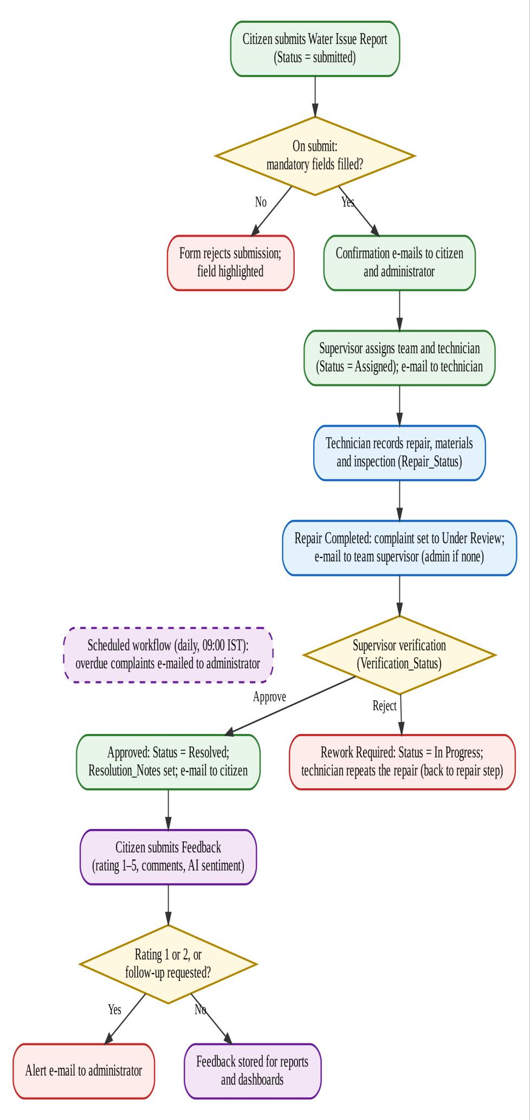
How the System Works
Citizen submits Water Issue Report (status: submitted); mandatory fields are validated
Confirmation e-mail goes to citizen and administrator
Supervisor assigns team and technician; status becomes Assigned; technician is e-mailed
Technician records the repair: times, cost, water loss, materials, checklist
Repair Status maps to the complaint: In Progress, On Hold, or Completed = Under Review
Supervisor verifies the repair: Approved = Resolved, citizen e-mailed; Rework Required = In Progress
Citizen submits feedback; rating 1–2 or follow-up request alerts the administrator
Dashboards update; daily 09:00 IST alert lists overdue complaints
Water Leakage & Wastage Reporting Management System | T Kaushika (240701239)
7
Notes:
Walk through top to bottom. Approved = Resolved; Rework Required = back to In Progress. Status is changed by form workflows in the same submission.

Slide 8
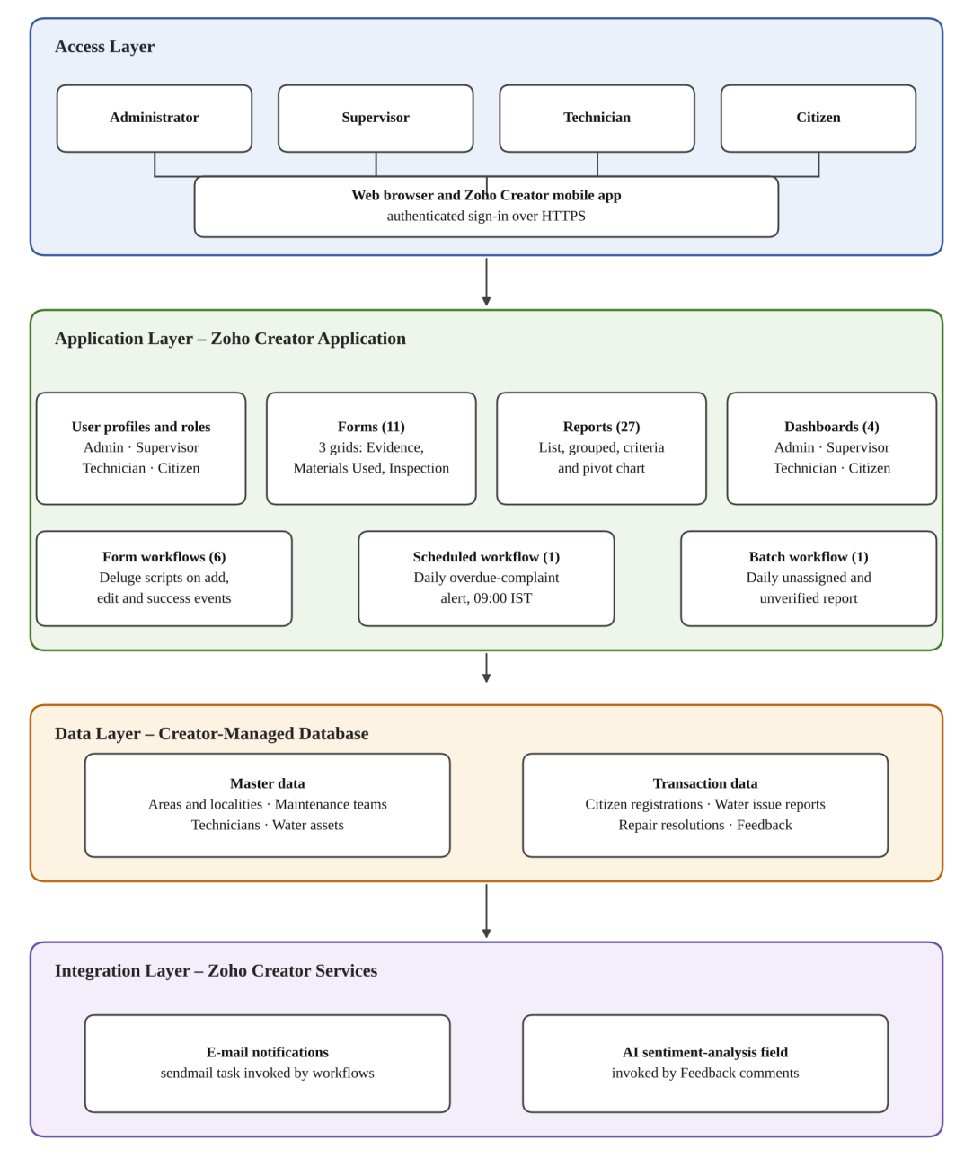
System Architecture
Access layer: all four roles use the web or Zoho Creator mobile app over HTTPS
Application layer: forms, reports, pages, workflows, Deluge scripts, profiles and roles
Data layer: Creator-managed database with master data and transaction data
Integration layer: Creator sendmail task and AI sentiment field
No external API or CRM is used in this version
Water Leakage & Wastage Reporting Management System | T Kaushika (240701239)
8
Notes:
Why no integrations: the platform mail task, reports and pages met every requirement; SMS, REST and CRM are future work.

Slide 9
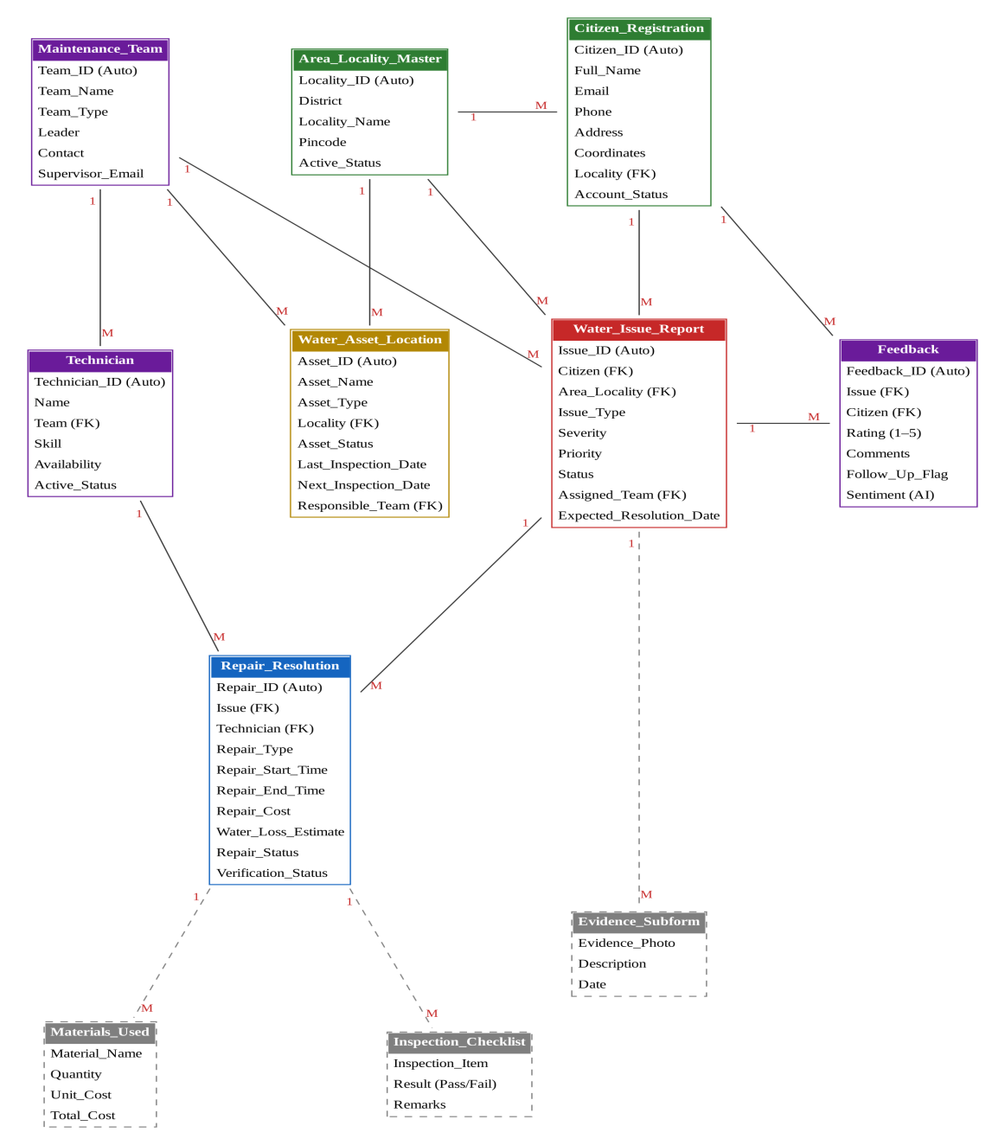
Data Model
Water Issue Report is the central form
Complaint links to citizen, area, team and technician
Repair Resolution links to one complaint and one technician
Feedback links to citizen and complaint
Area, team and technician masters feed the lookups
Dashed boxes are grid subforms
Water Leakage & Wastage Reporting Management System | T Kaushika (240701239)
9
Notes:
Lookups guarantee every complaint refers to an existing citizen, area and team.

Slide 10
Forms (11)
Form | Purpose | Key fields
Area_Locality_Master | Master list of districts and localities | Locality ID, district, locality, pincode, active status
Citizen_Registration | Registers citizens | Name, e-mail, phone, address, district, locality, status
Water_Issue_Report | Main complaint record | Issue ID, title, type, severity, priority, status, team, technician, expected date
Repair_Resolution | Repair work and verification | Issue, technician, repair type, times, cost, water loss, repair and verification status
Technician | Field staff register | Name, e-mail, phone, team, skill, availability
Maintenance_Team | Repair teams | Team type, leader, supervisor e-mail, district, size, availability
Water_Asset_Location | Asset register | Asset type, status, last and next inspection, responsible team
Feedback | Citizen feedback | Issue, rating 1–5, comments, follow-up flag, AI sentiment
Materials_Used | Materials per repair | Material, quantity, unit cost, total cost
Inspection_Checklist | Inspection per repair | Item, Pass/Fail result, remarks
Evidence_Subform | Complaint photos | Evidence photo, description, date
Water Leakage & Wastage Reporting Management System | T Kaushika (240701239)
10

Slide 11
Subforms (3 Grids)
Subform (grid) | Parent form | Fields | Use
Evidence_Subform | Water_Issue_Report | Evidence photo, description, date | Citizen attaches up to 10 photos of the problem
Materials_Used | Repair_Resolution | Material name, quantity, unit cost, total cost (quantity × unit cost) | Technician records materials; total is calculated automatically
Inspection_Checklist | Repair_Resolution | Inspection item, result (Pass/Fail), remarks | Technician records inspection results for the repair
Water Leakage & Wastage Reporting Management System | T Kaushika (240701239)
11
Notes:
Grids store many child rows inside one parent record, so photos, materials and checklist items stay linked to the complaint or repair.

Slide 12
Reports (1 of 3): Master Data and Assets
Report | Source form | Filter / grouping
Area/Locality Master Report | Area_Locality_Master | All rows
Citizen Registration Report | Citizen_Registration | All rows
Maintenance Team Report | Maintenance_Team | All rows
All Technicians | Technician | All rows
Technician Details | Technician | Only the logged-in technician (E-mail = login)
Water Asset Location Report | Water_Asset_Location | All rows
Water Asset Register | Water_Asset_Location | All rows, grouped by Asset Type
Materials Used Report | Materials_Used | All rows
All Inspection Checklists | Inspection_Checklist | All rows
Evidence Subform Report | Evidence_Subform | All rows
Water Leakage & Wastage Reporting Management System | T Kaushika (240701239)
12

Slide 13
Reports (2 of 3): Water Issues
Report | Source form | Filter / grouping
All Water Issues / Water Issue Report | Water_Issue_Report | All rows
Pending Issues | Water_Issue_Report | Status is not Resolved, Closed or Rejected
High-Priority Issues | Water_Issue_Report | Priority is High or Critical
District-wise Issues | Water_Issue_Report | All rows, grouped by District
Locality-wise Issues | Water_Issue_Report | All rows, grouped by Locality
Issue Type Analysis | Water_Issue_Report | All rows, grouped by Issue Type
Issue Type Split (pivot chart) | Water_Issue_Report | All rows, count by Issue Type
Priority Report (kanban) | Water_Issue_Report | All rows, arranged by Priority
My Complaints (technician view) | Water_Issue_Report | All rows (no criteria in the export)
My Complaints (citizen view) | Water_Issue_Report | Only complaints of the logged-in citizen (Citizen e-mail = login)
Water Leakage & Wastage Reporting Management System | T Kaushika (240701239)
13

Slide 14
Reports (3 of 3): Repairs and Feedback
Report | Source form | Filter / grouping
Repair Resolution Report | Repair_Resolution | All rows
Technician Performance | Repair_Resolution | Repair Status = Completed, grouped by Technician
Resolution Time | Repair_Resolution | Start and end time both filled, sorted by end time
All Feedback | Feedback | All rows
Citizen Feedback | Feedback | All rows, grouped by Sentiment
My Feedback | Feedback | Only the logged-in citizen (Citizen e-mail = login)
Own Citizen Registration | Citizen_Registration | Only the logged-in citizen (E-mail = login)
Water Leakage & Wastage Reporting Management System | T Kaushika (240701239)
14

Slide 15
Dashboards (4)
Dashboard | KPI panels | Charts | Embedded reports / forms
Admin | Total, pending, high-priority, resolved, overdue, awaiting verification | Complaints by district (column), by status (pie), issues by type (column) | High-priority, technician performance, all and pending issues, asset register, feedback
Supervisor | Complaints to review, high-priority, active repairs, awaiting verification | Complaints by locality (column), repairs by status (pie) | Pending, high-priority, repair resolution, locality-wise, performance, resolution time
Technician | Assigned issues, repairs in progress, completed repairs | None | My Complaints, repair resolution form and report, asset register
Citizen | Pending, resolved, total complaints | Issues by type (pie) | Complaint form, feedback form, My Complaints
Water Leakage & Wastage Reporting Management System | T Kaushika (240701239)
15
Notes:
Each dashboard binds KPI panels, charts and embedded reports directly to the forms, so figures reflect current data.

Slide 16
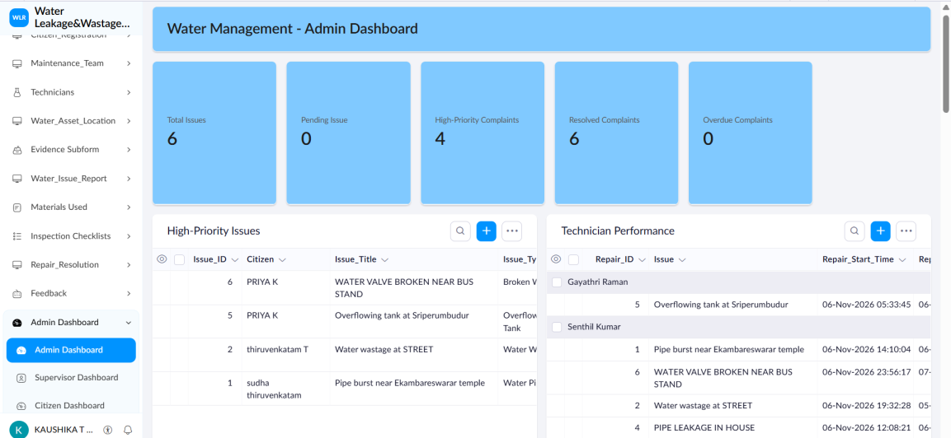
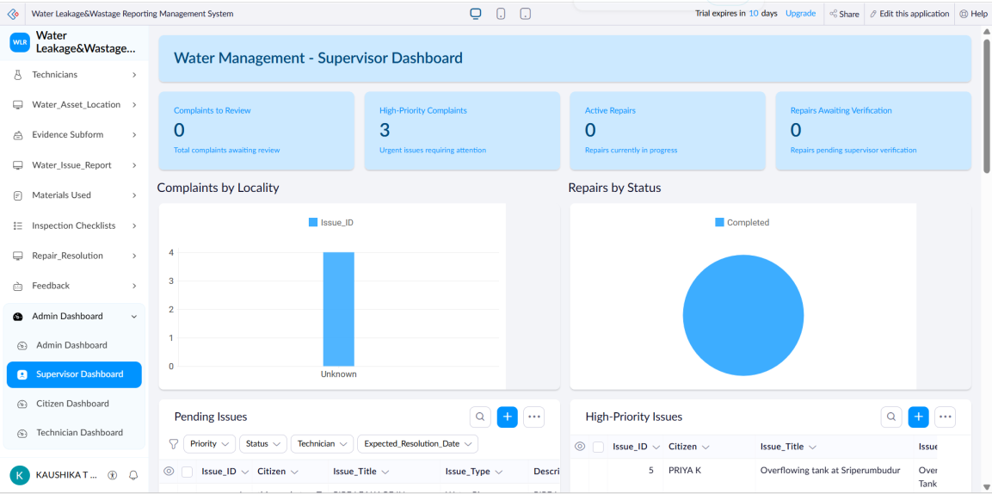
Dashboard Screenshots
Admin Dashboard
Supervisor Dashboard
Water Leakage & Wastage Reporting Management System | T Kaushika (240701239)
16

Slide 17
Workflows (8)
Workflow | Type / form | Trigger | Action
WF_Complaint_Submission_Confirmation | Form: Water Issue Report | On success of add | E-mail confirmation to citizen and administrator
WF_Technician_Assignment | Form: Water Issue Report | On edit, Technician updated | Status = Assigned; e-mail technician
WF_Repair_Progress | Form: Repair Resolution | On edit, Repair Status | In Progress / On Hold copied; Completed = Under Review; e-mail supervisor
WF_Repair_Verification | Form: Repair Resolution | On edit, Verification Status | Approved = Resolved, citizen e-mailed; Rework = In Progress, technician e-mailed
WF_Feedback_Follow_Up | Form: Feedback | On success of add | Alert administrator if rating is 1 or 2 or follow-up requested
Supervisor_Verification_Email | Form: Repair Resolution | On edit, Repair Status | E-mail team supervisor (duplicate of completion e-mail, see BUG-09)
WF_Daily_Overdue_Alert | Scheduled | Daily 09:00 IST | Locality-wise report as PDF; e-mail per overdue complaint
Daily_Assignment_and_Verification_Report | Batch (daily) | Daily | Administrator list of unassigned complaints and pending verifications
Water Leakage & Wastage Reporting Management System | T Kaushika (240701239)
17
Notes:
0 Blueprints, 0 approvals, 0 custom functions in v1.0. Closure approval via Blueprint is a planned enhancement.

Slide 18
Deluge Scripting
// WF_Technician_Assignment
if(input.Technician != null)
{
input.Status = "Assigned";
sendmail
[
from: zoho.adminuserid
to: input.Technician.Email
subject: "New Water Repair Assignment"
message: "..."
]
}
Forms, reports and dashboards: no-code
Status changes, e-mails and overdue alert: short Deluge scripts
Scripts fetch records, branch on status, update fields and call sendmail
Debugged with info statements, live-mode tests and execution logs
Water Leakage & Wastage Reporting Management System | T Kaushika (240701239)
18

Slide 19
Role-Based Access
Component | Admin | Supervisor | Technician | Citizen
Master forms | Full | View, edit some fields | Own details | Own details
Water Issue Report | Full | Assign, set status | View assigned | Create, view own
Repair Resolution | Full | Verify, view | Create, edit | No access
Feedback | Full | View | No access | Create, view own
Dashboard | Admin | Supervisor | Technician | Citizen
Role hierarchy: Admin > Supervisor > Technician; Admin > Citizen. Name, e-mail and phone of citizens and technicians are flagged as personal data.
Water Leakage & Wastage Reporting Management System | T Kaushika (240701239)
19
Notes:
Four permission profiles; TC-20 and TC-21 confirmed citizens and technicians see only their own records.

Slide 20
Testing and Review Findings
22 test cases traced to functional requirements FR-01 to FR-10; all recorded as pass
Levels: unit, integration, access and user acceptance testing
UAT with administrator, supervisor, technician and citizen; supervisor requested SMS alerts (future work)
Review of the export found 9 items, each with a proposed fix:
ID | Finding | Severity
BUG-01 | Admin KPI counts a status value that does not exist | High
BUG-06 | Overdue alert sends one e-mail per complaint; digest proposed | Medium
BUG-09 | Verification e-mail repeated on every repair status update | Medium
Others | Status casing, end-time validation, follow-up alert only on add, availability lists | Low / Medium
Water Leakage & Wastage Reporting Management System | T Kaushika (240701239)
20
Notes:
The abstract says eight findings but the defect log lists BUG-01 to BUG-09; make the report consistent. BUG-01 fix: count Repair Resolution records with Verification Status = Pending.

Slide 21
Limitations and Future Enhancements
Limitations | Future enhancements
Page builder offers fixed chart types | Fix BUG-01 to BUG-09
Workflow rules are not visible in the data model | Closure approval or Blueprint
E-mail is the only notification channel | SMS or push notifications
Water loss is entered manually | Meter and flow-sensor integration
Depends on Zoho hosting and release cycle | Month-on-month trends, locality ranking by water loss
 | District-wise permission sets
Water Leakage & Wastage Reporting Management System | T Kaushika (240701239)
21

Slide 22
Live Demo and Questions
Demo path: report issue, assign, repair, verify, feedback, dashboard
Live URL: water-complaint-portal.zohocreatorportal.in
Thank you
Water Leakage & Wastage Reporting Management System | T Kaushika (240701239)
22
Notes:
Keep citizen, supervisor, technician and admin logins ready.

