Slide 1





HbA1c Prediction from Retinal Fundus Images Using Multimodal Deep Feature Fusion and Ridge Regression
Paper ID : 101
Presented by:
School of Electronics Engineering (SENSE)
Vellore Institute of Technology ,Vellore, India- 632014.
Kaushik R Haran (kaushik.rharan2022@vitstudent.ac.in )
Nishtha Jain (nishtha.jain2022@vitstudent.ac.in)
Soham Khare (sohamamit.khare2022@vitstudent.ac.in)
Priyomedha Ghosh (priyomedha.ghosh2022@vitstudent.ac.in)
Under the guidance:
Dr. Jeeva J.B.
Associate Professor Senior
School of Electronics Engineering
Sensor and Biomedical Technology

Slide 2
Introduction
Diabetes Mellitus (DM) affects ~830 million people worldwide.
HbA1c is the gold standard biomarker for long-term glycemic control.
HbA1c testing requires invasive blood sampling and lab infrastructure.
Retinal fundus imaging provides non-invasive visualization of microvasculature.
Deep learning enables extraction of systemic biomarkers from retinal images.
This work explores non-invasive HbA1c prediction using multimodal deep learning.

Slide 3
Problem Statement
HbA1c measurement requires venepuncture and laboratory analysis.
Limited accessibility in rural and resource-constrained regions.
Most retinal AI studies focus on DR classification — not continuous HbA1c regression.
Small medical datasets risk overfitting in deep models.
Need for:
Leakage-free evaluation
Interpretable regression model
Multimodal integration (image + metadata)

Slide 4
Aim
To develop a non-invasive multimodal deep learning framework for predicting continuous HbA1c levels from retinal fundus images using demographic metadata and Ridge Regression under strict LOOCV evaluation.
Objectives
Extract deep retinal features using pretrained ResNet-18
Apply image preprocessing (bilateral filtering + normalization)
Fuse deep embeddings with age and gender
Use Ridge Regression to prevent overfitting
Evaluate using LOOCV (n=26)
Perform clinical agreement analysis (Bland–Altman, Clarke Grid)
Notes:
GAIT ANALYSIS AND PULL TEST.

Slide 5
Literature Review
S. No | Title | Authors | Journal | Key Points
1 | Development of oculomics artificial intelligence for cardiovascular risk factors: A case study in fundus oculomics for HbA1c assessment | J. Ong et al. | Asia-Pac. J. Ophthalmol. (2024) Vol. 13, Art. 100095 | Fundus-based HbA1c estimation using AI; highlights clinical feasibility and interpretability concerns
2 | Development and validation of a deep learning algorithm for detection of diabetic retinopathy | V. Gulshan et al. | JAMA (2016) Vol. 316, No. 22, pp. 2402–2410 | Large-scale CNN for automated DR detection; demonstrated high sensitivity and specificity; established clinical validation of retinal deep learning models
3 | Deep residual learning for image recognition | K. He, X. Zhang, S. Ren, J. Sun | Proc. IEEE CVPR (2016) | Introduced ResNet architecture; enables deep feature extraction (used in this study)
4 | Regularization and variable selection via the elastic net | H. Zou, T. Hastie | J. R. Stat. Soc. B (2005) 67(2):301–320 | Regularization theory; supports Ridge/Elastic Net methods for preventing overfitting
5 | HbA1c-dependent projection of long-term renal outcomes | F. Arnold et al. | J. Intern. Med. (2024) 295(2):206–215 | Demonstrates clinical importance of HbA1c as systemic risk predictor

Slide 6
Novelty
Research Gap:
Most studies → DR classification
Few → Continuous HbA1c regression
Ignore structured metadata
Weak validation strategies
Our work:
Multimodal feature fusion (image + age + gender)
Subject-level embedding averaging
Leakage-free LOOCV protocol
Ridge Regression for small-sample robustness
Clinical interpretability (Bland–Altman + Clarke Grid)

Slide 7
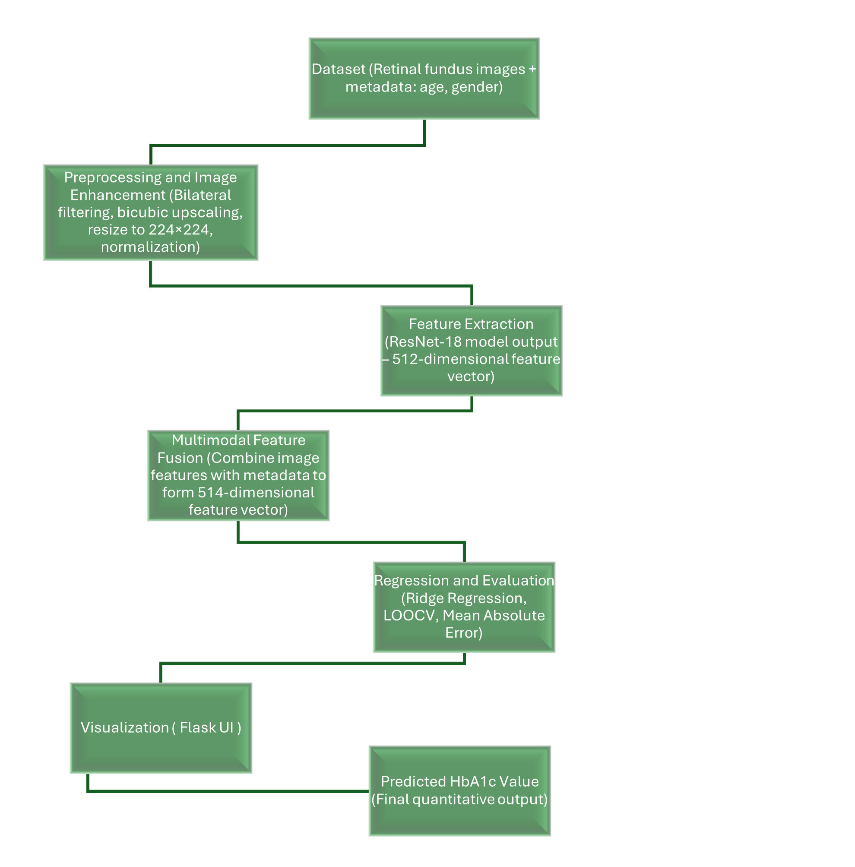
Block diagram/Flow chart
Pipeline:
Fundus Image Acquisition
Preprocessing (224×224 resizing, bilateral filtering)
ResNet-18 feature extraction (512-D vector)
Metadata fusion (Age + Gender → 514-D vector)
Ridge Regression
LOOCV Evaluation
Clinical Agreement Analysis

Slide 8
Methodology/Procedure
Dataset of 26 subjects with fundus image, age, gender, and HbA1c value
Images resized to 224×224, bilateral filtering applied, ImageNet normalization
Deep features extracted using pretrained ResNet-18 (512-D embedding)
Data augmentation (50 variations per subject); embeddings averaged to avoid duplication bias
Multimodal fusion: concatenate deep features + age + gender → 514-D feature vector
Ridge Regression used for HbA1c prediction to prevent overfitting
Evaluated using Leave-One-Out Cross-Validation (LOOCV)
Performance measured using MAE, RMSE, R², and clinical agreement analysis

Slide 9
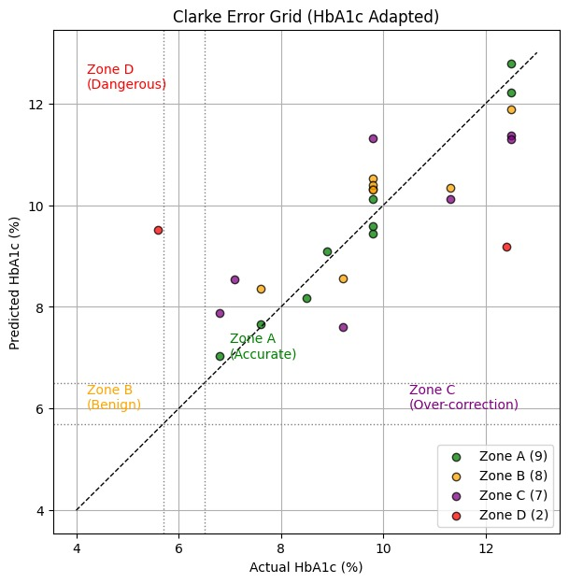
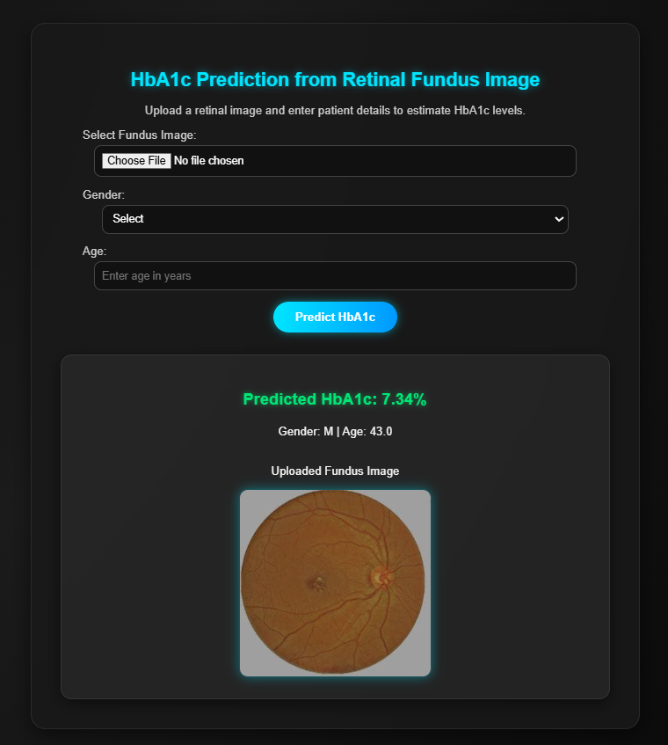
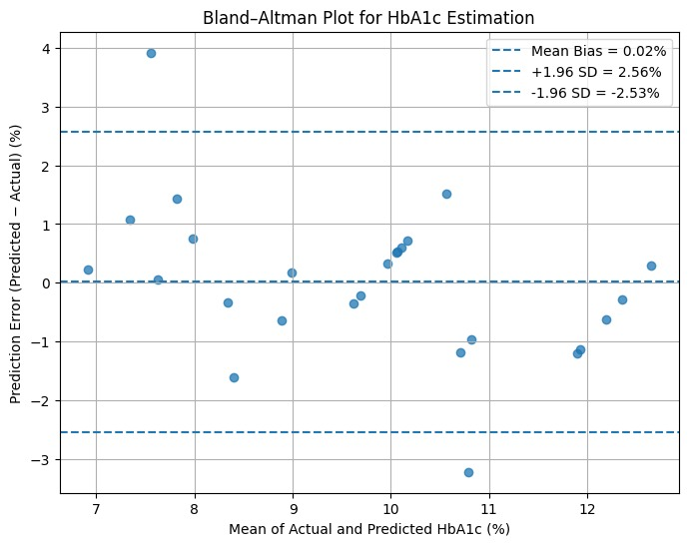
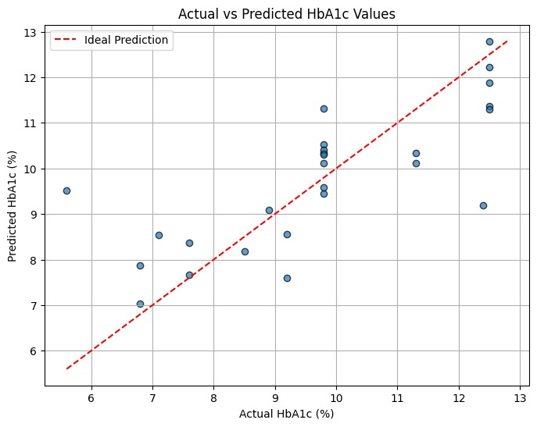
Result
LOOCV Performance:
MAE = 0.92%
RMSE = 1.28%
R² = 0.59
95% Bootstrap CI:
MAE: [0.63%, 1.30%]
RMSE: [0.76%, 1.77%]
R²: [0.30, 0.83]
Clinical Analysis:
65.4% predictions in Clarke Grid Zone A & B
Low mean bias in Bland–Altman analysis

Slide 10
Discussion
Physiological Insight
Chronic hyperglycemia causes retinal microvascular changes.
ResNet embeddings capture structural retinal features.
Moderate predictive correlation supports systemic-retinal link.
Clinical Implications
Useful for screening & triage
Not a replacement for lab testing
Suitable for low-resource settings
Limitations
Small dataset (n=26)
Only age & gender used
No external validation

Slide 11
Conclusion
Proposed multimodal framework for non-invasive HbA1c estimation.
Achieved moderate performance under strict LOOCV.
Retinal morphology contains quantifiable glycemic information.
Model serves as proof-of-concept.
Future work: multi-center validation, larger datasets, nonlinear models.

Slide 12
REFERENCE
[1] J. Ong et al., “Development of oculomics artificial intelligence for cardiovascular risk factors: A case study in fundus oculomics for HbA1c assessment and clinically relevant considerations for clinicians,” Asia-Pac. J. Ophthalmol., vol. 13, Article 100095, 2024, doi:10.1016/j.apjo.2024.100095.
[2] V. Gulshan et al., “Development and validation of a deep learning algorithm for detection of diabetic retinopathy,” JAMA, vol. 316, no.22, pp. 2402–2410, 2016, doi: 10.1001/jama.2016.17216.
[3] K. He, X. Zhang, S. Ren, and J. Sun, “Deep residual learning for image recognition,” in Proc. IEEE Conf. Comput. Vis. Pattern Recognit. (CVPR), Las Vegas, NV, USA, 2016, pp. 770–778, doi:10.1109/CVPR.2016.90.
[4] H. Zou and T. Hastie, “Regularization and variable selection via the elastic net,” J. R. Stat. Soc. Ser. B Stat. Methodol., vol. 67, no. 2, pp. 301–320, 2005, doi: 10.1111/j.1467-9868.2005.00503.x.
[5] F. Arnold et al., “HbA1c-dependent projection of long-term renal outcomes,” J. Intern. Med., vol. 295, no. 2, pp. 206–215, 2024, doi: 10.1111/joim.13736.

Slide 13
Thank you

