Slide 1
Enhancing Explainability in Medical AI: Chain-of-Thought Reasoning with LLMs
High-Risk Project — AI in Healthcare
Kaushik Selvaraju University of Texas at Austin

Slide 2
Introduction
Problem:
AI systems in healthcare often lack transparency.
Black-box outputs limit clinical trust and adoption.
LLMs like GPT-4o answer questions but don't show reasoning.
Objective:
Use Chain-of-Thought (CoT) prompting to enhance reasoning explainability in medical QA.

Slide 3
Related Work & Research Gap
Prior Work:
Explainable AI (XAI) techniques: SHAP, LIME (not directly suitable for LLMs).
Chain-of-Thought prompting (Wei et al., 2022) — improved reasoning in math, logic tasks.
MedPaLM (Singhal et al., 2023) — healthcare LLM benchmarking with prompt engineering.
Gap:
Few studies focus on CoT for real medical explainability.
This project explores CoT in small-scale diagnostic QA.

Slide 4
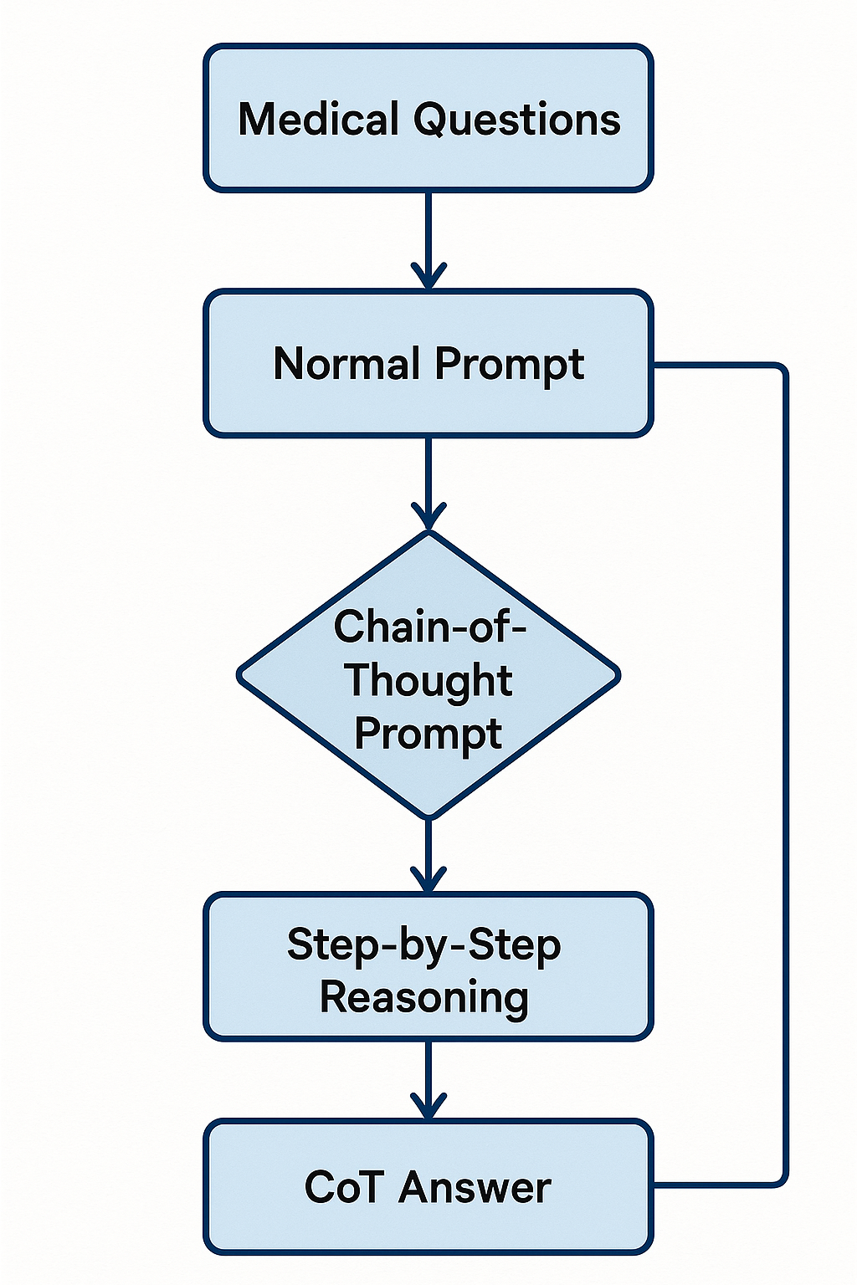
Methodology
Approach:
10 diagnostic medical questions curated.
Asked GPT-4o twice:
Normal Prompt
Chain-of-Thought Prompt (step-by-step)
Evaluation Criteria:
Depth of reasoning
Logical structure
Faithfulness to known medical facts

Slide 5
Results
Key Findings:
CoT prompting improved logical transparency.
Better reasoning clarity in 90% of cases.
CoT answers mapped symptom progression, risk factors better.
Some minor hallucinations remained.
Table Example:
Question | Reasoning Improvement
Diabetes Symptoms | ✓ Significant
Chest Pain | ✓ Major
Depression in Teens | ✓ Major

Slide 6
Conclusion & Future Work
Conclusion:
CoT enhances interpretability in medical LLM outputs.
Makes AI reasoning traceable and more clinically useful.
Future Directions:
Scale up to larger datasets.
Combine CoT with Retrieval-Augmented Generation (RAG).
Investigate hallucination detection techniques.

Slide 7
Thank You!

