Slide 1
Bootcamp Journey
Week-6
M Kaushik
mkaushik.kaushik@team.telstra.com​

Slide 2
Topics covered
API Gateway
KAFKA
Security Basics

Slide 3
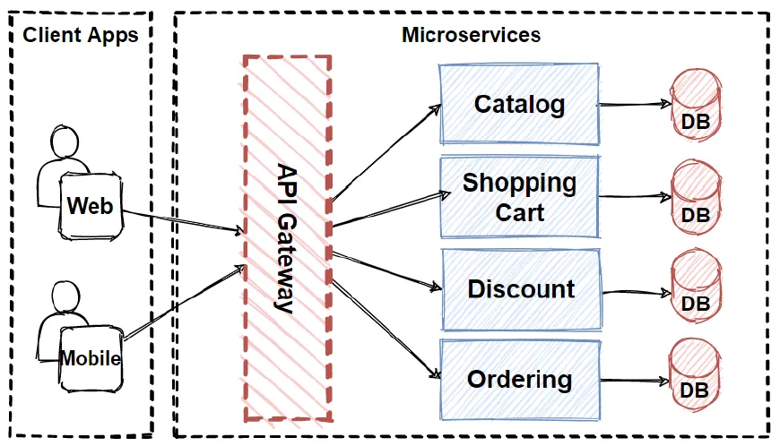
API Gateway

Slide 4
API Gateway
Uses of API Gateway
Request Routing: Routes client requests to the correct backend services, often aggregating responses.
Security: Manages authentication, authorization, and security measures like rate limiting.
Monitoring and Resilience: Provides logging, monitoring, and fault tolerance with retries, timeouts, and circuit breakers.

Slide 5
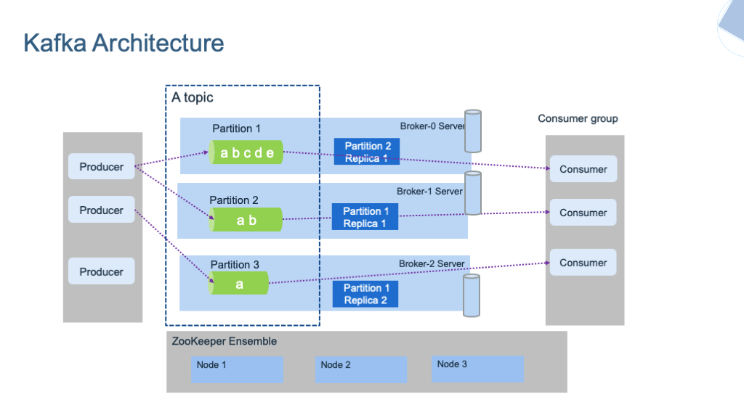
KAFKA

Slide 6
KAFKA
Kafka differs from other messaging systems in key ways:
Scalability: Kafka is designed for high throughput and scalability, supporting large volumes of data across distributed clusters with ease.
Durability: Kafka stores data on disk and replicates it across multiple nodes, ensuring durability and fault tolerance, unlike traditional systems that may lose messages if not consumed immediately.
Decoupling of Producers and Consumers: Kafka allows multiple consumers to read the same message independently, while other systems typically allow one-time consumption.
Stream Processing: Kafka supports real-time stream processing with tools like Kafka Streams, enabling complex event-driven architectures.

Slide 7
Security Basics
Security Principles:
Least Privilege: Give users and systems only the access they need, nothing more.
Defense in Depth: Use multiple layers of security to protect against threats.
Fail Securely: Ensure systems remain secure even when failures occur.
Minimize Attack Surface: Limit exposed features and entry points to reduce vulnerabilities.
Validate Input: Always check and sanitize inputs to prevent attacks.

Slide 8
Security Basics
OWASP:
OWASP Top 10: Highlights the most critical web security risks.
Open Source: Offers free, open-source security tools and resources.
Global Community: Backed by a worldwide community of experts.
OWASP Projects: Hosts numerous security projects, such as tools for vulnerability testing and secure development.
Industry Influence: OWASP resources are widely used by industries for compliance and security audits.
Standards Collaboration: Works with other organizations to develop security standards and frameworks.
Code Review Guides: Provides detailed guidelines on secure code review practices.
Mobile Security: Offers resources specific to mobile app security through the OWASP Mobile Security Project.

Slide 9
Thank you

