Slide 1
Bootcamp Journey
Week-7
M Kaushik
mkaushik.kaushik@team.telstra.com​

Slide 2
Topics covered
Basics of Network
Network layer: IPv4
Routing and Forwarding
EIGRP

Slide 3
Basics of Networking
OSI Model: The OSI model consists of 7 layers that guide the transmission of data, from physical hardware to application-level functions (e.g., Physical, Data Link, Network, etc.).
IP Addressing: Every device on a network is assigned an IP address, which is used to identify and route data to its destination.
Error Correction: Error correction techniques, like parity bits and checksums, ensure data integrity by detecting and fixing errors during transmission.
TCP/IP Protocol: TCP/IP is the fundamental protocol suite for internet communication, ensuring reliable data transmission through error handling and packet management

Slide 4
IPv4
Classful Addressing: IPv4 addresses are divided into classes (A, B, C, D, E), based on the network size and use case, with Class A for large networks and Class C for smaller networks.
Subnets: Subnets are created by dividing an IP address into smaller segments to organize networks efficiently and improve performance.
32-bit Address: IPv4 uses a 32-bit address format. It is written as four decimal numbers separated by dots (e.g., 192.168.1.1), with each number representing 8 bits.
Limited Address Space: IPv4 has a finite address space, which has led to the development of IPv6 to accommodate the growing number of internet-connected devices.

Slide 5
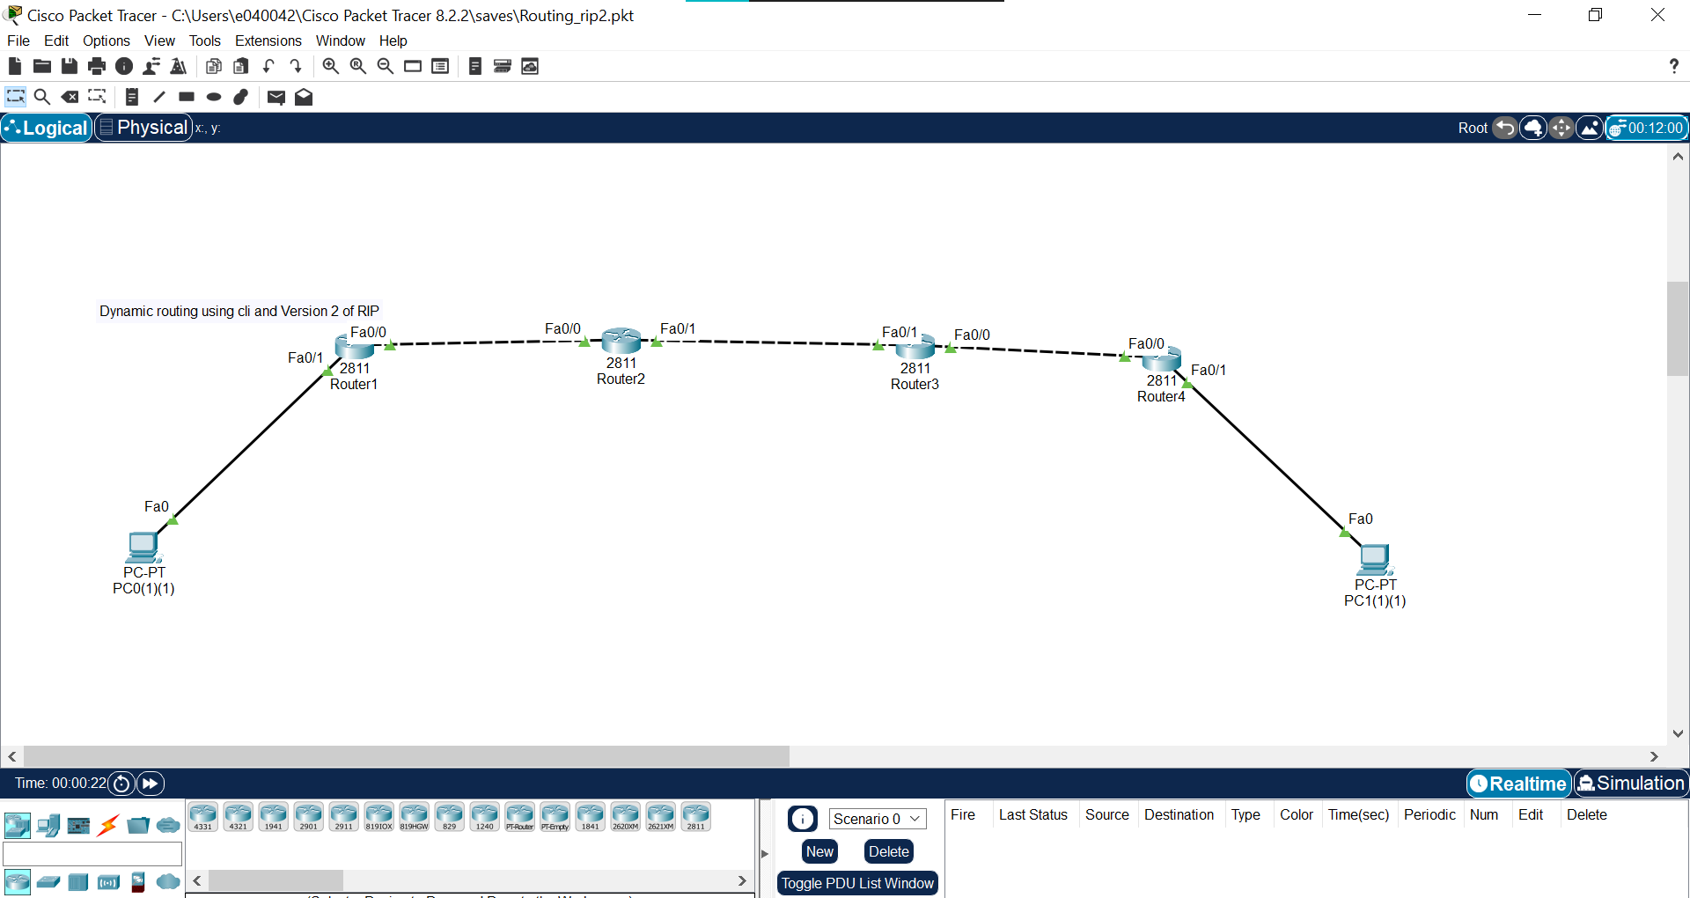
Routing and Forwarding
Fig. Routing using RIP version 2

Slide 6
Routing and Forwarding
Static Routing: In static routing, routes are manually configured by network administrators, making it simple but less flexible for large or changing networks.
Dynamic Routing: Dynamic routing uses protocols (e.g., OSPF, RIP, BGP) to automatically update routing tables based on network changes, allowing for adaptability and scalability.
Packet Forwarding: Routers forward data packets between networks by selecting the best path from the routing table, ensuring the packet reaches its destination.
Routing Table: The routing table contains information about network paths and is used by routers to determine the next hop for forwarding packets based on the destination IP address.

Slide 7
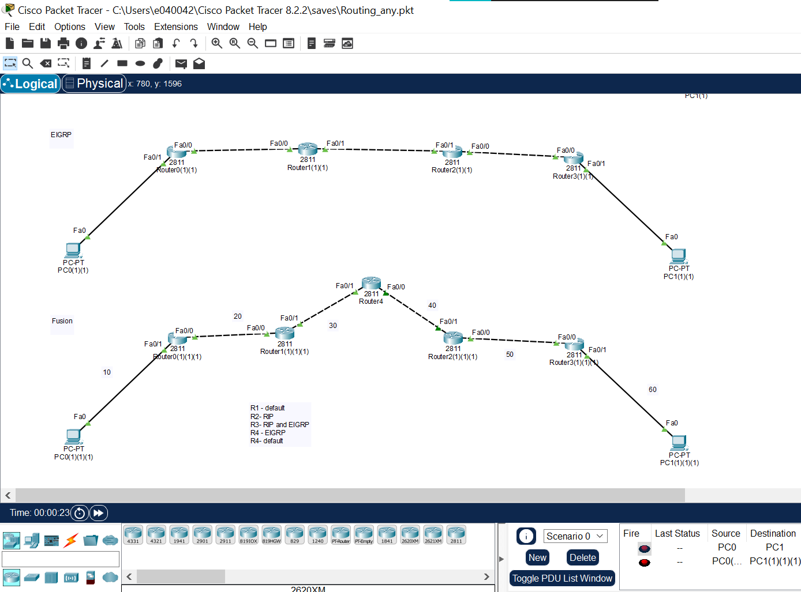
EIGRP
Hybrid Protocol: EIGRP is a hybrid routing protocol that combines features of both distance vector and link-state protocols for efficient routing.
Fast Convergence: EIGRP uses the Diffusing Update Algorithm (DUAL) to ensure fast convergence, quickly adapting to network changes without major delays.
Metrics: EIGRP uses a composite metric based on bandwidth, delay, load, and reliability to determine the best path for routing.

Slide 8
Thank you

