Slide 1

Customer personality prediction
Kaushal Shukla

Slide 2
Table of content
Problem Statement
Objectives and Benefits
Steps Followed
Visualization

Slide 3
Problem Statement
Customer Personality Analysis is a detailed analysis of a company’s ideal customers. It helps a business to better understand its customers and makes it easier for them to modify products according to the specific needs, behaviors and concerns of different types of customers.
Customer personality analysis helps a business to modify its product based on its target customers from different types of customer segments. For example, instead of spending money to market a new product to every customer in the company’s database, a company can analyze which customer segment is most likely to buy the product and then market the product only on that particular segment.

Slide 4
Objectives and Benefits
Objective
What people do: which reveals what people are doing rather than what they are saying about your product.
To predict the best segment of customers having highest probability of purchase
Benefits
Through data we will get to know about some patterns for our customers behaviour
Data visualization will help us identify criteria affecting the purchase probability

Slide 5
Dataset overview
Dataset name : marketing_campaign.csv
Format : CSV(comma sepereted value)
Size : 220kb
No. of Columns : 29
No. of Rows : 2240

Slide 6
Dataset information
Id : customer id
Year_Birth : Birth year of customer
Education : Highest education of customer
Marital_Status : marital status
Income : annual income
Kidhome : number of kids at home
Teenhome : number of teen at home
Dt_Customer : date of customer enrollment in company
Recency : Number of days since last purchase
MntWines : Amount spend on wines in last 2 years
MntFruits : Amount spend on Fruits in last 2 years
MntMeatProducts : Amount spend on MeatProducts in last 2 years
MntFishProducts : Amount spend on Fish Products in last 2 years
MntSweetProducts : Amount spend on SweetProducts in last 2 years
MntGoldProds : Amount spend on Gold Prods in last 2 years
NumDealsPurchases : Number of purchases made from deals
NumDealsPurchases : Number of purchases made from website
NumDealsPurchases : Number of purchases made from catalog
NumDealsPurchases : Number of purchases made from store
NumDealsPurchases : Number of web visit in last month
AcceptedCmp1 : 1, if purchase made in campaign 1
AcceptedCmp2 : 1, if purchase made in campaign 2
AcceptedCmp3 : 1, if purchase made in campaign 3
AcceptedCmp4 : 1, if purchase made in campaign 4
AcceptedCmp5 : 1, if purchase made in campaign 5
Complain : Complain made in last 2 years
Z_costcontact : contact cost(constant)
Z_Revenue : Revenue (constant)
Response : 1 if purchase made in last campaign

Slide 7
Real world data
Raw data collection
Importing Libraries in JupyterNB
Loading Dataset
Data-Preprocessing
Performing EDA
Modeling
Power BI desktop
Insights
Deployment
Architecture

Slide 8
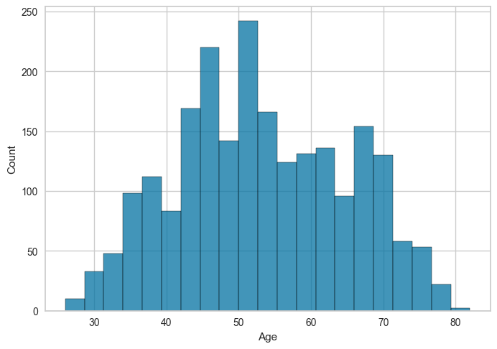
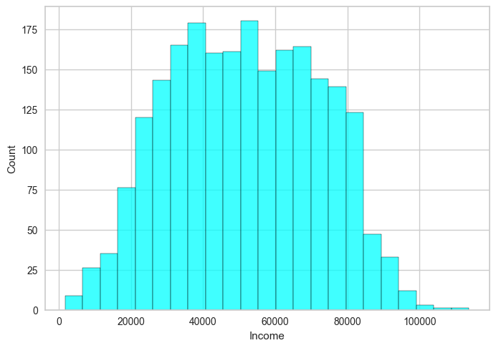
INSIGHTS
The range of customers is between 30 and 80
Income range of customers

Slide 9
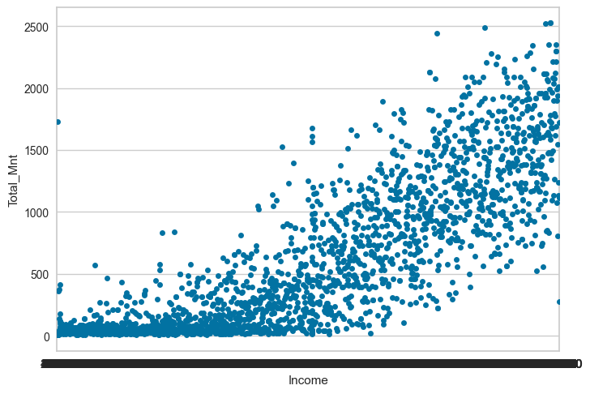
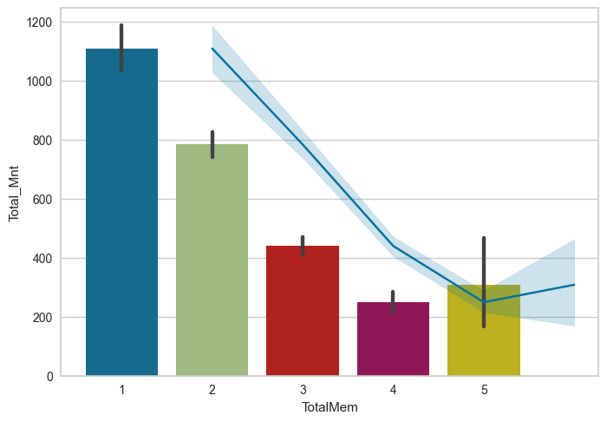
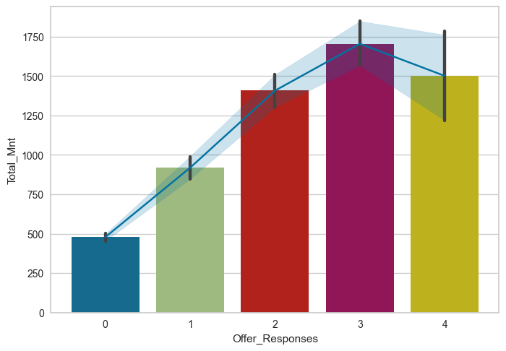
How much they spend on products.
Overall it increases with increase in income
People with less family members are spending more from us.
It increases with respect to number of offer they accept

Slide 10
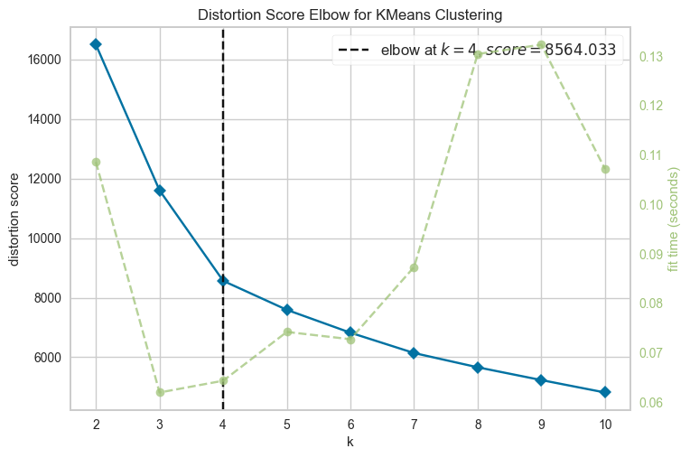
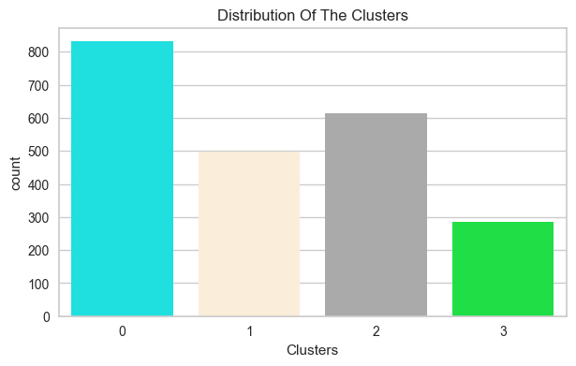
Modeling
We are using K-Means clustering.
To determine number of clusters we’ve used KElbowVisualizer from yellowbrick.cluster.
from the obtained graph , we get total 4 clusters
There are total 4 clusters
Namely 0,1,2 and 3
Where number of is maximum for 0 and minimum for 3

Slide 11
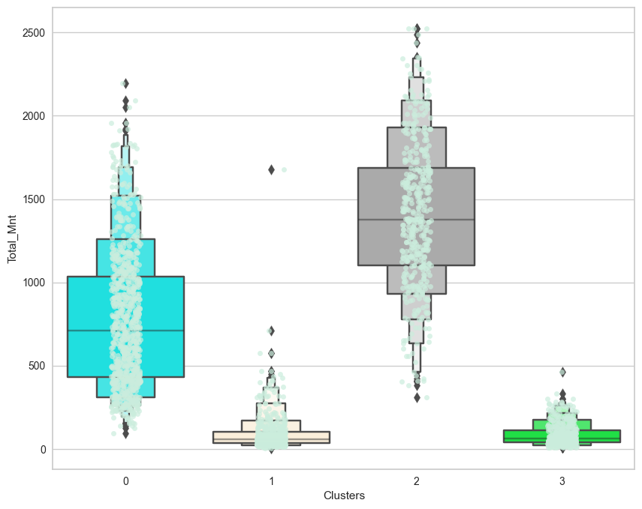
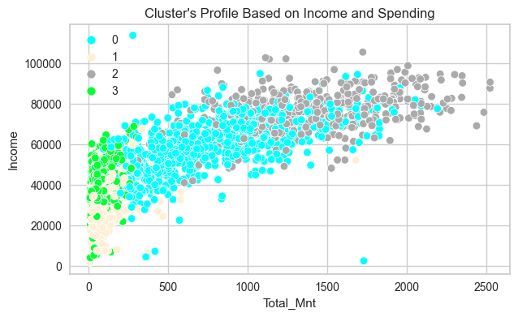
Observing Customer Type
Here we can observe that the cluster 0 and cluster 2 are having more overall spendings as compared to cluster 1 and 3.
Here cluster 0 is represented as Blue and Cluster 2 by Grey.
In this scatter plot with the color blue and grey , we can see that average income of cluster 2 is highest and 0 Is second highest.
Also the overall spendings of these two clusters are higher comparatively.

Slide 12
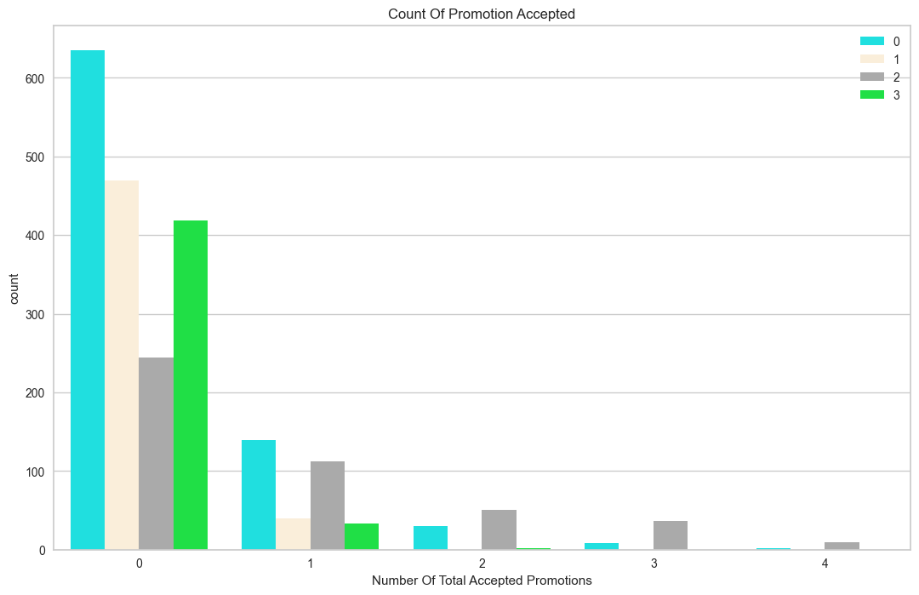
Offer Responses
In terms of over all Offer accepted , Blue and Grey are in lead comparatively.
Cluster 0 and 2 are having higher probability to accept the offers in future

Slide 13
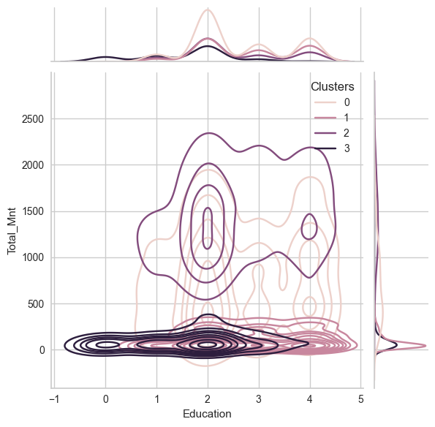
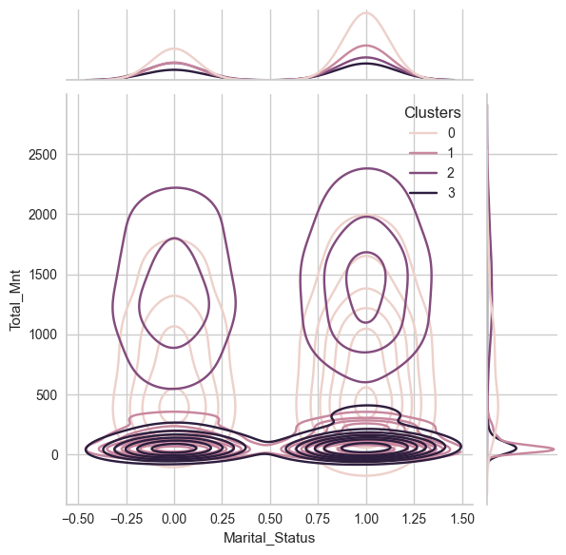
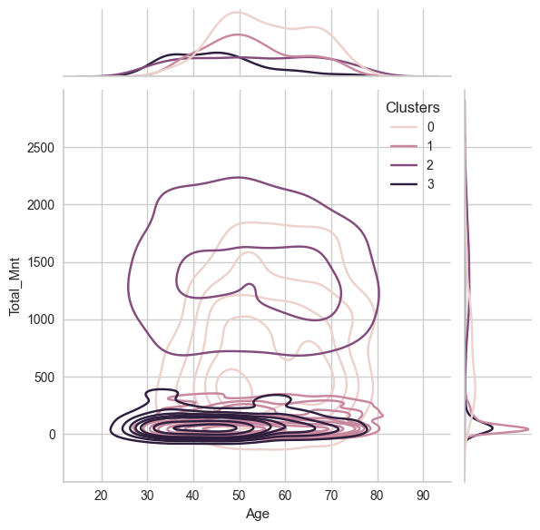
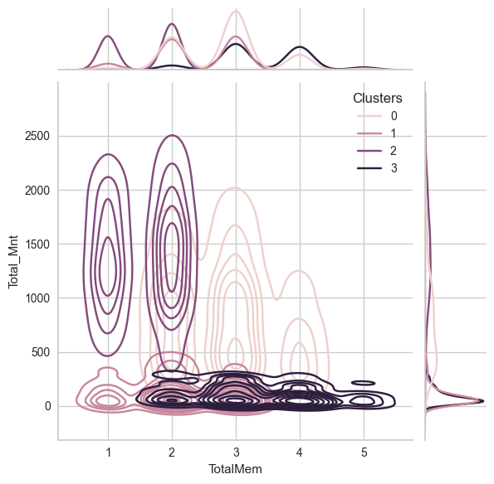
Other Factors
About Cluster 0:
1. They have atleast 2N cycle as education and Upto PHD
2. They are relatively older in age
3. Most likely to have a single child
4. Have 2-3 family members
About Cluster 1:
1. They majorly have basic education
2. They are relatively younger in age
3. Most likely they are not a parent or having max 1 child
4. Have 1-3 Total family members
About Cluster 2:
1. They have atleast 2N cycle as education and Upto PHD
2. From all age group
3. Definately not a parent
4. Have 1-2 Total family members
About Cluster 3:
1. They have atleast 2N cycle as education and Upto PHD
2. They are relatively older in age
3. Definately a parent
4. Have 2-5 Total family members

Slide 14
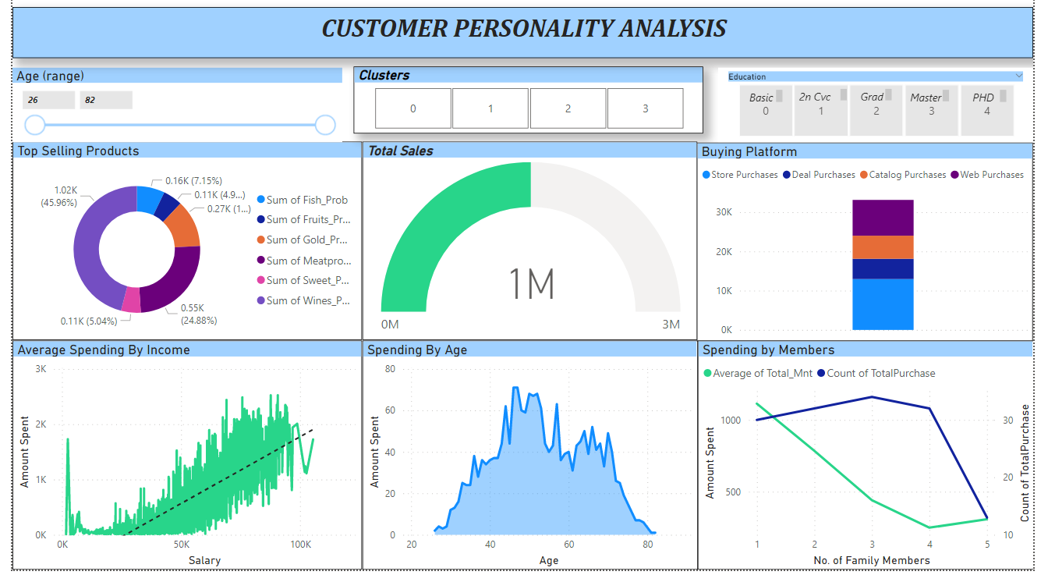
Power BI Dashboard

Slide 15
KEY PERFORMANCE INDICATOR (KPI)
Personality of customers
Age Distribution including Gender
Best performing products based on customer personality
Sales platform generating orders
Total spendings based on customers income and family members
Better audience for marketing for higher conversion rate

Slide 16
CONCLUSION
Customers of cluster 0 and 2 are having highest contribution in overall sales.
They have higher income (>60k avg.) comparatively.
Generally they are not parent or having maximum 1 child.
They are having family of size of 1-3 members.
Generally minimum education completed by them is atleast 2N Cycle.
They belong to higher age group.
Generally they prefer store and website for purchase
Best selling product is wine and meat products.

Slide 17
Q & A
Q1) What’s the source of data?
Ans. The Dataset was taken from iNeuron’s Provided Project Description Document - dataset
Q 2) What was the type of data?
Ans. The data was the combination of numerical and Categorical values.
Q 3) What’s the complete flow you followed in this Project?
Ans. Refer slide 7th for better Understanding
Q 4) What techniques were you using for data pre-processing?
Ans.
Removing unwanted attributes Visualizing relation of independent variables with each other and output variables Checking and changing Distribution of continuous values
Removing outliers
Cleaning data and imputing if null values are present.
Converting categorical data into numeric values.
Scaling the data
Q 5) What were the libraries that you used in Python?
Ans. I used Pandas, NumPy,sklearn , Matplotlib and Seaborn libraries in Pandas

Slide 18
Thank You

