Slide 1
Bus stop Prediction Analysis
Bus stop Prediction Analysis for Charge Point
Kausik
12 Dec 2025

Slide 2
Problem Statement
Need accurate bus stop identification from telematics data
  Static maps are outdated; actual stops differ
  Energy modeling requires precise stop–start behavior
  a dataset of 24,367 stop events for buses on a single route. A “stop” is defined as any point where the bus speed dropped below 0.5 m/s.
Columns in the dataset
lat: Latitude in WGS84
lon: Longitude in WGS84
start: Stop start time in milliseconds (UTC)
duration: Stop duration in seconds

Slide 3
Objective
Using only these stop events, we want to:
Detect all physical bus stops along the route from GPS stop data.
Estimate a robust location for each stop (to be used on maps and in models).
Characterize each cluster of stops, especially:
  how tight/loose is the cluster
  Duration profile (mean, variability, Coefficient of Variation)
Classify each location into:
  Regular Bus Stop
  Terminus / major stop
  Traffic / congestion zone

Slide 4
Approach
Data loading and preprocessing
Exploratory analysis of stop duration and spatial pattern
Filtering out “micro-stops” (too short to be bus stops, may be signal,curve etc)
Trip segmentation
Tuning DBSCAN parameters with a k-distance plot
DBSCAN clustering using the Haversine metric
Visualization of clusters vs noise
Cluster-level statistics and classification (Bus stop / Terminus / Traffic)

Slide 5
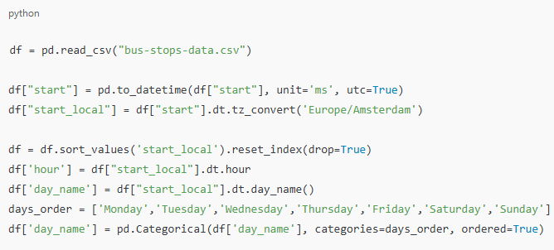
Data Loading and Preprocessing
Converts milliseconds to a timezone-aware datetime.
Converts UTC to Europe/Amsterdam time (relevant to the city/route).
Sorts stops chronologically.
Adds useful temporal fields:
Hour of day
Day of week (ordered Monday → Sunday)

Slide 6
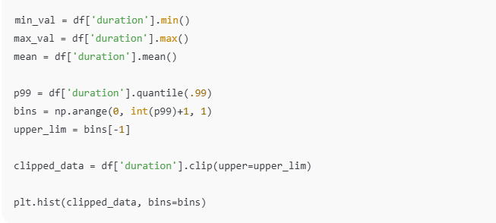
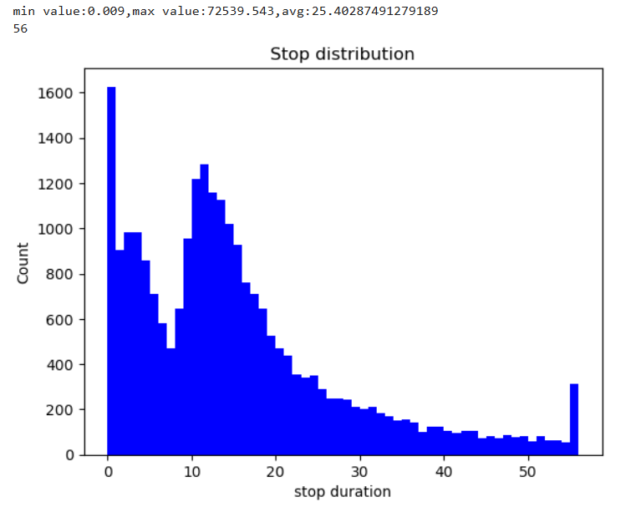
Exploratory Analysis-Duration
Check the range of stop durations.
Use the 99th percentile as an upper cap (p99) to avoid rare extreme stops from skewing the histogram.
Visually understand typical stop durations (most bus stops are short; very long durations could be layovers, breakdowns, or anomalies).
From the Histogram it is clear that duration has 2 peaks. To exclude micro-stop, consider below 8 seconds as cut-off.

Slide 7
Exploratory Analysis-Duration
Check the range of stop durations.
Use the 99th percentile as an upper cap (p99) to avoid rare extreme stops from skewing the histogram.
Visually understand typical stop durations (most bus stops are short; very long durations could be layovers, breakdowns, or anomalies).
From the Histogram it is clear that duration has 2 peaks. To exclude micro-stop, consider 8 seconds as cut-off.

Slide 8
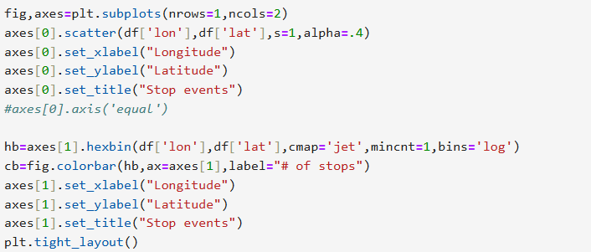
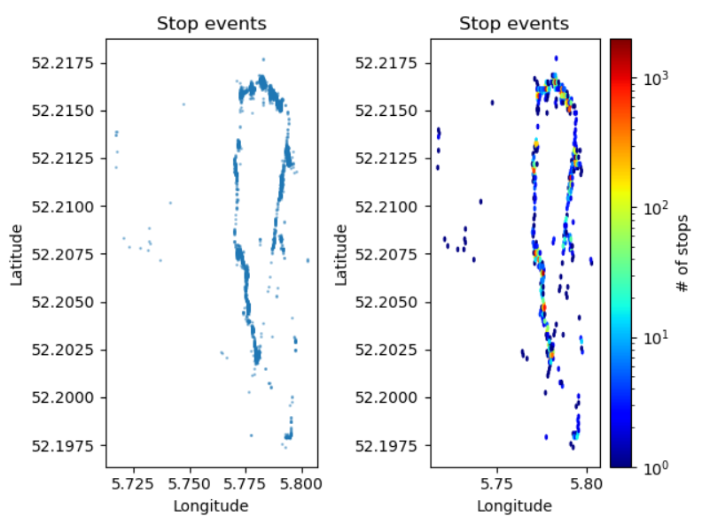
Visualization
Visually the route between
  Latitude:52.2175 and 52.2025
  Longitude: 5.75 and 5.80
  Other points may be detour
  Visualize the clusters

Slide 9
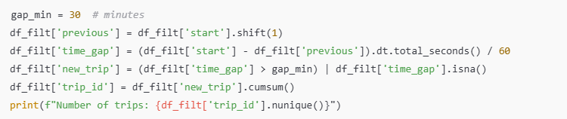
Trip Segmentation
Computes the time gap between consecutive stops.
If the gap > 30 minutes, it is treated as a new trip.
Each stop is assigned a trip_id
Around 314 trip data available

Slide 10
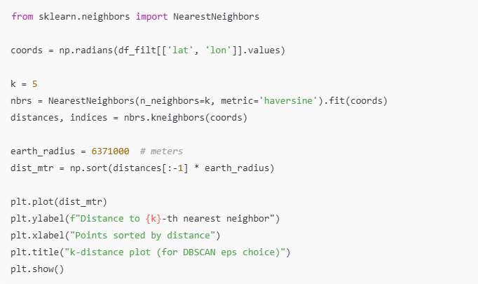
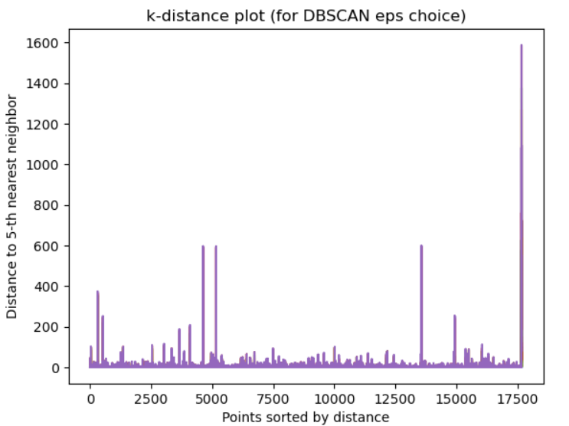
DBSCAN Methodology
NearestNeighbors with Haversine metric gives distances along the Earth’s surface.
The k-distance plot helps visually locate a “knee” or elbow where distances start increasing sharply.
That elbow is used to set eps (neighborhood radius) for DBSCAN.
From the k-distance plot eps~40 mtrs

Slide 11
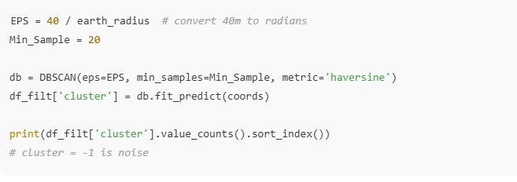
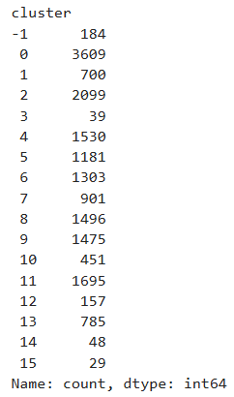
DBSCAN Methodology
Hyperparameters :eps,min_sample,metric
Clusters generated: 16 (including noise)
Cluster -1 = Noise
Cluster >=0 → physical stop location

Slide 12
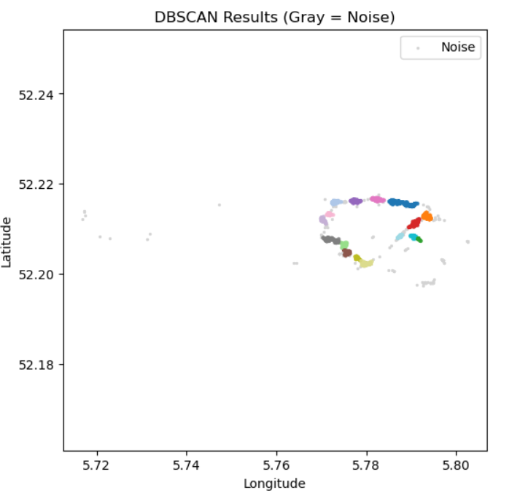
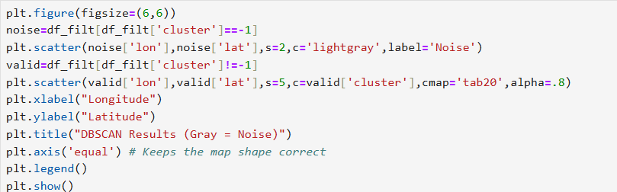
DBSCAN Methodology – Cluster Visualization
Confirms that cluster centers align along the bus route.
Distinguishes dense stop locations (colored clusters) from noise (gray points).

Slide 13
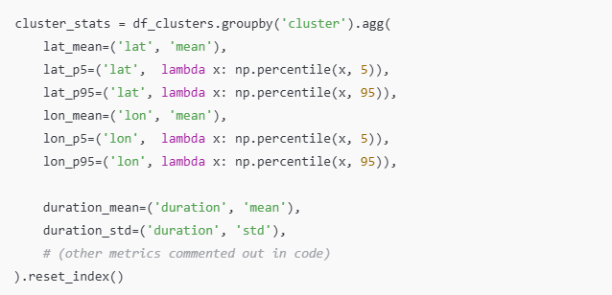
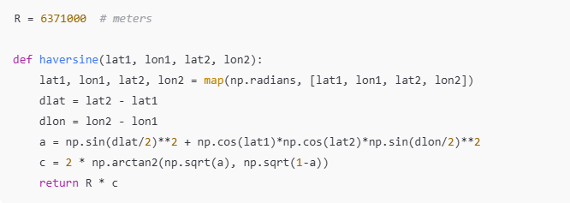
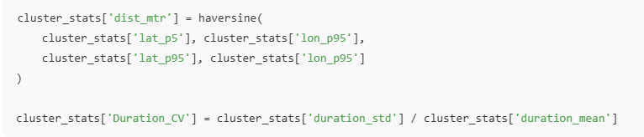
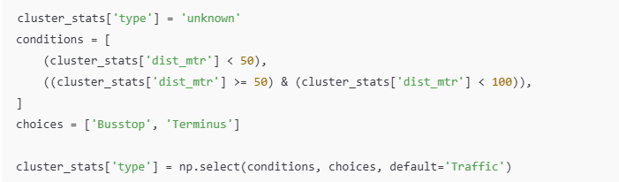
Cluster Statistics (1)
lat_p5/lon_p5 and lat_p95/lon_p95: 5th and 95th percentile bounds of each cluster in latitude and longitude → robust to outliers
dist_mtr: approximate physical diameter of the cluster between these percentiles → how “spread out” the cluster is.
uration_CV: Coefficient of variation of stop duration.
Low CV → consistent duration → scheduled bus stop.
High CV → variable duration → more like traffic congestion or signals.

Slide 14
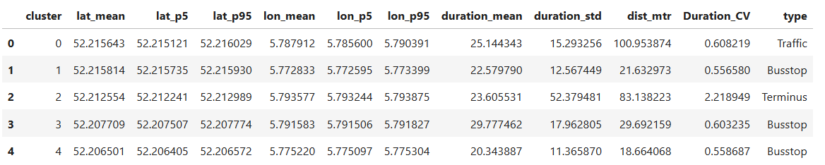
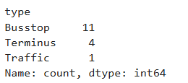
Cluster Statistics (2)
1st 5 rows shown
Duration variation is not consistent. Spatial spread used for type classification.
  dist_mtr < 50 m → Busstop
  50 m ≤ dist_mtr < 100 m → Terminus (larger area, potentially multiple stopping positions, end-of-line or hub)
  dist_mtr ≥ 100 m → Traffic (spread-out region → congestion zone or long traffic corridor)

Slide 15
Solution Summary
Automatic detection of physical stop locations
  Using DBSCAN with Haversine metric over filtered stop points.
  Each cluster corresponds to a candidate bus stop / stop area.
Robust geographical position per stop
  Cluster-level lat_mean and lon_mean give a stable center for mapping.
  5th–95th percentile lat/lon + Haversine spread give a robust stop “radius”.
Stop behavior characterization
For each cluster, you now have:
  Mean stop duration (duration_mean)
  Duration variability (duration_std, Duration_CV)
  Spatial spread (dist_mtr)
Classification into operational categories
  Busstop: tight spatial cluster (dist_mtr < 50 m), likely regular stop.
  Terminus: moderate spread (50–100 m), representing terminals or larger hubs.
  Traffic: large spread (≥100 m), indicative of congested segments or long queues.
Noise rejection
  Outlier or infrequent stop events automatically labeled cluster = -1 and excluded from stop inventory.

Slide 16
Business Use Case
Energy prediction models
Each cluster becomes a feature in energy models — Basic statistics about the clusters help to know when bus slows down, how long it usually stays, and how consistent that pattern is.
Route planning & operations
  Identify traffic cluster
  Validate or update official bus stop locations.
Data-driven map maintenance
  Over time, this approach can be re-run to detect new stops or changes in stop usage, even when the underlying map is outdated.

Slide 17
Enhancement Opportunities
Speed profile before/after stops
  Hourly/weekday duration patterns
  Odometer-based stop spacing
  Weather affected stopping
  Feature engineering
  Door open/close/passenger count
  Stop level classification using Machine learning

