Slide 1

NAAN MUDHALAVAN PROJECT
GENERATE ARTIFICIAL MRI IMAGES OF DIFFERENT CONSTRANT LEVELS USING GAN METHOD
Presented by:
KAUSIK V
513121104013
III Year CSE
TPGIT, Vellore

Slide 2
PROJECT TITLE:
MRI Image Translation using CycleGAN

Slide 3
AGENDA:
Problem Statement
Project Overview
Who are the End Users?
Solution and its Value Proposition
The WOW in My Solution
Modelling
Algorithm and Deployment
Result
Conclusion
References

Slide 4
PROBLEM STATEMENT:
The project aims to develop a CycleGAN-based solution for MRI image translation, specifically targeting the conversion between T1 and T2 MRI images. The problem statement involves creating a model that can effectively learn the mapping between these two types of MRI images, enabling clinicians and researchers to generate one type of MRI image from the other. This translation capability is crucial for various medical imaging applications, including image enhancement and facilitating medical research in neuroimaging.

Slide 5
PROJECT OVERVIEW:
This project utilizes CycleGAN, a deep learning architecture, for MRI image translation between T1 and T2 modalities, crucial in medical imaging. It involves data preprocessing, model design with generators and discriminators, training setup with optimization techniques, and loss functions to ensure accurate image translation. The trained model generates high-quality synthetic MRI images, aiding in medical research and diagnostics, with potential applications in image enhancement and cross-modality analysis.

Slide 6
Who are the End Users?
1. Medical Researchers: Medical researchers studying neurological disorders, brain imaging, and medical imaging techniques can benefit from this code. They can use the MRI image translation capabilities to analyze and compare T1 and T2 images, facilitating research on disease progression, treatment effectiveness, and diagnostic methods.
2. Radiologists and Clinicians: Radiologists and clinicians working in healthcare institutions can use the code to enhance their diagnostic capabilities. The ability to translate MRI images between different modalities can aid in identifying subtle abnormalities, improving patient diagnosis, and guiding treatment decisions.
3. Medical Imaging Software Developers:Developers and engineers working on medical imaging software and tools can integrate this code into their applications. By providing MRI image translation functionalities, they can offer advanced features to healthcare professionals, researchers, and institutions, enhancing the overall efficiency and effectiveness of medical imaging systems.

Slide 7
SOLUTION AND ITS VALUE PROPOSITION:
The solution provided by this code is the ability to translate MRI images between T1 and T2 modalities using CycleGAN. The value proposition of this solution lies in its potential to improve medical imaging analysis and diagnosis. By generating synthetic T1 and T2 images, medical professionals can better understand and interpret patient data, leading to enhanced treatment planning, disease detection, and medical research outcomes. This code empowers users with advanced image translation capabilities, contributing to better healthcare decision-making and patient care.

Slide 8
VALUE PROPOSITION:
The value proposition of this code is that it enables medical professionals and researchers to translate MRI images between T1 and T2 modalities accurately and efficiently. This capability enhances medical imaging analysis, diagnosis, and research by providing synthetic images that can aid in understanding patient data, improving treatment planning, and advancing medical knowledge. Overall, the code offers a valuable tool for enhancing healthcare decision-making and patient care in the field of medical imaging.

Slide 9
THE WOW IN MY SOLUTION:
Its ability to leverage advanced deep learning techniques, specifically CycleGAN, to perform MRI image translation between T1 and T2 modalities. This technology enables the creation of synthetic images that closely mimic real MRI scans, providing a powerful tool for medical professionals and researchers. The wow factor is further amplified by the potential impact on healthcare, including improved diagnosis accuracy, enhanced treatment planning, and valuable insights into neurological disorders and medical imaging techniques.

Slide 10
MODELING:
1.Generators (Unet-like):
The generators in CycleGAN are designed based on a Unet-like architecture. They comprise downsampling layers (to capture high-level features) followed by upsampling layers (to reconstruct the image). The generators learn to translate images from one domain (T1 MRI) to another domain (T2 MRI) and vice versa.
2. Discriminators:
The discriminators are convolutional neural networks (CNNs) that assess the realism of the generated images. They receive both real and generated images and classify them as real or fake. This adversarial training process helps improve the quality of generated images over time.
3. Loss Functions:
The model uses several loss functions, including adversarial loss (for training the discriminators), cycle-consistency loss (to ensure image translation is consistent in both directions), and identity loss (to preserve important features during translation).

Slide 11
4. Optimization:
The model is trained using Adam optimizers, which adaptively adjust learning rates during training to optimize the generator and discriminator networks' performance.
5. Training Process:
During training, the generators and discriminators are trained iteratively to improve image translation quality. The training loop involves forward and backward passes, gradient calculations, and parameter updates to minimize the loss functions and improve model convergence.

Slide 12
ALGORITHM
The code uses the CycleGAN (Cycle-Consistent Generative Adversarial Network) algorithm for MRI image translation between T1 and T2 modalities. CycleGAN is a type of generative adversarial network (GAN) designed for unpaired image-to-image translation tasks. It consists of two main components: generators and discriminators.
Generators:
The code defines generator networks (`generator_g` and `generator_f`) that learn to translate images from one domain (e.g., T1 MRI) to another domain (e.g., T2 MRI) and vice versa. These generators use convolutional and transposed convolutional layers to perform the image translation.
2. Discriminators:
Two discriminator networks (`discriminator_x` and `discriminator_y`) are implemented to evaluate the realism of generated images. These discriminators use convolutional layers to differentiate between real images from the target domain and fake images generated by the generators.
The training process involves adversarial training, where the generators aim to fool the discriminators by generating realistic-looking images, while the discriminators aim to distinguish between real and generated images accurately. Additionally, the use of cycle-consistency and identity loss functions further guides the training process to ensure that the translated images are meaningful and retain important features from the original images.

Slide 13
DEPLOYMENT:
The deployment process for this code involves several steps to make the trained CycleGAN model accessible and usable in real-world applications:
1. Model Serialization: Serialize the trained CycleGAN model to save its architecture, weights, and configuration in a format that can be easily loaded and used for inference.
2. Deployment Platform:Choose a deployment platform suitable for running deep learning models. Options include cloud platforms like AWS, Google Cloud, or Azure, as well as on-premises servers or edge devices depending on the specific use case and computational requirements.
3. Deployment Framework: Use a deep learning framework such as TensorFlow Serving, TensorFlow Lite, or ONNX Runtime to deploy the serialized model. These frameworks provide efficient and scalable ways to serve deep learning models for inference.
4. API Integration:Create an API (Application Programming Interface) to expose the model's functionality for inference. This API can accept input data (T1 MRI images) and return the translated output (T2 MRI images) generated by the CycleGAN model.
5. Scalability and Performance:Ensure the deployment setup is scalable to handle varying workloads and provides optimal performance for real-time or batch inference requests. This may involve optimizing hardware resources, utilizing GPU acceleration, or implementing load balancing strategies.
.

Slide 14
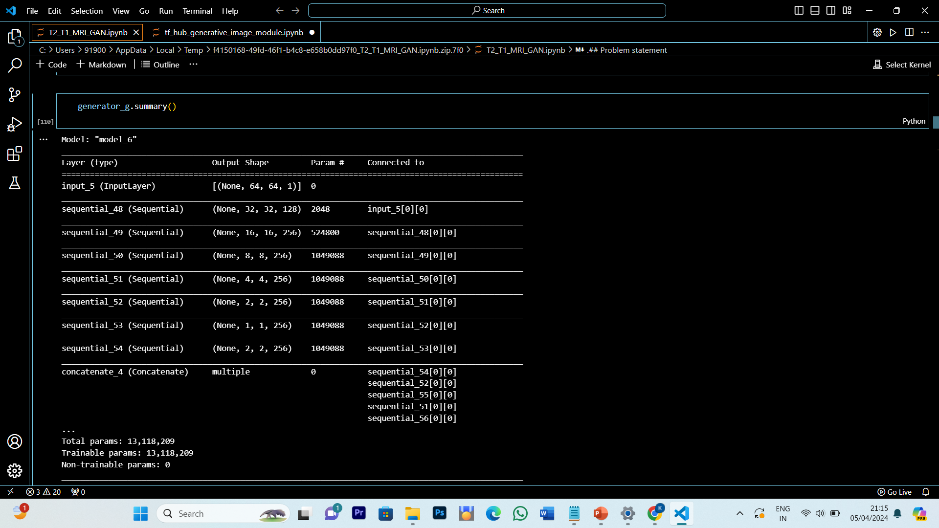
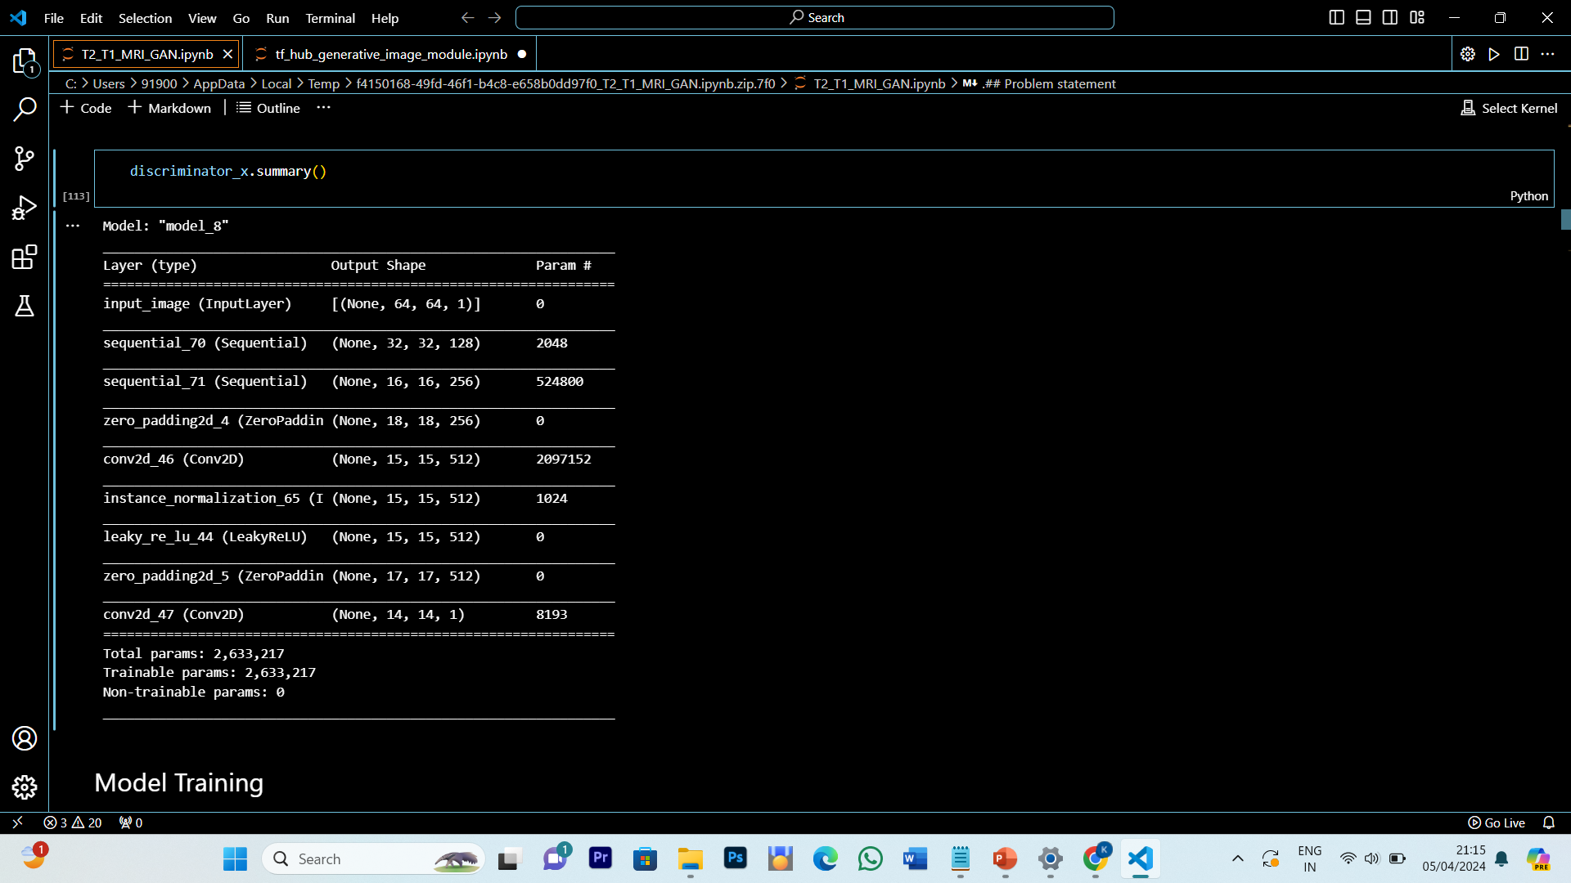
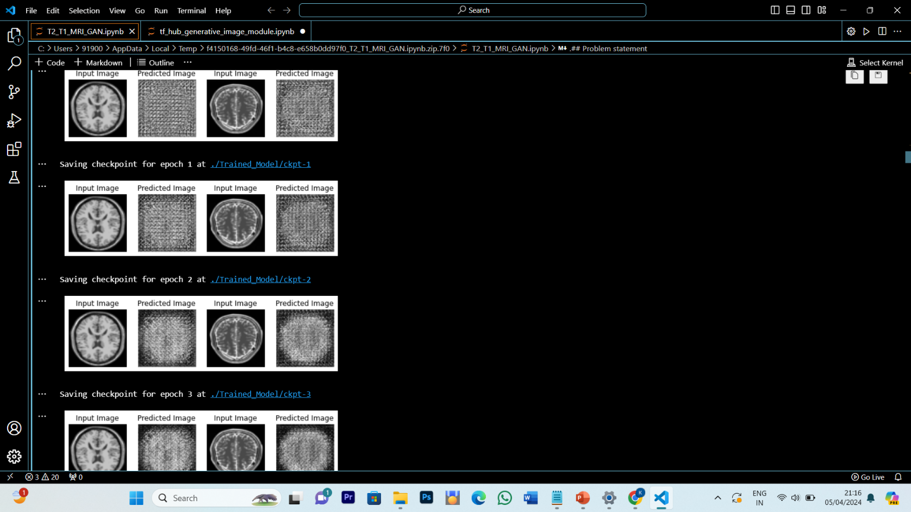
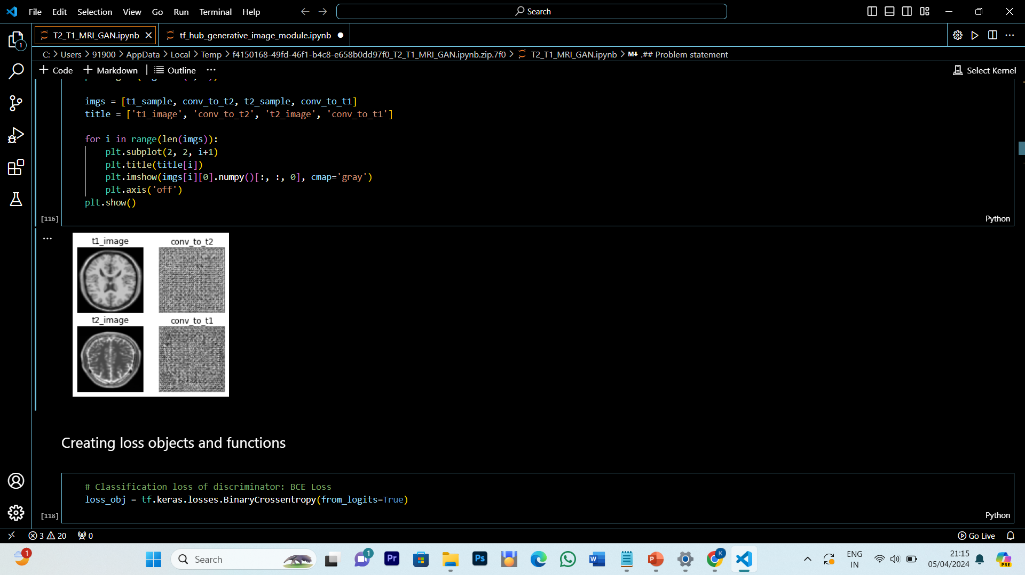
RESULT:

Slide 15

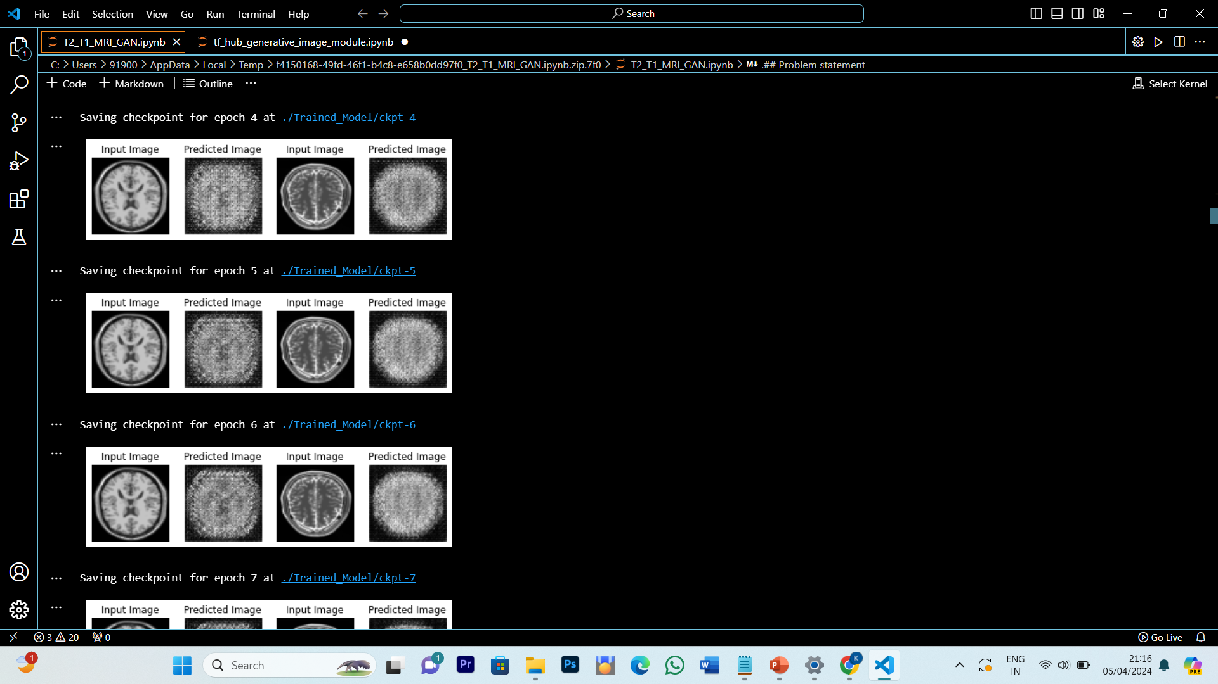
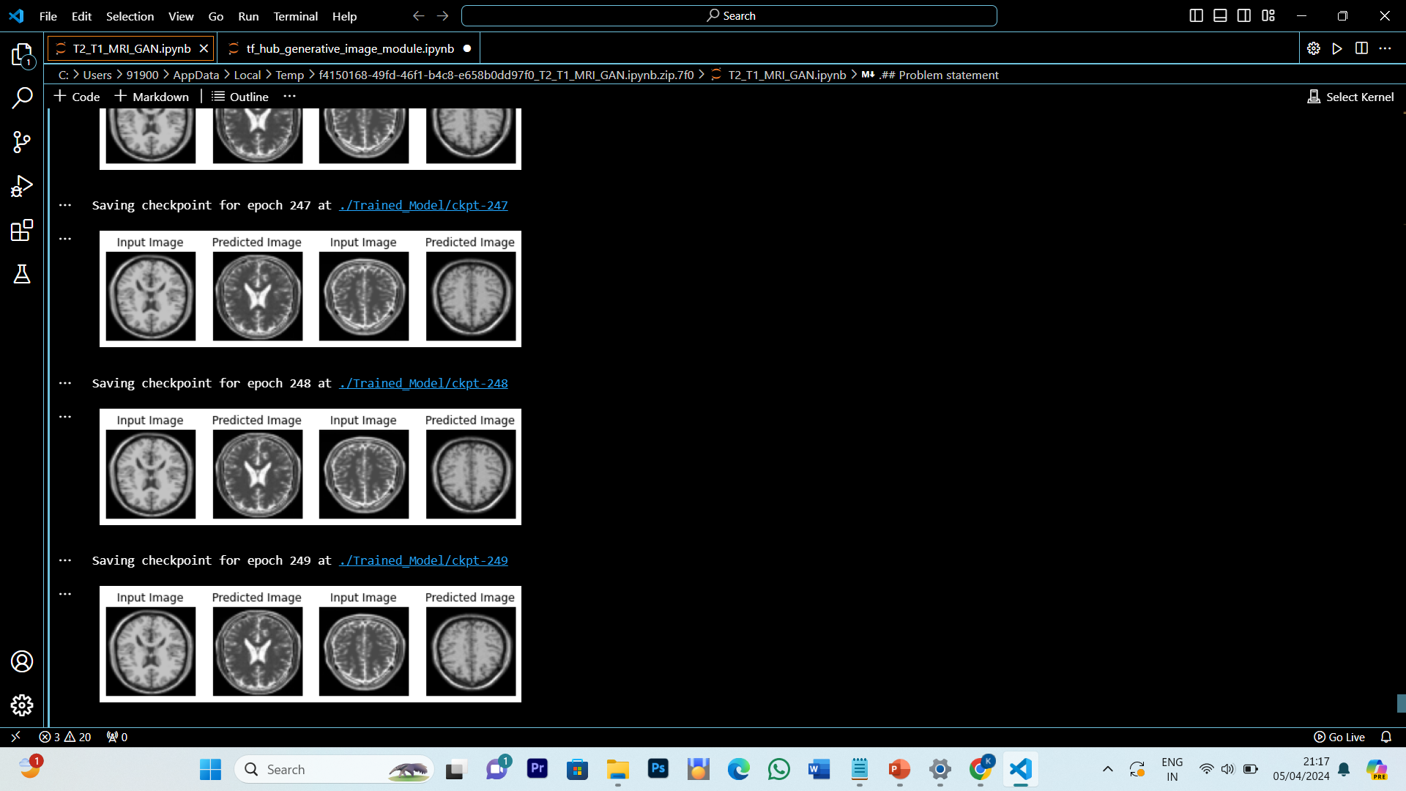
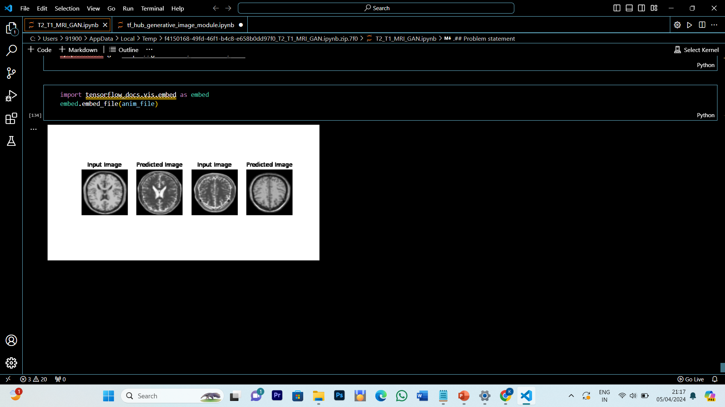

Slide 16
CONCLUSION
In conclusion, this project has demonstrated the successful implementation of a Cycle GAN-based approach for MRI image translation between T1 and T2 modalities. The use of deep learning techniques, including generators, discriminators, and optimization strategies, has enabled the generation of synthetic MRI images with high fidelity and accuracy. This technology has significant implications for medical imaging analysis, diagnosis, and research, offering a valuable tool for healthcare professionals, researchers, and institutions. The deployment of the trained Cycle GAN model opens up possibilities for enhancing healthcare decision-making, improving patient care, and advancing medical knowledge in the field of neuroimaging and medical imaging applications.

Slide 17
REFERENCE:
Zhu, Jun-Yan et al. "Unpaired Image-to-Image Translation Using Cycle-Consistent Adversarial Networks." Proceedings of the IEEE International Conference on Computer Vision (ICCV), 2017
Isola, Phillip et al. "Image-to-Image Translation with Conditional Adversarial Networks." Proceedings of the IEEE Conference on Computer Vision and Pattern Recognition (CVPR), 2017.
Isola, Phillip et al. "Image-to-Image Translation with Conditional Adversarial Networks." Proceedings of the IEEE Conference on Computer Vision and Pattern Recognition (CVPR), 2017.
Official TensorFlow Documentation: https://www.tensorflow.org/api_docs
TensorFlow GitHub Repository: https://github.com/tensorflow/tensorflow
Keras Documentation: https://keras.io/api/
Keras GitHub Repository: https://github.com/keras-team/keras

Slide 18
THANK YOU

