Slide 1
RAID and Introduction to Hadoop

Slide 2
What is RAID ?
RAID is data virtualization technology which combines multiple physical disks into one or more logical components.
RAID stands for Redundant array of Independent (Inexpensive) disks.
RAID is generally used for data redundancy purpose. (using commodity hardware)
RAID can be at Hardware/ Software levels.

Slide 3
Types of RAID
RAID comes with standard types like RAID 0,1,2,3,4,5,6 and nested type (hybrid) like RAID 10, 50 etc.
Most of the hybrid RAID levels are proprietary.
Reliability, availability, performance and capacity are the primary goals of RAID.
JBOD (Just a Bunch of Disks) in storage system does not use RAID and is simply a collection of stand-alone disks.

Slide 4
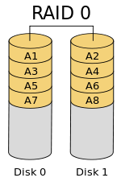
RAID 0 (Disk Stripping)
It splits the data across different Disks.
There is no duplication of data
Stripping can be at bit, byte or block level
Advantages
RAID 0 offers great performance, both in read and write operations. There is no overhead caused by parity controls.
All storage capacity is used, there is no overhead.
The technology is easy to implement.
Disadvantages
Not fault-tolerant.
Ideal Use
RAID0 is generally used for Live streaming or in video editing stations.
Minimum Disks - 2

Slide 5
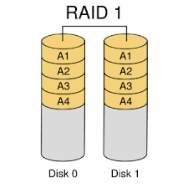
RAID 1 (Disk Mirroring)
Writes and reads identical data to pairs of device.
Primary function is to provide redundancy.
Advantages
Fault tolerance and easy data recovery.
Increases read performance.
Disadvantages
Lower usable capability. Higher cost per megabyte.
Ideal Use
RAID1 is generally used where data redundancy and availability is important.
Minimum Disks - 2

Slide 6
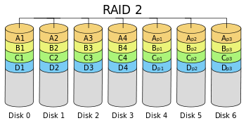
RAID 2 (Bit level Stripping)
Using hamming code, RAID2 stripes at bit level.
Advantages
Data protection by error correcting codes.
Disadvantages
Lower performance and reliability.
Ideal Use
RAID2 is no longer in usage.

Slide 7
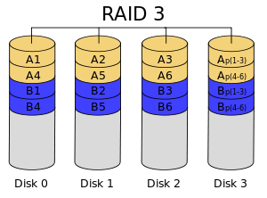
RAID 3 (Parity Disk)
Parity bit generated by RAID is stored in separate disks. {at byte level}
Advantages
Data protection.
Disadvantages
Availability when there are a lot of requests.
Ideal Use
Video servers that requires long sequential data transfer.
Minimum Disks - 3

Slide 8
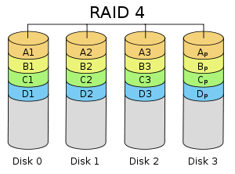
RAID 4 (Parity Disk)
Parity bit generated by RAID is stored in separate disks at block level.
Advantages
Good for sequential data access.
Disadvantages
Performance bottleneck for write operations.
Ideal Use
Not used much.

Slide 9
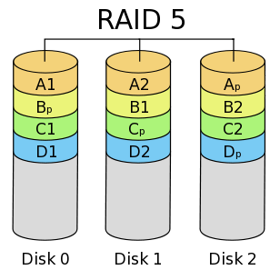
RAID 5 (Striping with Parity)
It stripes data blocks across multiple disks like RAID0, and also stores parity information to recover data in case of disk failure.
It uses one-third of the available disk capacity for storing parity information.
Data is recreated from the remaining distributed data and parity blocks.
Advantages
Fault tolerance.
Increased performance.
Disadvantages
Parity overhead.
Ideal Use
File Storage servers and application servers.
Minimum Disks - 3

Slide 10
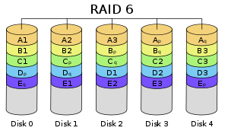
RAID 6 (Striping with double Parity)
Similar to RAID5, with extra parity bit to increase reliability.
Data can be easily built even if two drives fail.
Advantages
Higher redundancy than RAID5.
Increased read performance.
Disadvantages
Parity overhead.
Ideal Use
Large File Storage servers and application servers.
Minimum Disks - 4

Slide 11
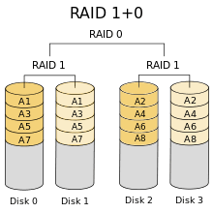
RAID 10 (Striping + Mirroring)
It combines RAID1 and RAID0, redundancy from RAID1 and increased performance of RAID0.
Advantages
High Fault Tolerance. (High Security)
Very High performance.
Disadvantages
Limited Scalability.
High cost
Usable capacity is low.
Ideal Use
Servers performing high write operations.
Highly utilized database servers.
Minimum Disks - 4

Slide 12
Other RAID levels
RAID 50 - Disk stripping at two levels.
RAID7- Combination of RAID3 and RAID4, which requires proprietary hardware.

Slide 13
Hadoop
Hadoop is a Framework or ecosystem that has two major components; one for storage and other for processing.
Hadoop uses HDFS for data storage and mapreduce for processing the data.
Hadoop ecosystem has tools like pig, Hive, HBase, Sqoop, Flume ideally for analytics.
Mahout, Scala, and spark made Hadoop more powerful for analytics.

Slide 14
For Knowledge Purpose
Pig – scripting language to write codes
Mahout – Used for machine Learning
Hive – Used for Databases/ Data Warehousing
HBase – working on dynamic schema-based databases
Flume – Store and analyze streaming data
Sqoop – used to connect and transfer data from hadoop to RDBMS
Zookeeper – Administrator for high availability
Oozie – Workflow scheduler
Ambari – Managing and monitoring Hadoop cluster

Slide 15
Why Hadoop ?
Hadoop is
Open source
Very Reliable
Highly Scalable
Uses Commodity Hardware
Hadoop is used for Recommendation systems, processing very large data sets, processing Diversity of data
Hadoop is not best for processing small Data sets, executing complex queries, and processing will be a bit tough if velocity of data is very high.

Slide 16
HDFS
The storage part of the Hadoop is handled by HDFS (Hadoop Distributed File System)
Hadoop clusters work in Master-Slave architecture where certain nodes acts as Master and certain nodes acts as slaves.
The Master side of the HDFS has two major components like
NameNode
Secondary NameNode

Slide 17
Contd..
The slave side of HDFS contain component
DataNode
For relatively smaller clusters, both NameNode and Secondary NameNode lies in the same machine.
NameNode, DataNodes, Secondary NameNodes are treated as daemons as they run in background once Hadoop ecosystem triggers it and should be stopped explicitly.

Slide 18
NameNode and DataNode
NameNode does not typically store data but manages to store and process the data from the slave nodes (DataNodes)
NameNode is connected with DataNodes in the cluster and typically stores details about DataNodes in terms of storage space and has link to every file in the Hadoop ecosystem.
DataNode contains the actual data which are stored in distributed manner.
There will be continuous communication between NameNode and DataNodes.

Slide 19
Secondary NameNode and Standby NameNode
Since its evolution, Hadoop has undergone three major version changes and current version is Hadoop 3.X
Hadoop 1.x typically had one NameNode and set of DataNodes, where NameNode is SPOF (Single-point-of-failure). If this NameNode fails, entire ecosystem would eventually fail.
In Hadoop 1.x, there is another daemon termed as Secondary NameNode that resides with the (Primary) NameNode.
Here Secondary NameNode does not store any data but typically stores metadata from the NameNode.

Slide 20
Contd…
Meta data is stored in two files
FSImage ; which typically stores all filenames, locations and block structures (i.e. entire Metadata)
EditLog; where modifications and transactions related updates are periodically updated.
When NameNode fails, these log files helps in quick start of NameNode from point of failure, termed as Checkpoint.
It is to be remembered that in case of NameNode failure, Secondary NameNode does not act as Primary NameNode but helps in retaining data from the logs that are stored.
In case of Hadoop 1.x, if the NameNode is down, then the whole ecosystem will be down until the NameNode is reconstructed or activated using Logs available from Secondary NameNode

Slide 21
Contd…
Hadoop 2.x has been introduced with another master daemon, termed as Standby NameNode, which can act as NameNode, in case if NameNode is down or to be migrated.
Standby NameNode increases the availability.
Hadoop 3.x boots this availability by introducing the concept of multiple Standby NameNodes (more than one Standby NameNode)
DataNodes also performs block creation, deletion and replication upon instructions from NameNode.

Slide 22
DataNode Heartbeat and Block Report
DataNodes maintains constant communication with the NameNode and sends its presence in terms of TCP Handshake, which is termed as Heartbeat.
By default, the heartbeat of DataNode is 3 seconds and for every 30 seconds DataNode sends this heartbeat is termed as Block report.
Block report contains data about list of blocks available, corrupt/missing blocks, total storage capacity and how much storage is utilized.
NameNode utilizes this block report to built metadata of the cluster.

Slide 23
Contd…
A checksum is maintained for every data block in HDFS file system.
Checksum helps in checking the integrity of the data. It typically finds measures like finding number of characters transmitted to the original to check for any change.
Checksums are generally checked by the clients for identifying any corrupted blocks
DataNode stores the checksum in metadata file. Every DataNode has list of checksums related to blocks it stores.
If DataNodes finds difference in checksum, it intimates to the NameNode and tries to fetch the copy from other block.

Slide 24
HDFS Block
When data is stored in HDFS, data files are broken into multiple chunks termed as “blocks”
A block is a basic unit of reading/writing.
Typically the minimum block size in Hadoop 1.x is 64 MB and for later versions it is typically 128MB.
The bigger block size creates less number of blocks and are excellent for storage of larger files.

Slide 25
Contd…
For example if data is of size
256MB, two blocks are created each of size 128MB.
For 300MB, three blocks 128MB, 128MB and 44MB will be created (HDFS typically allocates only required memory for data block)
NameNode tracks the DataNodes for these blocks.

Slide 26
Block Replication
When a data is to be stored in HDFS, the data is stored as blocks and are replicated into multiple blocks.
Block replication provides redundancy and fault tolerance.
The replication factor by default is 3, which can be configured as per requirement.
For example if there are two files with 300MB and 200 MB, with blocks B1, B2, B3, B4 and B5; it is stored in different Nodes as
Node A- B1,B3 and B4
Node B – B1, B2, B3 and B4
Node C – B3, B5
Node D- B1, B2 and B5
Node E- B2, B4 and B5

Slide 27
Rack Awareness
A Rack is a cabinet which accommodates multiple servers. Typically rack can have 20-25 slots where servers can fit.
Every Rack has a switch which allows the communication between the DataNodes.
HDFS is aware of location of every server in cluster, which comprises of multiple racks. (during data centre failure)
HDFS uses Rack awareness to distribute the storage of blocks to achieve Higher Data Availability and Fault Tolerance.
Rack Awareness principle makes Hadoop to avoid storing different replica of the same file in the same rack itself.
If all replica files are stored in same rack, then in case of failure, entire data would be lost eventually.

Slide 28
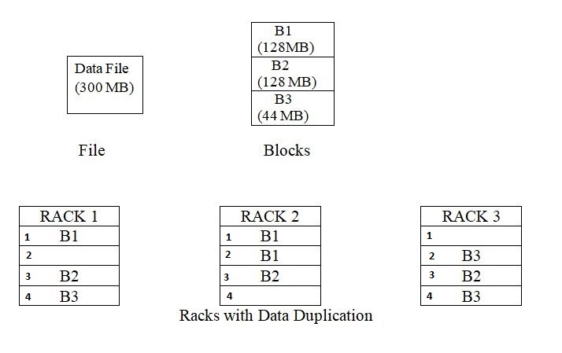
Rack Awareness and Block Replication

Slide 29
Commissioning and Decommissioning
Commissioning occurs when a node is added to the cluster or added back after maintenance.
Decommissioning occurs when a faulty node is removed permanently or removed for maintenance.
Commissioning and Decommissioning are termed as scale-out and scale-back of the clusters.
Typical Hadoop 2.x has resource manager termed as YARN (Yet Another Resource Negotiator) and HDFS takes care of the process.

Slide 30
Contd…
Once nodes are marked for decommissioning, cluster administrator specifies list of nodes going to be down.
HDFS starts transferring data from these nodes to other active nodes.
YARN stops assigning any new tasks to these nodes. Once this process is done, nodes are ready for removal.

Slide 31
Contd…
HDFS data volumes can be added or removed without shutting down the Datanode using “Hot Swappable Drives”
If there are new storage directories, the user should format them and mount them appropriately.
The user updates the DataNode config file dfs.datanode.data.dir to reflect the data volume directories that will be actively in use.
The user runs dfsadmin -reconfig datanode HOST:PORT start to start the reconfiguration process. The user can use dfsadmin -reconfig datanode HOST:PORT status to query the running status of the reconfiguration task.
Once the reconfiguration task has completed, the user can safely unmount the removed data volume directories and physically remove the disks.

Slide 32
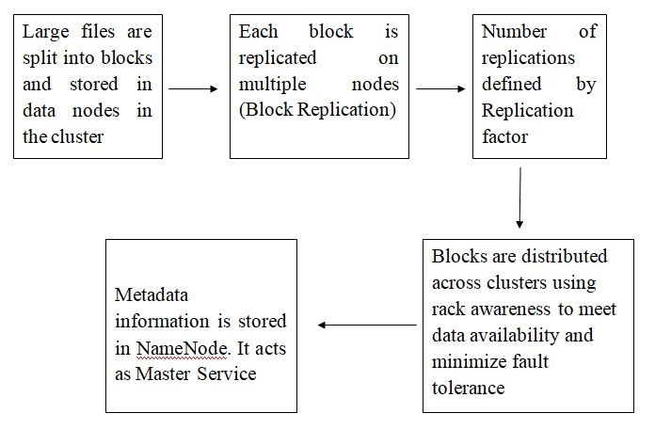
Process of Storing Data in HDFS

Slide 33
Anatomy of Reading and Writing files in HDFS
Step1 : HDFS splits the data into small blocks. [even though the block size by default in Hadoop 1.x is 64MB and in Hadoop 2.x is 128MB, it is configurable and is changed using “hdfs-site.xml” file. Number of replication can also be controlled, with default value of 3]
Step 2: Client will consult the NameNode regarding DataNodes in which data is to be stored.

Slide 34
Contd…
Step 3: Client writes the data to one DataNode directly allocated by NameNode
Step 4: DataNode will replicate the block. Once data is stored in specific DataNode, DataNode itself writes this data to different DataNodes.
Step 5: Step 3 and Step 4 are repeated with other blocks or DataNodes as given by NameNode

Slide 35
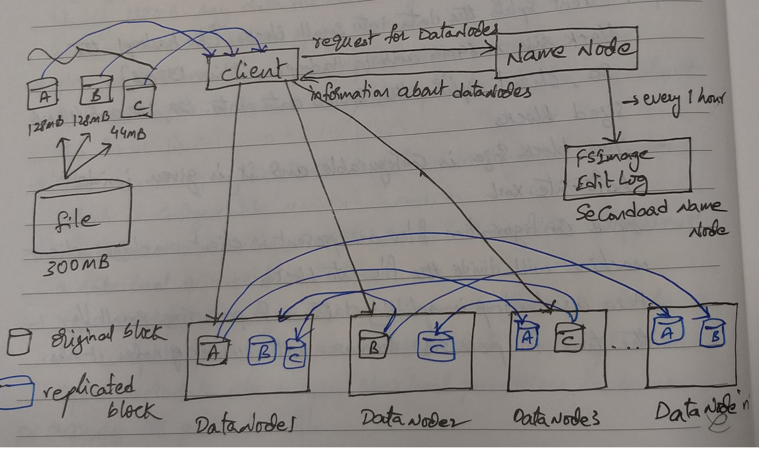
Contd…

Slide 36
Basic Operations in HDFS
S. No | Command | Purpose
1 | hdfs dfs –put {local file path} {hadoop path} | Used to upload a file to Hadoop
2 | hdfs dfs –get | Download a file from Hadoop
3 | hdfs dfs –ls/ | List all files present
4 | hdfs dfs –mkdir | To create a Directory
5 | hdfs dfs -rm | Remove a file
6 | hdfs dfs –mv {source} {destination} | Move a file
7 | hadoop jar {jar file name} {class name} {input path} {output path} | Run a Jar file in Hadoop

Slide 37

For Knowledge Purpose
Big Data Job Market

Slide 38
Contd…
As per IDC, the big data market is expected to grow to be worth of $46 billion by the end of this year.
As per predictions, the big data market will grow at a rate of around 23% in the period 2014 to 2019.
Among them, the growth of Hadoop is predicted to be approximately 58% for the period between 2013 and 2020.

Slide 39
BigData Market (Knowledge Purpose)
Big Data Related Titles | % growth in Job Demand
Software Developers | 94.86
Software Engineer/Architects | 93.19
System Analysts | 142.62
Information Security Analysts | 279.92
IT Project Managers | 121.92
Management Analysts | 162.92
IDC Report on Job Demand for 2018

