Slide 1
Marks allocation
Assignments + Class room engagement TASKs | Project | End semester
20+10 | 30 | 40

Slide 2
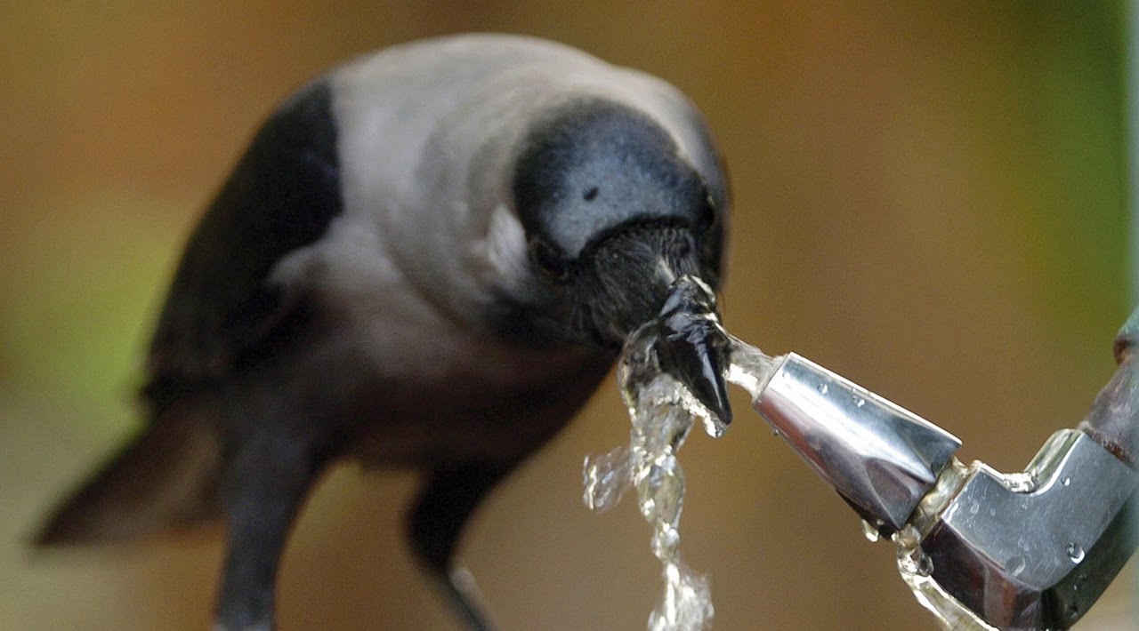
Designing Intelligent systems
DES203T
Jan – May 2019
Dr . Jayachandra Bingi

Slide 3
What you learned?
Concepts in engineering design
Systems thinking
What you are expecting to learn in DIS ?

Slide 4
Assuming you sense a real opportunity, you may still want to know?
Is my product concept really innovative?
Does it leverage the trend towards smart/intelligent products?
Is the product concept designed for intelligent behavior?

Slide 5
Task - 1
1. Observe the event
2. Analyze which acts and processes you consider as intelligence and why (Your Opinion and perspective)
3. Put it down on paper
An event of keeping bottle, with lid and with out lid, up side down
Smart / Intelligent

Slide 6
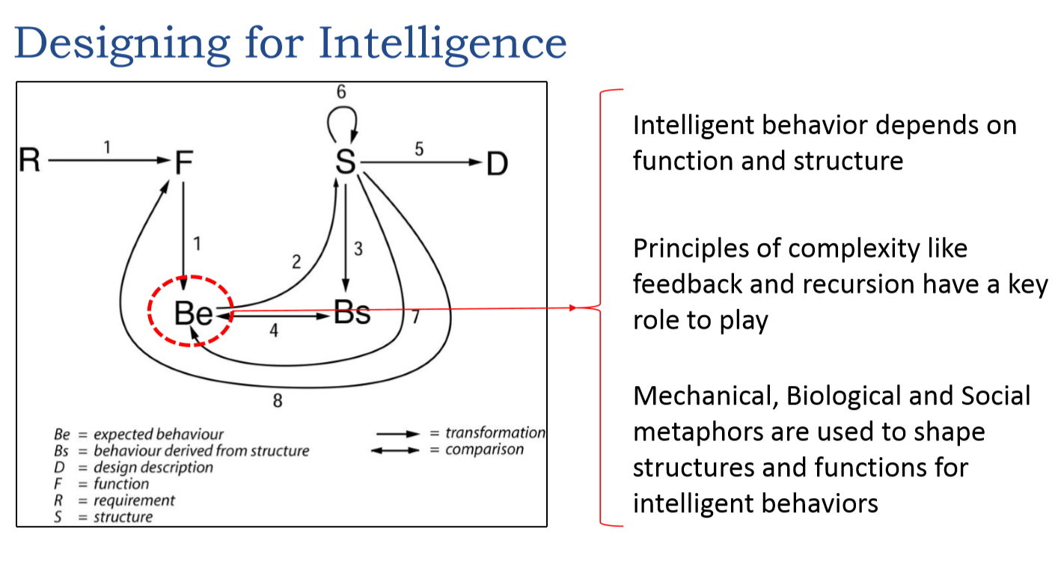

Slide 7
Learning outcomes
Identify and define the right type of intelligent behavior for a chosen product concept
Design high-level functional and component (structural) architecture for intelligent behavior using appropriate metaphor and analogy
Evaluate and select the right AI technique for the proposed functional and component architecture and vice versa

Slide 8
Intelligence definition
“The ability to use memory, knowledge, experience, understanding, reasoning, imagination and judgement in order to solve problems and adapt to new situations.” AllWords Dictionary, 2006
“...ability to adapt eﬀectively to the environment, either by making a change in oneself or by changing the environment or ﬁnding a new one ...intelligence is not a single mental process, but rather a combination of many mental processes directed toward eﬀective adaptation to the environment.” Encyclopedia Britannica, 2006
“the general mental ability involved in calculating, reasoning, perceiving relationships and analogies, learning quickly, storing and retrieving information, using language ﬂuently, classifying, generalizing, and adjusting to new situations.” Columbia Encyclopedia, sixth edition, 2006
“The ability to acquire and apply knowledge and skills.” Compact Oxford English Dictionary, 2006
“...the ability to adapt to the environment.” World Book Encyclopedia, 2006
“The ability to learn and understand or to deal with problems.” Word Central Student Dictionary, 2006

Slide 9
Intelligence definition
“Intelligence is not a single, unitary ability, but rather a composite of several functions. The term denotes that combination of abilities required for survival and advancement within a particular culture.” A. Anastasi [2]
“We shall use the term ‘intelligence’ to mean the ability of an organism to solve new problems ...” W. V. Bingham [6]
“A person possesses intelligence insofar as he has learned, or can learn, to adjust himself to his environment.” S. S. Colvin quoted in [35]
“Sensory capacity, capacity for perceptual recognition, quickness, range or ﬂexibility or association, facility and imagination, span of attention, quickness or alertness in response.” F. N. Freeman quoted in [35]
“...performing an operation on a speciﬁc type of content to produce a particular product.” J. P. Guilford
“Ability to adapt oneself adequately to relatively new situations in life.” R. Pinter quoted in [35]
There’s a cluster of cognitive abilities that lead to successful adaptation to a wide range of environments.” D. K. Simonton [33]

Slide 10
Intelligence definition
“...the ability of a system to act appropriately in an uncertain environment, where appropriate action is that which increases the probability of success, and success is the achievement of behavioral subtotals that support the system’s ultimate goal.” J. S. Albus [1]
“Any system ...that generates adaptive behviour to meet goals in a range of environments can be said to be intelligent.” D. Fogel [10]
Is a property that an individual agent has as it interacts with its environment or environments.
Is related to the agent’s ability to succeed or proﬁt with respect to some goal or objective.
Depends on how able the agent is to adapt to diﬀerent objectives and environments.
“Intelligence measures an agent’s ability to achieve goals in a wide range of environments.” S. Legg and M. Hutter [22]

Slide 11
Task - 2
1. Observe the event
2. Analyze which acts and processes you consider as intelligence and why
3. Put it down on paper
Computer with Anti-virus and performance monitoring code

Slide 12
Intelligent products
Technical foundations of intelligent products
Automatic identification
Embedded processing
Distributed information storage and processing
Agent based system
Technologies for fault detection
Remote maintenance

Slide 13
Intelligent product
Cooperative
Humanlike interaction
Autonomy
Adaptability
Reactive
Personality

Slide 14
Intelligent product
Cooperative
Humanlike interaction
Autonomy
Adaptability
Reactive
Personality

Slide 15
Task 3
Develop the smart water bottle concept applying different intelligence dimensions

Slide 16
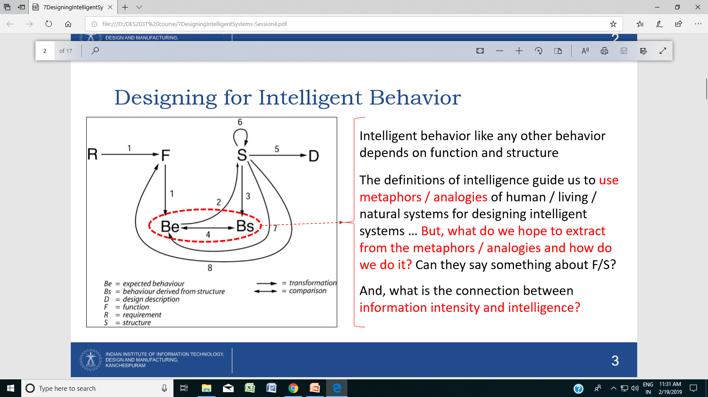
Metaphor based intelligent system design

Slide 17
• It is unique in the way that Ashby used rather sophisticated mechanical concepts, such as equilibrium and amplification, which were not particularly favored by other researchers
• And moreover, he used these concepts not merely metaphorically, but also imported their associated mathematical formulations as a basis for quantifying intelligent behavior.
Equilibrium
Amplification

Slide 18
It is unique in the way that Ashby used rather sophisticated mechanical concepts, such as equilibrium and amplification, which were not particularly favored by other researchers
And moreover, he used these concepts not merely metaphorically, but also imported their associated mathematical formulations as a basis for quantifying intelligent behavior
Exploiting the mathematical formulations of “equilibrium”
• Animal and human behavior shows many features. Among them is the peculiar phenomenon of ‘‘adaptiveness.’’ Although this fact is easily recognized in any given case, yet it is difficult to define with precision
• It is suggested here that adaptive behavior may be identical with the behavior of a system in stable equilibrium, and that this latter concept may, with advantage, be substituted for the former
• Stable equilibrium is necessary for existence, and that systems in unstable equilibrium inevitably destroy themselves… all dynamic systems change their internal organizations spontaneously until they arrive at some state of equilibrium

Slide 19
Analyze the concepts of equilibrium and amplification in the event ?
Relation between information intensity and intelligence

Slide 20
A scientific approach to using metaphors in design: Ashby on mechanisms of mind (1951)
• Intelligence is understood as a combination of the abilities to produce a great many meaningless alternatives, and to eliminate by appropriate selection the incorrect choices among those—a two stage process.
• All forms of intelligence depend necessarily on receiving information in order to achieve any appropriate selection that they make. And the greater the set of possibilities and complexity of the partitioning of alternatives, the more information will be required for the selection to be appropriate. … Increase in information intensity is a pre-requisite for intelligent behavior
How to increase/amplify/manage the information intensity

Slide 21
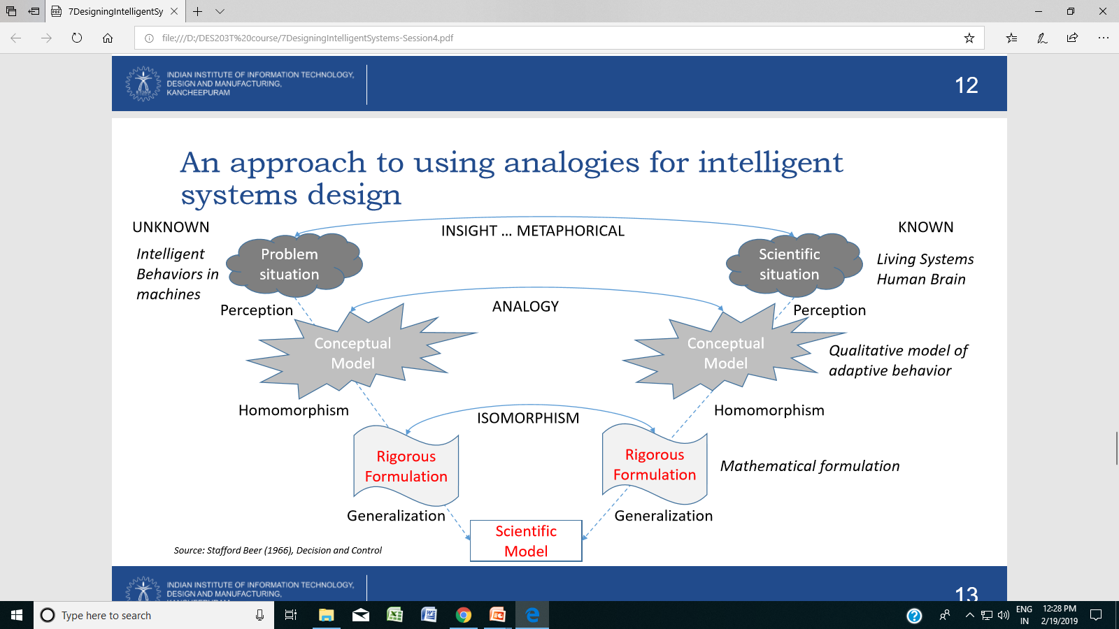

Slide 22
Where this event (Analyzed behavior/conceptual model) can be used as metaphor?

Slide 23
Bio-inspired intelligence behavior and system
Living system theory
Adaptive systems are composed of deferent heterogeneous parts or entities that interact and perform actions favoring the emergence of global desired behavior.
Further more, entities must self-evolve and self-improve by learning from their interactions with the environment. The main challenge for engineering these systems is to design and develop distributed and adaptive algorithms that allow system entities to select the best suitable strategy/action and drive the system to the best suitable behavior according to the current state of the system and environment changes.
During the past few years, research in artiﬁcial intelligence, agent-based systems, mobile and autonomous robots, distributed systems, and autonomic systems, has focused on the development of adaptive approaches and systems that modify their own behavior at run-time to address constantly changing environments. Some of these approaches are inspired by features and capabilities seen in natural and biological systems, e.g., human brain, immune systems, ant colony, ﬂocks of birds.

Slide 24
self-aware (e.g., self-conﬁguration, -organization, -optimization) properties
Recent studies have emphasized that designing adaptive systems requires a shift from the current top-down design approach to a bottom-up design approach
how to design basic system components in which decisions are distributed and not fully controlled by a single component?,
how to design strategies (at micro level) that allow the system to adapt to environment changes (at macro level) by selecting the best suitable actions/strategies?,
what are the dynamic rules that drive the system to the expected behavior (i.e., reliable, performance and energy eﬃcient)?,
What are techniques and tools for studying the electiveness of these mechanisms and evaluating the expected functionalities and performance metrics?.

Slide 25
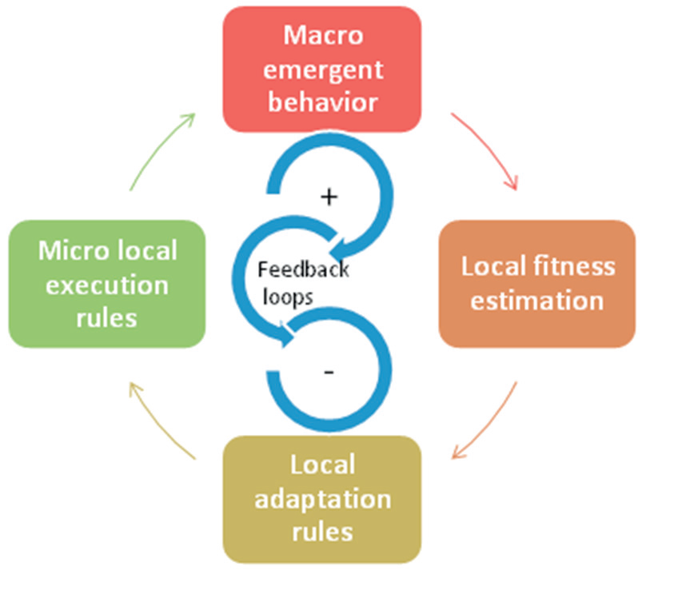
feedback loops are core design elements and should be made explicit in modeling, design,
implementation, and validation approaches
MAPE-K (monitor, analyze, plan, execute over a knowledge base) can be also seen as a feedback loop17

Slide 26
positive and negative feedback loops also seen in natural and biological systems
Positive or self-reinforcing feedback amplifies the current change in the system.
Negative or self-correcting feedback seeks balance and provides equilibrium by opposing the changes taking place in the system.
The two types of feedback should be combined to insure the stability of the system.
The most common techniques use if/switch statements to evaluate the
local function or expression to select a suitable action

Slide 27
honey bees, the waggle dance could be seen as a positive feedback to attract the attention of other
entities about foraging at a specific location
The biological immune system can be seen as a massively distributed architecture
with a diverse set of cells distributed throughout the body but communicating using chemical signals. There
is no central control (i.e. distributed); the multitude of independent cells work together resulting in the emergent behavior
of the immune system. The immune system evolves to adapt and improve the overall system performance (e.g.
organizational memory).
Task 4
Develop the robotic swach bharath gang inspired by feedback loops in immune system

Slide 28
Other swarm based distributed broadcasting approaches inspired by Ants and Bees direct and indirect communication principles for VANETs are proposed in 39. For example, when an abnormal environmental event is noticed on the road surface, a safety message is created to inform other vehicles and roadside units along its way. This is similar to Ant/Bee behaviour, i.e. when an Ant/Bee observes a food source it creates pheromone/dance to convey indirectly to other Ants/Bees about route information of that food source. Similarly, when a vehicle vi observes an event pj that needs to be disseminated to other vehicles, it will generate a safety message mpj and will report to RSU (Road Side Unit). This message includes a timestamp t0, the location information, and an initial relevance value R0v i ,pj (t0) and is disseminated periodically up to a time T, which represents the maximum timespan required to handle the event

Slide 29
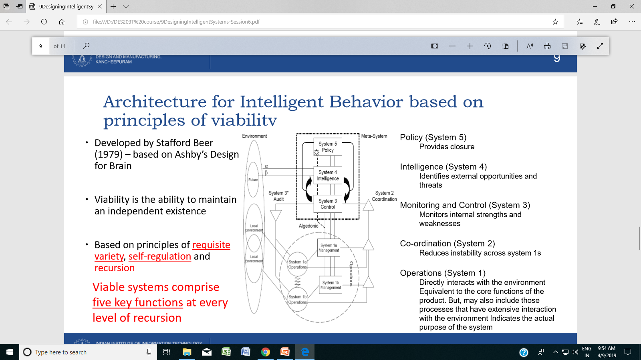

Slide 30
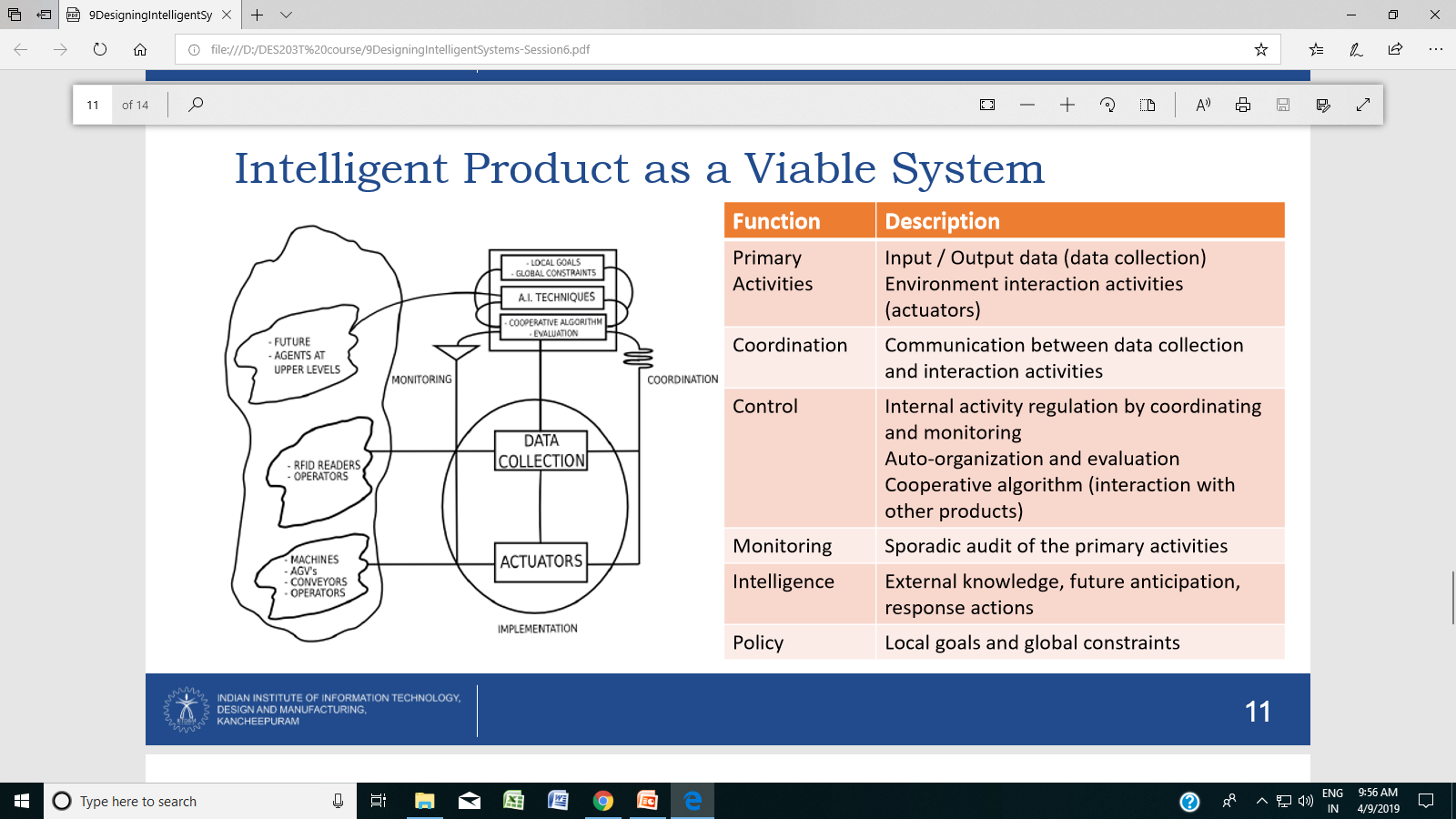

Slide 31
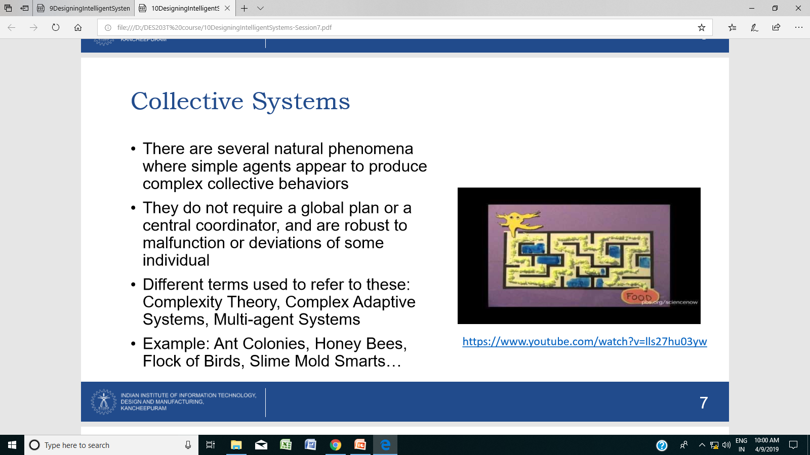

Slide 32
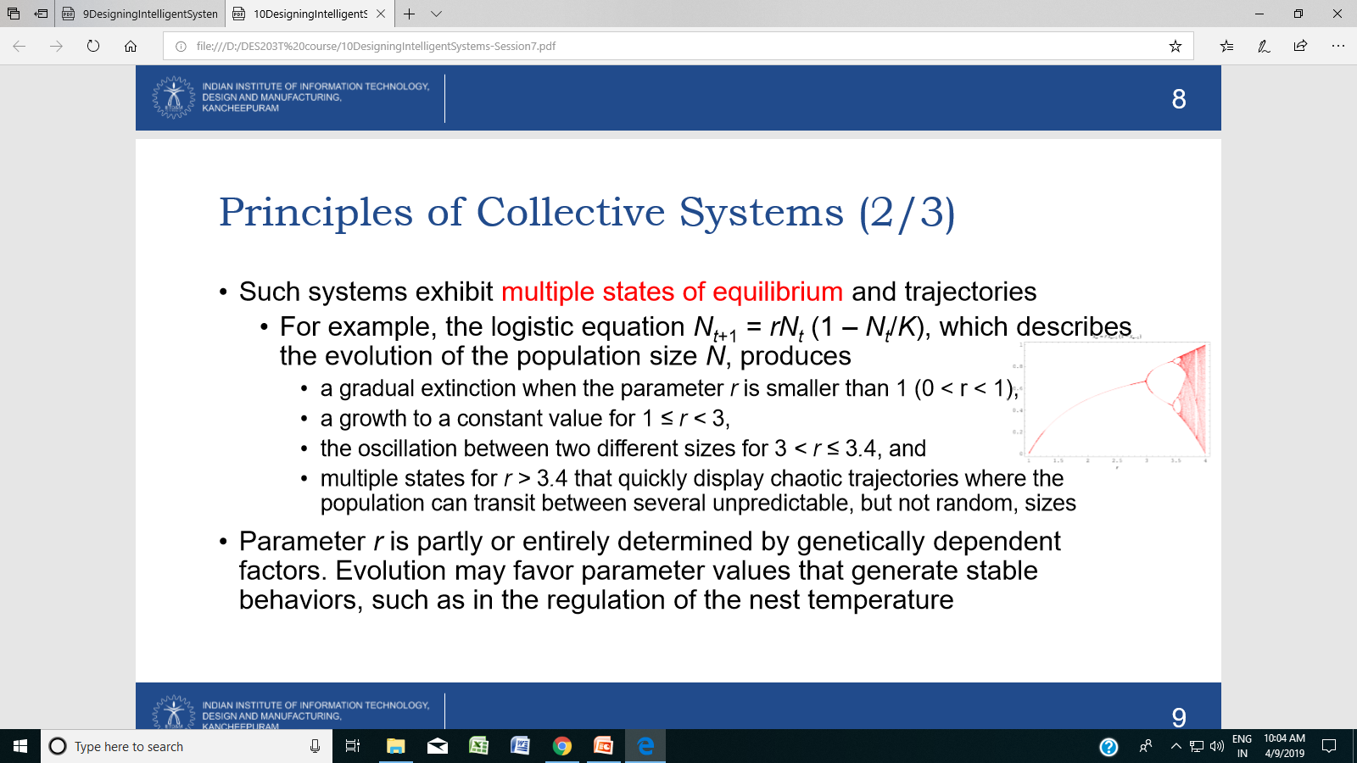
Principles of Collective Systems
• Self-organization in biological systems is based on two types of interactions
• Attraction or follow (Positive Feedback)
• Repulsion or avoid (Negative Feedback)

Slide 33
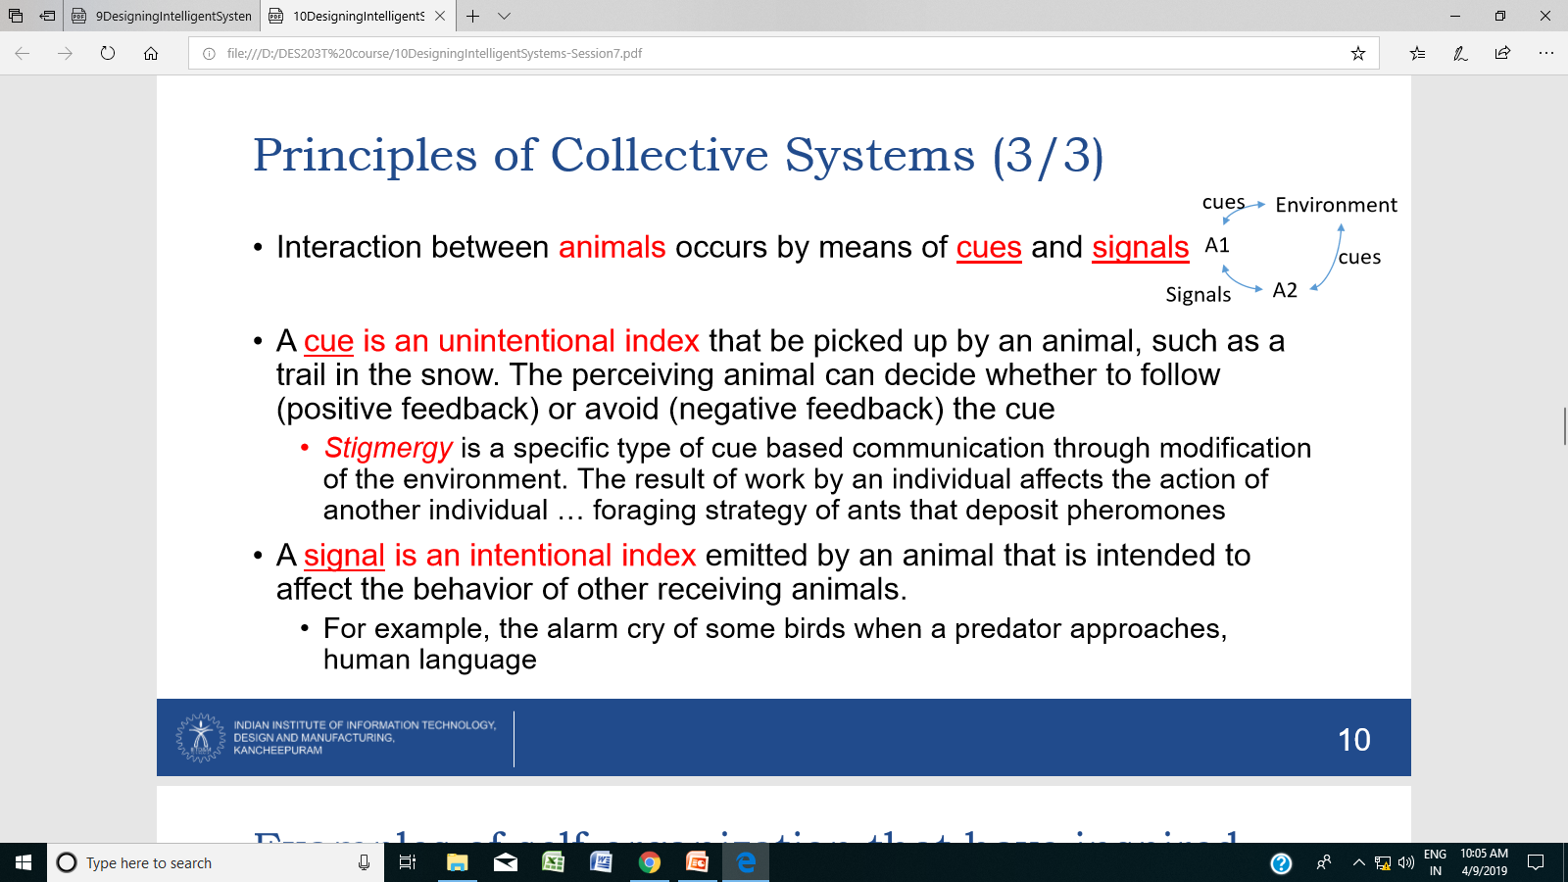

Slide 34
Aggregation: This behavior can be produced using models of positive & negative feedback loops - by assuming that fish displays four behavioral reactions that depend on the position and orientation of other fish:
if there is another fish in its immediate neighborhood, the focal individual will move away to avoid collision (negative feedback)
if there is another fish at an intermediate distance, the focal individual will tend to align along its orientation
if there is another fish at a greater distance, the focal individual will tend to swim toward it (positive feedback)
if there is no fish in sight, the focal individual will perform random search movements

Slide 35
• Clustering & Sorting
• Several ant species engage in clustering and sorting of objects. For example,
• Eggs are organized in regular patterns where neighboring eggs have similar maturation times for more efficient feeding
• Corpses of dead ants are organized in large clusters at the periphery, or near walls, of the nest for better circulation
Clustering & Sorting: These types of clustering and sorting behaviors can be explained by variations of a simple behavioral model that combines positive and negative feedback. Example,
• The probability that an ant picks up an object is inversely proportional to the number of objects that it has experienced within a short time window. Therefore, the ant will tend to pick up isolated objects, but won’t remove objects that occur in clusters
• The probability that an ant deposits an object is directly proportional to the number of perceived objects in a short time window. Therefore, the ant will be more likely to deposit an object near larger clusters of objects
• Sorting behaviors may be explained by adding different response probabilities for different types of objects in the environment

Slide 36
• Nest Construction
• Termites and wasps collectively build nests whose architectural complexities exceed the perceptual and cognitive abilities of single individuals
• A number of models based on positive and negative feedback have been advocated to explain how such engineering feats can be realized without a plan or a master architect
• All models rely on stigmergic communication whereby the perception of the result of previous work triggers specific construction behaviors genetically encoded as stimulus response associations
Foraging
• Some ant species lay a pheromone trail (stigmergy) that is used to select a path, find the shortest one, and establish a link between the food area and the nest – increasing efficiency of collective foraging
• If the ants are presented with two paths of different length, they will tend to choose the shorter one because ants on the short path return earlier to the nest and thus leave more pheromones on that path

Slide 37
Recall what we discussed so far
Definition of intelligence
Levels of intelligence
Dimensions of intelligence
Intelligence and information intensity relation (equilibrium, amplification)
Bio-inspired adaptive systems (Positive and negative feedback)
AI techniques
Theory of living systems
Theory of viable systems
Collective system model

