Slide 1
Week 1 Topics Presentation

Slide 2
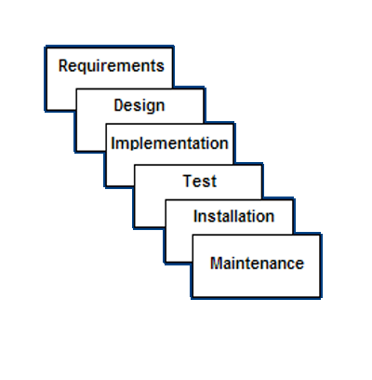
SDLC – Software Development Life Cycle
What?
The process of dividing software development work into distinct phases to improve design, product management, and project management.
Methods?
Waterfall – Linear model
V-Shaped – Waterfall with more emphasis on Testing
Spiral – Waterfall with risk analysis
Incremental – Constructs partial implementation of whole system
Prototyping – Prototype is built and it is analysed
Agile – Speeds up progress by bypassing some steps
Roles?
Business Analyst - analyses the system, defines the requirements, writes documents, explain the project to technical team and coordinate with them
Project Manager - Determine objectives, schedule and resource budgets, design a software project management plan (SPMP), sustain focused and motivated teams
Team Leader – Lead the team members, manage project meetings, present status to project manager
Technical Team – Perform given tasks within deadline and budget
Testers – Analyse requirements, prepare and do test cases, scenarios, data, etc, report bugs or errors to technical team

Slide 3
Website – Web Portal – E Commerce
 | Website | Web Portal | E Commerce
Def: | Any location on internet publicly accessible with a unique URL | Private location on internet accessible using a unique URL, username and password | It refers to the buying and selling of goods or services using the internet, and the transfer of money and data to execute these transactions.
1. 2. 3. Eg: | Login not required always Anyone can see content and it is the same for all Cant have a personalized database Google.com | Login with username and password required Only portal members can see content and it varies with person Has a personalized database India.gov.in | Login required for buying and selling Anyone can view products Can have a personalized database Amazon.com

Slide 4
Differences and CMS
 | Static Website | Dynamic Website
Def: | It is one that has web pages stored on the server in the format that is sent to a client web browser. | It is one that changes or customizes itself frequently and automatically.
1. | Prebuilt content is same every time the page is loaded. | Content is generated quickly and changes regularly.
2. | It uses the HTML code for developing a website. | It uses the server side languages such as PHP,SERVLET, JSP, and ASP.NET etc. for developing a website.
3. | It sends exactly the same response for every request. | It may generate different HTML for each of the request.
4. | Flexibility is the main advantage of static website. | Content Management System (CMS) is the main advantage of dynamic website.
 | Scripting Languages | Coding Languages
1. | They needn’t be compiled but need to be interpreted. | They have to be compiled.
Eg: | PHP, Python, Javascript | C, C++
What is CMS?
Content management System
It manages the creation and modification of digital content. It decides when to display what information from the database.
It is essential for any website.
eg. Wordpress, Joomla, Drupal

Slide 5
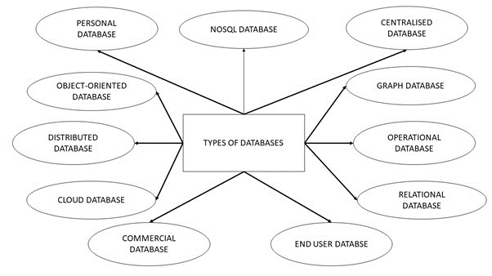
Types of Databases
Centralized Database – info stored in a centralized location and users can access
Distributed Database – data distributed to various locations and local computers
Personal Database – data stored in personal computers(small and easily manageable)
End-User Database - specifically designed for the end user
Commercial Database - paid versions of the huge databases designed uniquely for the users
NoSQL Database - used for large sets of distributed data
Operational Database - info related to operations of an enterprise is stored
Relational Database - categorized by a set of tables where data gets fit into a pre-defined category
Cloud Database – data stored in a virtualized environment
Object-Oriented Database - collection of object-oriented programming and relational database
Graph Database - collection of nodes and edges where each node is used to represent an entity and each edge describes the relationship between entities

Slide 6
Comparison between Languages
Name | Opensource | Complexity for Learning | Availability of Libraries and APIs | Key Advantage | Ability to do advanced tasks | Community Support | Dis advantage
PHP | Yes | Easy | Less | Rapid development | No | - | Cant do advanced tasks
Python | Yes | Easy | Many | Very Powerful website development | Yes | - | Makes heavy use of whitespace in coding
Ruby on Rails | Yes | Tough | Many for Text | Powerful String and Text Manipulation | Yes | - | Tougher to learn
.NET | Yes from 2014 | Moderate | Many | High Speed of development and less code needed | Yes | - | Limited Development and Debugging Tools
Java | Yes | Very Easy | Many | Short Learning curve and Rich API libraries | Yes | Best | Memory management is expensive

Slide 7
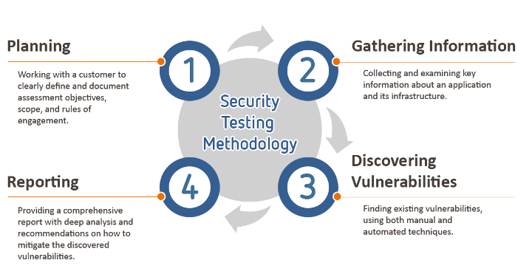

Ethical Hacking
What?
The act of locating weaknesses and vulnerabilities of computer and information systems by duplicating the intent and actions of malicious hackers.
Why?
To Find out vulnerabilities in the system by attempting to hack the system.
How?
Using various tools like Metasploit and languages like JavaScript, HTML, PHP, Python, C, C++,etc.
Penetration testing is an authorized simulated attack on a computer system, performed to evaluate the security of the system.

Slide 8
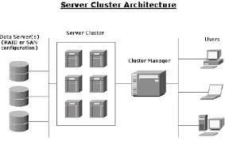
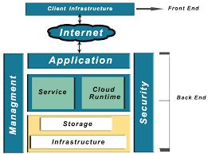
Server Architecture
Clustered
It is a group of computers etc that form the server and they are physically in the same place forming a cluster.
Cloud
Here, the server management and infrastructure is provided by an external provider over internet for money. Its types are Public, Private and Hybrid.
It is managed by System admins who are the persons who administer the computer system as a whole.
Network admins administer the networks.

Slide 9
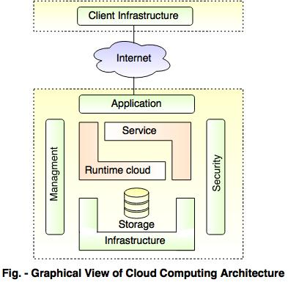
Cloud Computing
Why?
It helps organisations focus on business and not worry about IT, improves Business Agility, Reduces capital expenses, improves staffing efficiency and accessibility.
Future?
According to many analysts, the future of cloud computing lies in Hybrid clouds and soon many apps will be incorporating cloud computing.
Uses in Apps?
Data can be temporarily stored to be used later when the device is offline, supports various consumers prerequisites which include; backup schedule, security, and compression of data, operatable by any device with browser
Cloud Provides Software as a service(SaaS), Platform as a service(PaaS) and Infrastructure as a service(IaaS).

Slide 10
Firewall and Performance Tuning
Firewall:
It is a network security system that monitors and controls incoming and outgoing network traffic based on predetermined security rules. A firewall typically establishes a barrier between a trusted internal network and untrusted external network, such as the Internet.
Types are,
1) Network firewalls - filter traffic between two or more networks and run on network hardware.
2) Host-based firewalls - run on host computers and control network traffic in and out of those machines.
While Coding, we must consider the firewalls implemented so that our code is not blocked by the system.
Performance Tuning:
In a DBMS like SQL, many queries can be given to achieve same functionality. Some queries take longer to execute than others. By doing performance tuning, we implement the best queries so that execution time is minimum.

