Slide 1
Week 3 Topics Presentation

Slide 2
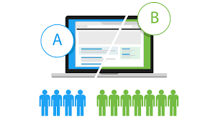
Big Data
What?
Big data is a term used to refer to data sets that are too large or complex for traditional data-processing application software to adequately deal with.
Eg. IoT sensor data, large medical data, aadhar data, etc
Characteristics:
Volume - Quantity of data
Variety - Nature of data
Velocity - Speed of data generation
Veracity - Quality of data
Softwares: Apache Hadoop, Apache Spark, Apache HBase, MapReduce
Techniques for analysing: A/B Testing, Machine Learning
6C architecture:
Connection (sensor and networks)
Cloud (computing and data on demand)
Cyber (model and memory)
Content/context (meaning and correlation)
Community (sharing and collaboration)
Customization (personalization and value)

Slide 3
Digital Marketing
What?
Digital marketing is the marketing of products or services using digital technologies, mainly on the Internet, but also including mobile phones, display advertising, and any other digital medium.
Methods:
SEO, SEM, content marketing, influencer marketing, content automation, campaign marketing, data-driven marketing, e-commerce marketing, social media marketing, social media optimization, email direct marketing, display advertising, e–books, and optical disks and games
Search Engine Optimization - Maximizing popularity by ensuring that the website occurs high on lists in search engines
Search Engine Marketing - SEO (Unpaid) + Paid Advertising (Paid Advertising - buying traffic thru paid search listings)
Tools: Google Trends, Google Keyword Planner, Ahrefs, AppAnnie, Facebook Audience insights

Slide 4
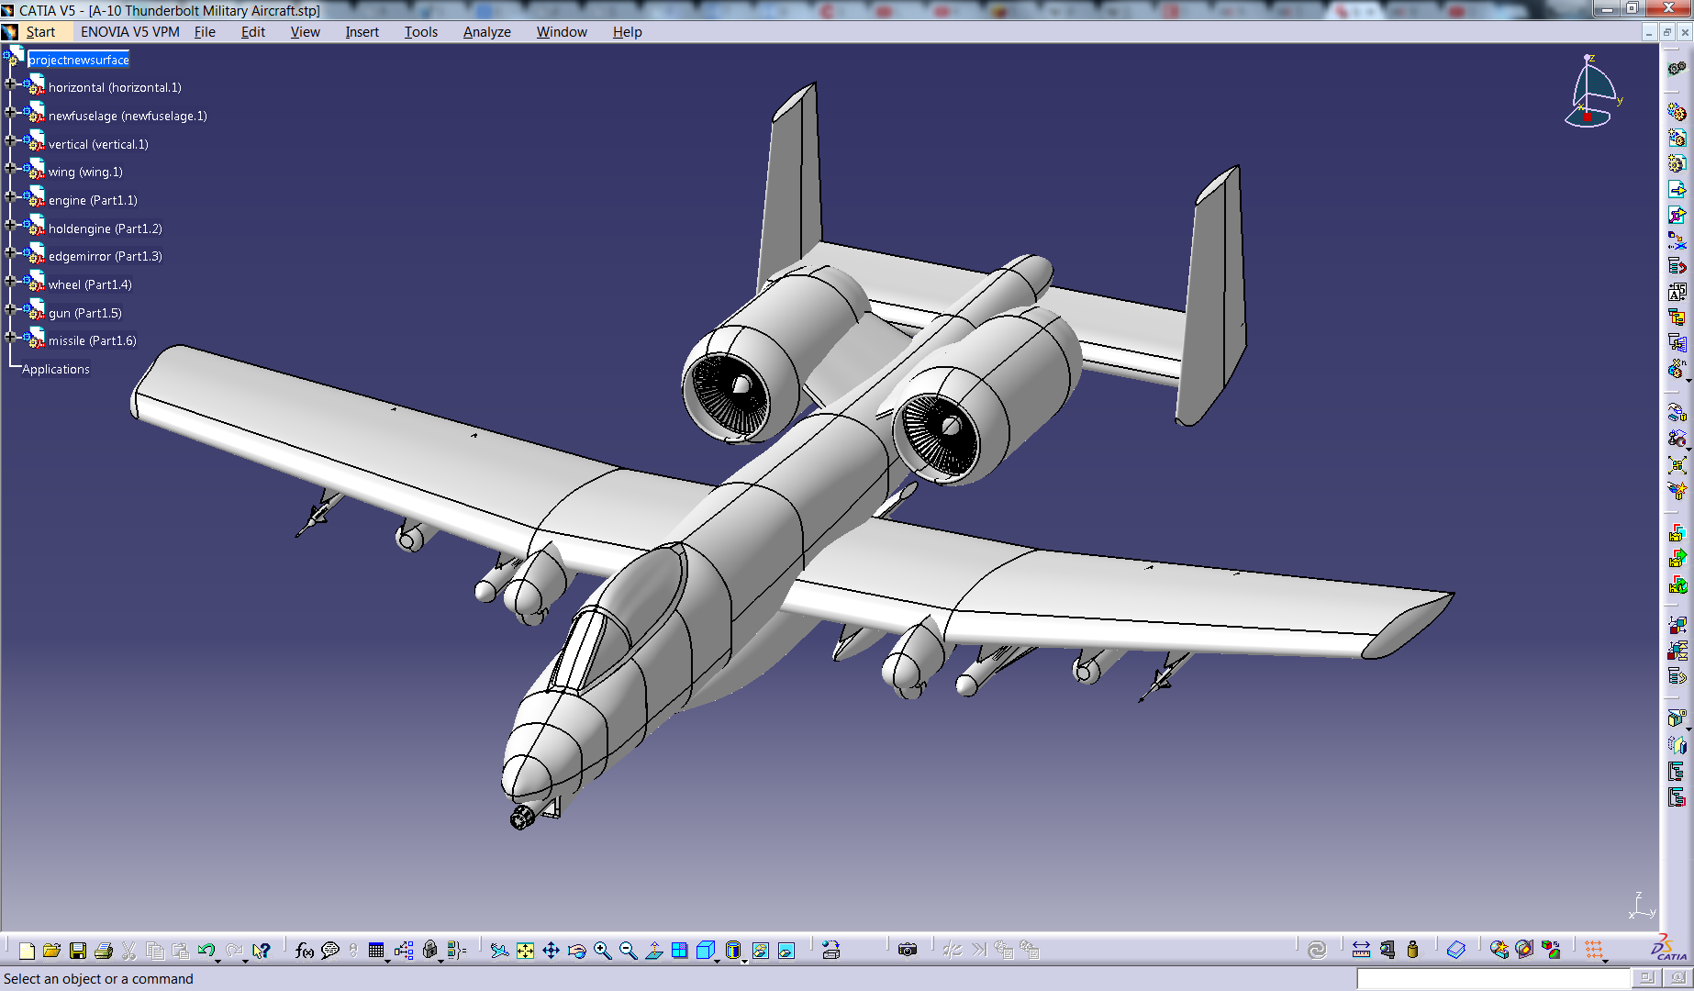
CAD, CAM and CATIA
CAD: Computer-aided design (CAD) is the use of computer systems (or workstations) to aid in the creation, modification, analysis, or of a design.
CAD tools are mainly used to make detailed designs of engineering systems.
CAM: Computer-aided manufacturing (CAM) is the use of software to control machine tools and related ones in the manufacturing of workpieces.
CAM tools simply help control the manufacturing process after CAD has been completed and the model is at hand.
Tools:
CAD - classified as 2D CAD tools, 3D CAD tools (Wire-frame models – they create skeleton like models with lines and arcs and Surface models – unlike wire frames, these models are created by joining 3D surfaces)
2D CAD - LibreCAD, DraftSight
3D CAD - AutoCAD, SolidWorks, FreeCAD
CAM - Siemens NX, PowerMILL, WorkNC
CATIA: Computer Aided Three-dimensional Interactive Application (CATIA) is a multi-platform software suite for computer-aided design, computer-aided manufacturing, computer-aided engineering, PLM and 3D, developed by the French company Dassault Systèmes.

Slide 5
Gaming
What?
Video games are interactive softwares that provide entertainment to the users.
Platforms: PC, Console, Handheld, Arcade, Web browser, Mobile, Virtual Reality, Blockchain (NEW)
Types: Casual, Serious, Educational
Development Tools: Unity, UnReal Engine, Godot Engine, GameMaker Studio
Criticisms:
Reduce Concentration in studies - Addiction to games
Influence young minds in possibly bad ways - Violence, etc
Children don't go out to play - increases risks of bad health
Benefits:
May be educational and fun
Some games bring attention to important issues(social, political, economic) - Dumb Ways to Die is a game aimed to improve awareness about train accidents
Puzzle Games help improve knowledge and memory, etc
Fitness Games help battle obesity and are also fun

Slide 6
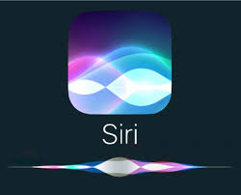
Artificial Intelligence
What?
Artificial intelligence (AI), sometimes called machine intelligence, is intelligence demonstrated by machines, in contrast to the natural intelligence displayed by humans and other animals.
Eg. Siri, Google assistant
AI Software - AlphaGo (computer program that plays the board game Go), Cyc, Libratus (computer program designed to play poker), Logic Theorist (computer program written in 1950 and 1951 engineered to mimic the grammar skills of a human being - called first AI program)

