Slide 1
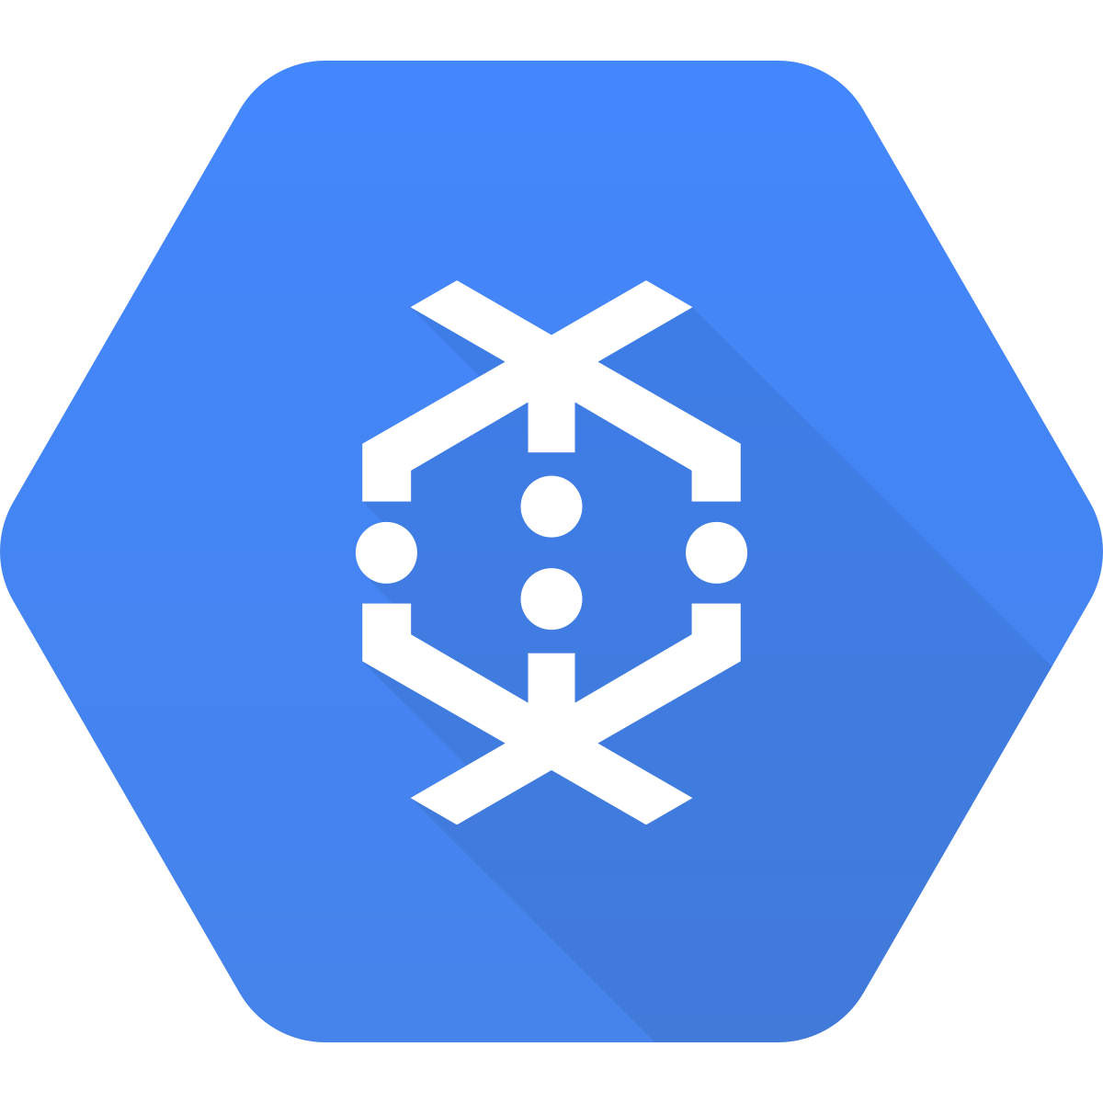
Big Data Lab- 3
GCF and Dataflow

Slide 2
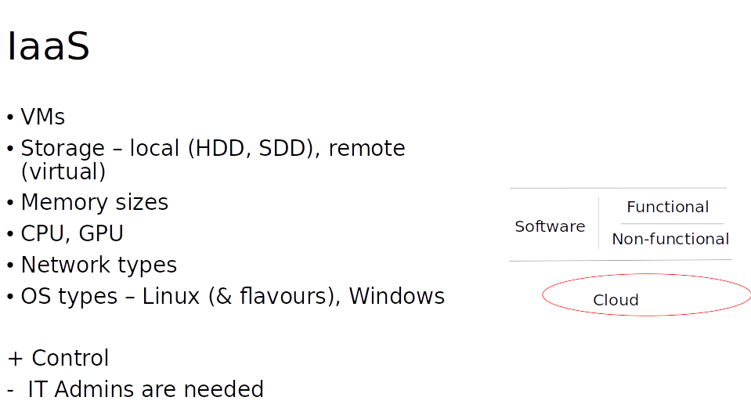

Slide 3
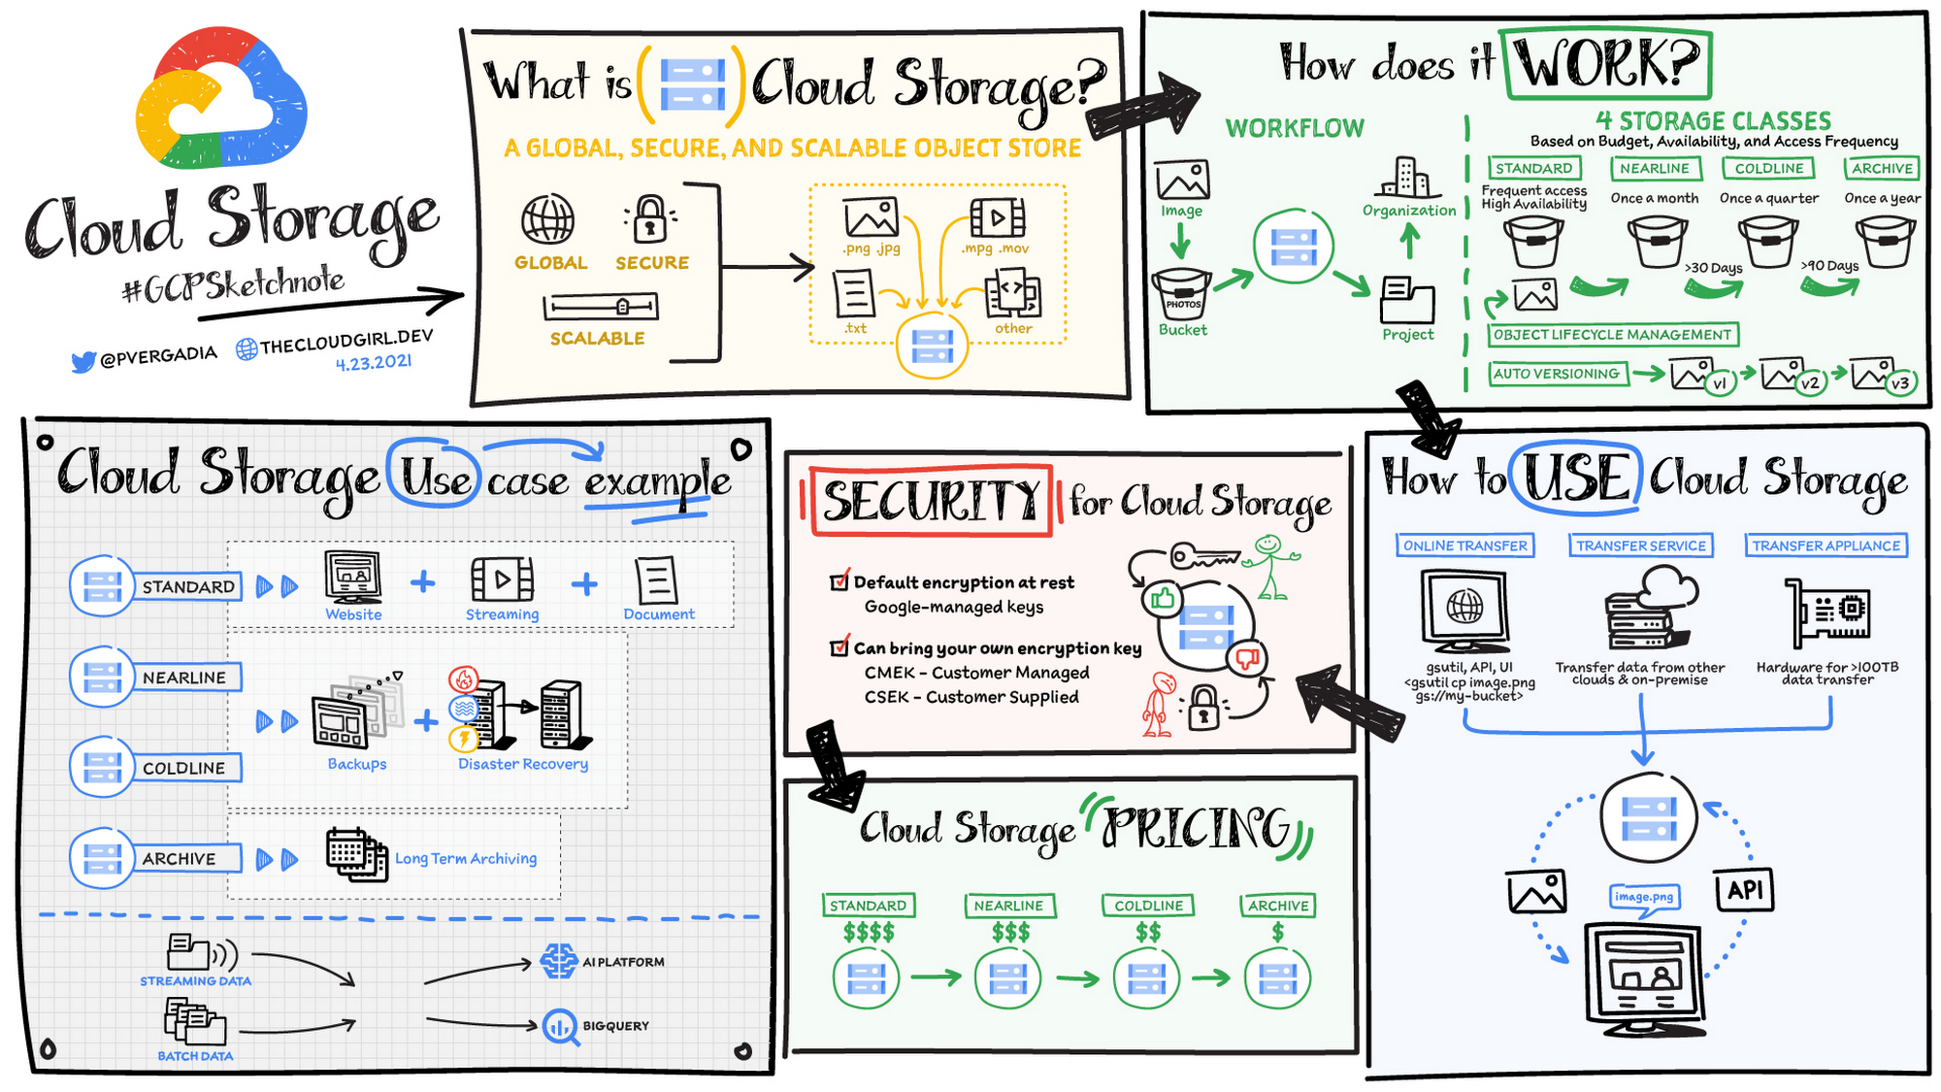

Slide 4
Exercise: IaaS
Write a Python program to count lines of a file that is placed in GCS executing within a VM, and print out.

Slide 5
PaaS
Databases
Application execution environments
Container service
Workload-specific execution environments – e.g. for big data
Amazon - AWS EMR
Microsoft - Azure Databricks, Azure HDInsights
Google – Dataproc, Dataflow
Databricks
+ Actively managed, for developers, focus on business needs
- Less control, & (in practice, based on newness of service) stability, predictability
Functional
Software
Non-functional
Cloud

Slide 6
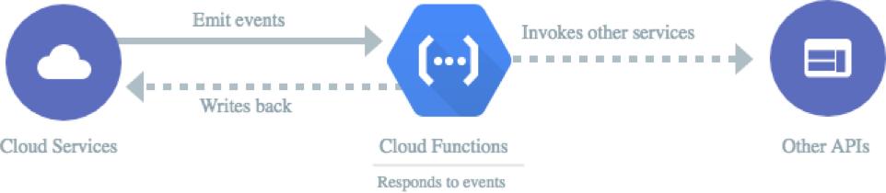
Google Cloud Functions
Faster way to build on the cloud
Makes sure the application runs resiliently, cost-effectively, and at a planet-wide scale!

Slide 7
Events
HTTP
Cloud Storage
Cloud Pub/Sub
Cloud Firestore
Firebase (Realtime Database, Storage, Analytics, Auth)
Cloud Logging—forward log entries to a Pub/Sub topic by creating a sink

Slide 8
Events
HTTP
Cloud Storage
Cloud Pub/Sub
Cloud Firestore
Firebase (Realtime Database, Storage, Analytics, Auth)
Cloud Logging—forward log entries to a Pub/Sub topic by creating a sink

Slide 9
Exercise: PaaS
Write a Python program to count lines of a file that is placed in GCS executing using Google Cloud Functions, and print out.
Tip:
Set a trigger on the bucket

Slide 10
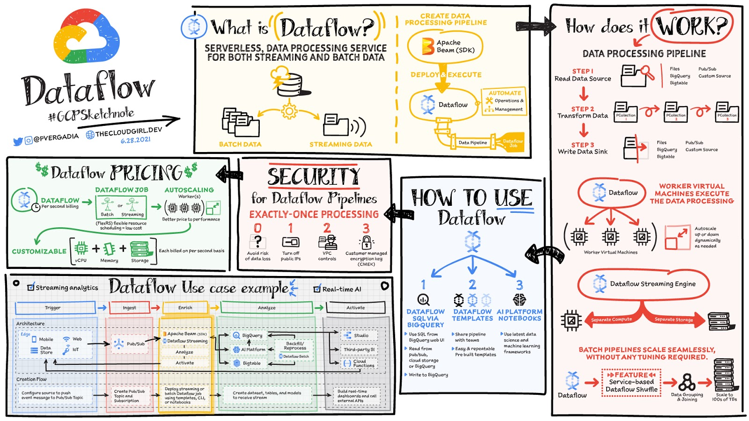

Slide 11
Programming model for Apache Beam
Pipelines
PCollection
Transforms
ParDo
Pipeline I/O
Aggregation
User-defined functions (UDFs)
Runner

Slide 12
Exercise: Big Data + PaaS
Write a Python program to copy a file’s content to another.
Tip:
Use Dataflow

