Slide 1
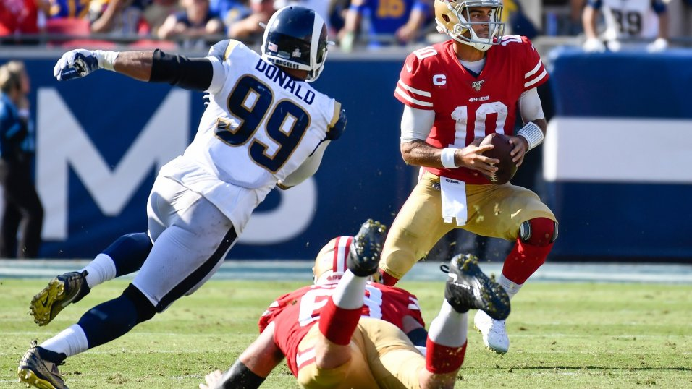

Predicting YARDS THROWN BY QUARTER BACK IN NFL - 2019
DATA ANALYSTS ON THIS PROJECT – RAHUL SONTI
KAUSIK VALETI
BHAGEERATH VULUPALA

Slide 2

AGENDA
Select proper data.
Modify the data as per our requirement.
Clean the data.
Use cleaned data on desired models to predict our response variable. (In our case it is yards_thrown)
Comparing results of each individual models.
Using predicted data we make valuable insights.
Conclusion.

Slide 3

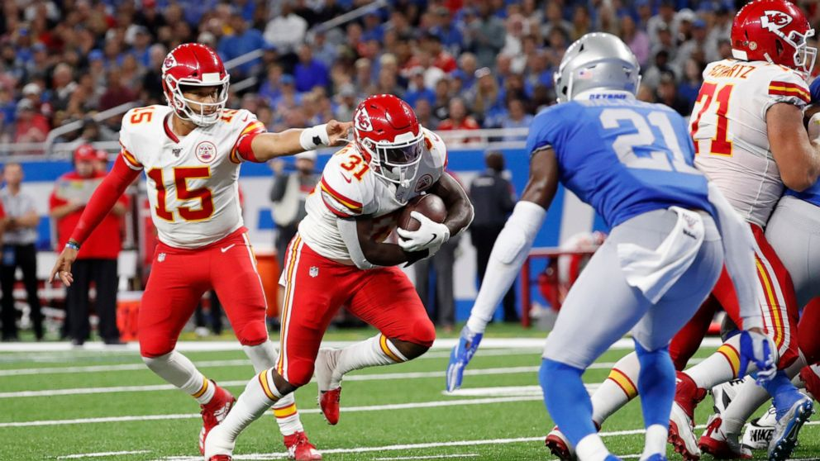
SELECTING PROPER DATA
https://www.pro-football-reference.com/boxscores/201009090nor.htm
With the help of web scraping we are able to obtain the data that we need.
Here we use R-script to do web scraping from season 2010 to 2019.
We use 2010 – 2018 season data to train our models and 2019 season as test data.
From this we can predict no.of yards thrown by each QB in 2019 season for each Quarter and Down.

Slide 4
Predicting plays in the National Football League
MODIFY THE DATA AS PER THE REQUIREMENT:
Here we use Python to modify the data since it is in the form of text, python has “re” package which is used to modify the text data.
The modified data looks as follows:

Slide 5
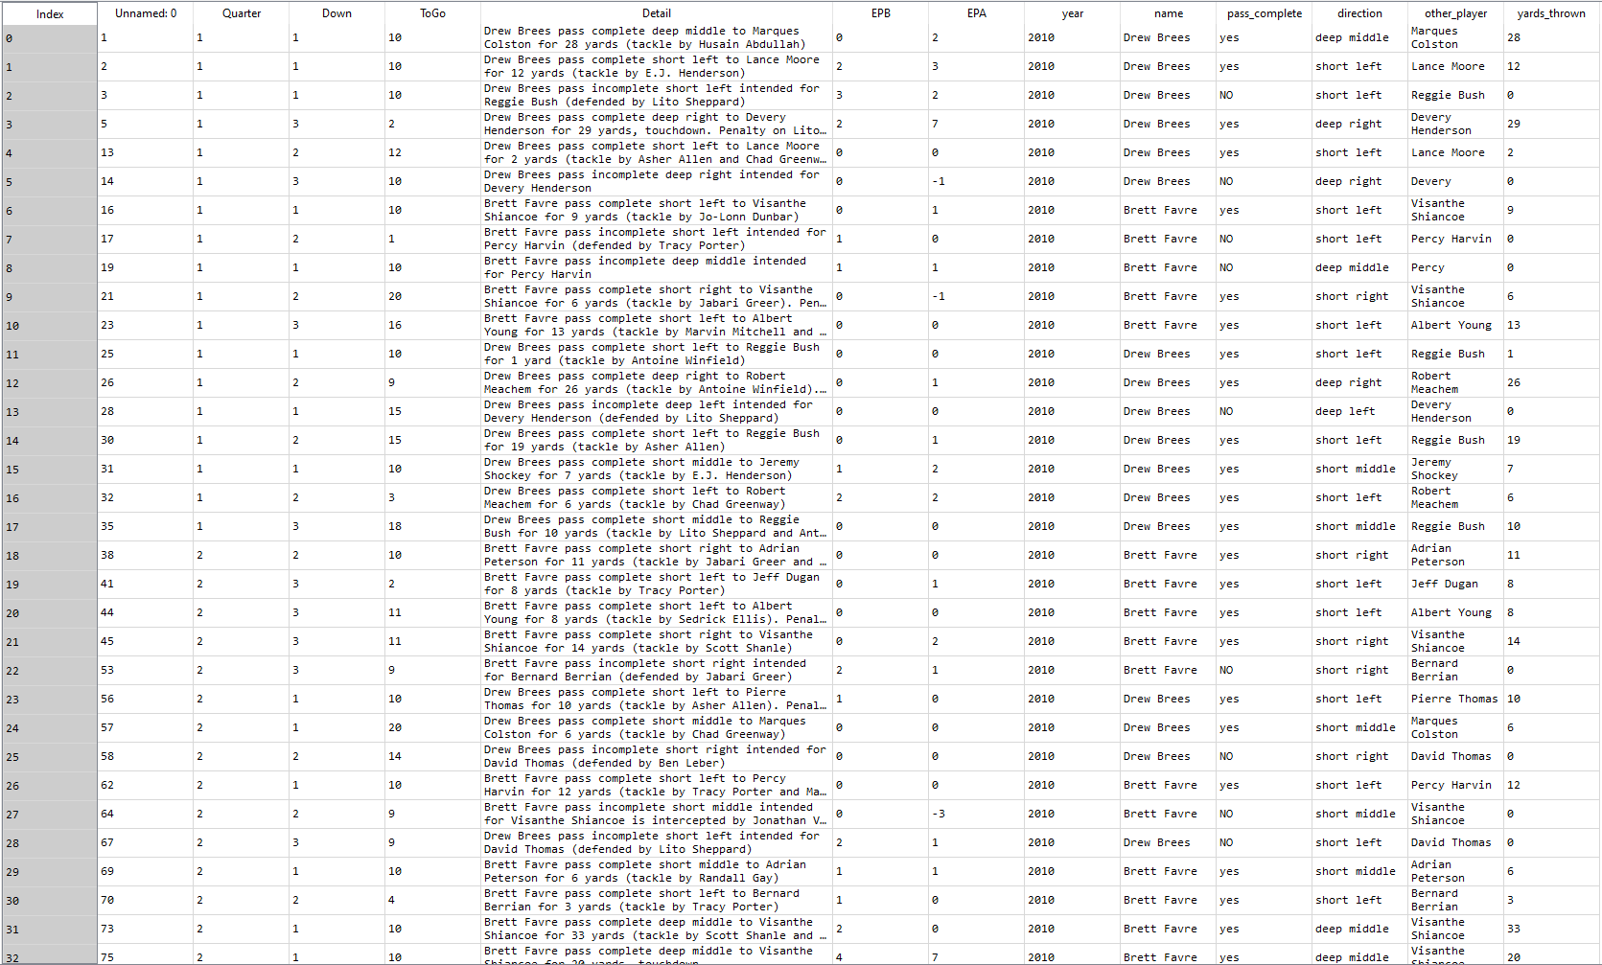

Slide 6
CLEANED DATA
Before passing this data to our model we need to remove unnecessary columns.
Here we included the direction of pass to identify any significant role played by direction of play to yards thrown.
We use label encoding and one hot encoding to convert direction into numerical form.
Final data that we use to train our model as follows:

Slide 7
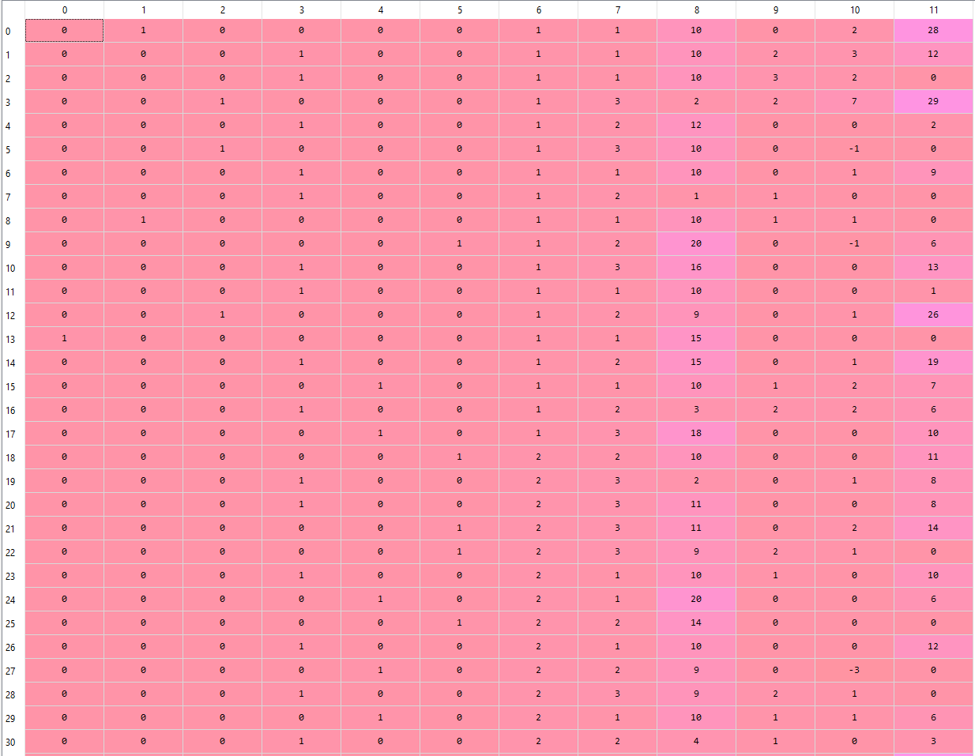

Slide 8
MODELS USED FOR PREDICTION
Random Forest with K – Fold cross validation, with best tuning parameters
{'bootstrap': True,
'criterion': 'mse',
'max_depth': 12,
'max_features': 'auto',
'min_samples_leaf': 3,
'min_samples_split': 16,
'n_estimators': 200}
Results:
Mean Absolute Error for Random Forest: 3.3362071836101217
Mean Squared Error for Random Forest: 27.262369404246297
Root Mean Squared Error for Random Forest: 5.221337894088669
R^2 for Random Forest: 0.7199196767766081

Slide 9
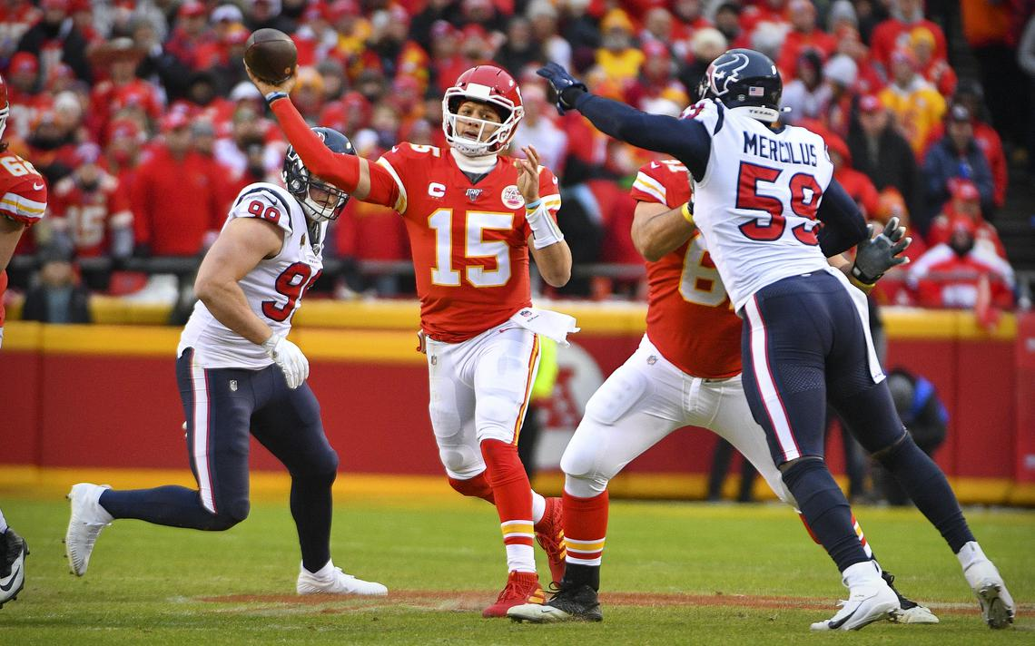
MODELS USED FOR PREDICTION
XGBOOST with K – Fold cross validation, with best tuning parameters
XGBRegressor(base_score=0.5, booster=None, colsample_bylevel=1,
colsample_bynode=1, colsample_bytree=0.7, eval_metric='rmse',
gamma=0, gpu_id=-1, importance_type='gain',
interaction_constraints=None, learning_rate=0.07, max_delta_step=0,
max_depth=7, min_child_weight=4, missing=nan,
monotone_constraints=None, n_estimators=200, n_jobs=-1, nthread=-1,
num_parallel_tree=1, objective='reg:linear', random_state=0,
reg_alpha=0, reg_lambda=1, scale_pos_weight=1, subsample=0.7,
tree_method=None, validate_parameters=False, verbosity=None)
Results:
Mean Absolute Error for XGBOOST: 3.379675912132907
Mean Squared Error for XGBOOST: 27.266324909098074
Root Mean Squared Error for XGBOOST: 5.221716663042727
R^2 for XGBOOST: 0.7198790398436632

Slide 10
MODELS USED FOR PREDICTION
ADABOOST with K – Fold cross validation, with best tuning parameters
ADBRegressor{'learning_rate': [.03],
'base_estimator__max_depth': [7],
'n_estimators': [100], cv=5,
n_jobs=5,verbose=True}
Results:
Mean Squared Error for ADABOOST: 27.266324909098074
Root Mean Squared Error for ADABOOST: 5.191716663042727
R^2 for ADABOOST: 0.694790398436632

Slide 11
MODELS COMPARISION:
All the models have almost similar performance with respect to RMSE and R^2 values.
Since R^2 is little higher for Random Forest we consider the predicted variables from this model.
We combine the predicted results with actual data to get insights.

Slide 12
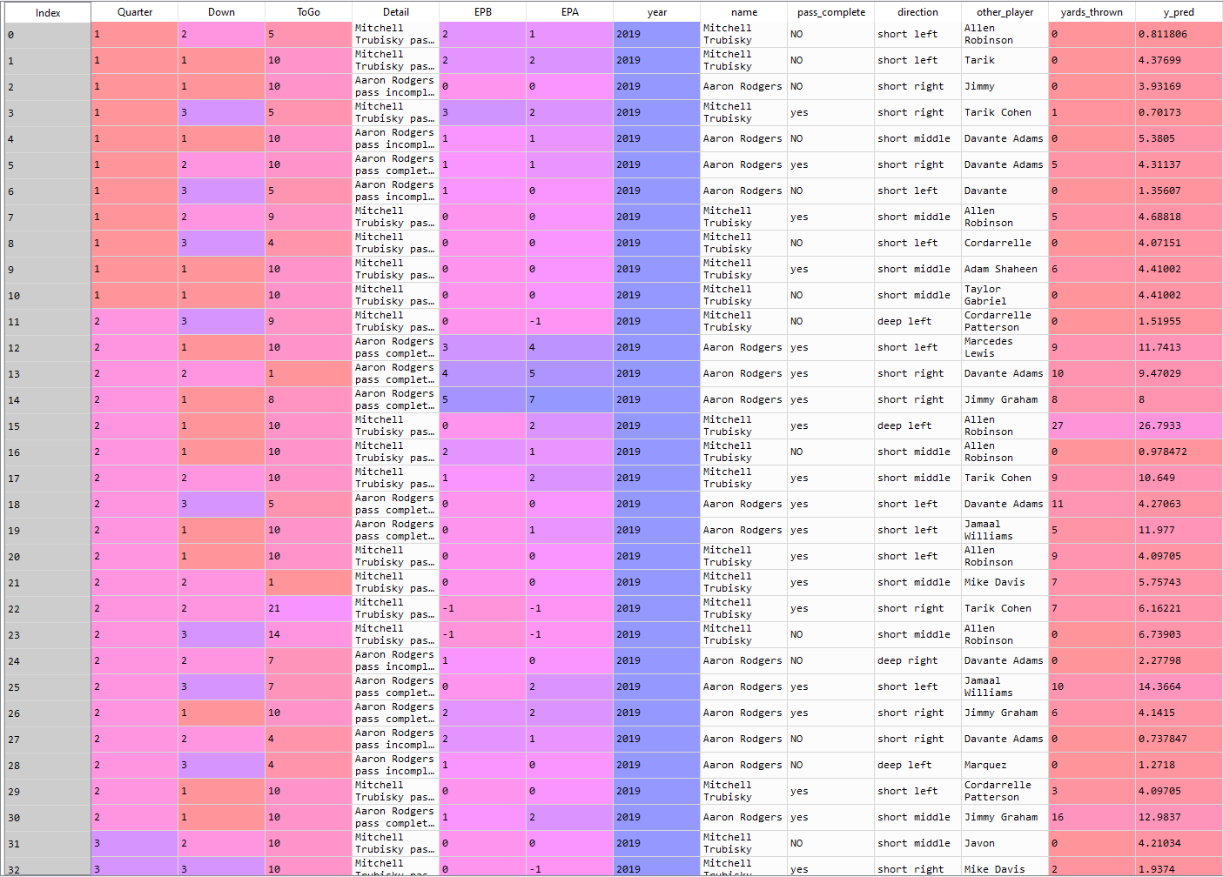

Slide 13
INSIGHTS THAT WE CAN DERIVE FROM THE ABOVE DATA:
Total number of yards that each QB can throw in 2019 season.
To which player does a QB throw the ball most times.
Number of yards thrown in all Down’s in 2019 season.
In which Quarter does the QB scores more yards.

Slide 14
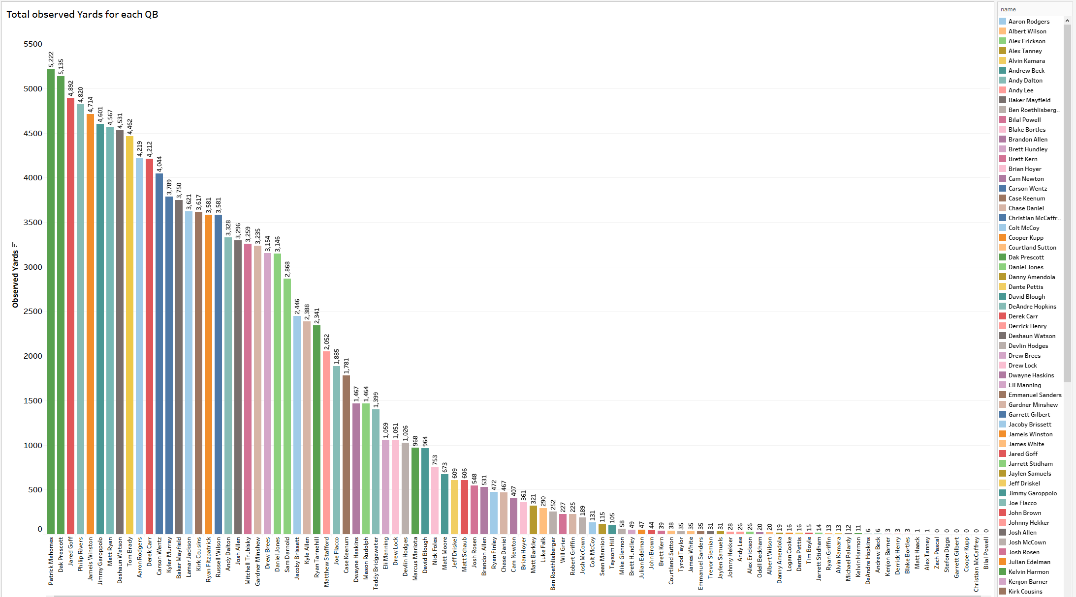

Slide 15
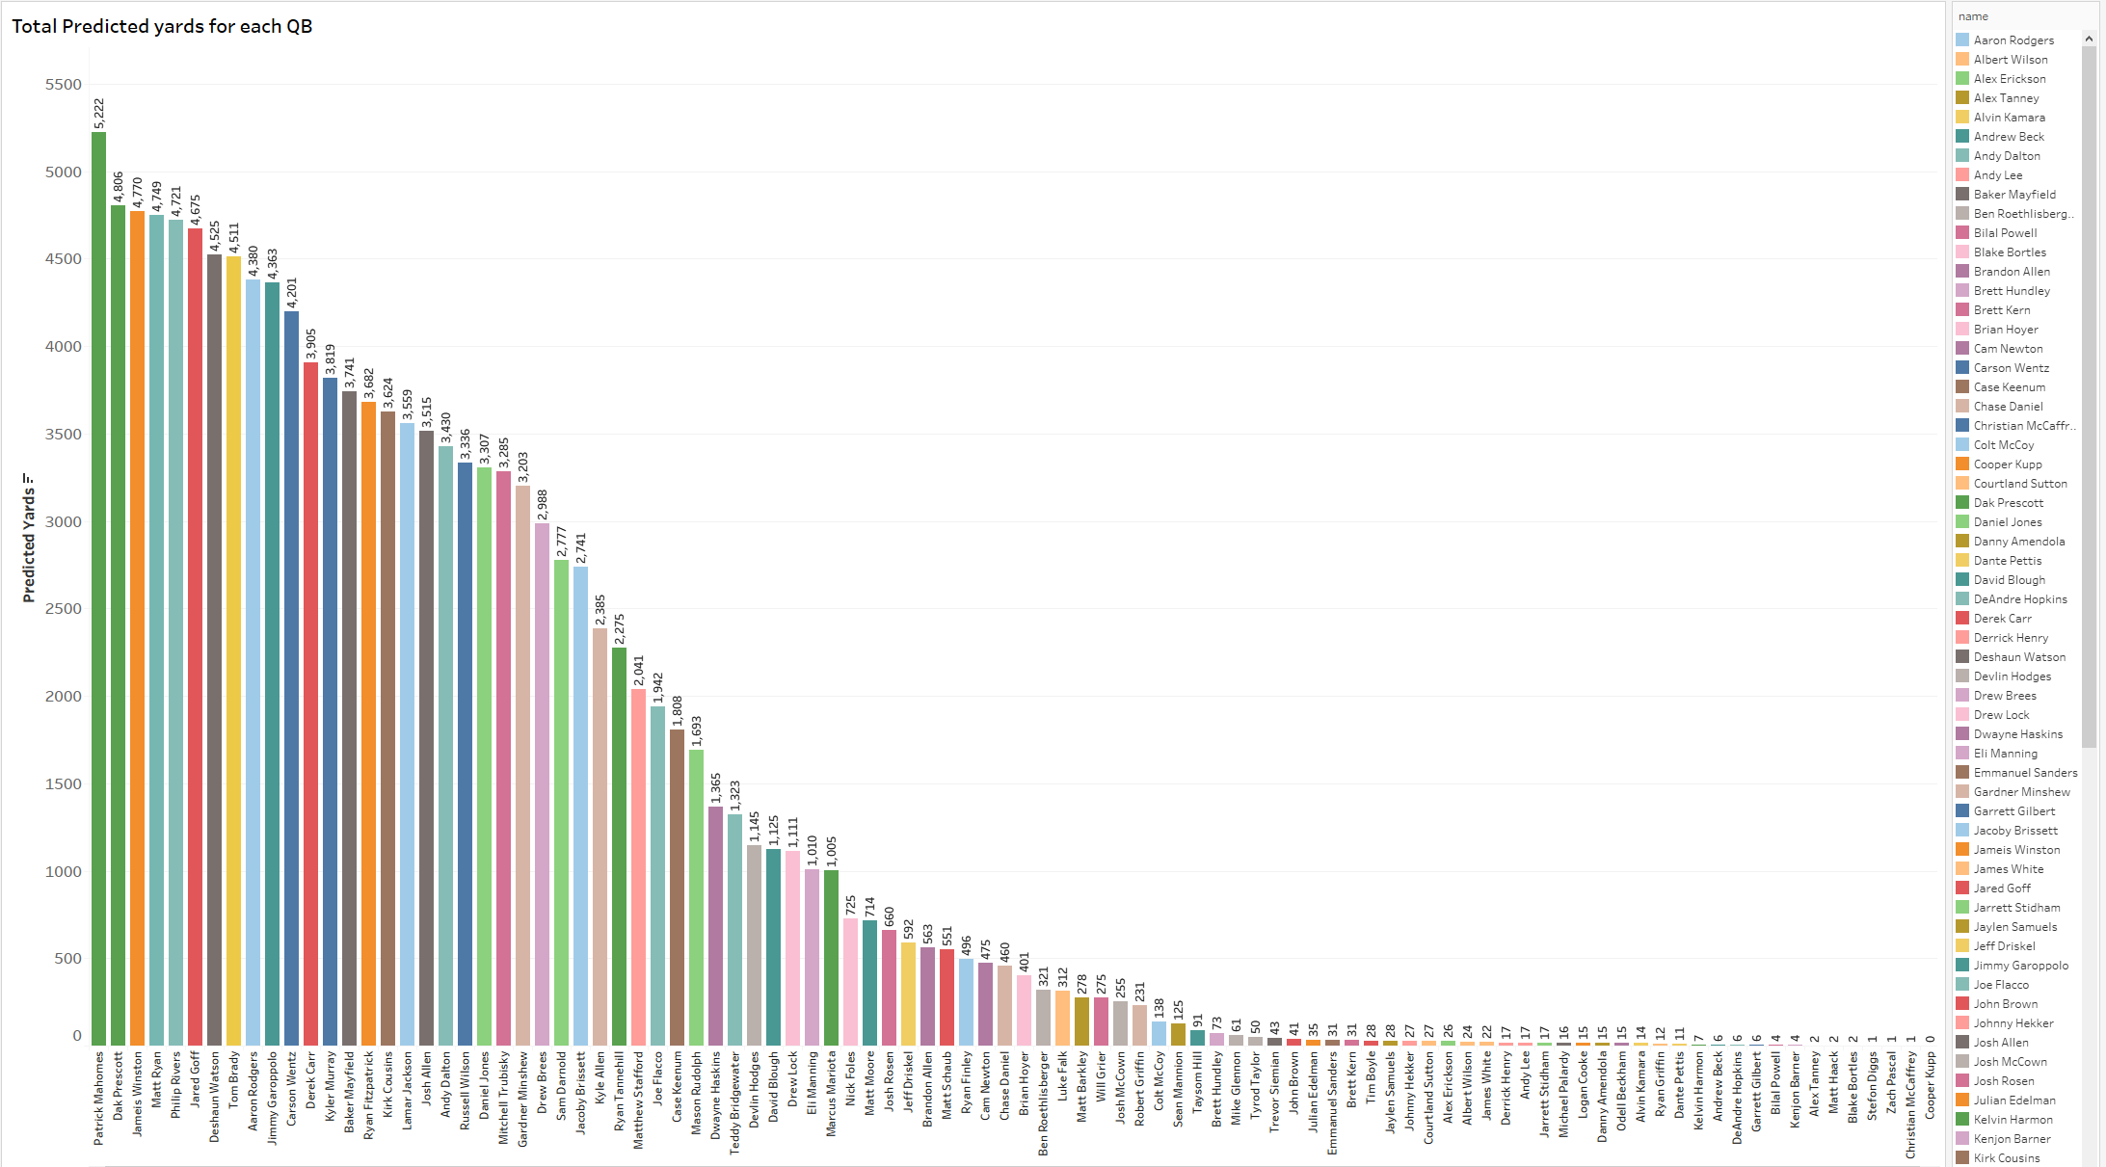

Slide 16
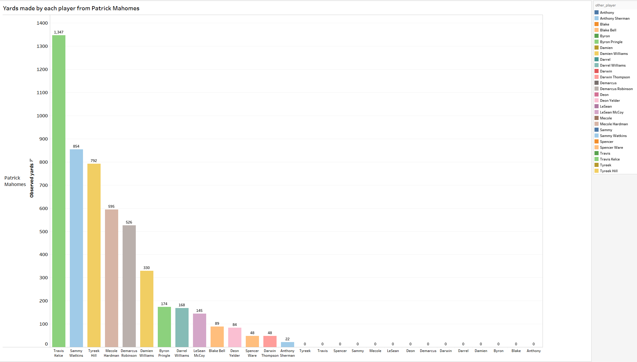

Slide 17
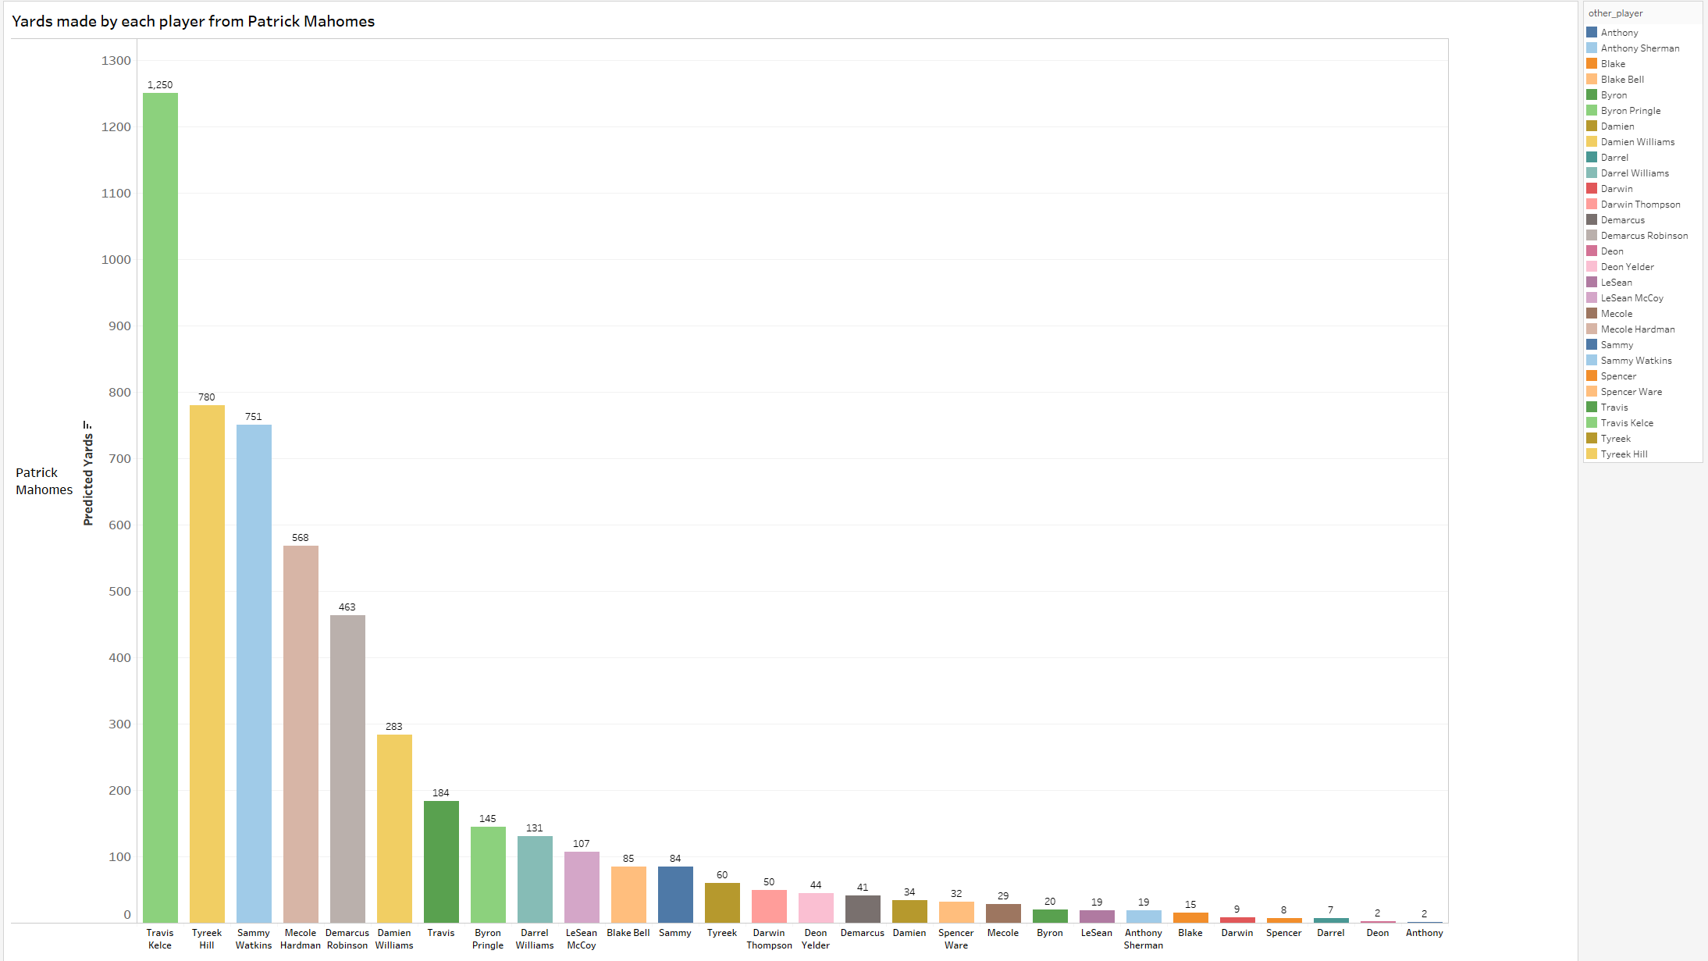

Slide 18
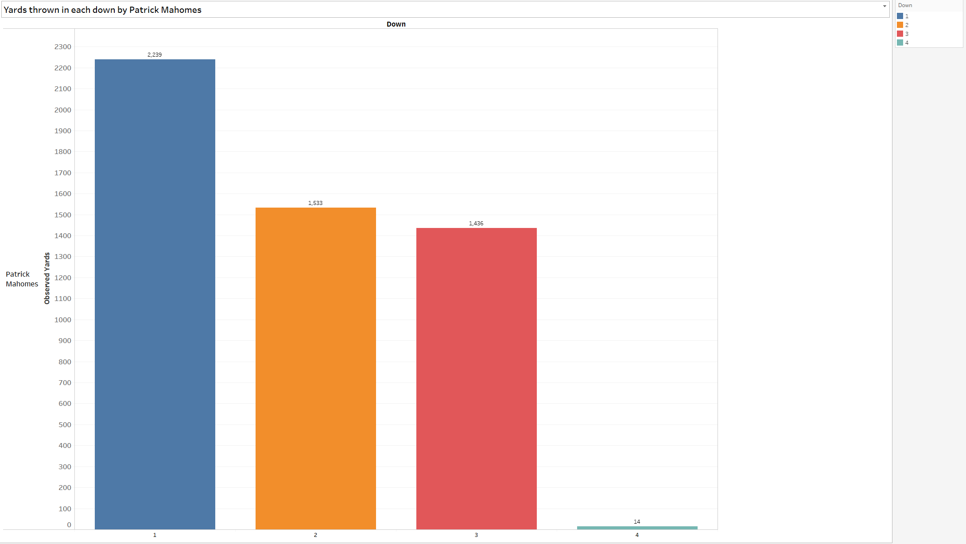

Slide 19
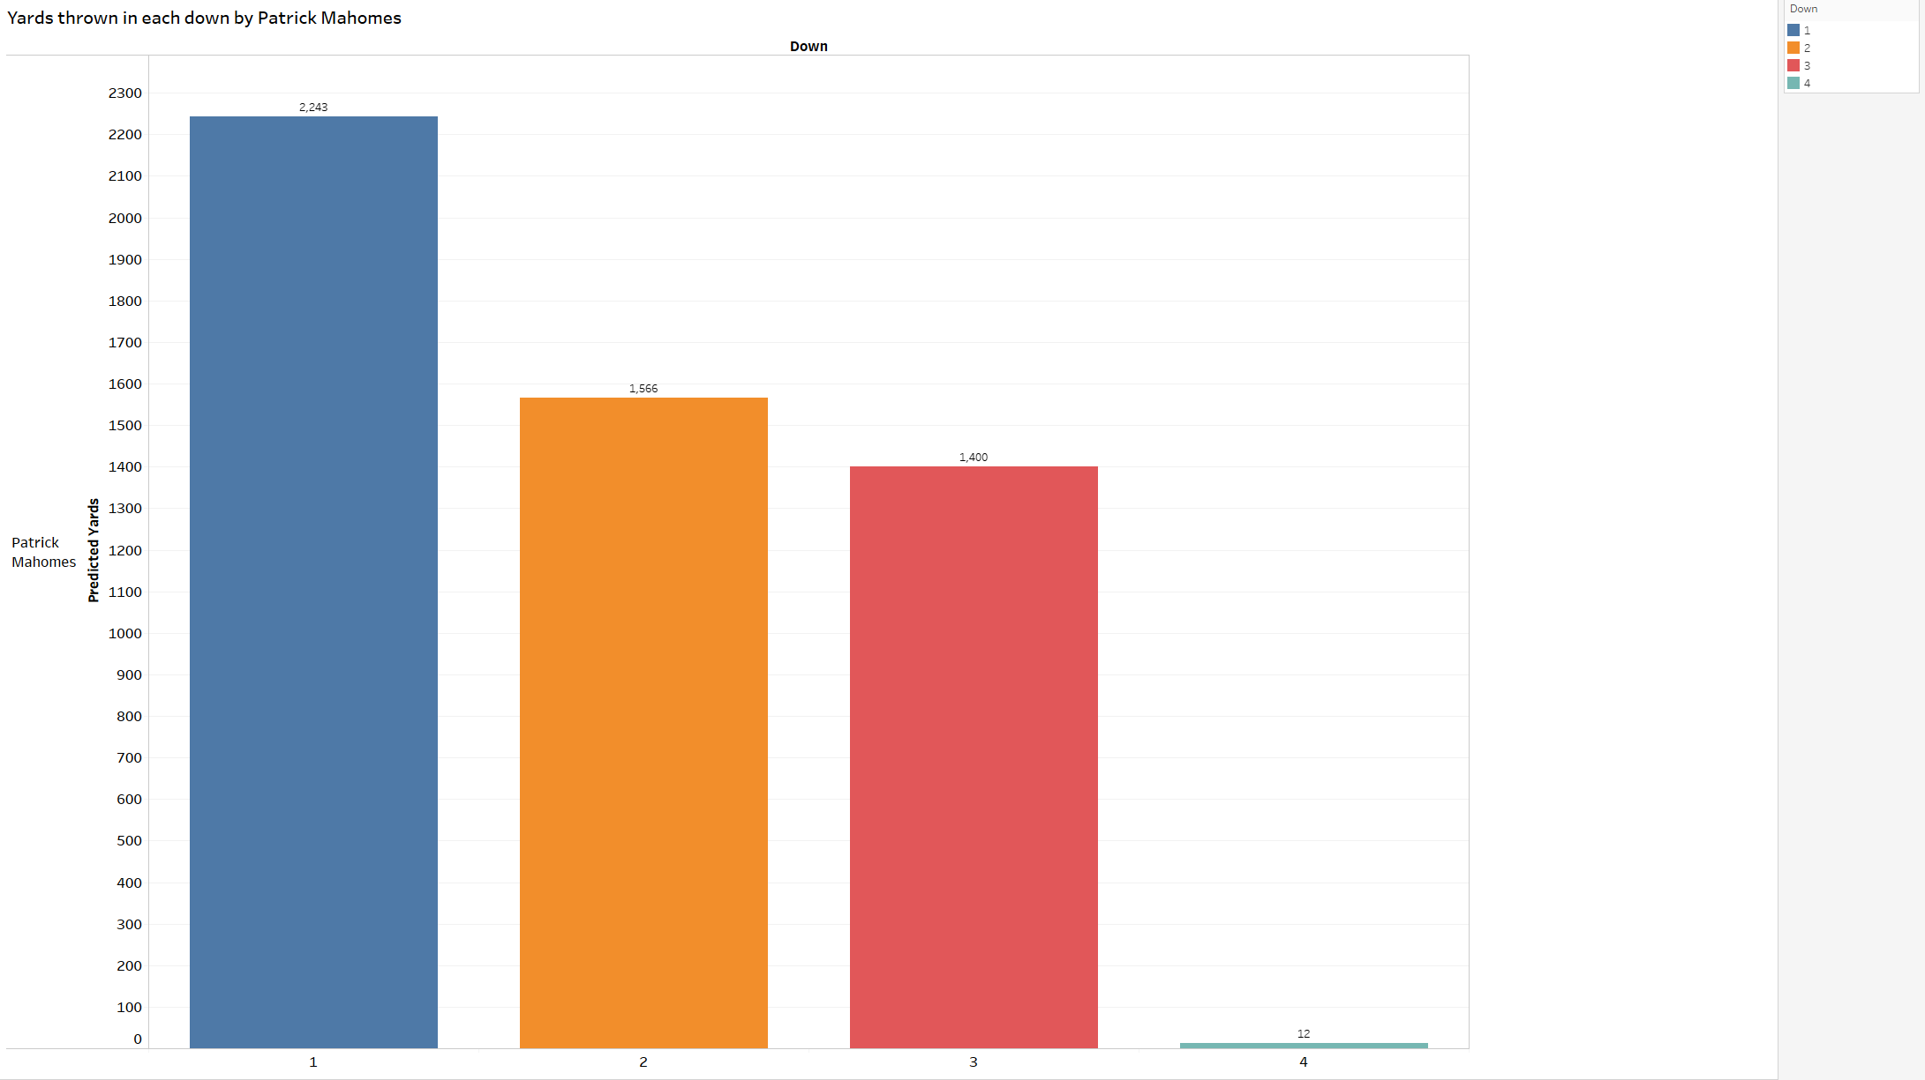

Slide 20
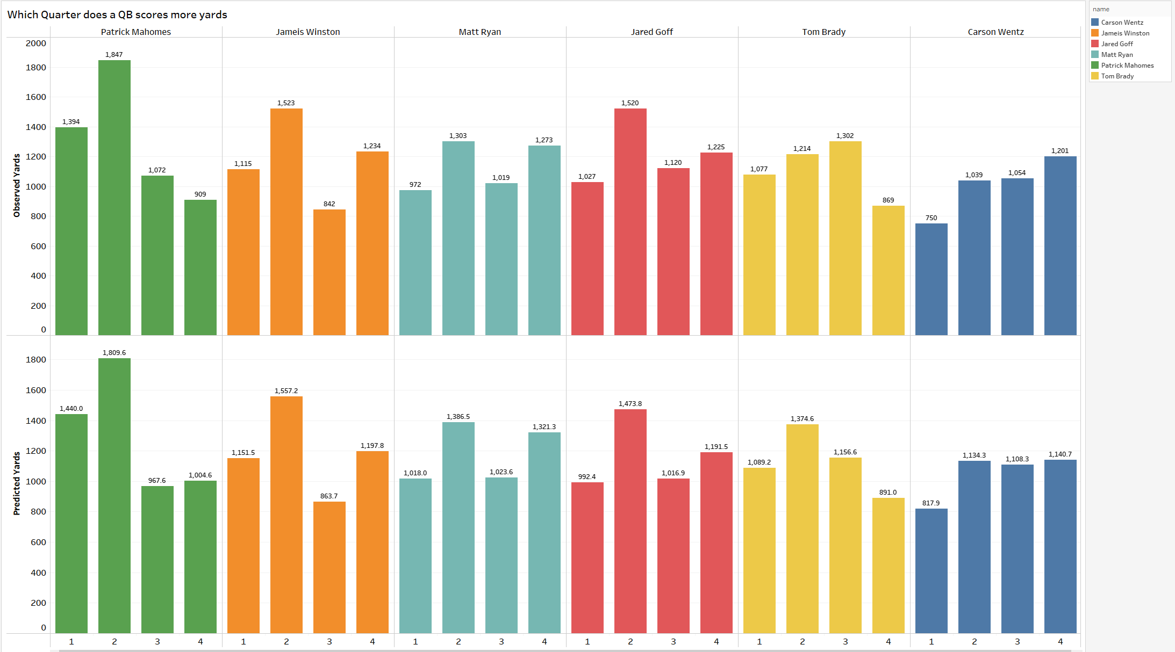

Slide 21
Conclusion:
We modified the data according to our needs to predict the yards thrown by a QB, similarly we can do this for specific positions to identify the patterns. Since the data is not quite accurate still we are able to predict yards thrown for QB. If we have accurate data this makes predictions more precise.

Slide 22
THANK YOU

Slide 23
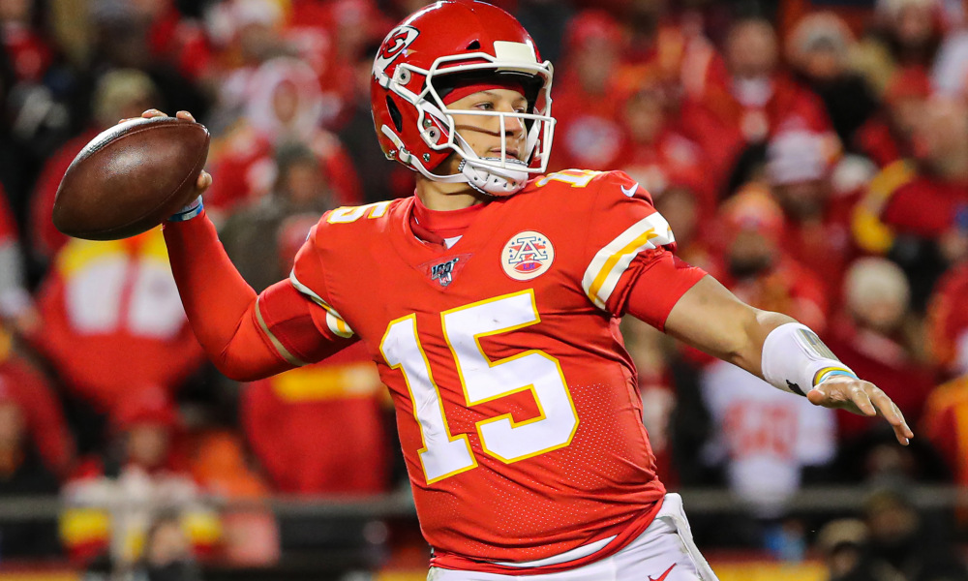
QUESTIONS?

