Slide 1
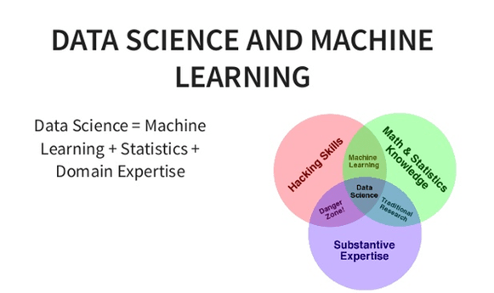
Data Science Overview

Slide 2
Types of data science work
Simple
Investigating- aggregating and inspecting data to get basic insights on what is currently happening.
Political election, Cricket etc.
Predicting- taking data and using it to understand what will happen in the future.
Movie recommendation, weather forecasting etc.
Optimizing- using the data to choose what the best choice of action will be.
Availing the medical help during crisis
Complex

Slide 3

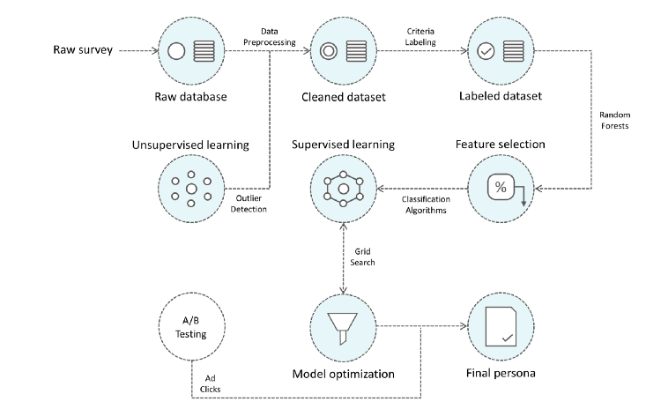

Slide 4

Dataset crawling from social media
Twitter
Tweepy API
Twython API
Reddit
Praw API
Yahoo
Yahoo answer API
Stackoverflow
Using SQL query

Slide 5
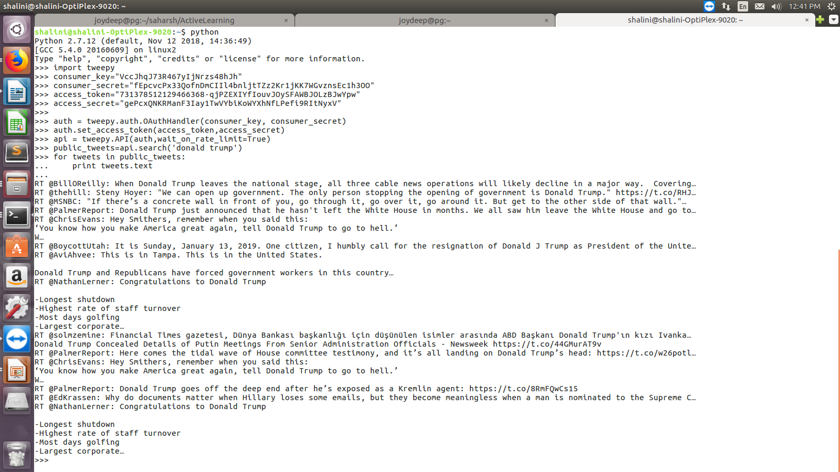
Data collection using tweepy API

Slide 6
Dataset parsing
Json file
Pickle file
csv file
Text file

Slide 7
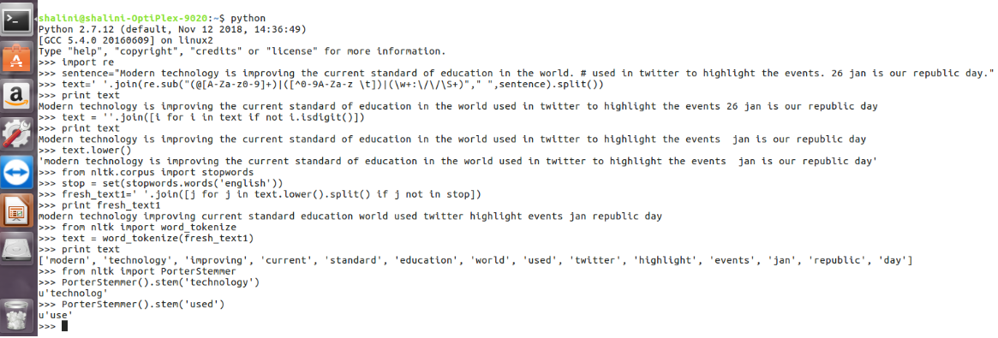
Pre-processing of Text data

Slide 8
Python library
Pip
sudo apt-get install python-pip
NLTK
sudo pip install –U nltk
nltk.download(“popular”)
Scikit-learn
pip install –U scikit-learn
Matplotlib
python –m pip install –U pip setuptools
python –m pip install matplotlib
Numpy
sudo pip install –U numpy
Pandas
sudo pip install pandas

Slide 9
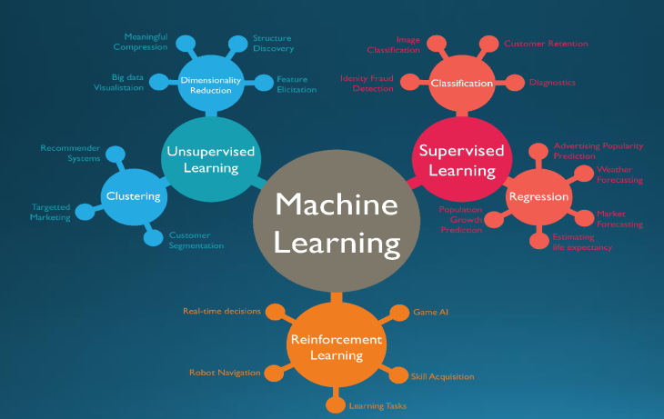
Machine learning task

Slide 10
Some Popular Algorithm
Supervised algorithm
Linear regression(Prediction)
Support vector machine
Decision tree
Naïve baye’s classifier
Ensemble learning
Unsupervised algorithm
K-means
Principal component analysis
Singular value decomposition

Slide 11
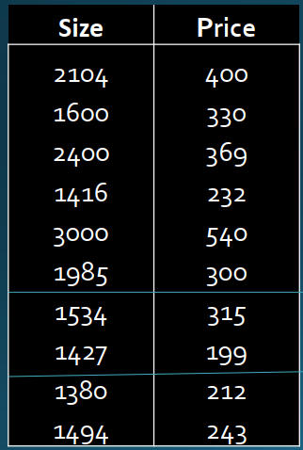
Training, validation, and test sets
Training Dataset: The sample of data used to fit the model.
Validation Dataset: The sample of data used to provide an unbiased evaluation of a model fit on the training dataset while tuning model parameters.
Test Dataset: The sample of data used to provide an unbiased evaluation of a final model fit on the training dataset.
Train dataset
Validation set
Test dataset

Slide 12
Feature generation and feature reduction
Feature set
Uni-gram, bi-gram, n-gram
Sentiment features
Fraction of url’s, hashtags, mentions etc.
Number of likes
Feature reduction
PCA(Principal component analysis)
https://scikit-learn.org/stable/auto_examples/decomposition/plot_pca_iris.html
Laplace filtering
Research paper: Laplacian Score for Feature Selection

Slide 13
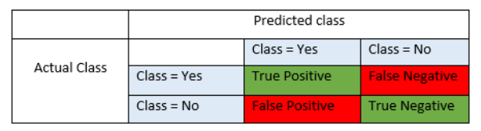
How good is our model(Evaluation metric)
Recall = TP/TP+FN
Precision= TP/TP+FP
F1 Score = 2*(Recall * Precision) / (Recall + Precision)
Accuracy = TP+TN/TP+FP+FN+TN
A confusion matrix is a table that is often used to describe the performance of a classification model on a set of test data for which the true values are known

Slide 14
Classification of IRIS dataset
# Load libraries
import pandas
from pandas.plotting import scatter_matrix
import matplotlib.pyplot as plt
from sklearn import model_selection
from sklearn.metrics import classification_report
from sklearn.metrics import confusion_matrix
from sklearn.metrics import accuracy_score
from sklearn.linear_model import LogisticRegression
from sklearn.tree import DecisionTreeClassifier
from sklearn.neighbors import KNeighborsClassifier
from sklearn.discriminant_analysis import LinearDiscriminantAnalysis
from sklearn.naive_bayes import GaussianNB
from sklearn.svm import SVC

Slide 15
# Load dataset
url = "https://raw.githubusercontent.com/jbrownlee/Datasets/master/iris.csv"
names = ['sepal-length', 'sepal-width', 'petal-length', 'petal-width', 'class']
dataset = pandas.read_csv(url, names=names)
print dataset.shape
(150,5)

Slide 16
Dataset description
# head
print(dataset.head(20))
sepal-length sepal-width petal-length petal-width class
0 5.1 3.5 1.4 0.2 Iris-setosa
1 4.9 3.0 1.4 0.2 Iris-setosa
2 4.7 3.2 1.3 0.2 Iris-setosa
3 4.6 3.1 1.5 0.2 Iris-setosa
4 5.0 3.6 1.4 0.2 Iris-setosa
5 5.4 3.9 1.7 0.4 Iris-setosa
6 4.6 3.4 1.4 0.3 Iris-setosa
7 5.0 3.4 1.5 0.2 Iris-setosa
8 4.4 2.9 1.4 0.2 Iris-setosa
9 4.9 3.1 1.5 0.1 Iris-setosa
10 5.4 3.7 1.5 0.2 Iris-setosa
11 4.8 3.4 1.6 0.2 Iris-setosa
12 4.8 3.0 1.4 0.1 Iris-setosa
13 4.3 3.0 1.1 0.1 Iris-setosa
14 5.8 4.0 1.2 0.2 Iris-setosa
15 5.7 4.4 1.5 0.4 Iris-setosa
16 5.4 3.9 1.3 0.4 Iris-setosa
17 5.1 3.5 1.4 0.3 Iris-setosa
18 5.7 3.8 1.7 0.3 Iris-setosa
19 5.1 3.8 1.5 0.3 Iris-setosa

Slide 17
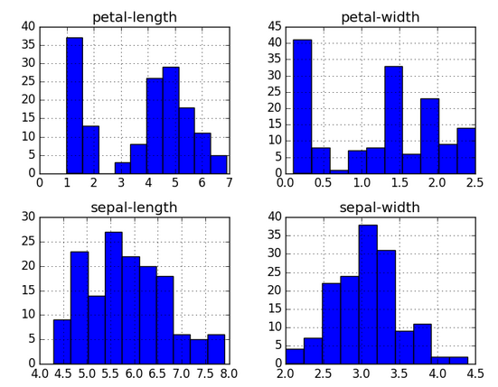
# histograms
dataset.hist()
plt.show()

Slide 18
Evaluation of some algorithm
# Split-out validation dataset
array = dataset.values
X = array[:,0:4]
Y = array[:,4]
validation_size = 0.20
seed = 7
X_train, X_validation, Y_train, Y_validation = model_selection.train_test_split(X, Y, test_size=validation_size, random_state=seed)
# Test options and evaluation metric
seed = 7
scoring = 'accuracy'

Slide 19
# Spot Check Algorithms
models = []
models.append(('LR', LogisticRegression()))
models.append(('LDA', LinearDiscriminantAnalysis()))
models.append(('KNN', KNeighborsClassifier()))
models.append(('CART', DecisionTreeClassifier()))
models.append(('NB', GaussianNB()))
models.append(('SVM', SVC()))
# evaluate each model in turn
results = []
names = []
for name, model in models:
kfold = model_selection.KFold(n_splits=10, random_state=seed)
cv_results = model_selection.cross_val_score(model, X_train, Y_train, cv=kfold, scoring=scoring)
results.append(cv_results)
names.append(name)
msg = "%s: %f (%f)" % (name, cv_results.mean(), cv_results.std())
print(msg)

Slide 20
Result of different supervised classifiers
LR: 0.966667 (0.040825)
LDA: 0.975000 (0.038188)
KNN: 0.983333 (0.033333)
CART: 0.975000 (0.038188)
NB: 0.975000 (0.053359)
SVM: 0.981667 (0.025000)
Link: https://machinelearningmastery.com/machine-learning-in-python-step-by-step/

Slide 21
Make prediction on validation set
# Make predictions on validation dataset
knn = KNeighborsClassifier()
knn.fit(X_train, Y_train)
predictions = knn.predict(X_validation)
print(accuracy_score(Y_validation, predictions))
print(confusion_matrix(Y_validation, predictions))
print(classification_report(Y_validation, predictions))
0.9
[[ 7 0 0] [ 0 11 1][ 0 2 9]]
precision recall f1-score support
Iris-setosa 1.00 1.00 1.00 7
Iris-versicolor 0.85 0.92 0.88 12
Iris-virginica 0.90 0.82 0.86 11
avg / total 0.90 0.90 0.90 30

Slide 22
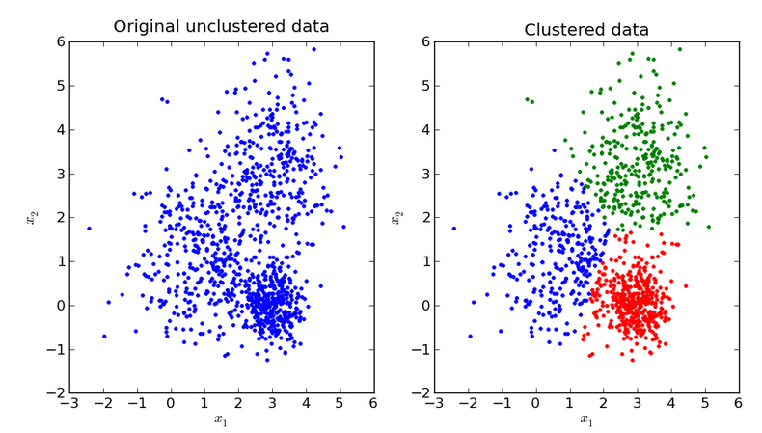
K-means unsupervised algorithm
K-Means is a very simple algorithm which clusters the data into K number of clusters.

