Slide 1

BDNS ET PROJECT using SPARK ML
CAR PRICE PREDICTION
Submitted by :-
Kaustav Ghosh – A23023

Slide 2
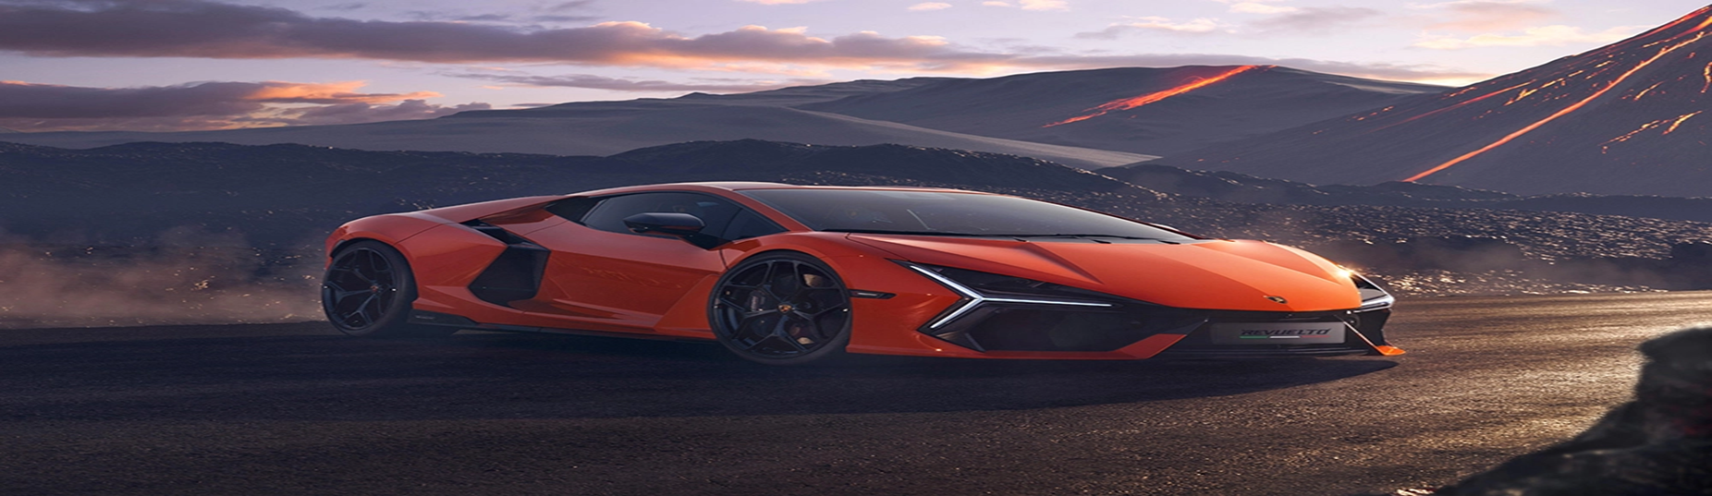
IMPORTANT LINKS
Link to the colab notebook
Link to the dataset used

Slide 3
OBJECTIVE
Our objective in this project is to predict resale value of used cars using spark and machine learning models.

Slide 4
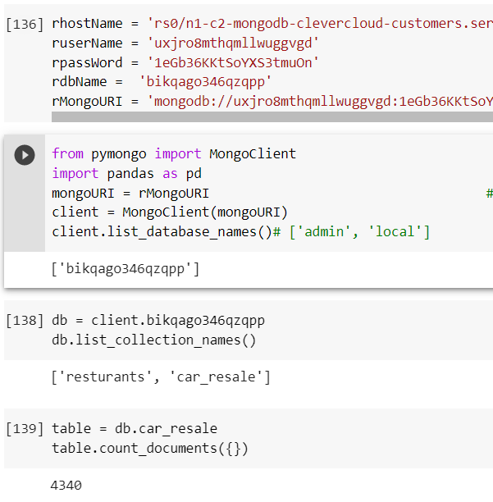
Usage of Mongo DB
Our data is hosted in a Mongo DB remote server. CLEVER CLOUD is used for the purpose of hosting our data.
Data is then fetched from clever cloud and a snapshot of the respective codes are attached .

Slide 5
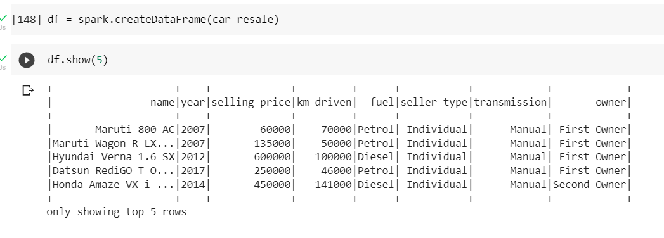
About the dataset
The dataset is downloaded from Kaggle, it has 4340 records. Sellin the target variable for us in the dataset. There were no null values in the dataset. There are 8 columns in the dataset. A snapshot the dataset is attached.

Slide 6
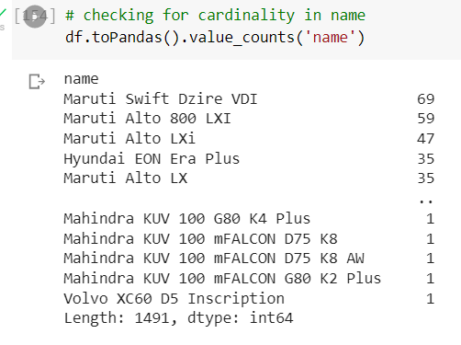
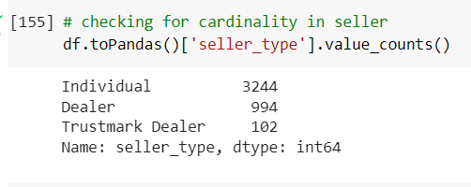
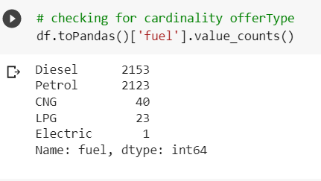
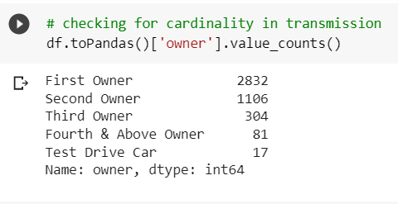

Cardinality of the categorical variables

Slide 7
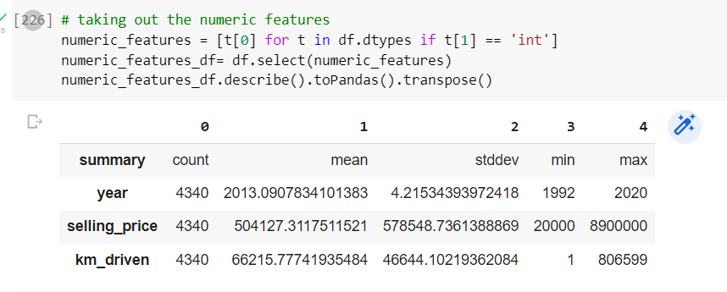
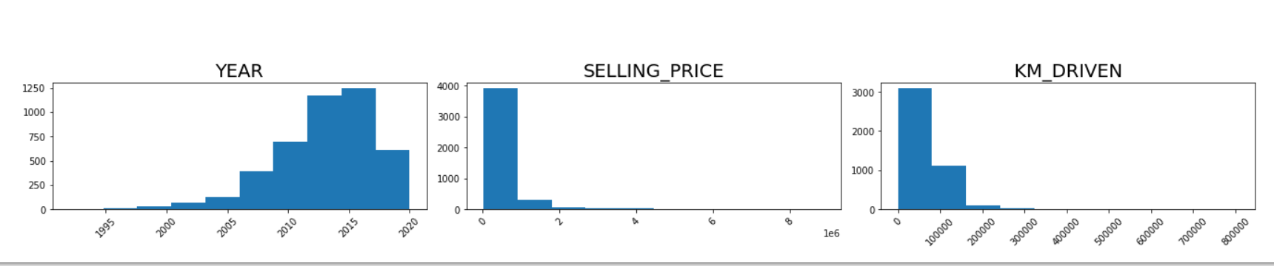
Continuous variables

Slide 8
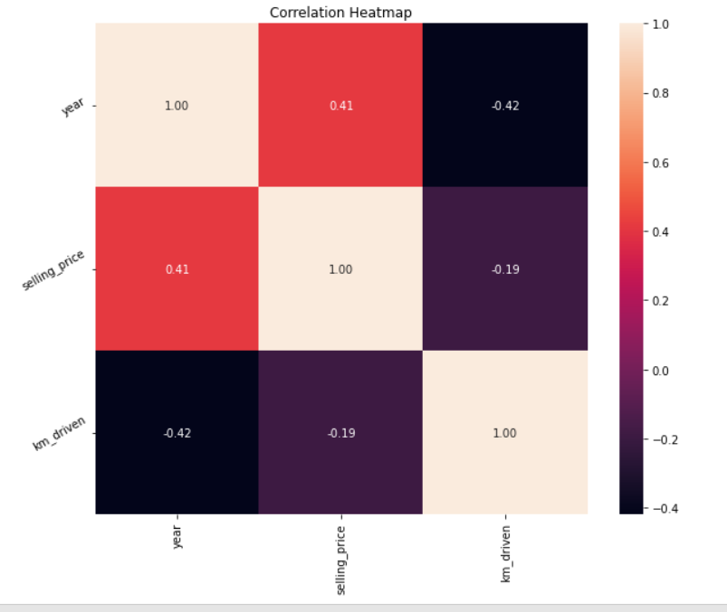
Checking for Multicollinearity
From the correlation heatmap we can see that the linear association/ correlation between our variables is not more than 0.5 in all the cases which can be considered as weak correlation. So we can conclude that there are minimal chances of multicollinearity in our dataset.

Slide 9
Data pre-processing
For the purpose of data pre-processing we have used the following tools :
String Indexer
One Hot encoder
Assembler
Standard Scaler

Slide 10
Basic Pipeline
In the basic pipeline added the following data pre-processing tools :
String Indexer
One Hot encoder
Assembler
Standard Scaler

Slide 11
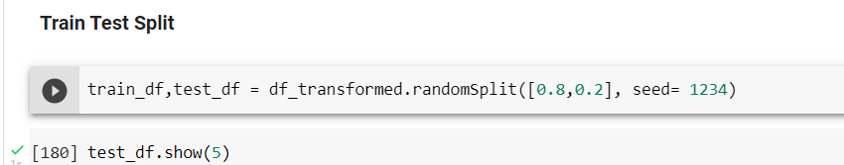
Train Test Split
Our dataset is split into training and testing in the ratio of 80 percent, 20 percent respectively.

Slide 12
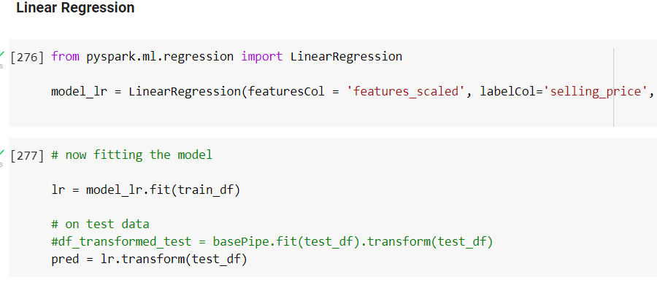
Linear Regression
Using a Linear regression model we got the following values of our evaluation metrics
RMSE - 379755.69
R-SQUARED – 0.67

Slide 13
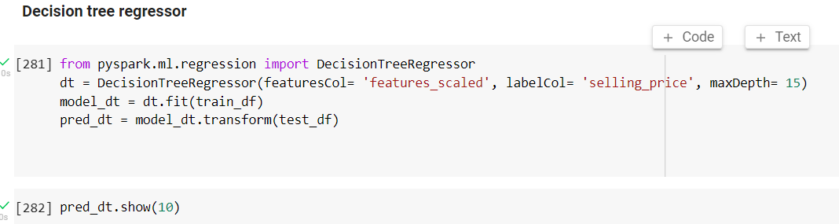
Decision Tree Regressor
Using a Decision Tree Regressor we got the following values of our evaluation metrics
RMSE - 433348.67
R-SQUARED – 0.57

Slide 14
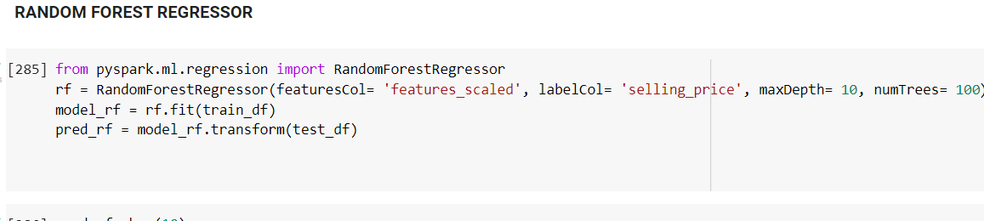
Random Forest Regressor
Using a Random Forest Regressor we got the following values of our evaluation metrics
RMSE - 420088.72
R-SQUARED – 0.60

Slide 15
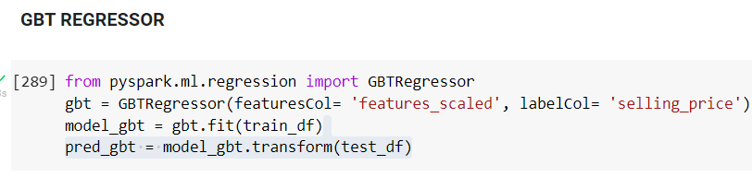
Gradient Boost Tree Regressor
Using a GBT Regressor we got the following values of our evaluation metrics
RMSE - 420589.36
R-SQUARED – 0.60

Slide 16
Gradient Boost Tree Regressor
Using a GBT Regressor we got the following values of our evaluation metrics
RMSE - 420589.36
R-SQUARED – 0.60

Slide 17
CONCLUSION
Linear Regression is giving the best result in our case when compared with other models with respect to RMSE and R-SQUARED.
MODELS | RMSE | R-SQUARED
Linear Regression | 379755.69 | 0.67
Decision Tree | 433348.67 | 0.57
Random Forest | 420088.72 | 0.60
Gradient Boost | 420589.36 | 0.60

Slide 18
Thank you

