Slide 1

Advanced Predictive Analytics and Temporal Activity of Dark Web Forums
Kausthub Kodamagulla
Advisor: Dr. Anu Bourgeois
University: Georgia State University, Atlanta, USA

Slide 2
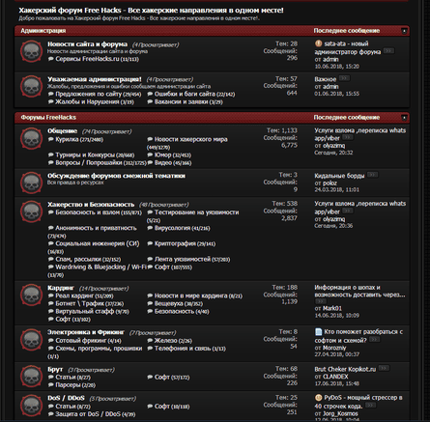
Problem Statement
The project seeks to enhance cybersecurity by improving the analysis and prediction of activities within darknet hacking forums. By extracting meaningful insights, identifying anomalies, and forecasting trends, the project aims to support cybersecurity professionals in proactively detecting and mitigating potential threats, thereby contributing to a more secure digital environment.
Fig 2.a Darknet Forum

Slide 3
Issues with Existing Solutions
Data Scarcity and Quality: Inconsistent sparse data and high level of data inaccuracies[noise] complicates model training
Variability in Content: Data factors such as Linguistic Diversity, contextual and topical ambiguity, post content length and structure also affected the modelling of trends and activity within darknet forums
Algorithm Challenges: Non-Linear and unpredictable user behavior patterns challenged traditional models. In addition to this, seasonal trends were not included while modelling which increases cybersecurity threat level
Resources and Scalability: High cost and computational resources required for sophisticated model training
Performance Metrics and Evaluation: Even though the existing techniques achieve commendable metrics, there is still a need for improvement since the existing model fails to consider factors like overfitting, capturing temporal dependencies, complex post content structures

Slide 4
Software Used
Programming Languages: Python
Data Processing Libraries: NumPy, Pandas, Matplotlib, Genism, BeautifulSoup, Selenium
Machine Learning[NLP]: Scikit-Learn, Transformers
Deep learning: PyTorch
IDE and Cloud : Jupyter Notebook, Google Colab, Arctic Cluster[HPC], GitHub
Algorithms Used: BiLSTM, BERT, VAE, NLP[VADER]
Notes:
Consider talking about:
Operating systems
Driver APIs
Firmware
Third-party application software
Software development tools

Slide 5
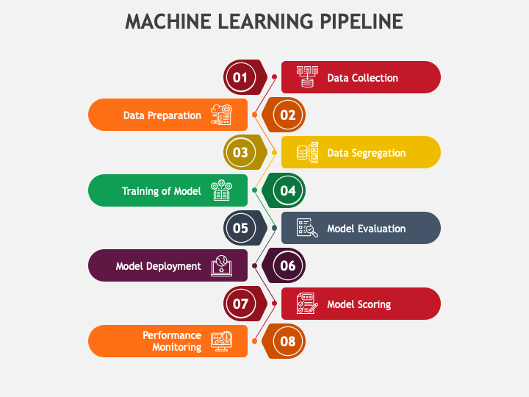
Methodology[Pipeline]
The Darknet Fraud Forum Data Pipeline consists of following Phases
1.Data Collection and Storage: We utilize scraping libraries and publicly available darknet forums for data collection , convert and store the data in .csv extension
3. EDA and Data Visualization:
The pristine data is then utilized to perform exploratory data analysis and visualizations to get comprehensive understanding of the data for accurate modelling
4. Predictive Analytics and Forum Activity prediction : Once we finalize relevant features[feature engineering], we proceed to model selection to experiment for the right candidate model and perform predictive analytics using NLP to identify common themes[sentiment analysis] within forum posts
5.Model training and Results Evaluation: Once we find out the underlying forum topics, we proceed to model vendor activity and activity spikes to detect temporal dependencies. Results were benchmarked against existing SOTA techniques and documented as well
2. Data Transformation: Since the fraud forum data is too noisy to be fed into model, we perform meticulous transformations and pre-processing
Fig 5.a. ML Pipeline

Slide 6
Project Plan
1. Data Acquisition and Management
- Articulates the systematic approach employed for harvesting extensive datasets from obscured darknet environments using advanced scraping technologies like Beautiful Soup and Scrapy
2. Data Engineering and Exploratory Data Analysis
- Discusses the normalization and structuring of raw data and strategic feature optimization to enhance model accuracy.-
-Covers the use of statistical models to uncover data patterns and advanced visualization techniques to analyze vendor longevity.
3. Modelling and Insights Synthesis
- Provides analysis of vendor behaviors and predictive insights into forum dynamics through sophisticated NLP and time-series analysis.
- Focuses on the extrapolation of vendor intent and forum dynamics to proactively identify trends and potential threats within the darknet marketplace.
4. Model Validation and Performance Evaluation
Assesses model performance using metrics like MSE and MAE, and benchmarks outcomes against current models to ensure reliability.
Maintains detailed documentation of all data processes and model analyses to ensure clarity and reproducibility.

Slide 7
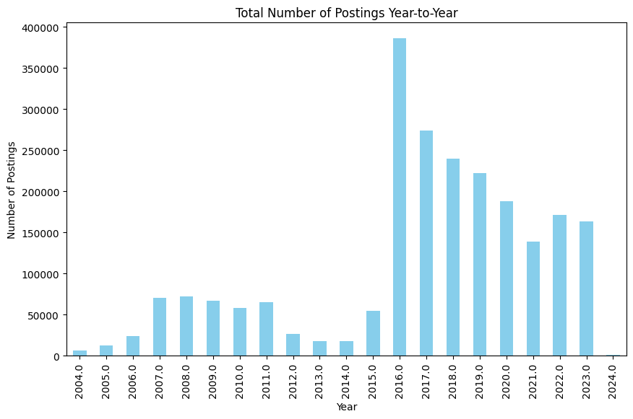
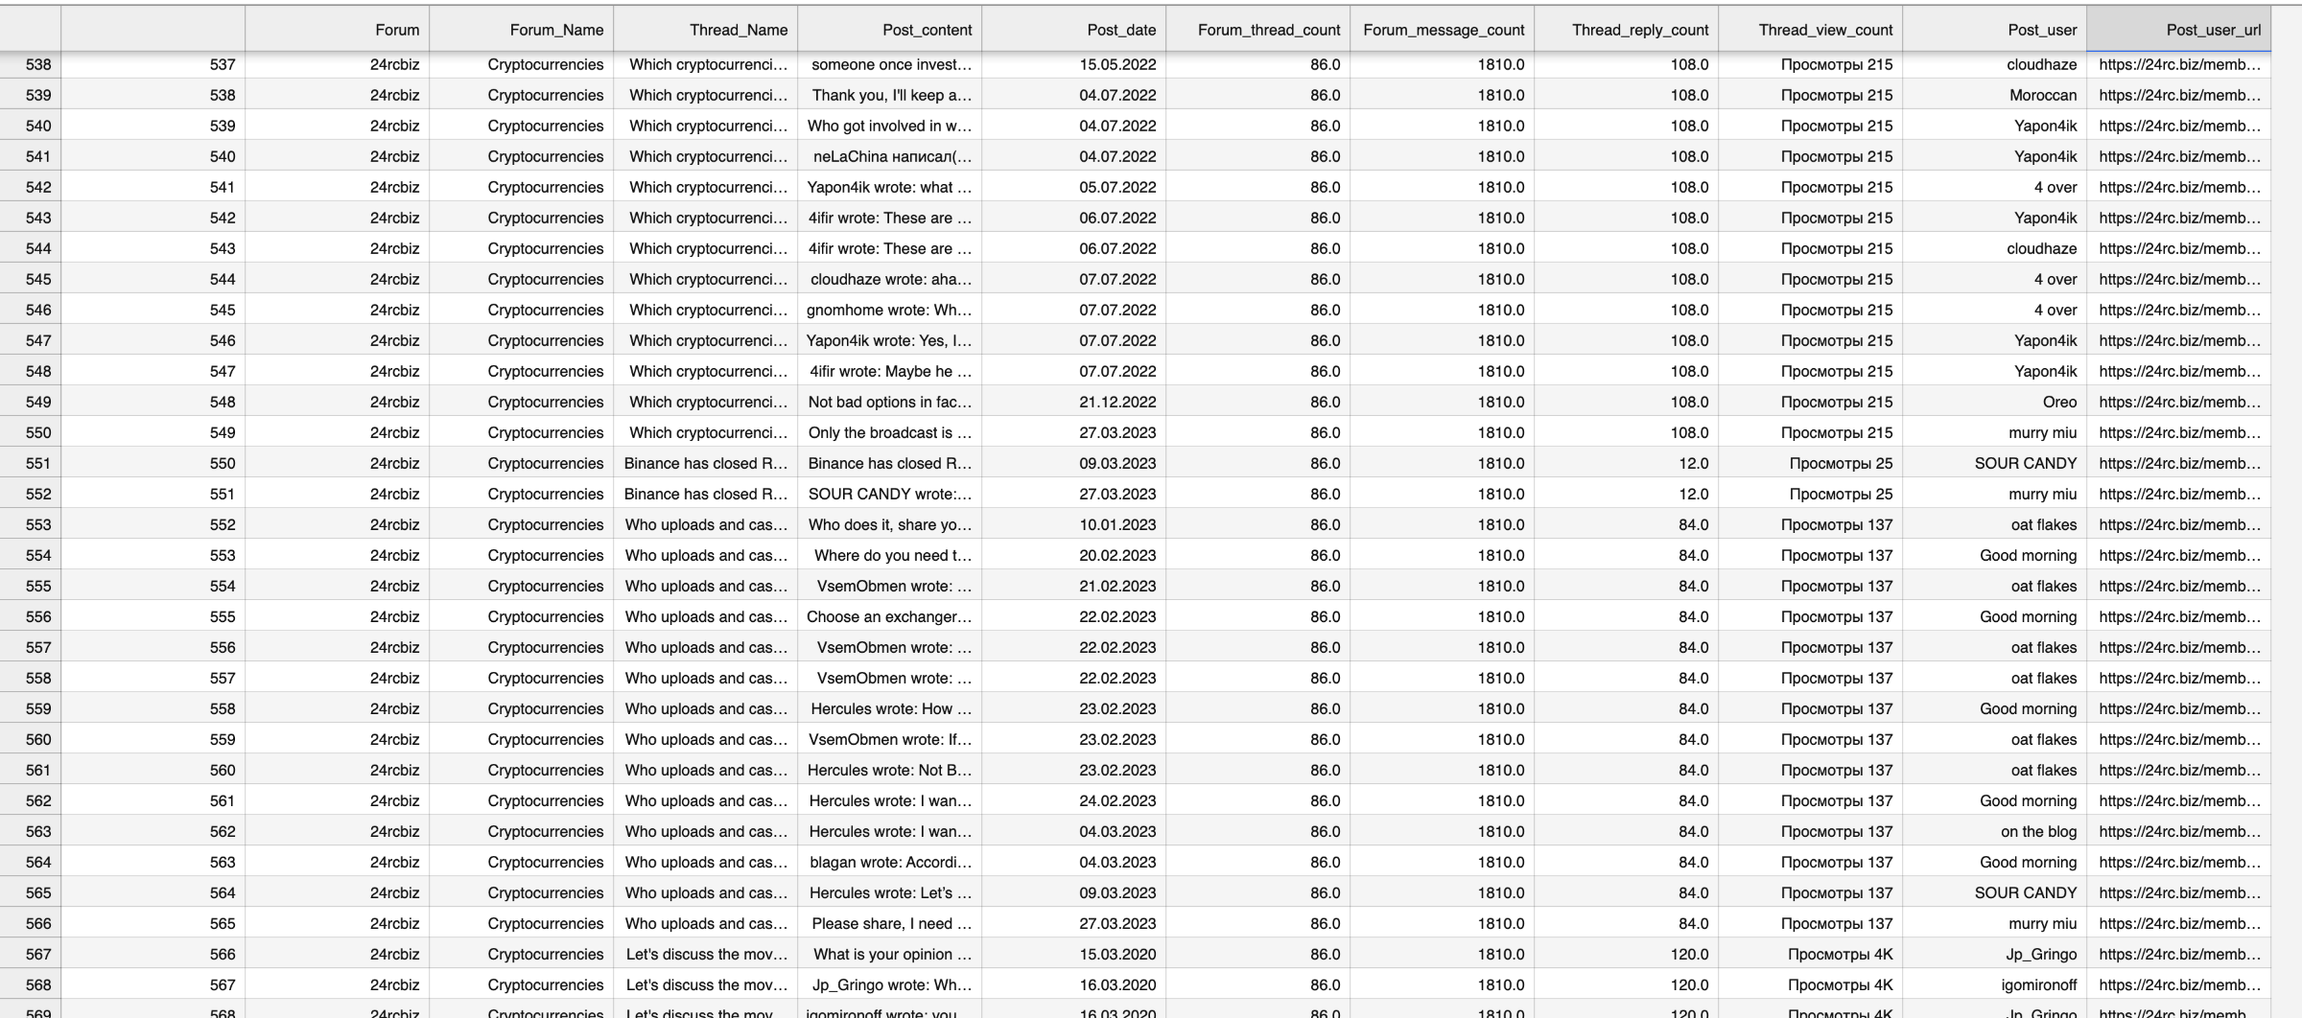
Data Acquisition and Management
Fig 7.a. Fraud Forum Dataset Snippet
Fig 7.b. Postings Graph
The data collection discussion discussion focuses on the processes involved in collecting and managing data within the context of forum data, based on columns such as Forum, Forum_Name[Domain], Thread_Name, Post_content, Post_date, Forum_thread_count, Forum_message_count, Thread_reply_count, Thread_view_count, Post_user, and Post_user_url.
To efficaciously collect this data, one can deploy web scraping methodologies or utilize APIs proffered by forum platforms. Tools such as BeautifulSoup, Scrapy, or Selenium in Python are prevalently employed for web scraping. This intricate process involves navigating the forum's HTML structure to pinpoint relevant information, systematically extracting the requisite data, and adeptly handling unstructured data
The dataset size is 137000 rows and 12 columns extracted from 20 Fraud Darknet data forums.[Around 1.6 GB] worth File. The formatting used for the data management purpose is .csv file since it supports flexibility in data representation, maintains encoding formats and compatibility efficiency

Slide 8
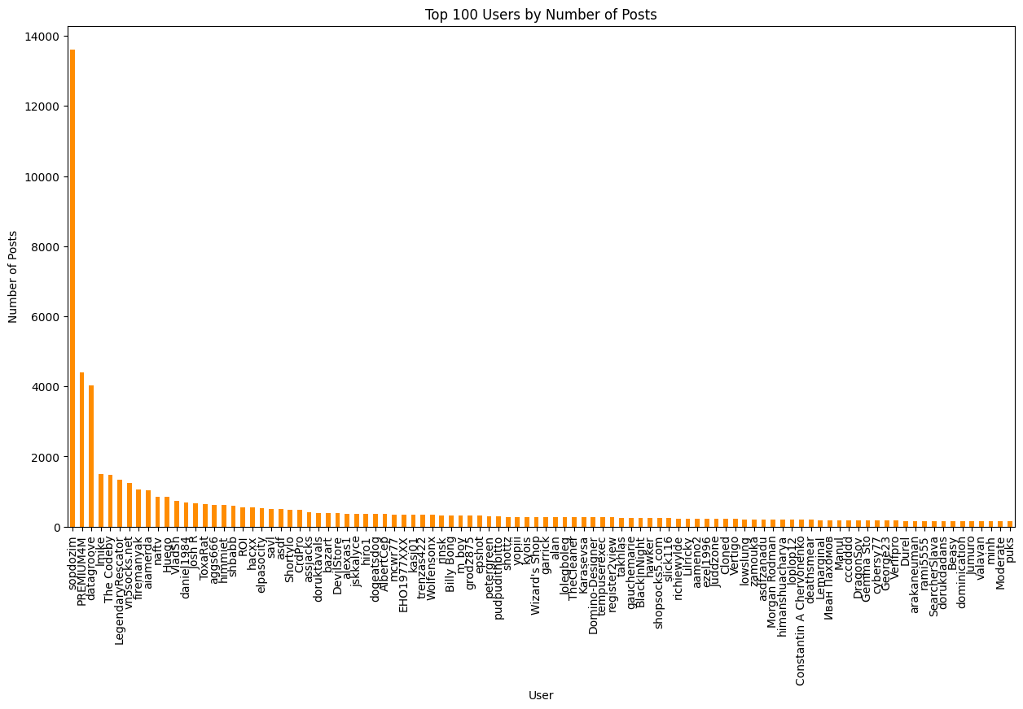
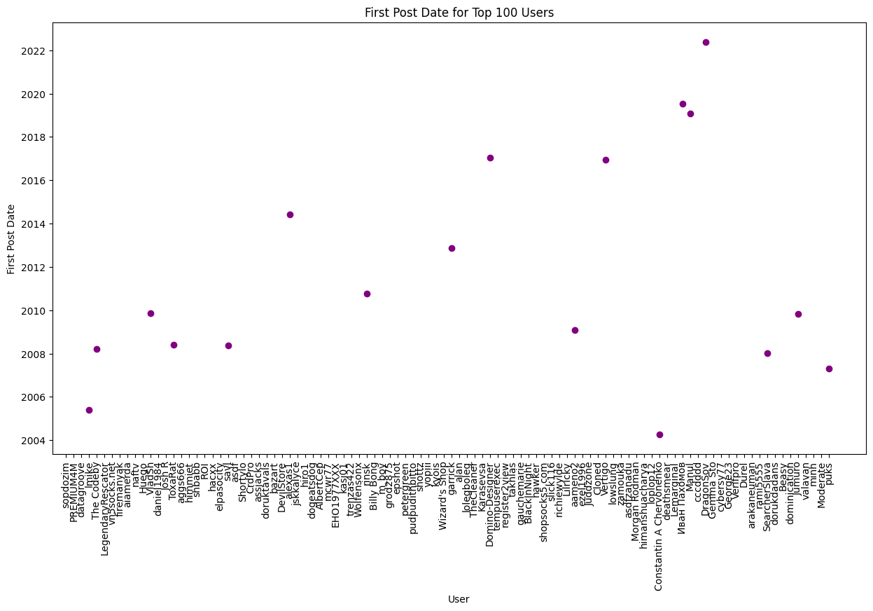
Data Engineering [Transformation Phase]
Fig 8.a. Top 100 users Postings
Methods:
Data Cleaning:
Handling Missing Values: Using imputation or removing incomplete rows/columns to ensure dataset completeness.[E.g.: removing empty values from Post_content column]
Removing Duplicates: Identifying and eliminating duplicate records within fraud dataset to maintain data quality.
Outlier Detection: Using Z-scores analysis to detect and handle outliers within the fraud dataset column values.
Language Translation: Converting multilingual text to a common language (e.g., using Google translate API to convert Russian text to English text).
Text Preprocessing: Utilizing NLP techniques [Libraries] to process text data in Post_content column
Standardizing Date Formats: Converting post dates to a consistent format (MM-DD-YYYY) using Python’s datetime library.
Feature Engineering:
Feature Selection: Retaining important features (e.g. Post_content and Post_date) and removing irrelevant ones to reduce dimensionality.
Fig 8.b. Post Date for Top 100 users

Slide 9
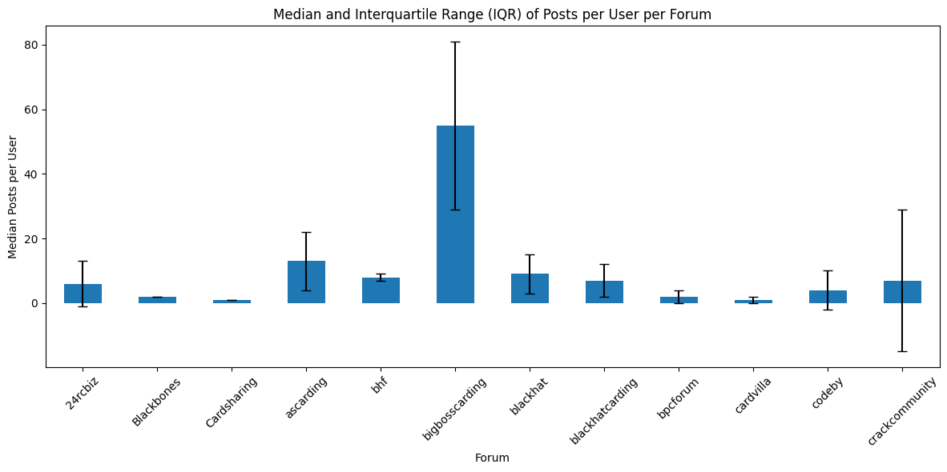
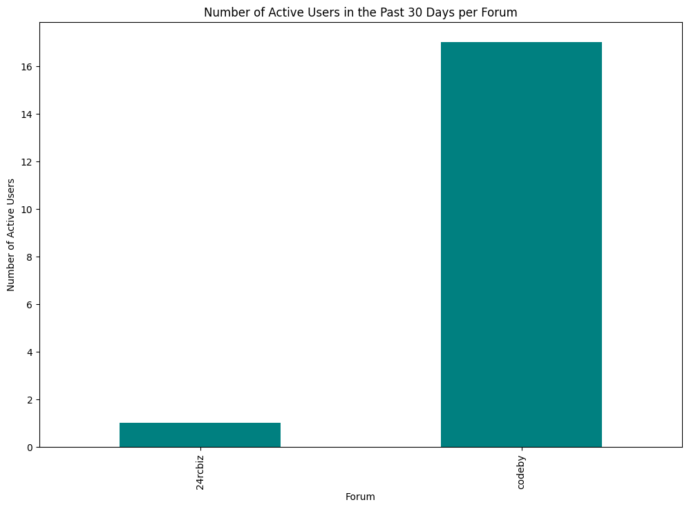
Exploratory Data Analysis[EDA]
Fig 9.a. Descriptive Statistics
1. Descriptive Statistics :
The Descriptive Statistics phase is essential for comprehending the core attributes of the forum activity within the darknet fraud dataset.
Mean and Median: These metrics reveal average and central activity levels, highlighting typical user behavior and any skewness in data distribution.
Mode: Identifies the most frequent post counts, indicating peak activity periods and common engagement days.
Standard Deviation: Provides insights into the variability of user activity, with high values suggesting fluctuating post counts across days.
2 . Data Visualization:[Vendor Longevity Analysis]
Data visualization is essential for identifying patterns and trends in the dataset, particularly for understanding vendor longevity in darknet forums. Vendor longevity, indicating how long a vendor has been active and consistently posting, is crucial for assessing their reputation and trustworthiness.
Focusing on Post_dates and Post_user columns, we use Matplotlib and Seaborn to create visual representations of vendor activity. Line plots illustrate the trend of posts over time for each vendor, highlighting their activity duration and consistency. Histograms show the distribution of posts made by vendors over specific periods, identifying those with high or low activity levels.
Heatmaps provide a visual density of posts over time, revealing periods of high and low activity, while box plots summarize the distribution of posts per vendor, highlighting median activity levels and outliers. These visualizations offer a comprehensive understanding of vendor behavior, helping to assess their reliability and reputation based on their posting patterns
Fig 9.b. Active Postings within 30 days

Slide 10
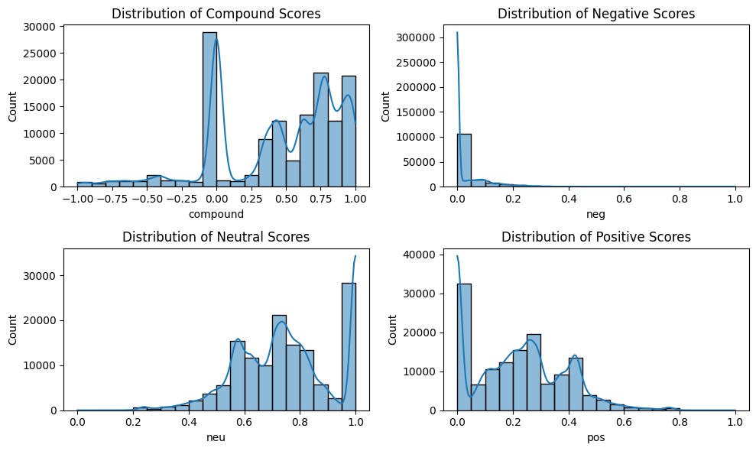
Predictive Analytics
The predictive analytics task aimed to understand vendor behavior within darknet forums using NLP techniques. The analysis focused on identifying words or phrases leading to higher view counts and post popularity. Key steps included:
A) Popular Word Identification: Used SpaCy to extract and analyze frequently occurring words from the "Post_content," removing stop-words to focus on impactful terms.
B) Intent Analysis: Employed Text Blob for sentiment analysis, categorizing posts as Positive, Neutral, or Negative, and studying their correlation with view counts. Utilize VADER library to get sentiment scores distribution
C) Frequency Analysis: Counted mentions of identified words across the dataset to evaluate their significance.
d) Data Visualization: Created visualizations to represent word frequency, impact, and sentiment distribution to better understand vendor intent and user engagement.
Fig 10.a. Sentiment analysis score distribution vs Post counts

Slide 11
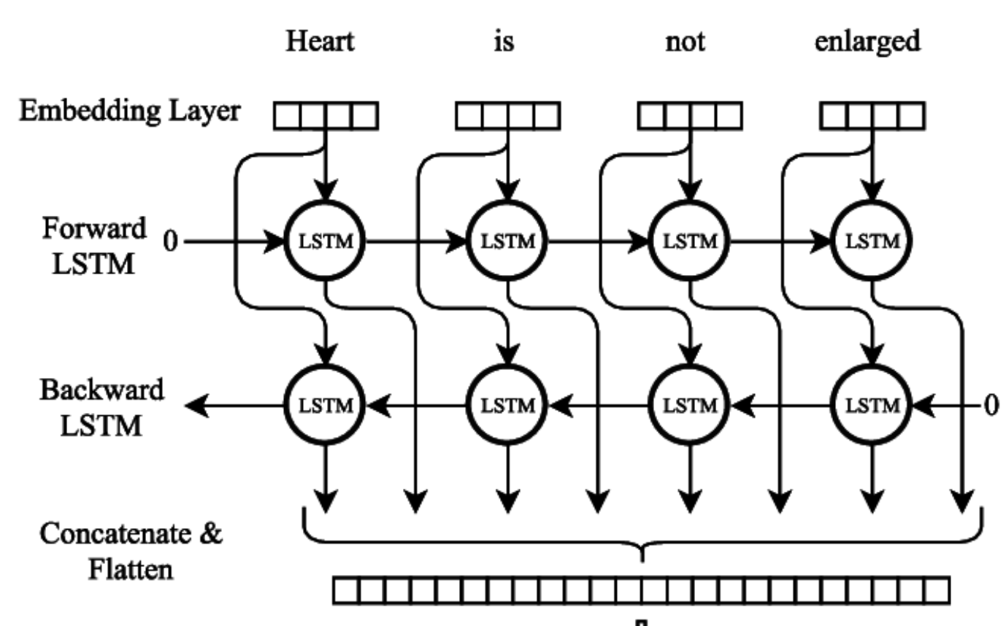
Model Selection[Forum Activity Prediction]
D) Once visualizations and vendor longevity analysis are complete, we proceed to the model selection phase, focusing on choosing an appropriate model and relevant features. Key features identified during the feature engineering phase include Post_content, Post_user, Forum_name, and Post_date, which are essential for understanding the posting behavior of darknet vendors.
Model selection:
A) In the model selection phase of analyzing darknet vendor activity, a Bidirectional Long Short-Term Memory (BiLSTM) network was selected for its ability to handle time-series data in both directions, capturing comprehensive temporal dependencies. Key features included Post_content, Post_user, Forum_name, and Post_date, crucial for understanding vendor behavior.
B) Data preparation involved loading and preprocessing the dataset, converting dates to datetime format, aggregating post counts by date, normalizing with MinMaxScaler, and splitting into training and testing sets. The BiLSTM model was configured with an input size of one, a hidden size of fifty, one layer, and an output size of one.
c) The scaled post count data was used to create time-series datasets with a time step of ten, which were then converted to PyTorch tensors. The model's architecture included a bidirectional LSTM layer to capture dependencies and a fully connected layer for output
Fig 11.a. BILSTM Architecture

Slide 12
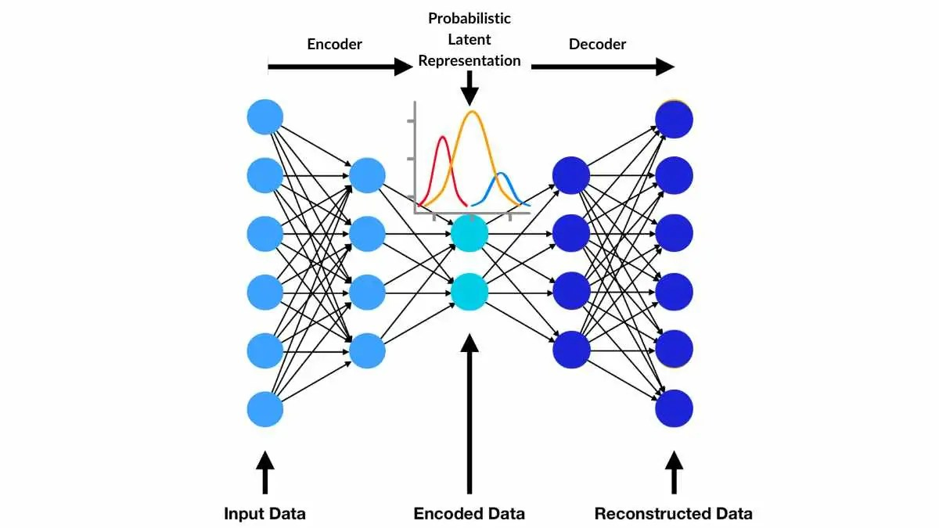
Temporal Forum Activity Anomaly Detection Using VAE[Behavioral Profiling]
Fig 12.a. VAE Architecture
The primary technique employed in this project is a Variational Autoencoder (VAE), a sophisticated generative model designed to learn the underlying distribution of data and detect anomalies based on deviations from this learned distribution.
The VAE model comprises an encoder and a decoder. The encoder compresses the input activity data into a lower-dimensional latent space, characterized by mean and variance. The decoder reconstructs the original data from this latent space. The VAE is trained using a combination of reconstruction loss and KL divergence loss, which ensures the latent space adheres to a normal distribution. Throughout the training phase, the VAE learns to reconstruct normal activity patterns, thus enabling the detection of anomalies as significant deviations from these patterns
Initially, data is collected from various forums, focusing on metrics including post counts, thread counts, and message counts. The collected data is meticulously preprocessed, involving normalization and structuring to ensure it is suitable for subsequent analysis.
The VAE is applied to detect temporal anomalies in forum activity metrics. By learning the typical temporal patterns, the VAE can identify unexpected spikes or drops in activity, aiding in real-time monitoring and prompt detection of unusual behavior. For instance, using the 95th percentile ensures only the most unusual patterns are flagged. Data points with errors exceeding this threshold are classified as anomalies, highlighting periods of unusual activity.

Slide 13
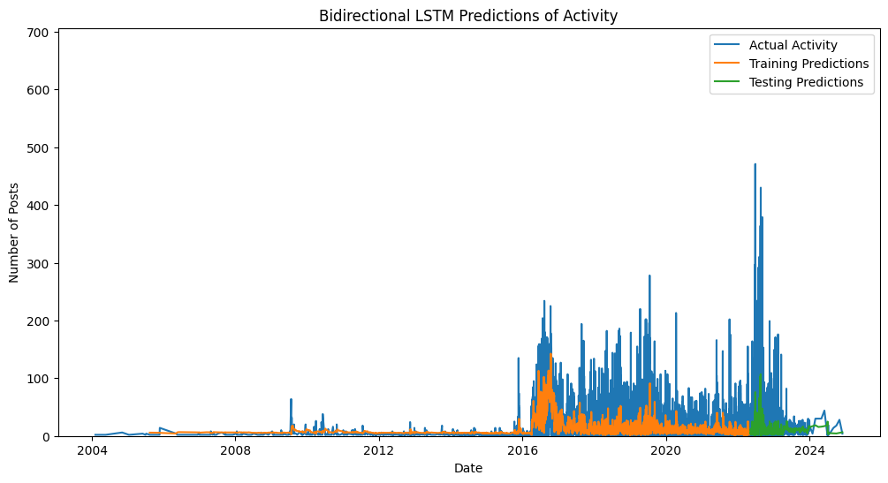
Results Evaluation
FORUM ACTIVITY ANALYSIS[BILSTM]
Fig 13.a. Forum Activity Analysis using BILSTM
This chart illustrates the comparison between actual activity and the predictions generated by a Bidirectional LSTM model for the number of posts over time (2004-2024).
Actual Activity (Blue Line): Represents the real number of posts, showing significant increases around 2015 and major spikes from 2020 to 2022.
Training Predictions (Orange Line): Indicates the model's predictions during the training phase, which closely follow the actual activity initially but diverge slightly after 2016.
Testing Predictions (Green Line): Depicts the model's predictions during the testing phase, generally aligning with the trend of actual activity but with some deviations, particularly in recent years.
Output Metrics for BILSTM:
The model begins with a loss of 0.0039 at epoch 10, quickly decreasing to 0.0034 by epoch 20, indicating rapid learning.
Stabilization of Loss: By epoch 30, the loss reduces to 0.0033 and stabilizes around 0.0031 by epoch 100, reflecting effective learning and data reconstruction.
Final Performance: The final loss of 0.0031 at epoch 100 and a training Mean Absolute Error (MAE) of 1.4% indicate the Bidirectional LSTM's strong performance and its ability to handle unseen data, which is crucial for reliable anomaly detection.

Slide 14
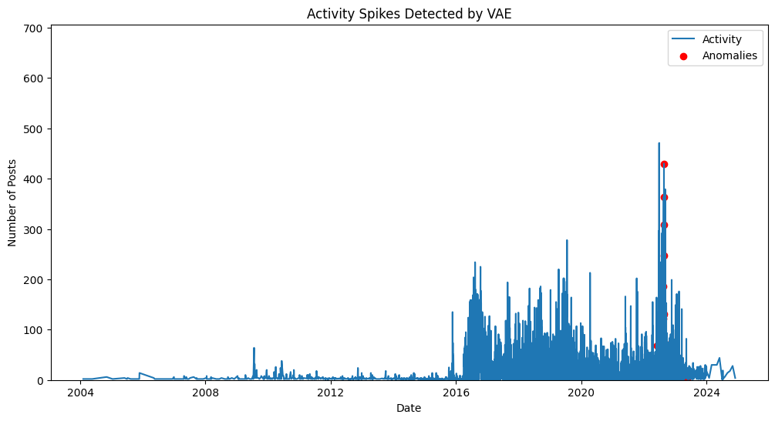
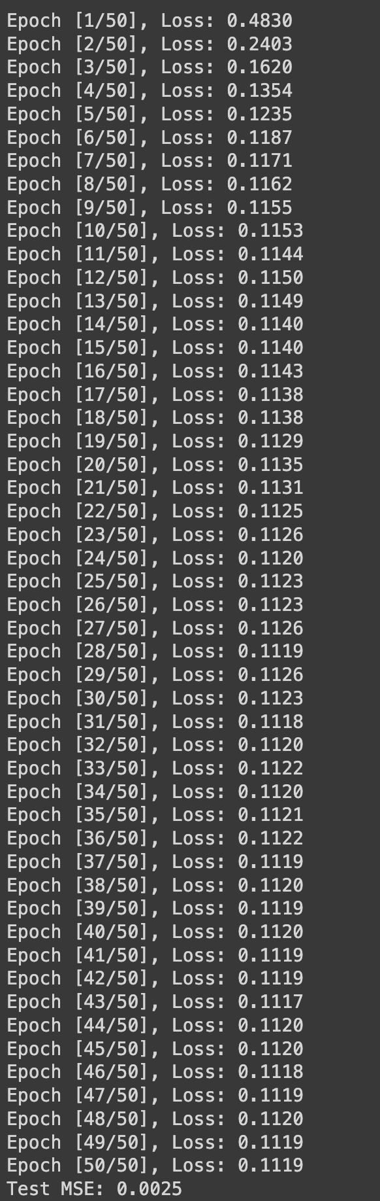
Metrics Evaluation
ANOMALY DETECTION BY VAE
Fig 14.a Activity Spikes Detection
Fig 14.b VAE Performance Metrics
The graph illustrates the number of posts over time, with the x-axis representing dates and the y-axis showing post counts.
Normal Activity (Blue Line): Indicates typical post counts over time. Minimal activity is observed before 2016, followed by a significant increase indicating a notable event or change. Peaks and troughs represent fluctuations in activity levels.
Anomalies (Red Dots): Represent unusual spikes in post activity detected by the Variational Autoencoder (VAE). These spikes, particularly noticeable between 2020 and 2022, may indicate significant events, changes in user behavior, or potential attacks.
Output Metrics for VAE Model:
Training Loss Over 100 Epochs:
The training process of the VAE, illustrated over 100 epochs, demonstrates significant improvement in reconstructing input data.
Epoch-wise Loss Values:
The model starts with a loss of 0.5563 at epoch 1, rapidly reducing the loss to 0.2782 by epoch 2, indicating swift learning.
Stabilization of Loss:
By epoch 10, the loss drops to 0.1156 and stabilizes around 0.1120 by epoch 100, showing effective learning in data reconstruction.
Final Performance:
The final loss of 0.1120 at epoch 100 and a Test Mean Squared Error (MSE) of 0.0025 demonstrate the VAE's strong performance and its capability to handle unseen data, which is crucial for reliable anomaly detection.

Slide 15
Future Work
AI-Driven Dark Web Monitoring: Implement adaptive learning systems that continuously learn from new data, adapting to evolving threats and improving detection accuracy.
Regulatory and Ethical AI Frameworks Usage: AI-driven compliance automation and implement transparent AI as well
Enhanced security Measures[Differential Privacy]:Utilize advanced differential privacy techniques to ensure robust protection of sensitive data
Interdisciplinary Approaches towards Modelling: Integrate data from diverse domains (e.g., social media, financial transactions, cybersecurity reports) to create comprehensive models and Foster interdisciplinary research initiatives combining expertise

Slide 16
References
https://www.newsweek.com/surge-russian-dark-web-us-election-interference-2024-1878905
Fayzi, Ali. (2023). Dark web activity classification using deep learning.
Abdullah Abdul Sattar Shaikh, M.S. Bhargavi, and C. Pavan Kumar. 2023. An optimised Darknet traffic detection system using modified locally connected CNN - BiLSTM network. Int. J. Ad Hoc Ubiquitous Comput. 43, 2 (2023), 87–96. https://doi.org/10.1504/ijahuc. https://doi.org/10.1007/s10257-023-00626-2
https://github.com/macanv/BERT-BiLSTM-CRF-NER
https://arcwiki.rs.gsu.edu/
https://github.com/AntixK/PyTorch-VAE

Slide 17


