Slide 1

Basic Details of the Team and Problem Statement
Ministry/Organization Name/Student Innovation: Indian Space Research Organization(ISRO)
PS Code: SIH1517
Problem Statement Title: Identification of place names from a natural language sentence
Team Name: Technocracy
Team Leader Name: Kausthuban R S
Institute Code (AISHE): 1217
Institute Name: Rajalakshmi Institute of Technology
Theme Name: Space Technology

Slide 2
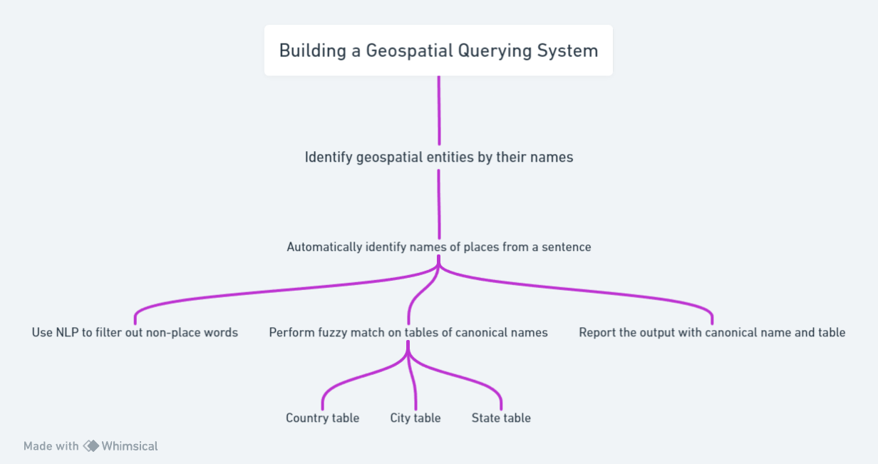
Idea/Approach Details
Describe your idea/Solution/Prototype here:
1. NLP Entity Recognition: The system employs LSTM neural networks to identify geopolitical entities (GPE) and place names in sentences, based on training with annotated data.
2. Table Matching with Fuzzy Algorithm: Identified entities are matched to entries in a reference table using an optimized fuzzy matching algorithm, accommodating variations in text.
3. Entity Coordination Extraction: Coordinates linked to recognized GPE or location entities are extracted from the reference table, enabling precise spatial reference.
4. Output Representation: The system outputs structured coordinates for the identified entities, facilitating integration into various applications and tasks such as geotagging and mapping.
Describe your Technology stack here:
NLP: Libraries like spaCy, NLTK, or Transformers, Pre-trained NLP models (e.g., BERT).
Fuzzy Matching: Fuzzy string matching libraries (e.g., fuzzywuzzy),
Data Sources: Geospatial datasets, GIS data, Access to climate data, geographic coordinates.
Machine Learning: ML models for entity recognition and fuzzy matching.
Geospatial Data Formats: GeoJSON, shapefiles for geographic representation.
Geocoding Services: Google Maps Geocoding API, OpenCage API

Slide 3
Idea/Approach Details
Describe your Use Cases here
Describe your Dependencies / Show stopper here
Weather and Climate Analysis: Retrieve climate data and generate graphs based on location-specific queries.
Travel and Tourism: Provide recommendations for travel destinations, accommodations, and local attractions.
Geographic Information Systems (GIS): Query and visualize geospatial data for professional use.
Disaster Management: Gather critical information for disaster response and mitigation.
Academic Research: Access geospatial data for academic and research projects and analysis.
Urban Planning: Assist urban planners in accessing data for city development and design
Real Estate Search: Assist homebuyers and renters in finding property listings and details.
Emergency Services: Supporting emergency response teams with real-time location data for faster and more efficient disaster response.
Natural Language Processing (NLP) Libraries: Dependencies on NLP libraries like spaCy, NLTK, Transformers, or BERT for text processing, tokenization, and named entity recognition.
Fuzzy Matching Libraries: Fuzzy matching libraries like fuzzywuzzy or custom-built algorithms for comparing and finding similarity between strings.
Database Management Systems: NoSQL databases like MongoDB for storing and managing tables of canonical geospatial names.
Geospatial Data Sources: Access to geospatial data sources, which may include geographic databases, GIS datasets, climate data repositories..
Web Development Dependencies : HTML, CSS, JavaScript for building the front-end user interface. Backend frameworks like Flask, Django, Express.js, or similar for handling user requests.
External Geocoding Services: Integration with geocoding services like Google Maps Geocoding API, for converting place names into geographic coordinates.
Machine Learning Models : Dependencies on machine learning libraries, such as TensorFlow or PyTorch, for enhancing entity recognition and fuzzy matching with custom models.
Monitoring and Logging Tools: Tools for monitoring system performance, tracking user interactions, and logging errors, such as Prometheus, Grafana, ELK Stack or custom logging solutions.
External APIs and Data Sources: Third-party APIs and data sources for obtaining real-time or historical geospatial data, weather information, climate data, and other relevant information.
Geospatial Data Formats: Dependencies for handling geospatial data formats like GeoJSON, shapefiles, and spatial databases (e.g., PostGIS).

Slide 4
Team Member Details
Team Leader Name: Kausthuban R S
Branch: B.Tech. Stream: AI&DS Year : III
Team Member 1 Name: Samuel Jayasingh S
Branch: B.Tech. Stream : AI&DS Year : III
Team Member 2 Name: Karthik S
Branch: B.Tech. Stream : AI&DS Year : III
Team Member 3 Name: Kathirvel S
Branch: B.Tech. Stream : AI&DS Year : III
Team Member 4 Name: Jothi V
Branch: B.Tech. Stream : AI&DS Year : III
Team Member 5 Name: Kishore A
Branch: B.Tech. Stream : AI&DS Year : III
Team Mentor 1 Name: Mr. Selvakumaran S
Category : Academic Expertise : AI Domain Experience (in years): 16
Team Mentor 2 Name: Dr . Arthi A
Category : Academic Expertise : AI Domain Experience (in years): 25

