Slide 1
Reinforcement
Learning
- Kaustubh Sable

Slide 2
Hello World of Reinforcement Learning:
Solving the Multi-Armed Bandit Problem

Slide 3
Problem Formulation:
Slot machine with n arms.
Stochastic reward of either R=+1 for success, or R=0 for failure
Objective:
To pull the arms one-by-one in sequence such that we maximize our total reward collected in the long run.

Slide 4
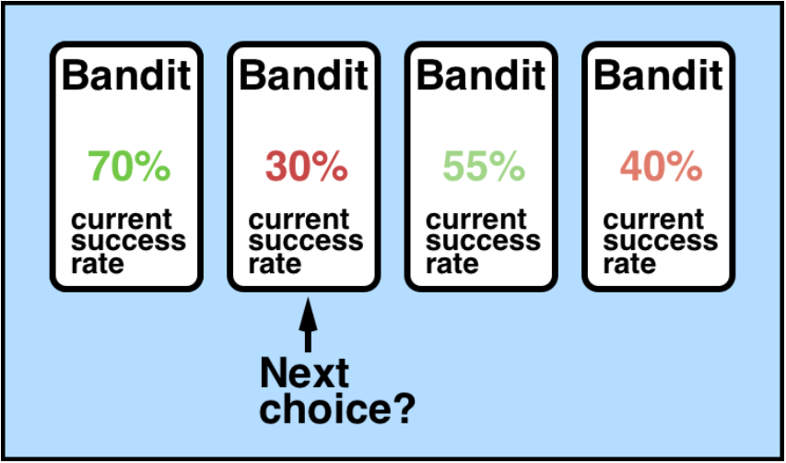

Slide 5
Non-triviality of the multi-armed bandit problem lies in the fact that we (the agent) cannot access the true bandit probability distributions — all learning is carried out via the means of trial-and-error and value estimation.

Slide 6
Our Strategy: Epsilon-greedy agent
With a probability ϵ, we will choose an action a at random,
and
the rest of the time (probability 1−ϵ) we will choose the best lever based on what we currently know from past plays.

Slide 7
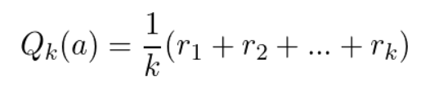
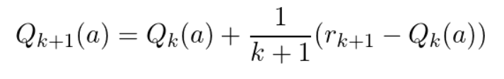
Action-value function:
Above definition can be re-written recursively as:

Slide 8
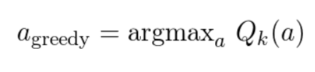
Greedily choose an action from our Q(a)

Slide 9
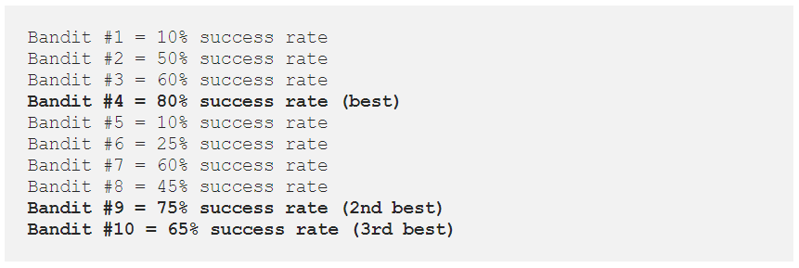
Let’s dive into the example:

Slide 10
References
Reinforcement Learning - Multi-Armed Bandit problem: https://towardsdatascience.com/solving-the-multi-armed-bandit-problem-b72de40db97c
Code for the Multi-Armed Bandit Problem: https://github.com/ankonzoid/LearningX/tree/master/classical_RL/multiarmed_bandit

Slide 11
Thank You!

