Slide 1
Recommender
Systems
- Kaustubh Sable

Slide 2
Basically -
Recommendation systems help users find and select items (e.g., books, movies, restaurants) from the huge number available on the web or in other electronic information sources.
Given a large set of items and a description of the user's needs, they present to the user a small set of the items that are well suited to the description.

Slide 3
Motivation
Information overload problem
Prioritization and Personalization

Slide 4
Applications
Playlist Generators - Netflix, Youtube, Spotify.
Product Recommenders - Amazon, Flipkart.
Content Recommenders - Facebook, Twitter.
And few specific applications...

Slide 5
Market Worth
Recommender systems are really critical in some industries as they can generate a huge amount of income when they are efficient or also be a way to stand out significantly from competitors.
The Netflix Prize (2006-2009) - $1 million.
Recommendation Engine Market size is reported to be $ 1.14 billion in 2018.

Slide 6
Types of Recommender Systems

Slide 7
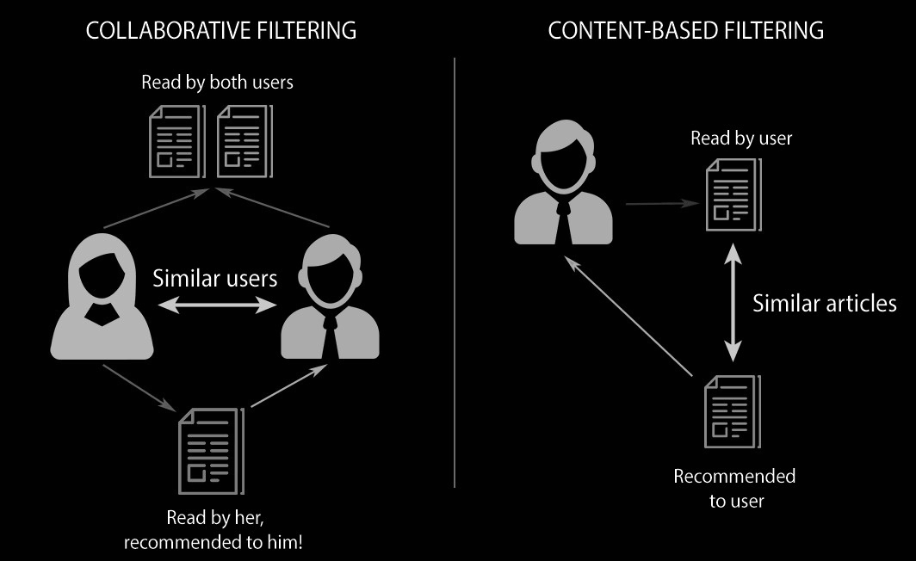

Slide 8


Slide 9
Evaluation
The commonly used metrics are:
The mean squared error
Root mean squared error
(The second having been used in the Netflix Prize)
The information retrieval metrics such as precision and recall or DCG are useful to assess the quality of a recommendation method.

Slide 10
What’s ahead?
Which machine learning models are typically used? Their pros and cons.
Which application to start with?
Which model/models to experiment with?
What evaluation metric to use?
What to analyze from results?

Slide 11
References
https://towardsdatascience.com/introduction-to-recommender-systems-6c66cf15ada
https://en.wikipedia.org/wiki/Recommender_system
https://www.linkedin.com/pulse/friendly-introduction-recommender-systems-oren-tevet/
Coursera Course: https://www.coursera.org/specializations/recommender-systems

