Slide 1
Recommender
Systems
- Kaustubh Sable

Slide 2
Playlist Generation

Slide 3
What users want?
Immediate attainment of their music demands.
An extended experience.

Slide 4
Sequence-to-Sequence Learning
What is it?
Simple autoencoder-type network which tries to map one domain of sequence to another.

Slide 5
Intuition
We make use of following relationship:
playlist : songs :: sentences : words

Slide 6
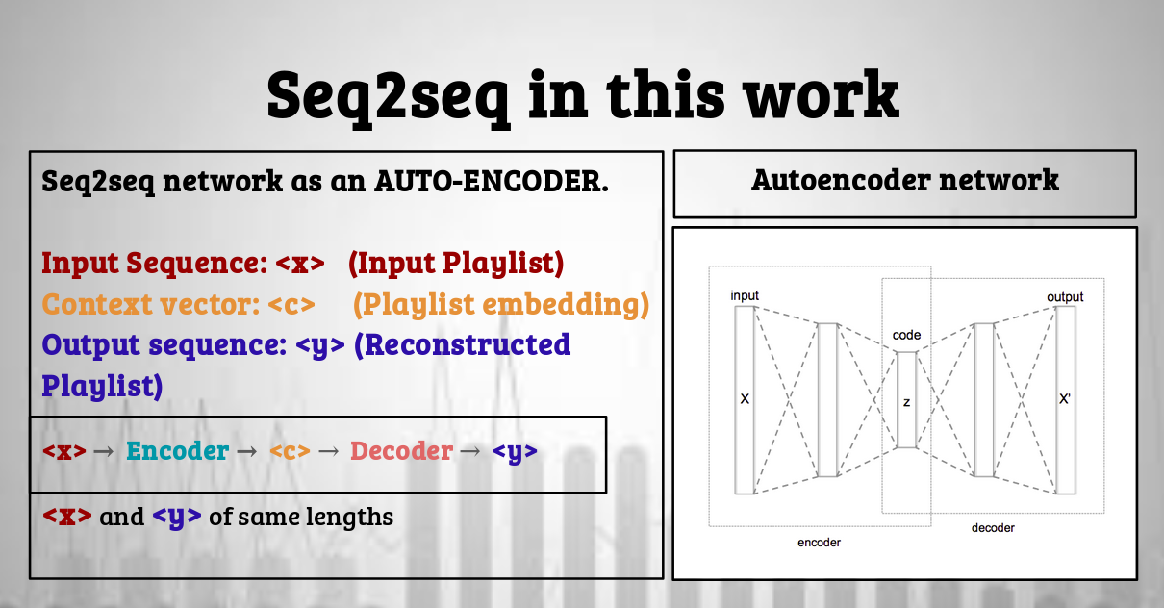

Slide 7
Datasets?
Spotify Web API
Spotify MPD (Million Playlist Dataset)

Slide 8
What’s ahead?
We can try out seq-2-seq model.
Neural collaborative filtering
Nearest Neighbor

Slide 9
References
Blog: https://towardsdatascience.com/building-music-playlists-recommendation-system-564a3e63ef64
Paper: https://arxiv.org/pdf/1907.01098.pdf

