Slide 1
Recommender
Systems
- Kaustubh Sable

Slide 2
Recommending music with Deep Learning
Collaborative Filtering
Cold Start problem
Content-Based Recommendation

Slide 3
What to do we make use of?
Audio Signals
One of the most difficult information sources to use effectively.

Slide 4
What can we extract from audio signals?
Fairly easy:
Genre of the music and the instruments used.
Challenging:
The mood of the music, and the year (or time period) of release.
Almost impossible:
The geographical location of the artist and lyrical themes.

Slide 5
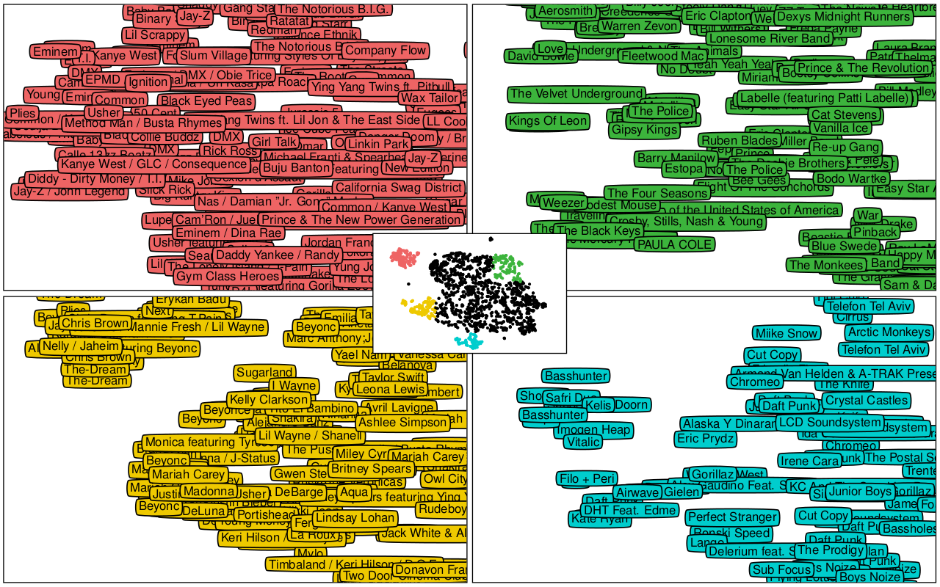
Latent Space

Slide 6
What’s ahead?
Try one of the neural models practically and observe its performance.
Explain its architecture.

Slide 7
References
Research Paper: http://papers.nips.cc/paper/5004-deep-content-based-music-recommendation.pdf
Related Blog: https://benanne.github.io/2014/08/05/spotify-cnns.html

