Slide 1
Recommender
Systems
- Kaustubh Sable

Slide 2
Content-Based Music Recommendation
Steps performed in this setup:
Creating Mel-Spectrograms
Dataset
CNN engine
Playlist Generation
Result/Evaluation

Slide 3
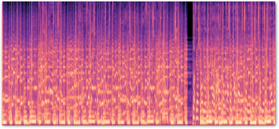
Mel-spectrogram of the first 30 seconds of a song:

Slide 4
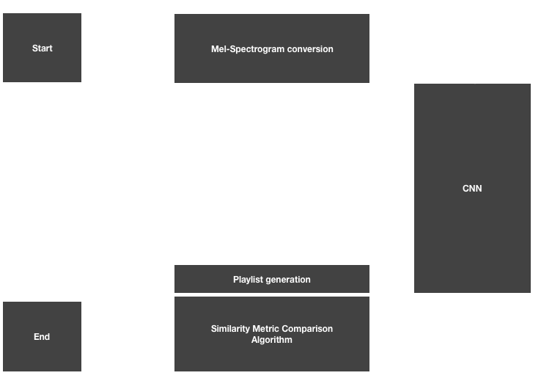
Recommender system architecture

Slide 5
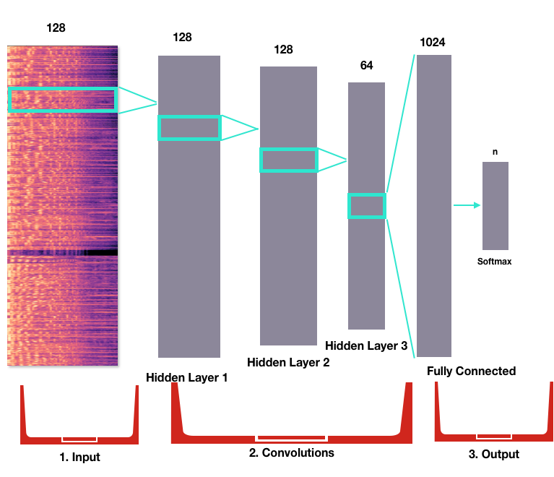
CNN engine

Slide 6
Playlist Generation
The probabilities output from the CNN are then used to create a high-dimensional genre-space, in which the query song will be plotted against a library of songs from the dataset.
A playlist generation algorithm then uses a similarity metric (Euclidean distance) to find and and rank the top 10 most similar songs, which will be output to the user.

Slide 7
Result/Evaluation
Another evaluation metric ...
The CNN model achieved 75% for 3 genre classification (Hip-Hop, Rock and Classical).

Slide 8
The Semantic Cohesion test
Uses the frequency of meta-data co-occurrence (e.g. songs by the same artist or of the same genre) or the entropy of the distribution of genres within a given playlist.
Thus, the higher the semantic cohesion, the ‘better’ the playlist.

Slide 9
What’s ahead?
Implementing the code for this model and evaluate the it based on the output.

Slide 10
References
Research Paper: http://papers.nips.cc/paper/5004-deep-content-based-music-recommendation.pdf
Related Blog: https://medium.com/@silvercloud438/how-i-taught-a-neural-network-to-understand-similarities-in-music-audio-d4fca54c1aed

